Slide 1
Volunteers Are Outta
This World!
Volunteer Orientation
Harbordale Elementary
August 23, 2018

Slide 2
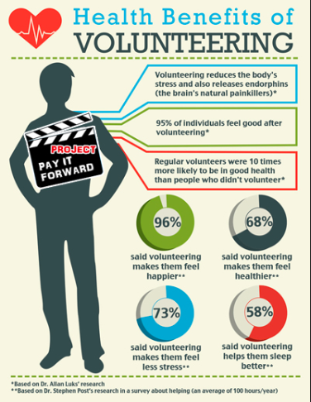

Slide 3
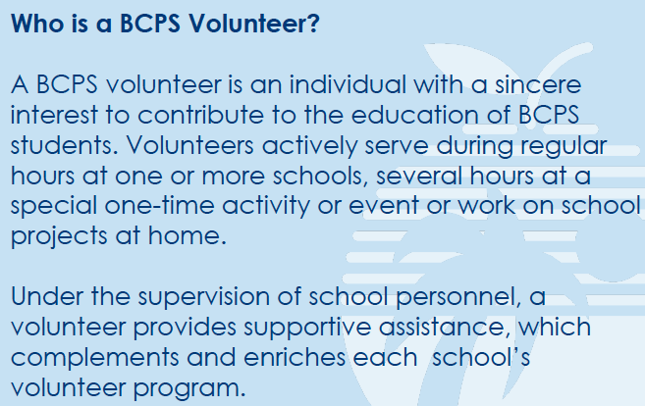
subtitle

Slide 4
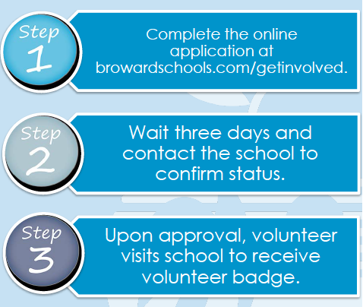
* ALL VOLUNTEERS MUST RE-REGISTER THIS YEAR!

Slide 5
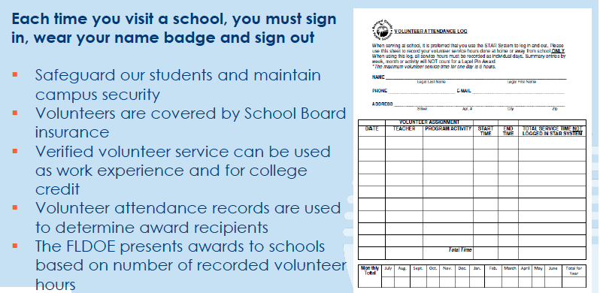

Slide 6
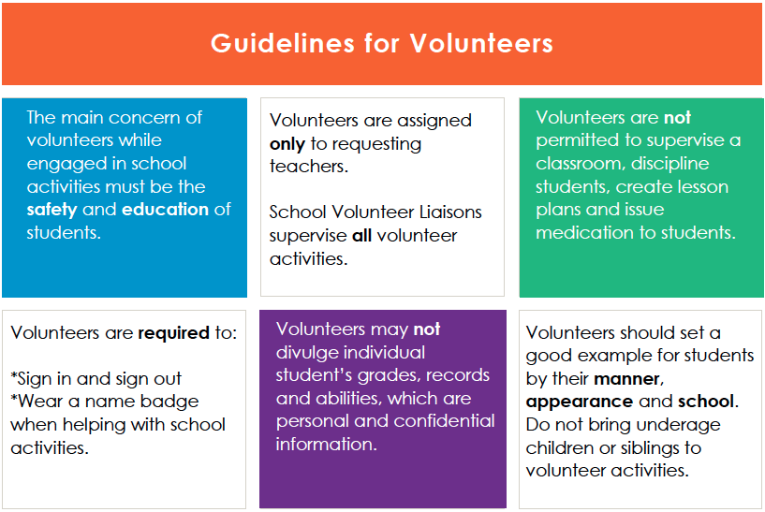

Slide 7
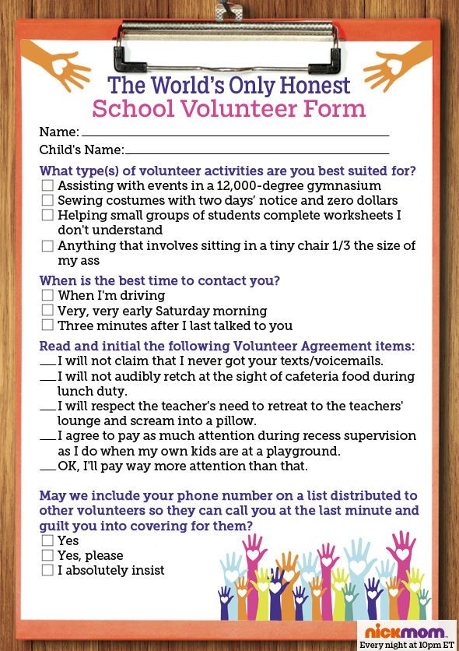
Harbordale Volunteer Needs
Shelving books in Media Center
Resource room organization and reshelving
Reading interventions
Uniform closet
Field Trips
Field Days
Author Visits
Health Screenings
Meet the Masters
HSA events during school such as Holiday Shop
HSA events in the evening like Tile or Bingo Night
Assisting teachers with projects in school or at home
and so much more…

Slide 8
Did You Know?
An active volunteer that has earned 5 or more hours during the current school year. All active volunteers will be invited to the Harbordale Volunteer Breakfast in the spring…totally worth it!
ALWAYS LOGIN TO STAR DURING SCHOOL HOURS WITH YOUR BADGE (I’M TALKING TO YOU, MEET THE MASTERS AND FIELD DAY PEOPLE)
Manually log ALL hours NOT during school time and turn them in the beginning of April (or earlier). Logs available in front office and on HSA website.
200 hours or more will earn you special recognitions
and honors. YOU CAN DO IT!
We receive the Golden School Award annually due to our dedicated volunteers and all the hours serviced through STAR.
WE LOVE OUR VOLUNTEERS!

Slide 9
Thank you!
Any questions?
Cari Rodriguez
cari.rodriguez@browardschools.com
or leave message at front desk

Slide 10
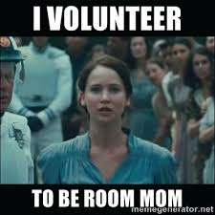
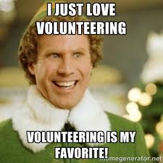
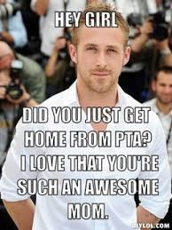
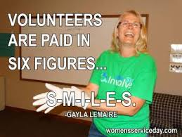
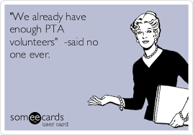
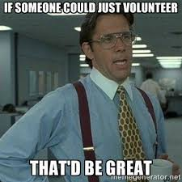

Slide 11
