Slide 3
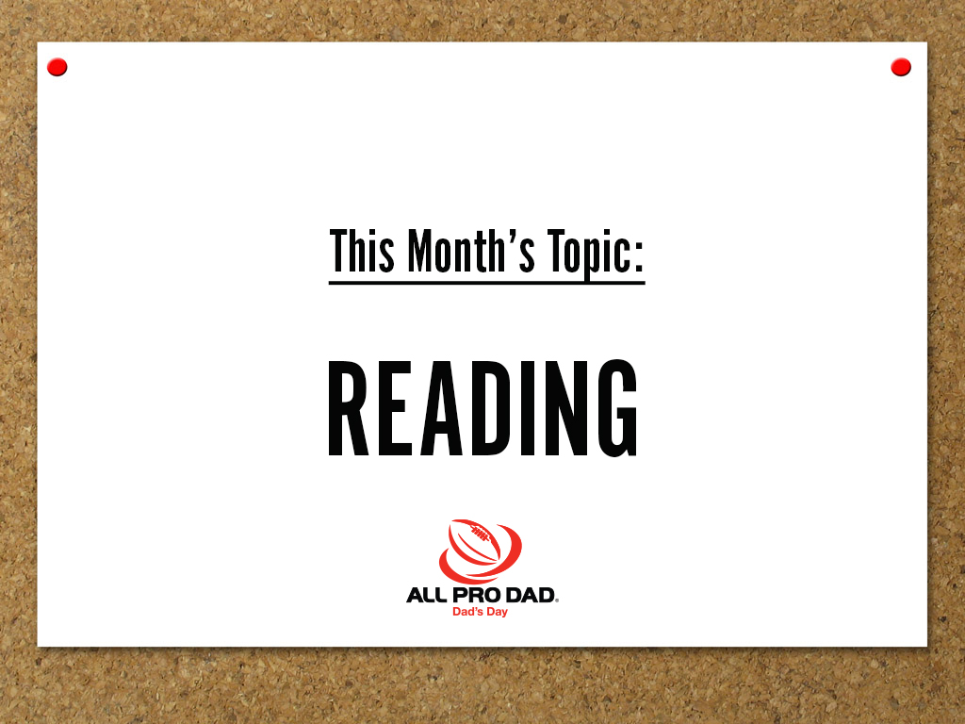

Slide 6
All Pro Dad Lib
Today, I came with my Dad: adjective kid to the All Pro Dad’s Day meeting. We rode together in my Kid: color Dad: transportation. We listened to Kid: popular on the radio. We arrived and were welcomed by a Dad: type of person. We sat Kid: direction and ate Dad: type of food together. When we were done, we felt Kid: type of feeling. During the meeting, we spent time Dad: action verb and having Kid: action verb. Afterwards, I walked Dad: kid’s name to Kid: teacher’s’s class. I said Dad: greeting and Dad: kid’s name said Kid: a popular saying.
Dad: Adjective
Kid: Color
Dad: Mode of Transportation
Kid: Popular Song
Dad: Type of Person
Kid: Direction
Dad: Type of Food
Kid: Type of Feeling
Dad: Action Verb
Kid: Action Verb
Dad: Kid’s Name
Kid: Teacher’s Name
Dad: Greeting
Dad: Kid’s Name
Kid: Popular Saying

Slide 7
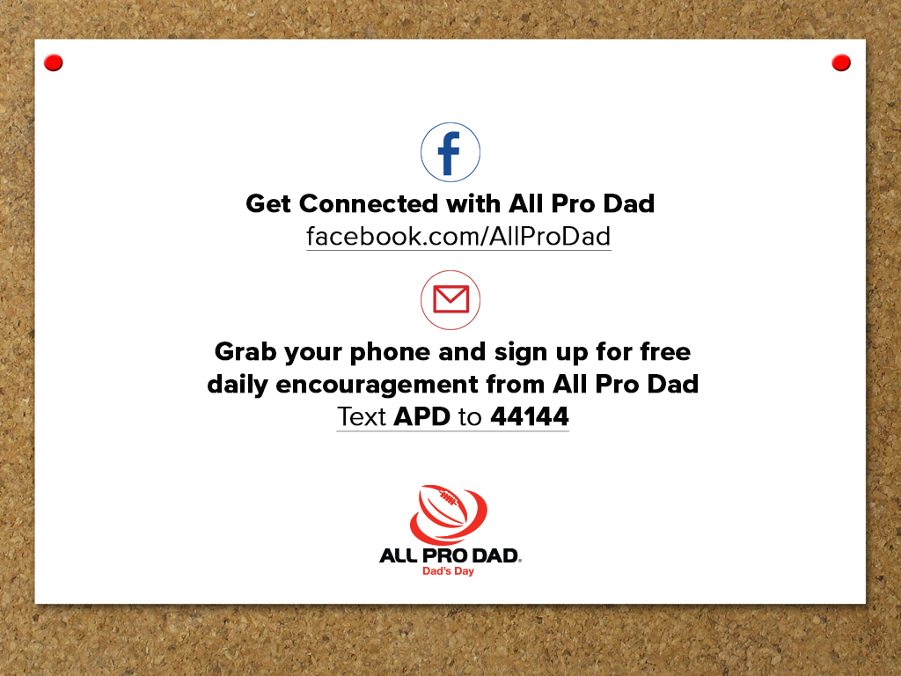

Slide 8
Bethune/Hollywood
All Pro Dad
Next meeting:
November 17, 2018
Volunteer for field Trips
Become a Mentor
Dad on Duty
Join PTO
READ……….

Slide 10
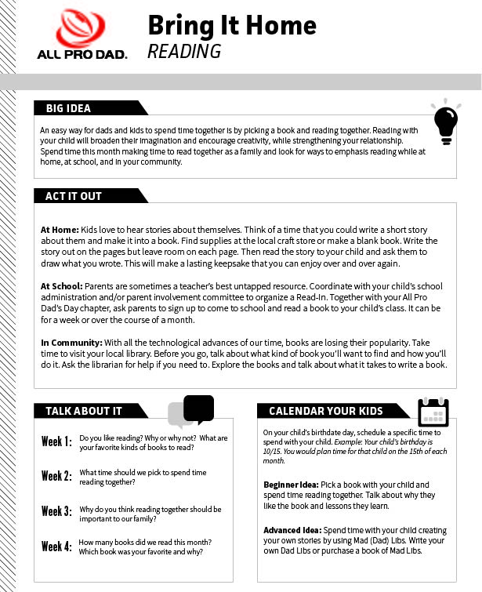
Bring It Home
An at-home resource for you to continue the conversation!
Log into you All Pro Dad’s Day Member account to download and print.

Slide 11
INSERT NEXT MEETING DETAILS

