Slide 1
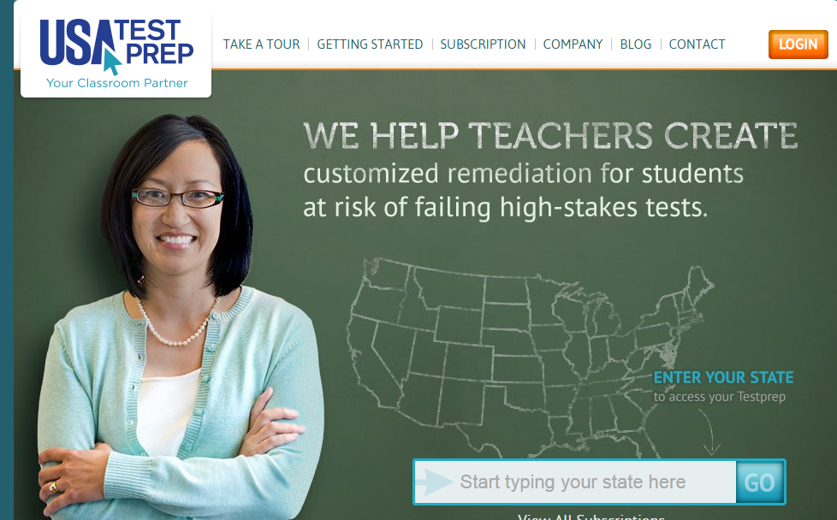
Website/Creating an Account
Open a browser (Google Chrome, Firefox, or Safari)
Enter the site www.usatestprep.com
Click on Login
Locate Create Account
Account Code: Cougars31
Teacher Code: tea5454
Choose an username/password that you can remember (personnel number, email address, etc.)
Enter your personal information
Click YES for Account Admin (Reports access)
Read the Terms Agreement, check I Agree
Congrats you Created an Account

Slide 2
USA TEST PREP
SETUP AND ADMINISTER

Slide 3
NORMS
Limit Sidebars
Only use computers during designated times
Keep electronic distractions to a minimum
Listen attentively
Respect all opinions and ideas
Save questions for parking lot

Slide 4
What is USA Test Prep?
USA test prep diagnostic benchmark system provides a performance snapshot at the student, class, school, and district level.
Easily create a custom test for your students in less than five minutes.
Administer and collect data for your class, department, school, and district.
Pinpoint student strengths and weaknesses using the data grid view.
Assignments that can supplement your curriculum program.

Slide 5
Purpose
Ongoing Assessment
Open Ended Discussion about the progress of our students within our departments and with other schools across the county (selected schools will be using this program)
Item Analysis in association with other technological programs that will be or that have been used in the classroom.

Slide 6
Home Screen

Slide 7
Grade Level Resources
At the top of the screen, you will see grade levels, click on your grade level/subject area…..

Slide 8
Resources, Resources, Resources

Slide 9
Bell Ringer

Slide 10
Bell Ringer Example…..

Slide 11
Games (solely optional)…….

Slide 12
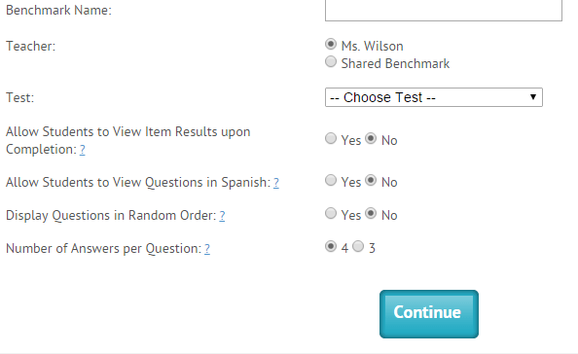
Creating Assessments
Assessments are created in the Benchmarks tab. How to create an assessment:
Click on Benchmarks
Create new benchmark
Choose a benchmark name
If working as a dept. or grade level please share
Choose test (Subject Area)
View Results Items (consider cheating when selecting yes) and randomizing is an option

Slide 13
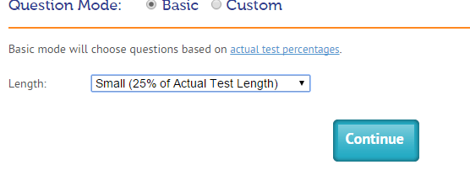
Choosing Questions for Assessment
You have the choice to create basic or custom questions for your assessment. In basic mode the questions are preselected.
Selecting Basic Question Mode (You have the option of choosing small, medium, large or actual test length)

Slide 14
Question Mode Custom
Custom mode allows you to choose domains that are being covered for the particular month. When using the custom question mode, questions can be selected that covers a particular domain/standard.
Click on Custom
Choose Domain or View by passage (On the right of the screen)
Select questions either by domain or passage
Click continue

Slide 15
FAVORITES (OPTIONAL)
Questions that are teacher-created or created by USATESTPREP.
This is solely optional.

Slide 16
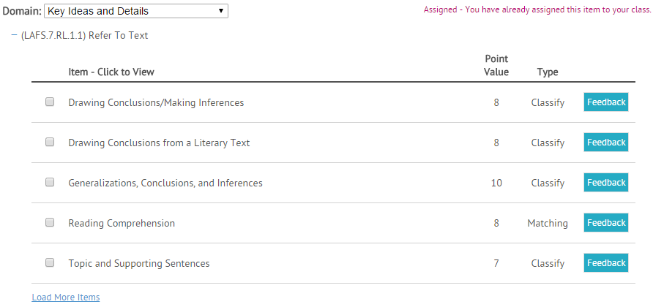
Performance Tasks
Performance tasks include graphs, drag and drops, etc. These are graded by the computer. These are optional, but are recommended. Once you click, YES, follow these steps:
Choose the domain/standard
Click on the item to preview
Choose the item

Slide 17
Performance Task Sample

Slide 18
FREE RESPONSE
Free response questions are open-ended and require higher-order thinking skills. They are not auto-graded, so you will need to manually grade these items upon completion. If you want to use this option select YES, I want to add FREE Response.
Choose Domain
Select the question (Preview the text)
Add question to test

Slide 19
USA Test Prep Practice Session
Within your groups, choose the selected subject area and create a class:
Session 1 – ELA – 8th Grade
Session 2 – Math – 7th Grade
Create a 5 question quiz on any three (3) benchmarks including the following:
Two (2) multiple choice
Two (2) Performance Tasks
One (1) Free Response
Save your assessment as your group number and session number
Group 1 Session 1
Create a new assignment and attach the benchmark
Share your assignment
When finished, take the post presentation survey and have a great lunch!

