Slide 1
Office of Service Quality
SCHOOL IMPROVEMENT TRAINING – QUARTER 4
MAY 1 – MAY 5, 2017
Notes:
WELCOME
INTRODUCTIONS

Slide 2
URGENT REMINDER: ASSIST STAKEHOLDER SURVEY
DIRECTIONS WERE SENT TO PRINCIPALS ON FEB. 23RD
AdvancED STAKEHOLDER SURVEY IS THE BCPS ANNUAL CUSTOMER SURVEY
The AdvancED Stakeholder will remain open until schools reach their quotas:
20% OF PARENTS, 40% OF STUDENTS, 60% OF STAFF
Use the following survey links to complete surveys:
• Web STAFF Survey Link: http://www.advanc-ed.org/survey/public/8530367
• Web PARENT Survey Link: http://www.advanc-ed.org/survey/public/0413263
• Web STUDENT Survey Links – Please use with the appropriate grade level: Early Elementary (Grades K-2) http://www.advanc-ed.org/survey/public/4852131 Elementary (Grades 3-5) http://www.advanc-ed.org/survey/public/6563635 Middle & High (Grades 6-12) http://www.advanc-ed.org/survey/public/2612735
OFFICE OF SERVICE QUALITY

Slide 3
URGENT REMINDER: VAL-ED SURVEY
THE VAL-ED SURVEY WINDOW IS APRIL 17 - MAY 5, 2017
The Principal, Principal’s Supervisor, and Instructional Staff are asked to complete the survey as part of the terms of the Wallace. VAL-ED results will be analyzed and provide insights for Principal Supervisors on how to better support principals with focused professional development.
PRINCIPALS WERE SENT DIRECTIONS ON
APRIL 6TH VIA PIVOT
A Best Practice for successful survey completion success is to have all instructional staff take the survey in a group setting.
OFFICE OF SERVICE QUALITY

Slide 4
AGENDA
2. ATTENDANCE
PLAN
SCHOOL
IMPROVEMENT
PLAN FOR
2017-2018
FACE PLAN
(Family and Community
Engagement)
MTSS/RtI ACTION PLAN
(Self Assessment of
Multi-Tiered System of
Supports - SAM)
5. TITLE 1
ADDENDUM
FLDOE CIMS
(Florida Department
of Education Continuous Improvement Management System)
OFFICE OF SERVICE QUALITY

Slide 5
OFFICE OF SERVICE QUALITY
1. SCHOOL
IMPROVEMENT
PLAN 2017-18
DISTRICT CONTACT:
Donna Boruch, Coordinator of School Improvement,
Office of Service Quality 754-321-3850

Slide 6
DATES/ DEADLINES FOR 2017-2018
Event Date/Deadline | Event/Document
September 7, 2017 | FLDOE SIP draft submitted on CIMS
September 11 - 12, 2017 Schools Will Choose to Attend One Half-Day Session: 8:30-11:30 or 12:30-3:30 | SIP Training Topics: SBBC SIP, SAC Composition, SAC Bylaws, AdvancED Self Assessment, Accreditation Portfolio, 2015–2016 SIP Closeout, and New Waivers
September 15, 2017 | Deadline for 2015–2016 SIP Closeout on SIP Template in OSPA Central V2.0
September 28, 2017 | Family and Community Engagement Plan completed by SIP
September 28, 2017 | Completion of SIP Template (Upload SAC, RtI, PLC Meeting Dates, Title 1 Plan, Attendance Plan, and School Goals on SIP Template in OSPA Central)
October 5, 2017 | SAC Composition Report, SAC Bylaws, ASSIST Self Assessment Completed and Uploaded in OSPA Central V2.0
November 16, 2017 | Deadline to Submit Intent to Apply Waiver Form
December 4 - December 8, 2017 Schools Will Choose to Attend One Half-Day Session: 8:30-11:30 or 12:30-3:30 | SIP Training Topics: Monitoring SIP, A+ Process, Continuation Waivers, Attendance Plan, and Mid-year Reflection
February 1, 2018 | A+ Fund Plans for Qualifying Schools completed and Uploaded
February 8, 2018 | New Waiver Applications Submitted
February 26 – March 2, 2018 Schools Will Chose to Attend One Half-Day Session: 8:30-11:30 or 12:30-3:30 | SIP Training Topics: SIP Planning for 2017-2018, Monitoring SIP, and Behavior Plan for 2017-2018
April 26, 2018 | Continuation Waivers All documentation requires for continuation of a waiver completed and uploaded
May 7 – 11, 2018 Schools Will Choose to Attend One Half-Day Session: 8:30-11:30 or 12:30-3:30 | SIP Training Topics: School Improvement Updates, Organization of 2018–2019 SAC & SAF, 2018 - 2019 SIP
OFFICE OF SERVICE QUALITY

Slide 7
SCHOOL IMPROVEMENT PLANNING
Best Practice #1
PLC (Professional Learning
Communities) Meeting
Schedule
Best Practice #2
Early Warning Indicators
RtI Team Meeting Schedule
School Wide Behavior Plan
Attendance Plan
MTSS/RtI Action Plan
Best Practice #3
FACE Plan
ASSIST Self-Assessment
Self-Assessment Results
SAC Composition Report
Waiver Application
Best Practice #4
Goals, Strategies and Activities or FLDOE SIP
Title I School Plan (for Title I A,B, or C Schools
BPIE Documents
School Goals:
Based on Pre-Populated
Targets
Must have Literacy Goal that
states reading program used
SMART Goals need to include Specific Strategies
Accountability Money must be earmarked in BP #4
SMART Goal
Specific: explicit about what will change
and when
Measurable: quantified and tracked with
assessments and other data
Attainable: challenging and realistic
Results-focused: direct impact student
learning
Time-bound: Goal has a specific
timeframe for completion.
OFFICE OF SERVICE QUALITY

Slide 8
SIP AND SAF SBBC POLICY
SAC/SIP: SBBC POLICY 1403 SCHOOL ACCOUNTABILITY AND IMPROVEMENT:
Each school has a School Advisory Council (SAC) to facilitate the development and monitor progress
of the annual School Improvement Plan. Agendas and minutes reflect annual needs assessment, SIP monitoring and allocation of Accountability Funds.
SAF: SBBC POLICY 1.3 SCHOOL ADVISORY FORUM:
Every school shall have a School Advisory Forum (SAF) that shall foster and promote
communication between stakeholders, the school, and the Area Advisory Council. The SAF shall bring forth recommendations, concerns and interests to and from their Area Advisory Council.
Both policies can be viewed at: http://www.broward.k12.fl.us/sbbcpolicies/index.asp
OFFICE OF SERVICE QUALITY

Slide 9
SAC & SAF ELECTION PROCEDURES
Once a nominating committee is named (as per your school's bylaws) the following procedures should be utilized.
1. Send out memo to school parent population (or otherwise advertise to your entire community, a notice that SAF elections will be held at the May meeting of the school year. Request nominations!
2. The Nominating Committee may extend a courtesy call to each of the present SAF officers asking if they wish to stay on as officers for the next school year (again, check your bylaws for limits on terms of office).
3. The Nominating Committee compiles a slate of officers from the names they have received from steps 1 and 2. It is the charge of the nominating committee to slate that candidate who is best qualified for the position.
4. The Nominating Committee makes a courtesy call to each slated officer to inform them of their nomination and reconfirm their acceptance of the nomination.
5. The Nominating Committee presents slate of officers to membership either at a general meeting usually one month prior to the election. (Check your bylaws!)
6. The Nominating Committee conducts the elections. They present the slate at the election meeting and ask for nominations from the floor. If there are no nominations from the floor the slate can be voted on as is - one vote for the entire slate.
7. If there are nominations from the floor you can have either an open or closed ballot election. An open ballot is typically taken by a show of hands; a closed ballot is taken by written ballot. You must vote for each position for which there is more than one nominee. Then, you can vote on the remainder of the slate. (For example: there is a nomination from the floor for the position of recording secretary. You must have a vote for the position of recording secretary (either open or closed) and then vote on the remainder of the slate.)
OFFICE OF SERVICE QUALITY

Slide 10
In the event there is no nominating committee formed then: Send out memo to school parent population (or otherwise advertise to your entire community) a notice that SAF elections will be held at the May meeting of the school year that Nominations will be taken from the floor. Anyone can nominate a candidate, even the candidate themselves, from the floor. You can have either an open or closed ballot election. An open ballot is typically taken by a show of hands; a closed ballot is taken by written ballot. You must vote for each position for which there is a nominee. SAC & SAF ELECTION PROCEDURES
In the event there is no nominating committee formed then:
Send out memo to school parent population (or otherwise advertise to your entire community) a notice that SAF elections will be held at the May meeting of the school year that Nominations will be taken from the floor.
Anyone can nominate a candidate, even the candidate themselves, from the floor. You can have either an open or closed ballot election. An open ballot is typically taken by a show of hands; a closed ballot is taken by written ballot. You must vote for each position for which there is a nominee.
SAF Minutes must reflect the voting procedure and who was elected to each position.
OFFICE OF SERVICE QUALITY

Slide 11
SAC BYLAW REVIEW
OFFICE OF SERVICE QUALITY

Slide 12
OFFICE OF SERVICE QUALITY
2. ATTENDANCE
PLAN
DISTRICT CONTACT:
Philip Shaver, Coordinator of District Attendance,
Student Services Department, 754-321-1623

Slide 13
STRUCTURE
Data (Populated mid-summer)
Goals for the Attendance Plan (Data Analysis with Goals)
Tier 1: Strategies
Tier 2: Strategies and Interventions
Tier 3: Individualized Responses and Legal Interventions
Attendance plan
Notes:
Image #535076351

Slide 14
DATA
Data will be pre-populated for all schools in July 2017
Two-year data by semester/compare 1st semester to 1st semester
2nd semester data will be available after reports cards are issued
1st Semester (2015/16) |  | Satisfactory (0-4.9% absences) |  | At-Risk 5-9.9% absences |  | Chronic Absences (10-19.9% absences) |  | Severe Absences (20% or more)
Grade | Total # of students | # | % | # | % | # | % | # | %
9th
10th
11th
12th
Totals |  | (Total #) | (Overall % of students) | (Total #) | (Overall % of students) | (Total #) | (Overall % of students) | (Total #) | (Overall % of students)
1st Semester (2016/17) |  | Satisfactory (0-4.9% absences) |  | At-Risk 5-9.9% absences |  | Chronic Absences (10-19.9% absences) |  | Severe Absences (20% or more)
Grade | Total # of students | # | % | # | % | # | % | # | %
9th
10th
11th
12th
Totals |  | (Total #) | (Overall % of students) | (Total #) | (Overall % of students) | (Total #) | (Overall % of students) | (Total #) | (Overall % of students)
Attendance plan
Notes:
Image #535076351

Slide 15
GOALS
Analyze school-wide data with the SIP team
An emphasis on early grades in elementary (K & 1) and high school (9 & 10) may be a focus
All grades in middle school (6, 7, 8)
Set SMART goals for each semester
District Goal is to reduce chronic absenteeism by at least 1%.
Attendance plan
Notes:
Image #535076351

Slide 16
TIERS & STRATEGIES
Tiers for attendance strategies include:
Monitor Data
Engage students and Families
Recognize good and improved attendance
Provide personalized outreach
Remove barriers
Tier 1: Strategies aimed at all students and families
Tier 2: Strategies for students with at-risk attendance and a history of chronic absenteeism
Tier 3: Coordinated school and district response (Student Services Department). Legal intervention (last resort)
Attendance plan
Notes:
Image #535076351

Slide 17
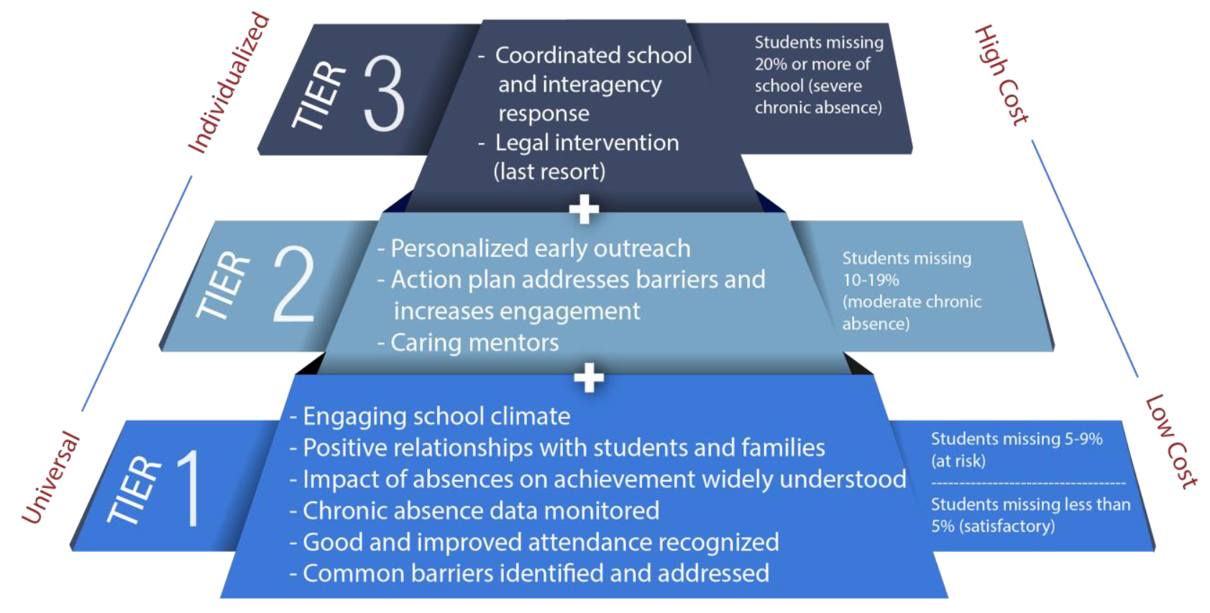
TIERS & STRATEGIES
Attendance plan
Notes:
Image #535076351

Slide 18
TIER 1 EXAMPLES
Attendance phone line for your school needs to be easily accessible on the school website
Recommended locations: Website header, Contact Us or School Info page.
Add attendance phone number to the school’s splash page on the District website
Attendance Clerk at the school must monitor the messages so parents don’t get the “voice mailbox is full” message
Teachers must take daily attendance and administrators and teachers need to work together to resolve conflicts in attendance records as a result of testing, field trips, illness, and other causes of a student’s absence from the classroom.
Parents are expected to update school records with a reliable, current phone number (On the school plan, how will parents know to do this?)
Attendance plan
Notes:
Image #535076351

Slide 19
TIER 2 EXAMPLES
Review attendance every week for students that are chronically absent or at-risk Look for patterns
Suggest a home visit or conference
Nurture teacher interest in helping to reach out to chronically absent students
Recognize good and improved attendance
Assign an attendance buddy (A student or teacher volunteer that checks in with students that have attendance concerns)
Refer families to appropriate services (Social worker, guidance counselor, HEART, health services)
Identify barriers (transportation, housing, income)
Attendance plan
Notes:
Image #535076351

Slide 20
TIER 3 EXAMPLES
Determine how many students have a history of missing 20% or more of school. Identify the students with your leadership team
Ensure continued positive contact with the family
Share data with appropriate agencies to coordinate services
Work with families to avoid legal consequences to the extent possible
Use appropriate protocol for B-TIP, CINS/FINS agencies
Attendance plan
Notes:
Image #535076351

Slide 21
OFFICE OF SERVICE QUALITY
3. FACE PLAN
(Family and Community Engagement)
District contact:
Nadia Clarke, Assistant Director,
Office of Family and Community Engagement, 754-321-1599

Slide 22
FACE PLAN (FAMILY AND COMMUNITY ENGAGEMENT)
1. Reminder...all FACE Plan docs are available on OSPA Central 2.0.
2. Cultural Ambassador interviews should be with adults,
not students.
3. Connect with School Social Workers for community resources.
4. FACE is a great opportunity to engage your SAF Chair!
5. Continue building on your current activities for next school year.
6. What is working well & what are your challenges?
OFFICE OF SERVICE QUALITY

Slide 23
PARENT ENGAGEMENT CONFERENCE FEEDBACK
Question: What are some of the barriers you have encountered that keep you from being involved in your child’s school?
Transportation
Meeting times are not flexible
Conflicting times of events (between elementary, middle, and high schools)
Not seeing any changes by administration (to requests from parent groups)
No child care
No communication consistently
Lack of parental knowledge about what is really happening at their child’s school and the need for the parent to be there.
Rude staff members
Lack of parental involvement activities
Language barrier
Time of day event is held
Lack of feeling valued or trusted by the school
No shared leadership (decision making)
Parents feel intimidated about not knowing what they think they should know.
Not feeling welcome as they enter the office
District calendar conflicts (two or three events planned on the same Saturday)
Lack of information coming from schools
Lack of outreach from school into community
Lack of transportation
Events are scheduled when people are working (example was a SAC meeting held at 3:30pm)
Not enough interesting school programs
FACE plan
Notes:
Image #535076351

Slide 24
CARE- Challenge, Achieve, Reward, and Engage

Slide 25
ACADEMIC PROGRAMS
Parent Engagement with Academic Events:
September “Curriculum Carnival/Family Game Night” (hands on participation of computer programs used to promote academics in a fun way! Social Studies “Jeopardy, Math “Who Wants to be a Millionaire, Language Arts “Scatagories” etc.
Nov./Dec. - “A Taste of Academic Success” (Presenters serve up FSA tips from the Math, Reading, Science and Social Studies department in courses while actual dinner is served “dinner theater style to parents in the cafe)
February - “Book Exchange; Family Literacy Night” (families bring books they would like to exchange for something new to read…could be a monthly event
April/May Academic Extravaganza Showcase Night “Best in Show” Gallery Walk including Science, Social Studies, and Literary Fair projects…could also be tied with “Talent Show”
FACE plan
Notes:
Image #535076351

Slide 26
TECHNOLOGY PROGRAMS
Parent Engagement with Technology Events:
September - “Back to school Program Analysis” (hands on use of computer programs available to parents: Examples: Achieve3000, Vocabulary.com, Buzz Math, GIZMOS)
Nov./Dec. - “Building Relationships”(Parents and students create robotics, participate in simulated medical procedures, participate in simulated building construction)
February - Website design, Gaming Design, Multimedia Essentials (Parents and students get the basics to create together)
April/May - Project showcase: Projects integrating technology Podcasts, Web-sites; I-Movies (gallery walk)
FACE plan
Notes:
Image #535076351

Slide 27
PHYSICAL FITNESS PROGRAMS
Parent Engagement with Fitness Events:
September - “Back to school scavenger hunt” (Parent and students discover school environment together; good for 6th grade)
Nov./Dec. - “Turkey Trot/ Jingle Jog” (PTSA fundraisers) Parents and students walk to raise $$ and get in shape
February - Jump Rope for Heart/ Hoops for Heart / The Great Replay (family fitness challenge with American Heart Association)
April/May - Family field day/picnic
FACE plan
Notes:
Image #535076351

Slide 28
OFFICE OF SERVICE QUALITY
4. MTSS/RtI ACTION PLAN
Self-Assessment of Multi-Tiered System of Supports (SAM)
DISTRICT CONTACT:
Adrienne Dixson, RtI Specialist,
Diversity, Prevention & Intervention Department, 754-321-1691

Slide 29
Diversity, Prevention and Intervention
MTSS/RtI Action Plan
Self-Assessment of
Multi-Tiered System of Supports (SAM)

Slide 30
OUR VISION of MTSS
Enhance the capacity of all schools to successfully implement and sustain a multi-tiered system of student supports with fidelity in every school;
Accelerate and maximize student academic and social-emotional outcomes through the application of collaborative data-based problem solving utilized by effective leadership at all levels of the educational system;
Inform the development, implementation, and ongoing evaluation of an integrated, aligned, and sustainable system of service delivery that prepares all students for college and career within our global society
SAM

Slide 31
CRITICAL COMPONENTS OF MTSS
Multiple Tiers of Instruction & Intervention
Problem Solving Process
Leadership
Data & Evaluation
Inform and Engage Parents
Frequently
Capacity & Infrastructure Building
Communication & Collaboration
SAM
Notes:
In looking at these components of a MTSS, we often find that educators misconceive that MTSS is only one of these components – for instance, they may think that MTSS is only the 3 tiers of instruction and intervention. All of these components are necessary for a comprehensive MTSS.
There must be:
1) Multiple tiers of instruction and intervention, aligned to standards, utilizing evidence based strategies, matched to student needs, and with assessments that allow the measurement of effectiveness
2) A structured, consistent, team-based, problem solving process, with decision rules used to make educational decisions
3) An integrated data system that allows for ongoing assessment of student learning as well as decision making
4) Open and transparent communication and collaboration between stakeholders with relationships based upon mutual respect and shared responsibility
5) The capability for the system to build the necessary capacity and infrastructures necessary for MTSS implementation including data-driving professional development, aligning policies and procedures to support MTSS, and the creation of implementation plans
6) Leadership that expects and supports data-based decision making, team functioning, and coaching supports
MTSS is a framework to ensure successful education outcomes for ALL students by using a data-based problem solving process to provide, and evaluate the effectiveness of multiple tiers of integrated academic, behavior, and social-emotional instruction/intervention supports matched to student need in alignment with educational standards.
These are the six essential components of MTSS within the state of Florida(Read each). These essential components are backed by what we know to be effective, evidence-based practices that lead to sustainable implementation.
MTSS is an evidence-based model of educating students
Data-based problem solving is essential
Academic and behavioral instruction and intervention are interrelated
Need-driven decision-making is necessary to ensure that resources reach the appropriate students at appropriate levels to accelerate the performance of ALL students to achieve and/or exceed proficiency
Collaborative teaming is essential for effective implementation of MTSS

Slide 32
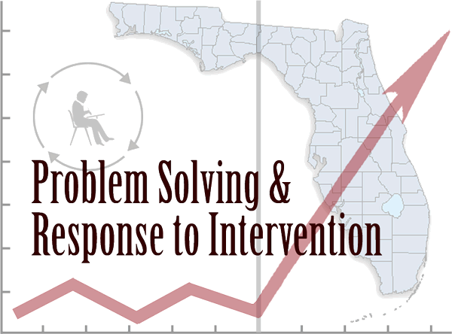
THE BIG PICTURE
+
_______________________________________________________________________
=
SAM
Notes:
Academic Success is related to behavior in school AND Behavioral success is related to academics which EQUALS “MTSS” a Multi-Tiered integrated support system that addresses both academics and behavior for all students.
Response-to-Intervention (RtI)
RtI:B - Positive Behavioral Interventions & Supports (PBIS)
Social and Emotional Learning (SEL)
Family and Community Engagement (FACE)
Professional Learning Communities (PLCs)
General & Special Education Collaboration

Slide 33
SAM Self-Assessment of Multi-Tiered System of Supports Instrument Overview
Notes:
Current tools not adequate for assessing all components of MTSS
Desire for an instrument to guide action planning towards improved implementation

Slide 34
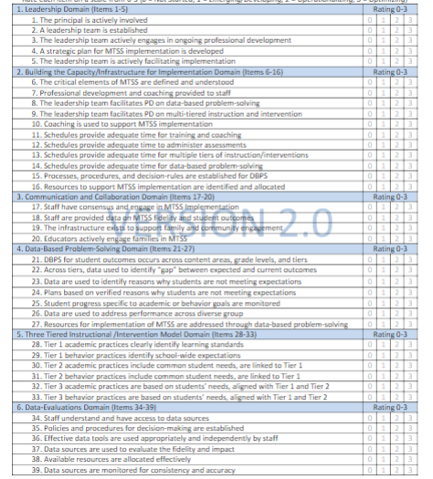
ELEMENTS & SCORING RUBRIC
“0” = Not Implementing
The school does not have the consensus or infrastructure to implement the components of an MTSS model
“1” = Emerging/Developing
The school is building consensus and designing the infrastructure to implement an MTSS model
“2” =Operationalizing
The school implements the structures designed during the Emerging/Developing stage and works to build consistency and integrity
“3” = Optimizing
The MTSS model is embedded with integrity. The focus is on how effective the model is and changes are based on data
SAM

Slide 35
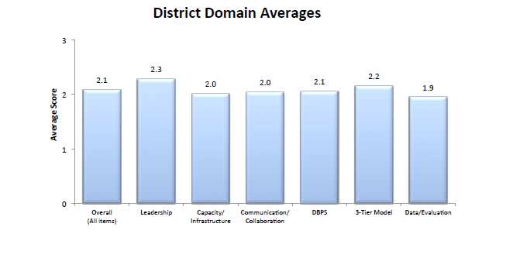
SAM REPORT
Download your SAM report, convene your school -based team, analyze your SAM data, identify effective practices, identify lowest levels of implementation, and complete your action plan. At a minimum the school -based team must address the 2 lowest average SAM domains and at a maximum address all 6 SAM domains.
SAM

Slide 36
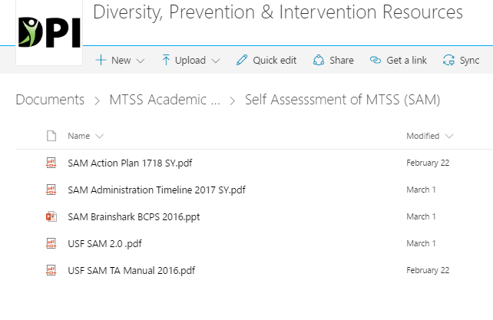
ADMINISTRATION PROCEDURES
School leadership team members receive instrument beforehand
Members should independently review instrument and think about school ratings
School leadership team meets
Designated facilitator guides team through instrument, coming to consensus on the rating for each item
Designated team member enters final version into Qualtrics online database
Notes:
-Critical for school leadership team members to have the opportunity to review SAM before team completion. Allows individual team members to familiarize themselves with the SAM and come to the team meeting more prepared for conversations regarding their school’s implementation level.
-ONE SAM PER SCHOOL!

Slide 37
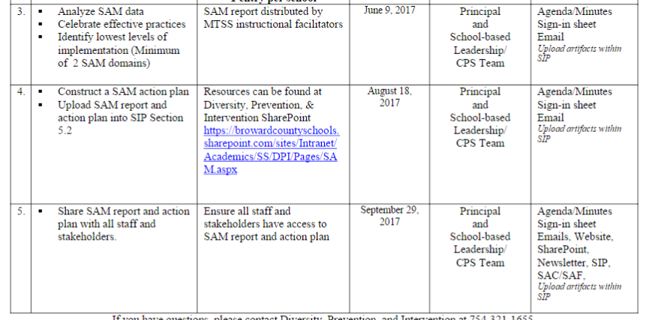
ADMINISTRATION TIMELINE

Slide 38
SAM PROBLEM SOLVING: STEP #1
SAM

Slide 39
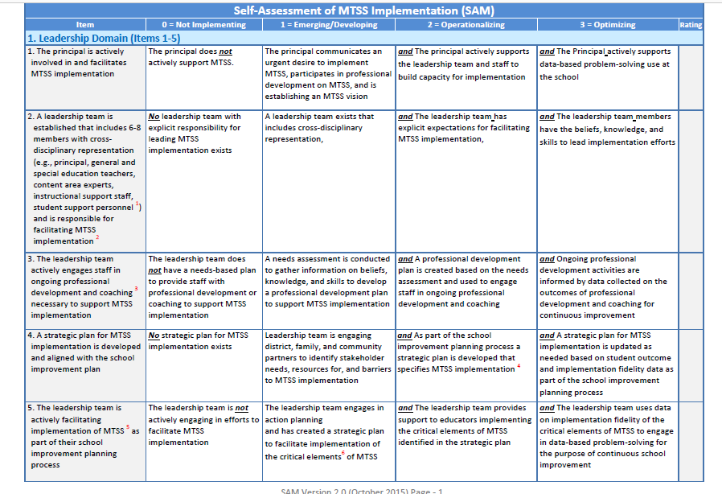
SAM PROBLEM SOLVING: STEP #1
SAM

Slide 40
SAM PROBLEM SOLVING: STEP #2
SAM

Slide 41
SAM PROBLEM SOLVING: STEP #3
SAM

Slide 42
SAM PROBLEM SOLVING: STEP #3
SAM

Slide 43
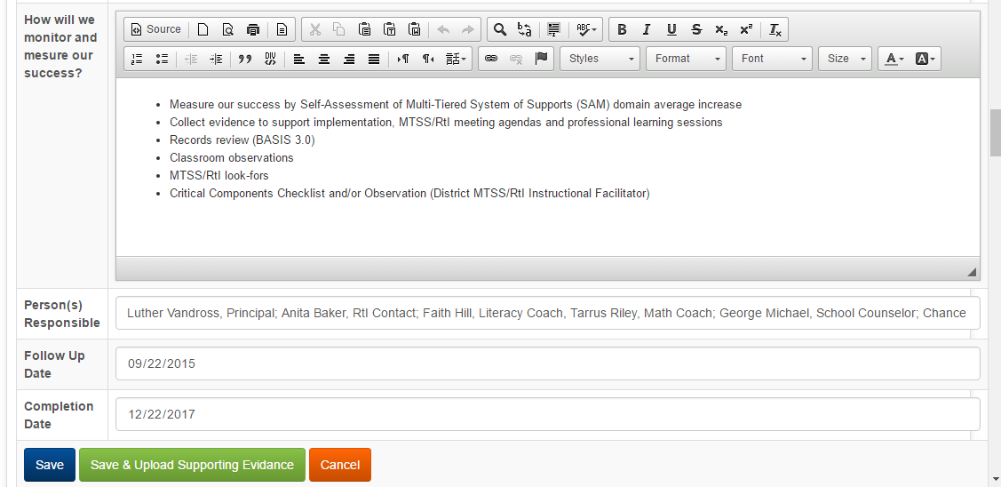
SAM PROBLEM SOLVING: STEP #4
SAM

Slide 44
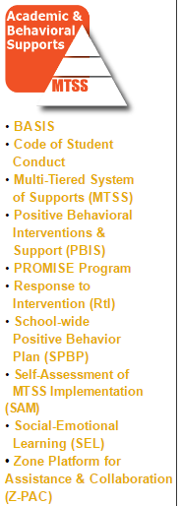
RESOURCES AND SUPPORT
Diversity, Prevention & Intervention SharePoint
https://browardcountyschools.sharepoint.com/sites/Intranet/Academics/SS/DPI/Pages/default.aspx
MTSS/RtI Instructional Facilitator
(See Support Matrix)
Diversity, Prevention & Intervention
754-321-1655
Adrienne T. Dixson
954-235-6886
SAM

Slide 45
OFFICE OF SERVICE QUALITY
5. TITLE I
ADDENDUM
DISTRICT CONTACT:
Paula Lovett-Canady, Program Specialist
Title I, Migrant & Special Programs, 754-321-1407

Slide 46
Title I, Migrant & Special Programs
2017-2018 Title I Plan (Addendum)
Paula Canady, Program Specialist
Tamara Battle, Grant Facilitator
Yolanda Nails, Grant Facilitator
Notes:
WELCOME
INTRODUCTIONS

Slide 47
TITLE I PLAN (Addendum)
Why do Title I Schools complete the SIP
and/or Title I Plan (Addendum)?
Public Law No. 107-110, Section 1114(b)(1),
codified at 20 U.S.C. § 6314(b)
requires that all Title I Schools complete a
Schoolwide Plan.
.
2017 – 2018 Title I Plan (Addendum)

Slide 48
TITLE I PLAN (Addendum)
In Broward County:
If your school has a grade of D or F
(FLDOE Focus or Priority school):
You are required to complete
The Florida Department of Education
School Improvement Plan
template which has embedded the required components of a schoolwide program, as set forth in the No Child Left Behind (NCLB) Act of 2001 (reauthorized as the Every Student Succeeds Act in 2015).
2017 – 2018 Title I Plan (Addendum)

Slide 49
TITLE I PLAN (Addendum)
In Broward County:
If your school has a grade of A, B or C…
You are required to complete the
Broward School Improvement Plan template.
This template does not include the
Title I required components, therefore,
a Title I Plan (Addendum) must be completed.
2017 – 2018 Title I Plan (Addendum)

Slide 50
LETS REVIEW!
2017 – 2018 Title I Plan (Addendum)

Slide 51
REQUIREMENTS
Comprehensive Needs Assessment of the entire school (including the needs of migrant children)
Instruction by HIGHLY QUALIFIED TEACHERS in all core content area classes
Strategies to Attract HIGH QUALITY, HIGHLY QUALIFIED TEACHERS to the school
2017 – 2018 Title I Plan (Addendum)

Slide 52
ADDITIONAL REQUIREMENTS:
Coordination & Integration
Title I, Part A
Title I, Part C-Migrant
Title I, Part D
Title II (Professional Development)
Title III (ELL)
Title X, Homeless Education
2017 – 2018 Title I Plan (Addendum)

Slide 53
ADDITIONAL REQUIREMENTS: Coordination & Integration
Supplemental Academic Instruction
Violence Prevention Programs
Nutrition Programs
Housing Programs
2017 – 2018 Title I Plan (Addendum)

Slide 54
ADDITIONAL REQUIREMENTS:
Coordination & Integration
Head Start
Adult Education
Career and Technical Education
Job Training
Other
2017 – 2018 Title I Plan (Addendum)

Slide 55
PRE-SCHOOL TRANSITION
Indicate how your school services the pre-school aged students
(i.e. Head Start, Title I/VPK, Specialized Pre-K ESE)
Describe the process for orienting new families to your school
(i.e. Kindergarten Round-Up)
2017 – 2018 Title I Plan (Addendum)

Slide 56
PARENT INVOLVEMENT ACTION PLAN
Level/Expected Level of Parent Involvement as it relates to total number of participants
2017 – 2018 Title I Plan (Addendum)

Slide 57
PARENT INVOLVEMENT ACTION PLAN
Parent Involvement Action Plan Activities
(Aligned to School-Level PIP)
New Name: Parent and Family Engagement Plan ~ PFEP
2017 – 2018 Title I Plan (Addendum)

Slide 58
PARENT INVOLVEMENT ACTION PLAN
High Quality and Ongoing Professional Development
(Aligned to Title I, Part A School-Based Budget)
2017 – 2018 Title I Plan (Addendum)

Slide 59
SUGGESTIONS FOR BEST PRACTICES
Include your Title I Liaison on your SIP team. (6 eBinder compliance items reference the SIP/Title I Plan)
Complete ALL requirements in a detailed, narrative format
Please indicate if the requirement is not applicable to your school
Refer to the “More Information” pull down tab as needed for examples
Be complete and concise with your responses
Title I Plan (Addendum)

Slide 61
NEED HELP? CONTACT US!
Paula Canady
754-321-1407
Tamara Battle
754-321-1400
Yolanda Nails
754-321-1400
2017 – 2018 title I addendum

Slide 62
OFFICE OF SERVICE QUALITY
6. FLDOE CIMS
https://www.floridacims.org
STATE CONTACTS:
Bureau of School Improvement
Bryan Jones, Assistant Director, 513-602-1906
Roxanne Green, School Improvement Specialist, 754-321-1623

Slide 63
CIMS 101 Continuous Improvement Management System
S T A R T

Slide 64
What is CIMS?
CIM S
Built on the concept of continuous improvement
Online system available to all
districts and schools
Embedded with project management features

Slide 65
What can CIMS do?
School Improvement Plans
District Improvement and Assistance Plans School Improvement Grant 1003(g) proposals

Slide 66
CIMS Resources
Step Zero needs assessment tool
8-Step Planning and Problem Solving Module Review and monitoring tools
Event registration (BSI sponsored events)

Slide 67
Logging In
Go to https://www.floridacims.org
USERNAME: PASSWORD:
your email address your CIMS password

Slide 68
Individual Accounts for All
Benefits of using your unique account and password—
Personalized support in Intercom
Accurate tracking information for historical records
Personalized dashboard with quick access to your own data, portfolios, applications, plans, tasks and events

Slide 69
Clean Up Access Permissions
Leadership Team
Curriculum Team
School Advisory Council
No longer at school
Changed responsibility at school
Notes:
Time: 1 minute (36 minutes running total)
Purpose: Remind principals to update permissions of users in CIMS
Facilitator’s Script:
Schools will need to clean up access permissions. Individuals who are no loner at their schools or those who have changed responsibilities should not be deleted, but their permissions changed to Zero.
If schools need assistance, they should contact their OSPA representative.

Slide 70
Four Levels of CIMS Support

Slide 71
Four Levels of CIMS Support
The Guidance tab is specific to the visible page, and typically contains a combination of the following types of information: requirements, performance and functionality.

Slide 72
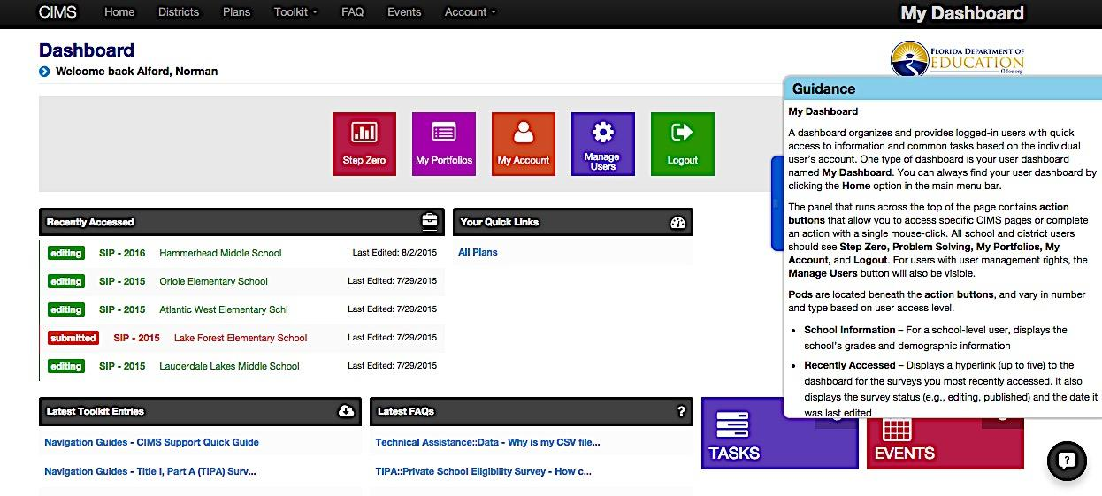
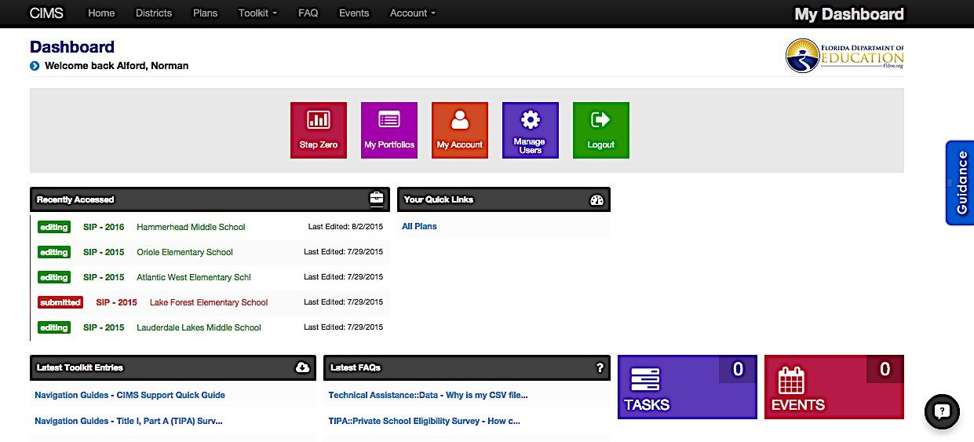
CIMS Level 1 Support: Guidance Tab
Notes:
Time: 1 minutes (41 minutes running total)
Purpose: Levels of Support for CIMS users – Level 1
Facilitator's Script:
Within Step Zero, there are pull out “guidance tabs.” Guidance Tabs provide overview information and may answer just-in-time questions.
L1 Support is specific to the visible and typically contains a combination of the types of information

Slide 73
Four Levels of CIMS Support
FAQ contains the most commonly asked questions, organized by category and then by subcategory.

Slide 74
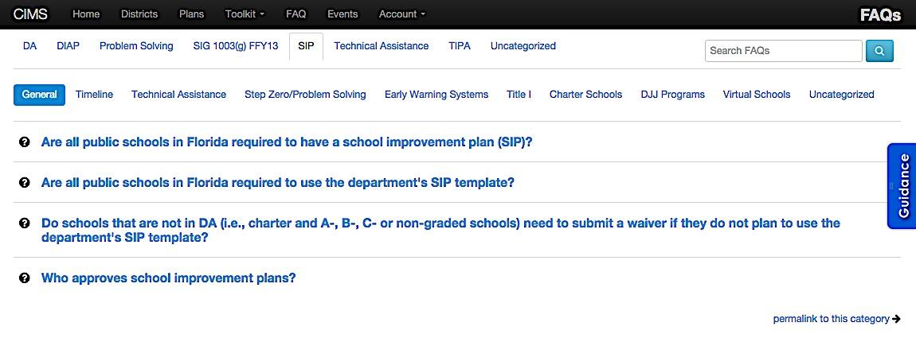
CIMS Level 2 Support:
FAQs
Notes:
Time: 1 minute (42 minutes running total)
Purpose: Levels of Support for CIMS users – Level 2
Facilitator's Script:
Level 2 support is provided via FAQs. The CIMS FAQs are organized by a variety of topics based on questions submitted from throughout the state. Select a topic and an area of interest.
Time permitting, encourage participants to select sub tab topics to explore the FAQ’s and answers.
Use the search box in the top right corner of the page to locate questions and/or answers containing a specific keyword or phrase.

Slide 75
Four Levels of CIMS Support
The Toolkit provides downloadable documents, as well as
e-learning modules, that are organized by category.

Slide 76
CIMS Level 3 Support: Toolkit - eLearning
1
2
3
Notes:
Time: 2 minutes (44 minutes running total)
Purpose: Levels of Support for CIMS users – Level 3
Facilitator's Script:
Level 3 support is provided through the CIMS Toolkit.
The Toolkit includes two types of resources. Documents and e-Learning.
Under overview, there are 4 modules for CIMS:
CIMS for Public Users
CIMS for New Registered Users
Introduction to CIMS Dashboards
4 Levels of CIMS Support
Under Problem Solving there are 2 e-Learning Modules for Step Zero:
Step Zero Module 1 is about Academic Outcomes
Step Zero Module 2 is about the Academic Outcomes Plot

Slide 77
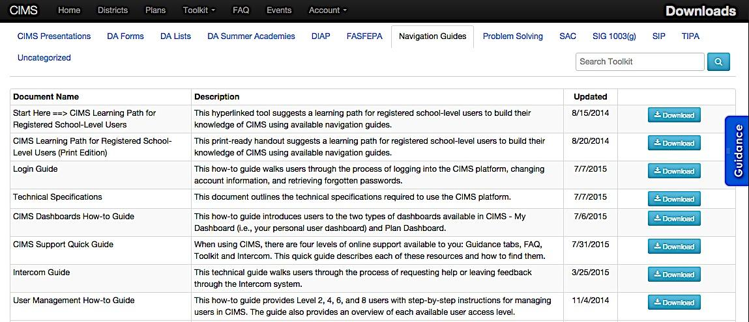
CIMS Level 3 Support: Toolkit - Documents
1
2
Notes:
Time: 2 minutes (46 minutes running total)
Purpose: Levels of Support for CIMS users – Level 3
HANDS-ON EXPLORATION TIME ALLOWING
Facilitator's Script:
The toolkit is your one-stop shop for downloadable documents.
The documents are located under a wide range of topics. The two most popular topics are Navigation Guides and SIP.
Navigation guides provide step-by-step instructions and screen shots for that particular selected document.
These documents are kept up to date by the Bureau of School Improvement.
The documents in the CIMS Toolkit are updated often and the updated column identifies when a document was last updated and/or posted.
You can download any document to view, save, and/or print to your computer→ click the teal “download” to any document.
Point out to participants that:
Some forms in CIMS have historical versions as well as current forms archived in the Documents folders.
Participants should check the full list of resources and the dates they were updated to ensure they have the most, current version.
Time allowing, have participants browse the CIMS page document names, descriptions and find resources of interest to them.

Slide 78
Four Levels of CIMS Support
Intercom is an embedded message system that allows users to ask specific questions when answers cannot be found using the other three support resources.

Slide 79
CIMS Level 4 Support: Messaging Intercom
CIMS Project Developers
BSI Team
Cayce
Ask questions using the messaging intercom.
Notes:
Time: 2 minutes (48 minutes running total)
Purpose: Levels of Support for CIMS users – Level 4
Facilitator's Script:
When all other levels of support (Guidance Tab, FAQ’s, and Toolkits) are exhausted and you still don’t have the answers you need, CIMS offers Level 4 support in the form of direct messaging to the CIMS Project Developers and BSI team.
Access Level 4 support clicking the online messaging intercom to ask specific, complex questions which are not addressed in Levels 1-3 Support; make suggestions for improvement, and/or point out errors you may discover while utilizing the CIMS interface.
You can instant message the developer in real time in CIMS, or via email notification. Your message automatically tags the location of the page from which you are asking the question.
Since the message tags the location of the page. You do not have to mention the location of your question.
You can also see past conversations. The conversations are not deleted so you can always use them as a point of reference.
Your message will be sent directly to the developer that will trouble shoot and respond or forward to an appropriate staff member in BSI.
Remember:
Level 4 support for the CIMS platform is to address technical questions. District-specific questions should be addressed to your district-based School Improvement Support (OSPA).

Slide 80
Notes:
SIP Development Process
Communication between school and DOE

Slide 81
What is “8-Step”?
A structured, data-based, planning
and problem-solving process
that helps guide systems-
level change.

Slide 83
“Do We Have To?”
A School Improvement Plan using Form SIP-1 is required
of each non-charter Focus, Priority, and Former F school using the CIMS Platform
District Improvement and Assistance Plan using Form DIAP-1 is required of each district with one or more non- charter Focus or Priority schools
Documenting the 8-Step Planning and Problem Solving process is required in the state board-approved forms SIP-1 and DIAP-1

Slide 84
Congratulations!

Slide 85
Contact Info:
Roxanne Green-Reid
School Improvement Specialist
Bureau of School Improvement
roxanne.green@fldoe.org
Bryan Jones
Assistant Regional Director
Bureau of School Improvement
bryan.jones@fldoe.org
Notes:
Introduce yourself. Should not be a full resume. ☺ better to undersell yourself and over-deliver than to oversell yourself and under-deliver.

Slide 86
Thank you!

Slide 87
SIP TRAINING 2017-18 SIP TRAINING 2017-18 SIP TRAINING 2017-18
Quarter 1: September 11 - September 15
Quarter 2: December 4 - December 8
Quarter 3: February 6 – March 2
Quarter 4: May 7 – May 11
OFFICE OF SERVICE QUALITY

