Slide 1
Office of Service Quality
SCHOOL IMPROVEMENT TRAINING – QUARTER 3
FEBRUARY 27 – MARCH 3, 2017
Notes:
WELCOME
INTRODUCTIONS

Slide 2
AGENDA
2. FACE PLAN
(THE OFFICE OF PARENT AND COMMUNITY ENGAGEMENT)
SAC AND
SAF
UPDATES
1. STAKEHOLDER
SURVEY &
VAL-ED
SURVEY
4. BEHAVIOR
PLAN
(THE OFFICE OF DIVERSITY, PREVENTION AND INTERVENTION)
5. MID-YEAR
SIP
REFLECTION
6. SHARING
BEST
PRACTICES
OFFICE OF SERVICE QUALITY

Slide 3
OFFICE OF SERVICE QUALITY
1. STAKEHOLDER
SURVEYS
AND
VAL-ED
SURVEYS

Slide 4
ASSIST STAKEHOLDER SURVEY: MARCH 6-31
DIRECTIONS SENT TO PRINCIPALS ON FEB. 23RD
GO TO http://extranet.advanc-ed.org/systems
TO DOWNLOAD DOCUMENTS ABOUT SURVEY ADMINISTRATION
OFFICE OF SERVICE QUALITY

Slide 5
ASSIST STAKEHOLDER SURVEY: DIRECTIONS FOR STAFF SURVEY
• Web STAFF Survey Link: http://www.advanc-ed.org/survey/public/8530367
This survey is to be completed by INSTRUCTIONAL staff only. This includes APs, ESE Specialists, Academic Coaches, and Media Specialists
• Web STAFF Survey Invitation: Use for communication to distribute the link information:
In an effort to improve System Practices, the Broward County School District is conducting a Staff Survey. We value your opinion and ask that you please take time to complete this survey. In order to complete the survey, go to: http://www.advanc-ed.org/survey/public/8530367 Please be assured that your responses to this survey will be anonymous. Your honest opinion is appreciated. Thank you for your time and attention to this matter.
• Paper surveys will not be available for the staff.
OFFICE OF SERVICE QUALITY

Slide 6
ASSIST STAKEHOLDER SURVEY: DIRECTIONS FOR STUDENT SURVEY
• Web STUDENT Survey Links – Please use with the appropriate grade level:
Early Elementary (Grades K-2) http://www.advanc-ed.org/survey/public/4852131
Elementary (Grades 3-5) http://www.advanc-ed.org/survey/public/6563635
Middle & High (Grades 6-12) http://www.advanc-ed.org/survey/public/2612735
• Web STUDENT Survey Invitation - use for any communication to distribute the appropriate link to your students:
In an effort to improve System Practices, the Broward County School District is conducting a Student Survey. We value your opinion and ask that you please take time to complete this survey. Please be assured that your responses to this survey will be anonymous. Your honest opinion is appreciated. Thank you for your time and attention to this matter.
• Paper surveys will not be available for the students.
OFFICE OF SERVICE QUALITY

Slide 7
ASSIST STAKEHOLDER SURVEY: DIRECTIONS FOR PARENT SURVEY
• Web PARENT Survey Link: http://www.advanc-ed.org/survey/public/0413263
Send this link home to parents via Parent Link, flyer, email, etc. if your school chooses to use the web for the parent survey.
• Web PARENT Survey Invitation: use for any communication to distribute the link information:
In an effort to improve System Practices, Broward County School District is conducting a Parent Survey. We value your opinion and ask that you please take time to complete this survey. In order to complete the survey, go to: http://www.advanc-ed.org/survey/public/0413263 Please be assured that your responses to this survey will be anonymous. Your honest opinion is appreciated.
Thank you for your time and attention to this matter.
• Paper PARENT Survey:
Principals were emailed a zip file with their school’s parent surveys in multiple languages and instructions for survey administration. Each zip file contains uniquely identified surveys for the noted school and should not be administered to other institutions. Schools are responsible for reproducing, distributing, and mailing paper surveys for processing.
OFFICE OF SERVICE QUALITY

Slide 8
VAL-ED SURVEY
The VAL-ED is an online survey all directors, principals and teachers take to rate the effectiveness of instructional leadership at each school site
The survey results will serve as a guide for professional development for cadre directors
• Survey answers are completely anonymous and the online survey will take about 20-30 minutes
• It is advised that the survey be completed in one sitting
SPECIFIC
DIRECTIONS
WITH ACCESS
CODES WILL
BE SENT TO
PRINCIPALS
• Ratings for each question are scored from 1 (lowest) to 5 (highest) • When a score for each item is given, an item from the “evidence” choices needs to be indicated
• Schools will receive a school survey code and unique access codes to be randomly distributed
OFFICE OF SERVICE QUALITY

Slide 9
VAL-ED SURVEY
2017 VAL-ED SURVEY WILL BE CONDUCTED
MARCH 20 - APRIL 7
PRINCIPALS WILL BE EMAILED DIRECTIONS THE
WEEK OF MARCH 13TH
A Best Practice for successful survey completion success
is to have all instructional staff take the survey
in a group setting.
OFFICE OF SERVICE QUALITY

Slide 10
OFFICE OF SERVICE QUALITY
2. FACE PLAN
If you have any questions or concerns, please contact
Nadia.Clarke@browardschools.com or at 754-321-1599

Slide 11
FACE PLAN (FAMILY AND COMMUNITY ENGAGEMENT)
1. Reminder...all FACE Plan docs are available on OSPA Central 2.0.
2. Cultural Ambassador interviews should be with adults,
not students.
3. Connect with School Social Workers for community resources.
4. FACE is a great opportunity to engage your SAF Chair!
5. Continue building on your current activities for next school year.
6. What is working well & what are your challenges?
OFFICE OF SERVICE QUALITY

Slide 12
OFFICE OF SERVICE QUALITY
3. SIP AND SAF
UPDATES

Slide 13
SIP AND SAF SBBC POLICY
SAC/SIP: SBBC POLICY 1403 SCHOOL ACCOUNTABILITY AND IMPROVEMENT:
Each school has a School Advisory Council (SAC) to facilitate the development and monitor progress
of the annual School Improvement Plan. Agendas and minutes reflect annual needs assessment, SIP monitoring and allocation of Accountability Funds.
SAF: SBBC POLICY 1.3 SCHOOL ADVISORY FORUM:
Every school shall have a School Advisory Forum (SAF) that shall foster and promote
communication between stakeholders, the school, and the Area Advisory Council. The SAF shall bring forth recommendations, concerns and interests to and from their Area Advisory Council.
Both policies can be viewed at: http://www.broward.k12.fl.us/sbbcpolicies/index.asp
OFFICE OF SERVICE QUALITY

Slide 14
SAC BYLAW REVIEW
OFFICE OF SERVICE QUALITY

Slide 15
CONTINUATION WAIVERS
All documentation must be
completed by April 27, 2017.
Remember:
The faculty must vote to continue
the waiver each year.
OFFICE OF SERVICE QUALITY

Slide 16
OFFICE OF SERVICE QUALITY
4. BEHAVIOR
PLAN
Upload Completed Behavior Plan to the 2017-2018 SIP Template

Slide 17
SCHOOL –WIDE POSITIVE BEHAVIOR PLAN (SPBP)
THE FOLLOWING INFORMATION WAS SENT TO PRINCIPALS VIA PIVOT JANUARY 17, 2017
ACTION 1: Before January 30, 2017 and using their own Personnel Identification Number, the principal is to sign in and watch the “School-Wide Positive Behavior Plan (SPBP) Brainshark for Principals”, found at http://www.browardprevention.org/mtssrti/rtib/ School-Wide Positive Behavior Plan.
The principal is to download the SPBP template from the School Improvement Plan (SIP), Best Practice #2, for their SPBP team.
ACTION 2: Between January 17, 2017 and April 28, 2017, the SPBP team is to complete the SPBP template.
The SPBP needs to be shared with all stakeholders (students, staff, parents/caregivers, community, etc.) and be available to all school guests, District visitors, and substitute teachers. Faculty who are part of the bargaining unit are to vote on the SPBP.
OFFICE OF SERVICE QUALITY

Slide 18
SCHOOL –WIDE POSITIVE BEHAVIOR PLAN (SPBP)
ACTION 3: Before May 1, 2017, all schools must upload their completed SPBP template as part of the SIP, Best Practice #2, in OSPA Central V2.0.
RATIONALE: In our continuing efforts to address schoolwide behaviors and improve school climate, the School-Wide Positive Behavior Plan remains an important component of the School Improvement Plan. The template aligns with the District’s focus on Response to Intervention (RtI) and reflects the essential items of effective Positive Behavior Intervention and Support (PBIS).
Article 11-3 of the Collective Bargaining Agreement indicates that contractually, every school must have a Discipline Committee working in conjunction with the School Advisory Committee. It is this team who creates the SPBP. Please refer to Article 11-3 for more detailed information.
Every plan will be reviewed and rated by a District team. Individual feedback will be provided to the principal and their assigned cadre director by June 30, 2017.
If you have any questions or concerns, please contact
Tyyne.Hogan@browardschools.com or at 754-321-1642
OFFICE OF SERVICE QUALITY

Slide 19
OFFICE OF SERVICE QUALITY
5. MID-YEAR
REFLECTION
Upload Completed Mid-Year Reflection to SAC/SAF Upload Center

Slide 20
SIP MID-YEAR REFLECTION
Has
your
school
made
progress
towards
achieving
the goal?
How do the structures
& systems in place at your school ensure all facets of the school culture create predictable environments and a school climate that supports your SIP goal?
☑
What are the
gaps that exist between your
current state and your desired state?
How will you
address them
between now
and the end of
this school year?
OFFICE OF SERVICE QUALITY

Slide 21
SIP MID-YEAR REFLECTION
Have
alterable
barriers
been
eliminated
or
reduced?
(Alterable barriers are in-house infrastructure mechanisms such as scheduling, class structures, teacher attendance, student attendance, staff development plan, etc.)
A. What evidence do you see that a barrier has been reduced or eliminated?
C. If progress towards eliminating the barrier is not sufficient, where or what is the breakdown?
B. What evidence do you have that the barriers are wide-reaching and will help you achieve your goal?
D. Did you identify other barriers that could serve as effective re- entry points into the plan?
OFFICE OF SERVICE QUALITY

Slide 22
SIP MID-YEAR REFLECTION
3. Are your
strategies
being
implemented
with
fidelity?
A. Were decisions to continue, intensify, modify, or terminate strategies or action steps based on specific evidence?
☑
OFFICE OF SERVICE QUALITY

Slide 23
SIP MID-YEAR REFLECTION
4. What
are your
benchmarks
for
success?
A. How will you progress towards your goal impact student achievement?
☑
C. What gaps exist between your current state and your desired state?
What is
your desired state?
OFFICE OF SERVICE QUALITY

Slide 24
OFFICE OF SERVICE QUALITY
6. SHARING
BEST
PRACTICES

Slide 25
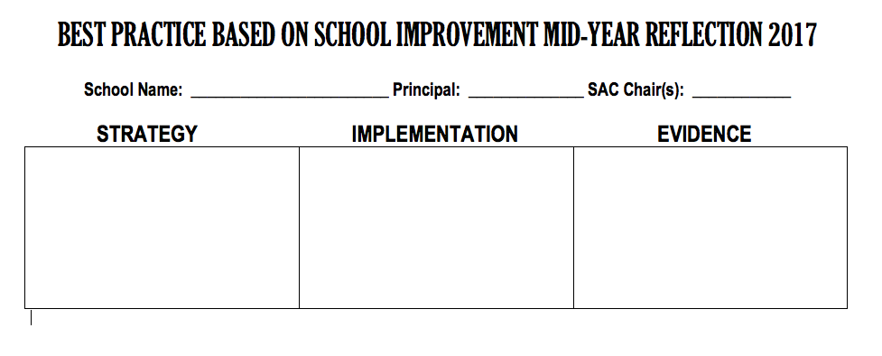
SHARING BEST PRACTICES
SIP MID YEAR BEST PRACTICES ARE POSTED ON OUR WEBSITE: http://www.broward.k12.fl.us/ospa/initiatives.asp?initiative_id=3
OFFICE OF SERVICE QUALITY

Slide 26
NEXT SIP TRAINING
MAY 1-5, 2017
TENTATIVE AGENDA:
• SIP 2017-2018
• ATTENDANCE PLAN
• TITLE I PLAN
• ORGANIZING SAC & SAF FOR NEW YEAR
Questions? Call Donna Boruch
Coordinator of School Improvement 754-321-3850
OFFICE OF SERVICE QUALITY

