Slide 1
Office of Service Quality
2017-2018
SCHOOL IMPROVEMENT TRAINING – QUARTER 2
Notes:
WELCOME
INTRODUCTIONS

Slide 2
THANK YOU FOR
BEING A PART
OF SCHOOL OUR
IMPROVEMENT
TEAM !
OFFICE OF SERVICE QUALITY

Slide 3
SCHOOL IMPROVEMENT DATES/DEADLINES for 2017-2018
Event Date/Deadline | Event/Document | Person(s) Responsible
December 6 - 8, 2017 Schools Attend One Half-Day Session: 8:30-11:30 or 12:30-3:30 | SIP Training Topics: Monitoring SIP, SAC Meeting Structure utilizing Roberts Rules of Order & Sunshine Law, A+ Process, Val-ED, Continuation Waivers and Mid-Year Reflection | Donna Boruch & OSQ IFs
January 8 - January 31 | Val-ED Survey Online survey for all directors, principals, and teachers; results will serve as a guide for professional development for principal supervisors | Principal
February 1, 2018 | A+ Fund Plans (This is a mandatory FLDOE deadline) Qualifying schools must complete upload all documentation to OSPA Central | Principal & SAC Chair(s)
February 1, 2018 | Mid-Year Reflection Completed wit the Leadership Team, reviewed with SAC, and uploaded in the SAC Upload section on the BCPS SIP. DA Schools must enter information in the FLDOE SIP located of Florida CIMS. | Principal & SAC Chair(s)
February 8, 2017 | New Waiver Applications Completed, signed, and submitted to Office of Service Quality for approval | Principal & SAC Chair(s)
February 26 – March 2, 2018 Schools Attend One Half-Day Session: 8:30-11:30 or 12:30-3:30 | SIP Training Topics: Monitoring SIP, SIP Planning for 2017-2018, & Attendance Plan, Behavior Plan, FACE Plan, RtI Plan for 2018-2019 | Donna Boruch & OSQ IFs
April 26, 2018 | Continuation Waivers All documentation required for continuation of a waiver completed & uploaded | Principal & SAC Chair
May 7 – 11, 2018 Schools Attend One Half-Day Session: 8:30-11:30 or 12:30-3:30 | SIP Training Topics: School Improvement Planning for 2018-2019, Organization and Elections of SAC & SAF for next school year | Donna Boruch & OSQ IFs
OFFICE OF SERVICE QUALITY

Slide 4
AGENDA
2. ATTENDANCE PLAN
FACE PLAN
MTSS/RtI ACTION PLAN
TITLE 1 ADDENDUM
BEHAVIOR PLAN
1. SCHOOL
IMPROVEMENT
3. VAL-ED
SURVEY
TIMELINE &
PROCEDURES
4. A+ SCHOOL
RECOGNITION
FUNDS
5. SCHOOL
ADVISORY
FORUM
6. SIP
MID-YEAR
REFLECTION
OFFICE OF SERVICE QUALITY

Slide 5
OFFICE OF SERVICE QUALITY
1. SCHOOL
IMPROVEMENT
PLAN 2017-18
DISTRICT CONTACT:
Donna Boruch, Coordinator of School Improvement,
Office of Service Quality 754-321-3850

Slide 6
OSPA/OSQ WEBSITE
For all School Improvement information, log on to:
http://www.broward.k12.fl.us/ospa/initiatives.asp?initiative_id=3
• View any school’s School Improvement Plan (SIP)
• Access SAC & SIP Standard Operating Procedural Manual
• A+ Recognition Fund Process Information
• Waiver Application & Waiver Database
• Log on to OSPA Central 2.0 to access SIP template
OFFICE OF SERVICE QUALITY

Slide 7
SIP SCHOOL IMPROVEMENT PLAN
• School mission
• Baseline data to identify needs
• Expected student learning outcomes
• Strategies & timeframes for improvement
• Action steps for:
- instructional strategies
- budget
- training
- instructional materials & technology
- student support services and other
resources
• Necessary training & technical assistance
SBBC
POLICY 1403 REQUIRES THAT ALL SIPs
INCLUDE:
OFFICE OF SERVICE QUALITY

Slide 8
SBBC SCHOOL IMPROVEMENT PLAN IMPORTANT CLARIFICATION POINTS
• All schools must complete the SBBC School Improvement Plan which is aligned with the District Strategic Plan.
• The FLDOE SIP (Required for all DA Schools) is a component of the SBBC SIP in Best Practice 4.
• The SAC Composition Report needs to be updated and uploaded as a PDF periodically to SAC Upload section to reflect the actual, current membership.
• AdvancED Self-Assessment needs to be completed annually.
OFFICE OF SERVICE QUALITY

Slide 9
SIP AND SAF SBBC POLICY
SAC/SIP: SBBC POLICY 1403 SCHOOL ACCOUNTABILITY AND IMPROVEMENT:
Each school has a School Advisory Council (SAC) to facilitate the development and
monitor progress of the annual School Improvement Plan. Agendas and minutes reflect
annual needs assessment, SIP monitoring and allocation of Accountability Funds.
SAF: SBBC POLICY 1.3 SCHOOL ADVISORY FORUM:
Every school shall have a School Advisory Forum (SAF) that shall foster and promote
communication between stakeholders, the school, and the Area Advisory Council.
The SAF shall bring forth recommendations, concerns and interests to and from their
Area Advisory Council.
Both policies can be viewed at: http://www.broward.k12.fl.us/sbbcpolicies/index.asp
OFFICE OF SERVICE QUALITY

Slide 10
PURPOSE OF SAC
• Facilitate the development
of the School Improvement
Plan (SIP)
• Monitor progress of the SIP
and make modifications as
needed
OFFICE OF SERVICE QUALITY

Slide 11
SAC MEMBERSHIP
School Advisory Council Members representing teachers, education support employees, students, and parents shall be elected by their respective peer groups at the school in a fair and equitable manner as follows:
1. Teachers shall be elected by teachers.
2. Education support employees shall be elected
by education support employees.
3. Students shall be elected by students.
4. Parents shall be elected by parents.
OFFICE OF SERVICE QUALITY

Slide 12
SAC COMPOSITION
SAC Composition must reflect the community and must include:
Principal (Not assistant principal)
Teachers
BTU Steward (Or designee)
Parents
Innovation Zone Representative (Must be a parent)
SAF Chairperson (Must be a parent)
ESOL Representative (Must be the parent of ELL student)
ESE Representative (Must be the parent of an ESE student)
Gifted Representative (Must be the parent of a Gifted student)
Pre-K (If applicable-parent or certified teacher)
Non-Instructional Employees
Community/ Business Representatives
Students (mandatory for High School, optional for Middle School)
Community School Representative (if applicable)
Important reminders:
- SAC COMPOSITION MUST BE KEPT UPDATED ON THE DATABASE AND IN THE SAC UPLOAD
SECTION OF THE SIP
- QUORUM MUST BE MET FOR EACH SAC MEETING: 51% OF SAC COMPOSITION
- AFTER TWO ABSENCES IN A ROW, A SAC MEMBER NEEDS TO BE REPLACED
OFFICE OF SERVICE QUALITY

Slide 13
SAC CHAIR(S)
Elected AFTER SAC members are chosen
Must represent SAC at Area Advisory Meetings
Will represent SAC as a voting member at School Advisory Forum Meetings
OFFICE OF SERVICE QUALITY

Slide 14
SAC BYLAWS
• School Advisory Councils should review their SAC Bylaws
the periodically and make necessary revisions.
• School Advisory Councils need to review their Bylaws and
revise them using the SAC Bylaws Template.
• Once the SAC Bylaws have been revised and approved, they
need to be submitted through the SAC Documentation Upload
on the SBBC SIP.
• Schools are also expected to post SAC Bylaws on their website,
maintain a hard copy of their annual SAC Bylaws in the main
office and should ensure that they are available for anyone who
may wish to see them.
OFFICE OF SERVICE QUALITY

Slide 15
SAC BYLAW REVIEW
OFFICE OF SERVICE QUALITY

Slide 16
SAF SCHOOL ADVISORY FORUM
SBBC POLICY 1.3 SCHOOL ADVISORY FORUM: Every school shall have a School Advisory Forum (SAF) that shall foster and promote communication between its stakeholders, the school, and the Area Advisory Council. The SAF shall bring forth recommendations, concerns and interests to and from their Area Advisory Council.
MEMBERSHIP: Oﬃcers should be elected per their school bylaws.
DUTIES: Actively participate with the SAC in identifying the needs and priorities of the school.
Comprehensive SAF information can be found by logging onto:
http://www.broward.k12.fl.us/sbbcpolicies/index.asp
OFFICE OF SERVICE QUALITY

Slide 17
HOW DOES SAC RELATE TO SAF?
SAC School Advisory Council
Mandated by School Board Policy
Main purpose is increasing student achievement through school improvement
Chair(s) can be employee and/or parent
Develops and approves SAC bylaws
Separate agenda, sign-in, and minutes for
eachmeeting
SAF- School Advisory Forum
Mandated by School Board Policy
Main purpose is communication between
stakeholders, the school, and the Area
Advisory Council Chair
MUST be a parent
SAF Chair is a member of SAC
Develops and approves SAF bylaws
Separate agenda, sign-in, and minutes for
Each meeting
****************
OFFICE OF SERVICE QUALITY

Slide 18
SAC AND SAF ELECTION PROCEDURES
Once a nominating committee is named (as per your school's bylaws) the following procedures should be utilized.
1. Send out memo to school parent population (or otherwise advertise to your entire community, a notice that SAF elections will be held at the May meeting of the school year. Request nominations!
2. The Nominating Committee may extend a courtesy call to each of the present SAF officers asking if they wish to stay on as officers for the next school year (again, check your bylaws for limits on terms of office).
3. The Nominating Committee compiles a slate of officers from the names they have received from steps 1 and 2. It is the charge of the nominating committee to slate that candidate who is best qualified for the position.
4. The Nominating Committee makes a courtesy call to each slated officer to inform them of their nomination and reconfirm their acceptance of the nomination.
5. The Nominating Committee presents slate of officers to membership either at a general meeting usually one month prior to the election. (Check your bylaws!)
6. The Nominating Committee conducts the elections. They present the slate at the election meeting and ask for nominations from the floor. If there are no nominations from the floor the slate can be voted on as is - one vote for the entire slate.
7. If there are nominations from the floor you can have either an open or closed ballot election. An open ballot is typically taken by a show of hands; a closed ballot is taken by written ballot. You must vote for each position for which there is more than one nominee. Then, you can vote on the remainder of the slate. (For example: there is a nomination from the floor for the position of recording secretary. You must have a vote for the position of recording secretary (either open or closed) and then vote on the remainder of the slate.)
OFFICE OF SERVICE QUALITY

Slide 19
In the event there is no nominating committee formed then: Send out memo to school parent population (or otherwise advertise to your entire community) a notice that SAF elections will be held at the May meeting of the school year that Nominations will be taken from the floor. SAC AND SAF ELECTION PROCEDURES
In the event there is no nominating committee formed then:
1. Send out memo to school parent population (or otherwise advertise to your entire community) a notice that SAF elections will be held and Nominations will be taken from the floor.
2. Anyone can nominate a candidate, even the candidate themselves, from the floor. You can have either an open or closed ballot election. An open ballot is typically taken by a show of hands; a closed ballot is taken by a signed, written ballot. You must vote for each position for which there is a nominee.
SAF Minutes must reflect the voting procedure and who was elected to each position.
OFFICE OF SERVICE QUALITY

Slide 20
NEW & CONTINUATION WAIVERS
ALL WAIVER INFORMATION CAN BE FOUND AT:
http://www.broward.k12.fl.us/ospa/initiatives.asp?initiative_id=5
New Waiver Applications: Must be completed by February 8, 2018
Only schools that have completed an Intent to Apply form and
have been given permission to proceed may submit an application.
Continuation Waivers: All documentation must be completed by
April 26, 2018. Remember: The faculty must vote to continue
the waiver each year.
Special Note: Schedule Changes do not require a waiver. However, you must follow Article 15, Section K of the BTU Contract. Contact the Office Employee and Labor Relations for assistance.
OFFICE OF SERVICE QUALITY

Slide 21
SBBC SIP FOR ALL SCHOOLS
The SBBC SIP public view site can be found
by logging on to:
http://www.broward.k12.fl.us/ospa/select_school.asp
ALL STAKEHOLDERS CAN VIEW ALL
COMPONENTS OF ALL SCHOOL
IMPROVEMENT PLANS FOR ALL SCHOOLS
IN THE DISTRICT
OFFICE OF SERVICE QUALITY
Notes:
All Schools will log on to SIP at this point in the training.

Slide 22
OFFICE OF SERVICE QUALITY
2. ATTENDANCE
PLAN
DISTRICT CONTACT:
Phillip Shaver, Coordinator of District Attendance,
Student Services Department, 754-321-1623

Slide 23
PLAN STRUCTURE: Attendance Plan
Data (Populated on August 2, 2017)
Goals for the Attendance Plan (Data Analysis with Goals)
Tier 1: Strategies
Tier 2: Strategies and Interventions
Tier 3: Individualized Responses and Legal Interventions
Attendance plan
Notes:
Image #535076351

Slide 24
ATTENDANCE PLAN DATA
Data is included in the SIP
Two-year data by semester can be compared by switching the year to 2015/16
1st Semester (2016/17) |  | Satisfactory (0-4.9% absences) |  | At-Risk 5-9.9% absences |  | Chronic Absences (10-19.9% absences) |  | Severe Absences (20% or more)
Grade | Total # of students | # | % | # | % | # | % | # | %
9th
10th
11th
12th
Totals |  | (Total #) | (Overall % of students) | (Total #) | (Overall % of students) | (Total #) | (Overall % of students) | (Total #) | (Overall % of students)
2nd Semester (2016/17) |  | Satisfactory (0-4.9% absences) |  | At-Risk 5-9.9% absences |  | Chronic Absences (10-19.9% absences) |  | Severe Absences (20% or more)
Grade | Total # of students | # | % | # | % | # | % | # | %
9th
10th
11th
12th
Totals |  | (Total #) | (Overall % of students) | (Total #) | (Overall % of students) | (Total #) | (Overall % of students) | (Total #) | (Overall % of students)
Attendance plan
Notes:
Image #535076351

Slide 25
ATTENDANCE PLAN GOALS
Analyze school-wide data with the SIP team
An emphasis on early grades in elementary (K & 1) and high school (9 & 10) may be a focus
All grades in middle school (6, 7, 8)
Set SMART goals for each semester
District Goal is to reduce chronic absenteeism by at least 1%.
Attendance plan
Notes:
Image #535076351

Slide 26
ATTENDANCE PLANS TIERS & STRATEGIES
Tiers for attendance strategies include:
Monitor Data
Engage students and Families
Recognize good and improved attendance
Provide personalized outreach
Remove barriers
Tier 1: Strategies aimed at all students and families
Tier 2: Strategies for students with at-risk attendance and a history of chronic absenteeism
Tier 3: Coordinated school and district response (Student Services Department). Legal intervention (last resort)
Attendance plan
Notes:
Image #535076351

Slide 27
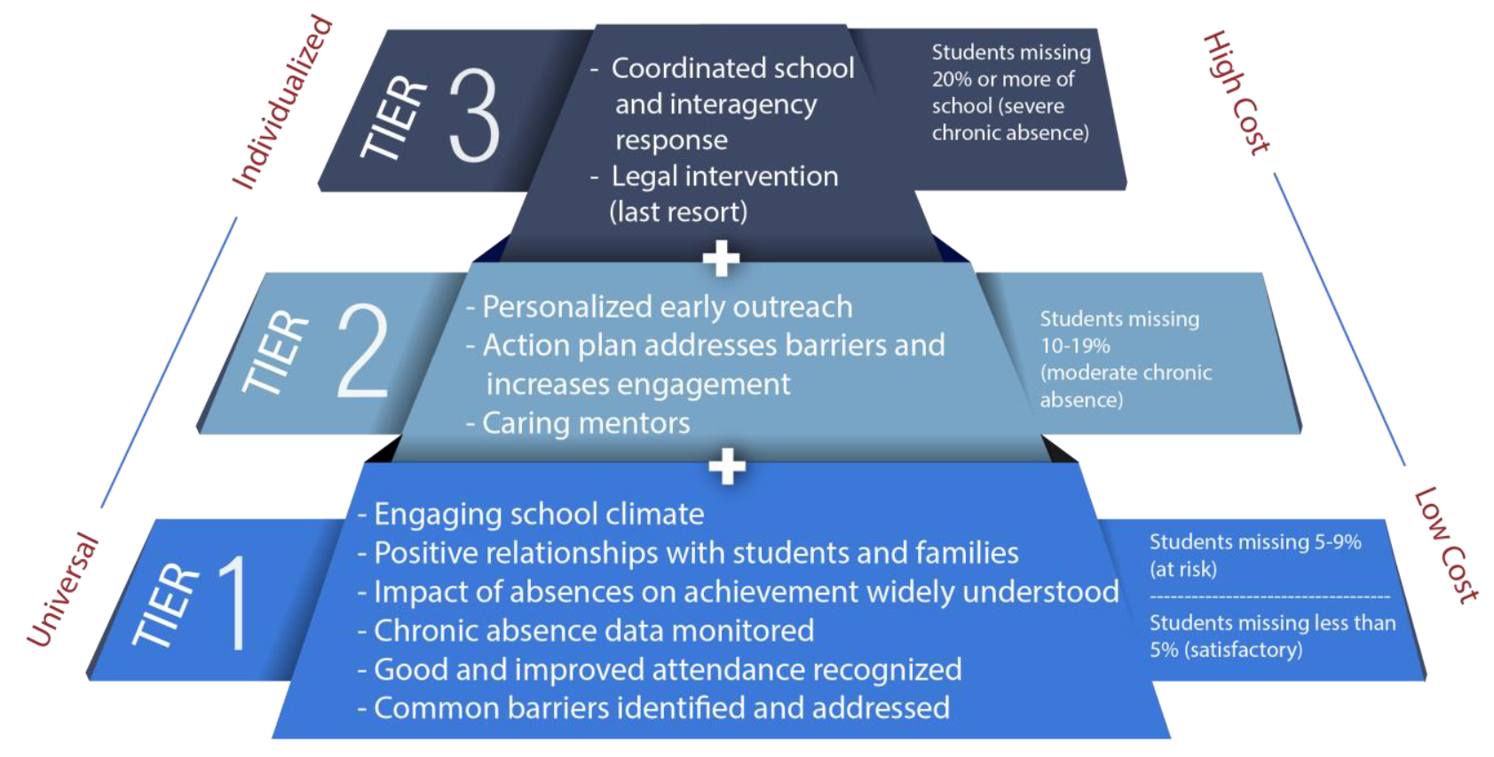
ATTENDANCE PLANS TIERS & STRATEGIES
Attendance plan
Notes:
Image #535076351

Slide 28
ATTENDANCE PLAN TIER 1 EXAMPLES
Attendance phone line for your school on the school website. EASILY ACCESSIBLE, not in a document that has to be downloaded.
Recommended locations: 1. Contact Us and 2. Absence Reporting Policy. Use a phone number intended for attendance reporting.
Add to the school’s splash page on the District website.
Attendance Clerk at the school should monitor the messages. Try to keep up so parents don’t get the “voice mailbox is full” message.
Teachers take daily attendance. Administrators and teachers work together to resolve conflicts in attendance records as a result of testing, field trips, illness, and other causes of a student’s absence from the classroom.
Parents are expected to update school records with a reliable phone number. On the school plan, how will parents know to do this?
Attendance plan
Notes:
Image #535076351

Slide 29
ATTENDANCE PLAN TIER 2 EXAMPLES
Review attendance every week for students that are chronically absent or at-risk Look for patterns
Suggest a home visit or conference
Nurture teacher interest in helping to reach out to chronically absent students
Recognize good and improved attendance
Assign an attendance buddy (A student or teacher volunteer that checks in with students that have attendance concerns)
Refer families to appropriate services (Social worker, guidance counselor, HEART, health services)
Identify barriers (transportation, housing, income)
Attendance plan
Notes:
Image #535076351

Slide 30
ATTENDANCE PLAN TIER 3 EXAMPLES
Determine how many students have a history of missing 20% or more of school. Identify the students with your leadership team
Ensure continued positive contact with the family
Share data with appropriate agencies to coordinate services
Work with families to avoid legal consequences to the extent possible
Use appropriate protocol for B-TIP, CINS/FINS agencies
Attendance plan
Notes:
Image #535076351

Slide 31
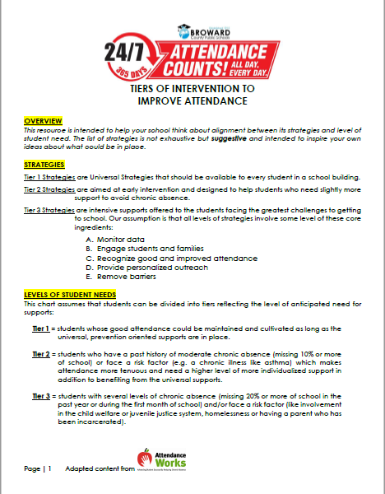
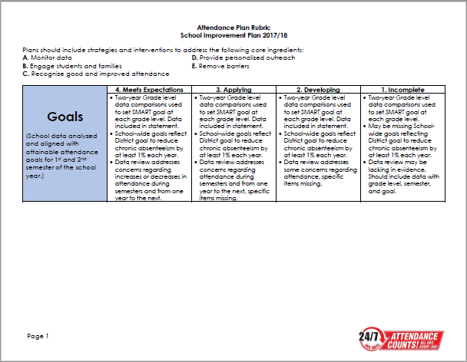
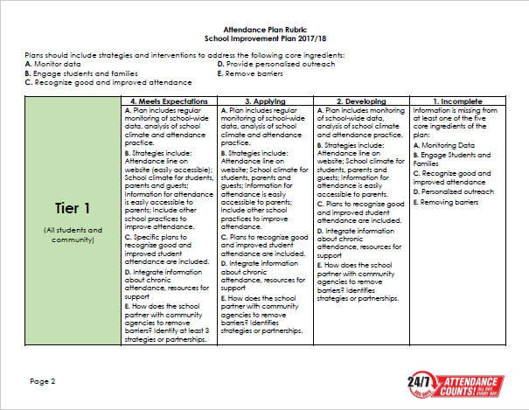
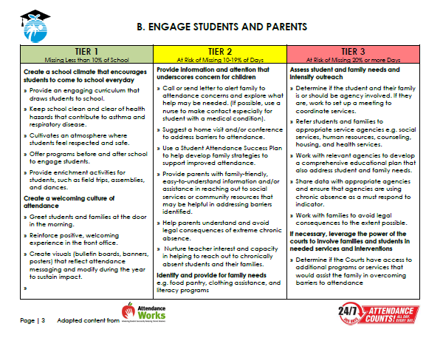
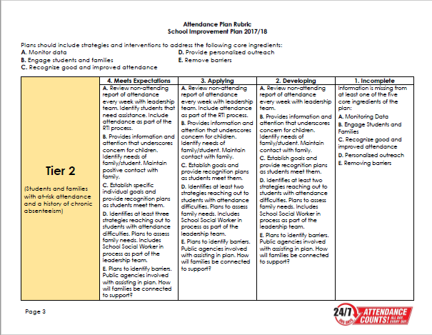
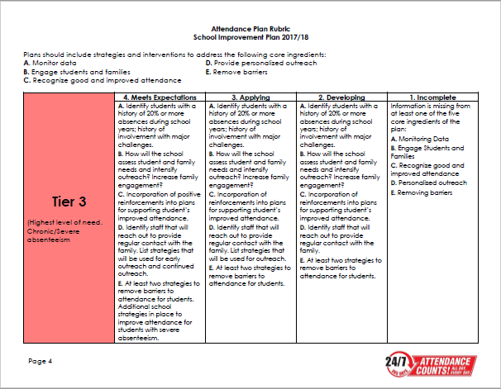
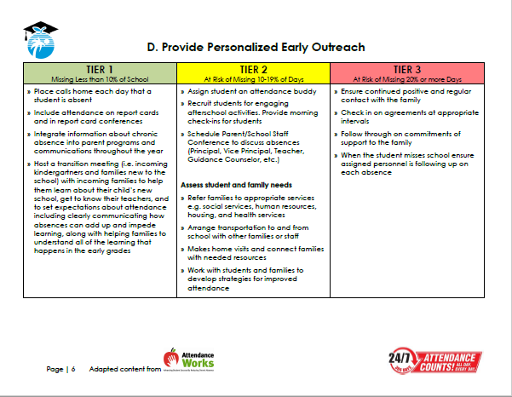
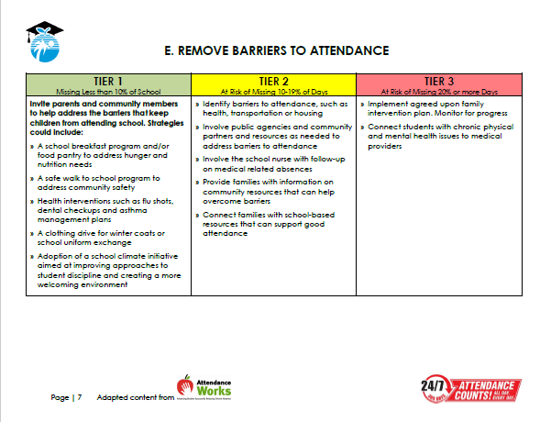
RESOURCES TO HELP WITH THE PLAN
RUBRIC – Rating to be led by SSW. Shared by SIP Team.
TIERED STRATEGIES RESOURCES.
Attendance plan
Notes:
Image #535076351

Slide 32
OFFICE OF SERVICE QUALITY
FACE PLAN
(Family and Community Engagement)
District contact:
Nadia Clarke, Assistant Director,
Office of Family and Community Engagement, 754-321-1599

Slide 33
Office of Family and Community Engagement (FACE)
FACE in Broward Schools
Engaging families and the community in support of healthy schools
Notes:
WELCOME
INTRODUCTIONS

Slide 34
Family and community engagement
Vision:
A district where every family actively partners with schools in supporting their children's learning and academic achievement. Schools have systems and practices in place that value and engage families and their communities in essential and meaningful ways
Mission:
To work collaboratively with families, community members and schools to ensure student success

Slide 35
From “Involvement” to “Engagement”
Involve is "to enfold or envelope“
Identifying projects, needs, and goals and then telling parents how they can contribute
Engage is "to come together and interlock“
Listening to what parents think, dream, and worry about with a goal of not to serve clients but to gain partners
Involvement implies doing to; in contrast, Engagement implies doing with
Family and community engagement

Slide 36
2017-2018 Strategy
Tier 3
Tier 2
Tier 1
Tier 1: All Schools and Communities
FACE Plan in SIP (BP 3)
Access to monthly engagement ideas
Monthly school-focused workshops
Parent workshops
Tier 2: Identified Schools & Faith-Based Partnerships
Site-based training with school team using AECF Planning tool
Facilitate planning session to identify ways to support school
Tier 3: SPARKS (Dillard and BA Zones)
Enhancing/strengthening support for educators, families and communities
Joint community partnership development
Zone engagement activities
SY 18 Project
Update Parent Resource Guide
Gulfstream Family Resource Center – FACE Center
Community University
Family and community engagement

Slide 37
FACE Plan in SIP
Family And Community Engagement (FACE) Plan
Impact Area: Program Environment/Culture
Engagement Goal: The environment or culture in which engaging programs take place must consider and plan for: families to feel welcomed, valued, and respected by program staff; two-way communication and relationship building with families are adapted to meet changing family and community circumstances; opportunities are provided for family support and development through the family partnership process and through intentional parent/family peer groups within the program and community.
Strategy (Specific action, including cultural proficiency connections as appropriate) | Date | What needs to be done for the activity? When does it need to be done? | Who is responsible? | What is our objective? | How will we measure our progress? | Identify artifacts to be uploaded
Review and distribute customer service handout to staff | Within the first 30 days | Link to the "Providing Quality Customer Service" document |  | Provide exceptional customer service to families and community stakeholders |  | Description of training held and copy of roster
Create a dedicated FACE Resource space in the building providing an updated calendar, district resources, academic & testing information, and specific community resources that can be accessed discreetly (FACE Resource tool provided to school by the Office of Family And Community Engagement) | Within the first 60 days | Identify space in the school that is frequently trafficked and easily accessible to families |  | Provide ongoing updated relevant resources to families and the community |  | Monthly photos of updated tool; copies of documents shared
Create Cultural Ambassadors and Resident Expert to facilitate a workshop around the cultural uniqueness of families served in the school/community | Between the 5th and 6th week of school | Link to the "10 Things You Should Know" document |  | Bridge the Cultural Gap between Families & Staff |  | Copy of information shared with the school community
Create a staff focused “Catch Them Being Good” program recognizing individuals supporting a positive environment/culture in your school | Monthly | Print/distribute/ post CTBG postcards for families to complete at anytime during the day/school year - embed link |  | Provide incentives to maintain a positive school environment |  | Ex. Scanned copies of submitted postcards, pictures from recognition activity
Engage in deliberate school-wide Social Emotional Learning (SEL) activities in LEAPS evidenced in SIP, Positive Behavior Plan (SPBP), RtI Action Plan, Attendance Plan | Daily | Embed activities in SIP, Behavior Plan, RtI Action Plan, Attendance Plan |  | Provide tiered support for Social Emotional Learning |  | LEAPs usage, SIP accreditation
Family and community engagement

Slide 38
Engagement Goal
Ospa central – Face Plan

Slide 39
Strategy 1 – Customer Service
Ospa central – face plan

Slide 40
Strategy 2 – Cultural Ambassador
Ospa central – face Plan

Slide 41
Strategy 3 – FACE Resource Space
Ospa central – face plan

Slide 42
Strategy 4 – “Catch Them Being Good”
Ospa central – face plan

Slide 43
Strategy 5 – SEL
Ospa central – face plan

Slide 44
Optional Objectives and Upload Documents

Slide 45
Questions and Support
Nadia Clarke
Office of Family and Community Engagement
754-321-1599
nadia.clarke@browardschools.com
Family and community engagement

Slide 46
OFFICE OF SERVICE QUALITY
MTSS/RtI ACTION PLAN
Self-Assessment of Multi-Tiered System of Supports (SAM)
DISTRICT CONTACT:
Adrienne Dixson, RtI Specialist,
Diversity, Prevention & Intervention Department, 754-321-1691

Slide 47
Celebrate Success!
96% of all schools completed the
MTSS/RtI Action Plan within the SIP
Increase in Leadership (Principals and APs) actively involved and facilitates MTSS implementation.
Increase in BASIS RtI usage
MTSS/RtI Action Plan

Slide 48
Objectives
Identify critical components of MTSS and alignment to BCPS Strategic Plan
Identify the content/curriculum of MTSS
Identify district-wide MTSS levels of implementation
Areas of strength
Areas of growth
Identify district-wide support for MTSS implementation
Identify MTSS/RtI Action Plan expected outcomes and sustainable practices
Provide technical assistance and support
Share professional learning opportunities

Slide 49
SAM Self-Assessment of Multi-Tiered System of Supports Instrument

Slide 50
Multi-Tiered System of Supports
Response to Intervention

Slide 51
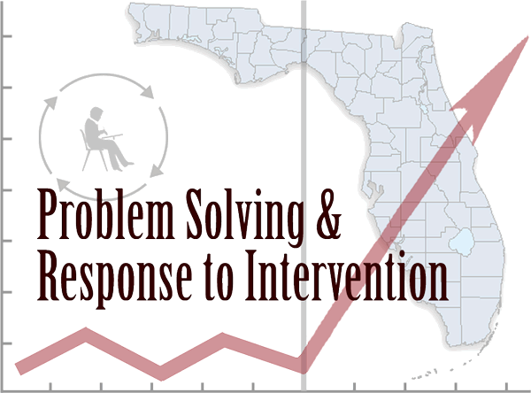
The Big Picture
+
_______________________________________________________________________
=
MTSS/RTI ACTION PLAN

Slide 52
Purpose & Scope Statement
Purpose: Enhance the capacity of all Broward County Public Schools to successfully implement and sustain a multi-tiered system
of student supports with fidelity.
Scope: To enhance the capacity/infrastructure of district
school-based leadership teams in implementing
MTSS/RtI critical elements with fidelity, for K - 12 learning
to meet the academic, behavioral and social-emotional needs of all learners, to be completed by June 2018.

Slide 53
Strategic Plan: High Quality Instruction
Areas of Focus
Areas of Focus
Alignment and integration of multiple initiatives
Provide early support for students’ academic, behavior, and social emotional needs
Literacy and Early
Learning
RtI
PBIS
Connect MTSS/RtI with graduation readiness metrics
Middle Grades Learning
SEL
UDL
Use the MTSS/RtI process to support graduation and post-secondary transitions
College and Career Readiness

Slide 54
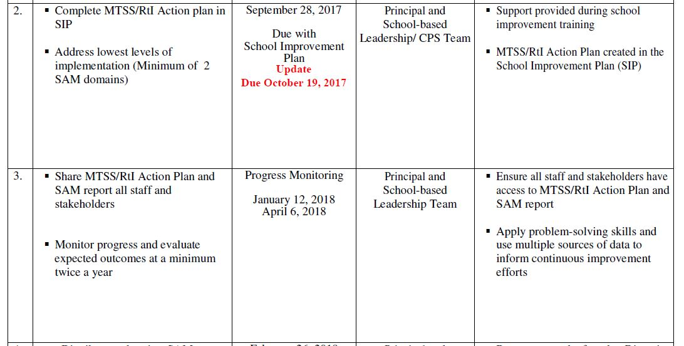
SAM Administration Timeline
The SAM instrument is used to measure school level implementation of a Multi-Tiered System of Supports.

Slide 55
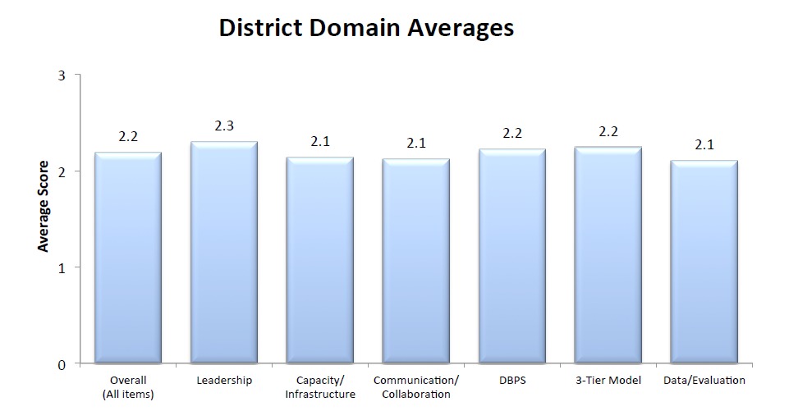
District SAM Report
Download your SAM report, convene your school -based team, analyze your SAM data, identify effective practices, identify lowest levels of implementation, and complete your action plan. At a minimum the school -based team must address the 2 lowest average SAM domains and at a maximum address all 6 SAM domains.
MTSS/RTI ACTION PLAN

Slide 56
District-wide Implementation
Lowest Levels of Implementation

Slide 57
Support Alignment
OSPA
OoA
OoA
OoA
Pre-K
Pre-K
Pre-K
15 Cadres Directors
Elementary Learning
1 Specialist, RtI
(10) Pre-K - 5th Grade
& Combo
25 Instructional Facilitators
(2) Middle Schools
(2) High Schools
Student Support Initiatives
(10) Pre-K - 5th Grade & Combo Schools*
5
5
5
(2) Middle Schools
(2) High Schools
(1) Center Schools
6
6
6
(1) Center Schools
Secondary Learning
(4) District-wide
(6) Climate Grant
12
12
12

Slide 58
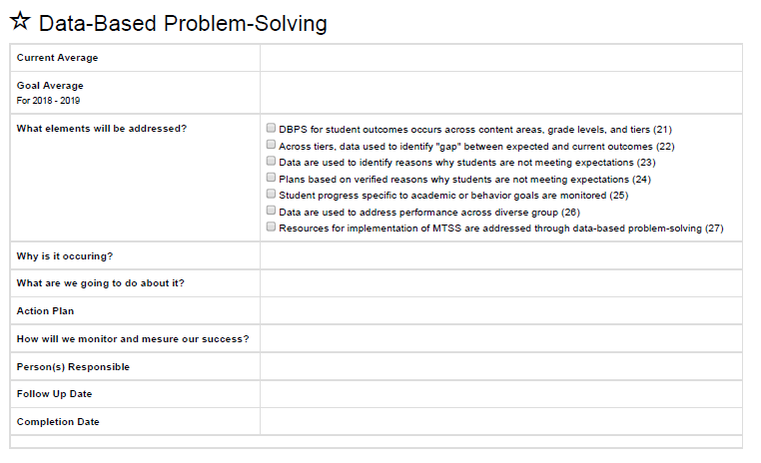
MTSS/RtI Action Plan
MTSS/RTI ACTION PLAN

Slide 59
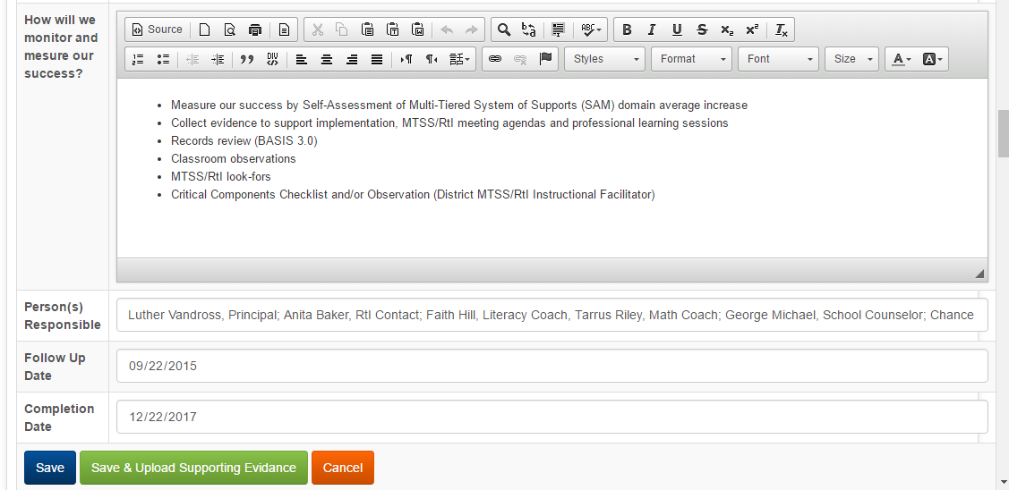
MTSS/RtI Action Plan Implementation
MTSS/RTI ACTION PLAN

Slide 60
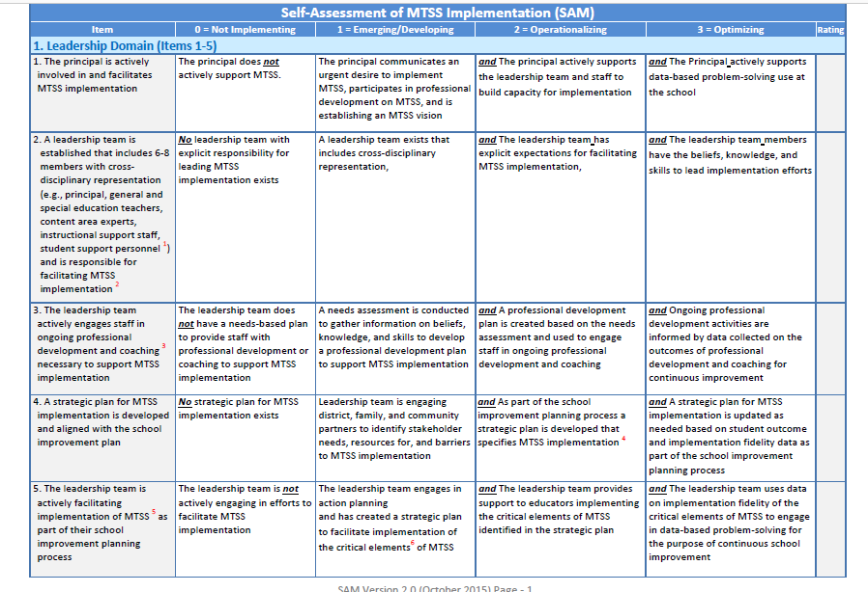
SAM Elements & Rubric
MTSS/RTI ACTION PLAN

Slide 61
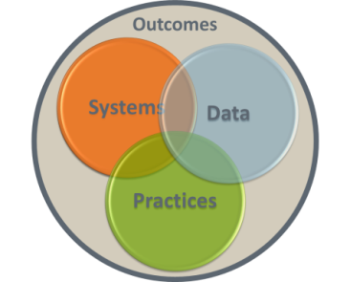
MTSS/RtI Action Plan Outcomes
Preventative approach applied across all tiers
Identify who needs support as early as possible
Implement supports as early as possible as needed and determine if those supports are effective
Prevent development of new problems/challenges
Reduce the number of existing problems/challenges
Reduce the intensity and complexity of needed supports
Implement and sustain a multi-tiered system of student supports with fidelity
MTSS/RTI ACTION PLAN

Slide 62
Next Steps
SBLT/CPST implement MTSS/RtI Action Plan steps
Collect data and evidence that demonstrates increase in
MTSS implementation
Monitor MTSS implementation progress
Update MTSS/RtI Action Plan
Communicate plan and progress to staff
SAM Administration Timeline
MTSS/RTI ACTION PLAN

Slide 63
Professional Learning
“An Introduction to a Multi-Tiered System of Supports” (MTSS) accessible through Florida’s Professional Development Portal
http://pdportal.florida-ese.org
What Is an MTSS and Why Is It Important
Multi-Tiered System of Support
The Problem-Solving Process
ESE Eligibility in an MTSS
Case Study Applications of MTSS Practices
Contact Diversity, Prevention & Intervention – 754-321-1655
Email certificate of completion to adrienne.Dixson@browardschools.com

Slide 64
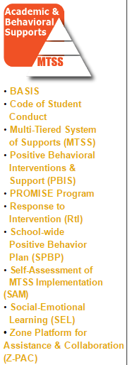
Resources And Support
Diversity, Prevention & Intervention SharePoint
https://browardcountyschools.sharepoint.com/sites/Intranet/Academics/SS/DPI/Pages/default.aspx
MTSS/RtI Instructional Facilitator
(See Support Matrix)
Diversity, Prevention & Intervention
754-321-1655
Adrienne T. Dixson
954-235-6886
MTSS/RTI ACTION PLAN

Slide 65
Questions & Answers
What of this is consistent with what I already know?
What of this is new?
How might this learning affect your thinking in relation to MTSS implementation?
How has this validated or changed your thinking?
What might you consider for changing your practice or your system?
What resources/supports might you need for your next steps
MTSS/RTI ACTION PLAN

Slide 66
OFFICE OF SERVICE QUALITY
TITLE I PLAN
(ADDENDUM)

Slide 67
Title I, Migrant & Special Programs
2017-2018 Title I Plan (Addendum)
Adriana Karam, Program Specialist
Tamara Battle, Grant Facilitator
Yolanda Nails, Grant Facilitator
Notes:
WELCOME
INTRODUCTIONS

Slide 68
Title I Plan (Addendum)
Why do Title I Schools complete the SIP
and/or Title I Plan (Addendum)?
Public Law No. 114-95,
Section 1116
requires that all Title I Schools complete a
School-wide Plan.
.
2017 – 2018 Title I Plan (Addendum)

Slide 69
Title I Plan (Addendum)
In Broward County:
If your school has a grade of D or F
(focus or priority school):
You are required to complete
The Florida Department of Education
School Improvement Plan
template, which has embedded the required components of a schoolwide program, as set forth in the No Child Left Behind (NCLB) Act of 2001 (reauthorized as the Every Student Succeeds Act in 2015).
2017 – 2018 Title I Plan (Addendum)

Slide 70
Title I Plan (Addendum)
In Broward County:
If your school has a grade of A, B or C…
You are required to complete the
Broward School Improvement Plan template.
This template does not include the
Title I required components,
therefore,
a Title I Plan (Addendum) must be completed.
2017 – 2018 Title I Plan (Addendum)

Slide 71
DIRECT LINK TO OSPA CENTRA 2.0
Welcome to OSPA Central 2.0
http://www.broward.k12.fl.us/ospa/ospa-central2/login.asp

Slide 72
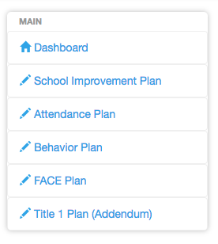
Let’s Review!
Title I Plan (Addendum)
2017 – 2018 Title I Plan (Addendum)

Slide 73
Title I Plan (Addendum)
*REQUIREMENTS*
Comprehensive Needs Assessment of the entire school (including the needs of migrant children)
Instruction by STATE CERTIFIED TEACHERS in all core content area classes
(Strategies) Attract HIGH QUALITY, STATE CERTIFIED TEACHERS to the school
2017 – 2018 Title I Plan (Addendum)

Slide 74
Title I Plan (Addendum)
*ADDITIONAL REQUIREMENTS*
Coordination & Integration
Title I, Part A
Title I, Part C-Migrant
Title I, Part D
Title II (Professional Development)
Title III (ELL)
Title X, Homeless Education
2017 – 2018 Title I Plan (Addendum)

Slide 75
Title I Plan (Addendum)
*ADDITIONAL REQUIREMENTS, cont.*
Coordination & Integration
Supplemental Academic Instruction
Violence Prevention Programs
Nutrition Programs
Housing Programs
2017 – 2018 Title I Plan (Addendum)

Slide 76
Title I Plan (Addendum)
*ADDITIONAL REQUIREMENTS, cont.*
Coordination & Integration
Head Start
Adult Education
Career and Technical Education
Job Training
Other
2017 – 2018 Title I Plan (Addendum)

Slide 77
*PRE-SCHOOL TRANSITION*
Indicate how your school services the pre-school aged students
(i.e. Head Start, Title I/VPK, Specialized Pre-K ESE)
Describe the process for orienting new families to your school
(i.e. Kindergarten Round-Up)
2017 – 2018 Title I Plan (Addendum)

Slide 78
PARENT INVOLVEMENT Action Plan
Level/Expected Level of Parent Involvement as it relates to total number of participants
2017 – 2018 Title I Plan (Addendum)

Slide 79
PARENT & FAMILY ENGAGEMENT Action Plan
Parent Involvement Action Plan Activities
(Aligned to School-Level PIP)
New Name: Parent and Family Engagement Plan ~ PFEP
2017 – 2018 Title I Plan (Addendum)

Slide 80
PARENT & FAMILY ENGAGEMENT Action Plan
High Quality and Ongoing Professional Development
(Aligned to Title I, Part A School-Based Budget)
2017 – 2018 Title I Plan (Addendum)

Slide 81
Suggestions for Best Practices
Include your Title I Liaison on your SIP team. (6 eBinder compliance items reference the SIP/Title I Plan)
Complete ALL requirements in a detailed, narrative format.
Please indicate if the requirement is not applicable to your school.
Refer to the “More Information” pull down tab as needed for examples.
Be complete and concise with your responses.
Title I Plan (Addendum)

Slide 83
Need help? Contact us!
Adriana Karam
754-321-1417
Tamara Battle
754-321-1400
Yolanda Nails
754-321-1400
2017 – 2018 title I addendum

Slide 84
OFFICE OF SERVICE QUALITY
BEHAVIOR
PLAN
Upload Completed Behavior Plan to the 2017-2018 SIP Template

Slide 85
School Improvement Plan Presentation
December 2017
School-wide Positive Behavior Plan
SPBP

Slide 86
Objectives
After this presentation, you will know:
Why all schools need to complete a SPBP
How the SPBP is connected to PBIS
What the template contains this year
What your next steps should be
SPBP Implementation Plan
Where to find the resources to complete the SPBP
When the SPBP is due
HINT: April 30
every year!
Notes:
By the end of this presentation, you will know:

Slide 87
Rationale
Does every school have to have a SPBP?
Yes, the SPBP is a part of the School Improvement Plan (SIP) and includes the BTU-contracted discipline plan. Even if your school completes the state SIP they still need to complete the SPBP. It is also an embedded piece of Best Practice # 2: Ensuring High Quality Embedded RtI Processes.
Why?
The SPBP is the blueprint of your behavior curriculum. It needs to be documented and monitored for you to be able to evaluate the success of your curriculum. All schools, regardless of level or type, must have an individualized implementation plan submitted on the District’s template.
Notes:
Every school has to complete a SPBP as a part of their SIP. Regardless of level or type, schools need to chart out their academic curriculum programs to ensure that their students meet academic achievement, even if that curriculum needs to be differentiated or individualized. Similarly, * all schools need to have a behavior blueprint, clearly indicating the critical elements of a comprehensive Tier 1 behavior plan.

Slide 88
Multi-Tiered System of Supports (MTSS)
The District’s Initiative
MTSS is a term used to describe an evidenced based model of schooling that uses data based problem solving to integrate academic and behavioral instruction and intervention. The integrated instruction and intervention is delivered to students in varying intensities (multiple tiers) based on student need.
Notes:
Implementing MTSS district-wide in Broward is a mandate since the Every Student Succeeds Act of 2015. PBIS ensures that every school has a blue print of their behavior curriculum. All schools must have an SPBP submitted on the District’s template.

Slide 89
How does it all fit together?
MTSS
PBIS
SPBP
SIP
10 Critical Elements
Notes:
To give you a better idea of how CHAMPs fits into our district initiatives, let’s look at a graphic organizer.
Multiple Tiered Systems of Support or MTSS came about as a part of the Every Student Succeeds Act in December 2015, ensuring that all students are provided with the academic, behavioral, and social skills instruction needed to be successful.
*Positive Behavior Interventions and Supports is the process of implementing multiple tiered systems of support around behavior for all students.
* Effective PBIS implementation involves 10 Critical Elements.
* A school’s PBIS process is documented, monitored, and updated in the *School-wide Positive Behavior Plan, so each of the 10 Critical Elements are in the SPBP.
*And finally, the SPBP is found in *Best Practice #2 of each school’s School Improvement Plan.

Slide 90
The SPBP is PBIS!
10 Critical Elements:
1. Active PBIS/Discipline Team with Leadership Participation
2. Faculty & stakeholder buy-in & commitment
3. School-wide Expectations with Lesson Plans
4. Location-based Rules with Lesson Plans
5. Effective Reward/Recognition Programs
6. Effective Discipline Process and Procedures
7. Classroom Management System (CHAMPs)
8. Data-based decision making
9. Implementation Planning
10. Ongoing Progress Monitoring & Evaluation
Notes:
As some members on your team may remember, there are 10 Critical Elements in PBIS and we have been adding 1 to 2 elements each year until all 10 are included in the SPBP. This year we have added the last two elements, classroom management and Implementation planning. Now all 10 elements are represented in SPBP.

Slide 91
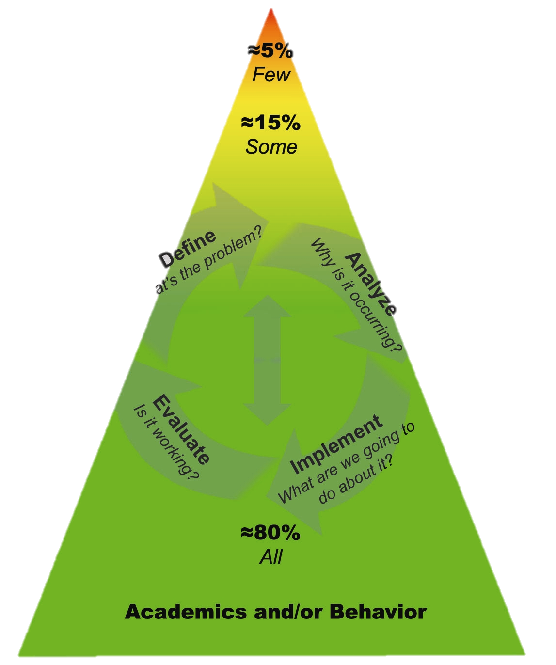
Multiple Tiered Systems of Supports
ACADEMIC SYSTEMS
Tier 3: Comprehensive & Intensive Students who need individualized interventions.
Tier 2: Strategic Interventions Students who need more support in addition to the core curriculum.
Tier 1: Core Curriculum All students, including students who require curricular enhancements for acceleration.
BEHAVIOR SYSTEMS
Tier 3: Intensive Interventions Students who need individualized intervention.
Tier 2: Supplemental Supports: Students who need more support in addition to school-wide positive behavior program.
Tier 1: Universal Interventions All students in all settings.
RtI
PBIS
Notes:
91
Has anyone seen this before? It has academics on one side and behavior on the other and it describes the 80, 15, 5 allocation of resources. We have been using the MTSS Triangle for at least 3 years now and I know you are tired of seeing it, so I’m going to talk about MTSS with a different graphic.

Slide 92
Multiple Tiered Systems of Supports
Academic swirl
Tier 1
100% students
Behavior swirl
Notes:
92
How about this picture? Much sweeter, but vital to the idea of MTSS. If we apply MTSS concepts to it, *here we have an academic swirl and a behavioral swirl – both intertwined with each other – and this is how our triangle should present, instead of on separate sides. You know that if your students have behavior issues then they impact academics and if there are academic issues, they often result in behavior problems. We need to stop seeing academics and behavior as separate, but as interconnected components.
Also, the triangle indicates that successful implementation of MTSS means that 80% of students are successful at Tier 1, but fails to impress that *100% students – every student, every day – is in MTSS and thus, PBIS.

Slide 93
Multiple Tiered Systems of Supports
Tier 2
15% students
Tier 1
100% students
Academic RtI
Academic swirl
Behavior swirl
Notes:
93
The yummy addition of the chocolate sauce represents the small percentage – no more than 15 percent – of students who may require Tier 2 or more targeted support. Chocolate sauce is more expensive than ice cream and so can only be applied sparingly at the top, similar to the resources that we can apply to our Tier 2 students.

Slide 94
Multiple Tiered Systems of Supports
Tier 3
5 %
Tier 2
15% students
Tier 2
15% students
More expensive
More intensive
More expensive
More expensive
=
=
More resources
Tier 1
100% students
Tier 1
80% students
Academic RtI
Academic swirl
Behavior swirl
Notes:
94
And finally, the cherry on the top. Your ice cream only gets one cherry because it is the *most expensive part of the sundae. Similarly, in MTSS providing *intensive resources for students who need Tier 3 support is expensive to the school in personnel and time. Therefore, a maximum of only 5% of students at your school can be provided with these services. This drives the importance of a strong Tier 1 or core behavior curriculum for all students school-wide.

Slide 95
Outcomes of Tier 1 PBIS
effectively and consistently implementing
PBIS
Builds environments in which positive behavior is more effective than problem behavior
Is a collaborative, assessment-based approach to developing effective interventions for problem behavior
Emphasizes the use of preventative, teaching, and reinforcement-based strategies to achieve meaningful and durable behavior and lifestyle outcomes
Decrease in office discipline referrals & suspensions
Increase in student attendance
Increased academic engaged time for teachers and students
Improved school climate
Increased student and staff safety
Decreased staff absenteeism
>31,000
23,000 SCHOOLS
IMPLEMENT TIER 1
PBIS IN U.S.A.
Notes:
The positive outcomes of implementing PBIS are well documented in our state and nationally. Consequently, the number of schools who implement PBIS have increased by 35% just since we did this presentation last year. Implementing PBIS through your SPBP builds a positive environment for all stakeholders emphasizing the use of preventative teaching and reinforcement strategies. *And because behavior and academics are so inter-twined, the effects of having a positive school climate impacts student academic achievement.
Of course, for this impact, *PBIS has to be implemented effectively and consistently.

Slide 96
Where is the new SPBP template?
Directions to get on to OSPA v 2.0 for the School-wide Positive Behavior Plan
Go to http://browardschools.com/
Hover on “About Us” and click on “Departments”
Click on “Office of School Performance and Accountability” (OSPA)
Click on “OSPA Central v2.0” in the quick links box on the right side
Log in using PIN number and Password
(user must have access to the plan from your Principal)
Click on “Behavior Plan” in the Dashboard on the left side
Click on “View”
Make sure you are in 2018-19 school year in upper right corner
Read directions and click on the green download button to get your new SPBP template
Notes:
The SPBP template is in the same location as it was last year – in OSPA. We have requested that the Principal download it, but anyone with access can also download it. This is the same site where you will upload your completed template. Once your SPBP is scored in May, your review and score will also be uploaded here by the district team. These directions have been provided to Principals and are also on your handout

Slide 97
What’s on the new template?
It is 40% shorter!
Includes all 10 Critical Elements from PBIS
Classroom Management
SPBP Implementation Plan (to be used through the year, next year)
11 pages (1 page per Critical Element, plus 1 Discipline Flow Chart
Behavioral Lesson Plans not included this year (maintain on file at school)
New points for submitting on time (before May 1)
TITLE BOXES have pink shading for 2018-19 template
Notes:
We have a present for you! This year, the template is 40% shorter. About 8 of the pages were Classroom Behavior Plans that are not going to be included in the template. That doesn’t mean you don’t need to do them, it just means that you don’t need to submit them. You will need to maintain copies of your behavior curriculum, just like your academic curriculum, at the school.
The new template contains all 10 Critical Elements including the two new ones – Classroom Management and the Implementation Plan and is 11 pages – one page for each Critical Element, plus a Discipline Flow Chart. This will not change from now on.
You will know that you are working on the correct template because all of the title boxes will have pink shading.

Slide 98
Step 1: Create a team
6-10 committed members:
Represent all major stakeholders and every grade level at the school:
Administration
BTU
Instructional representation from every grade level
Non-instructional staff
Specialists
Support Staff
Specials teachers
ESPs
Parents / community
Notes:
Okay, so how does your school attack this initiative? Let’s look at the next steps for your school.
First, your school needs to have a team to address the SPBP. This team may be a current team from the school or you may create one. Members of the team must represent all of the major stakeholders in the school, including:

Slide 99
Step 2: Meet regularly
Teams will:
Meet a minimum of quarterly; check SPBP for meeting dates
Review SPBP documentation vs actual implementation
Follow the SPBP Implementation Plan (See handout)
Review behavior data for trends and weak areas
Modify the SPBP as needed
Share behavior data and implementation fidelity with staff quarterly
Share behavior data and implementation fidelity with stakeholders quarterly
Hold a faculty vote on the SPBP
Submit the SPBP in OSPA v.2.0 by April 30th every year
Notes:
This team meets at least quarterly to discuss Tier 1 data. After analyzing behavior data and developing the plan, the team shares plan details, such as school-wide expectations, location-specific rules, and behavior lesson plans with their respective stakeholders for feedback. I’ve provided you with a handout that details the implementation timeline for an effective team. The final SPBP for the new year is voted on by faculty then submitted by April 30th.

Slide 100
Step 3: Use your resources
Broward website:
http://www.browardprevention.org/mtssrti/rtib/
Principal Brainshark
Team Overview Brainshark
Team mini “how to” Brainsharks
SPBP Lesson Plan and flow chart samples
In-depth 10 Critical Element Brainsharks and resources
State website:
http://flpbs.fmhi.usf.edu/
PBIS information, forms, webinars, etc.
Tyyne.Hogan@browardschools.com
Notes:
The team has many supports and resources to help them with the initiative. The Broward website contains all of the Brainsharks needed to complete the SPBP along with Additional Items such as samples.
The state website is full of PBIS resources for you to apply to your SPBP if you need more.
And then, there’s always me! Please feel free to email me at any time with your questions.

Slide 101
Step 4: Send out a staff survey
To earn bonus points:
OPTIONAL
1. Provide ALL school employees with this Surveymonkey link:
https://www.surveymonkey.com/r/preSPBP18
2. Once ALL (>50% of staff) of your surveys are completed,
email Tyyne.Hogan@browardschools.com to request an analysis report.
include: school name
contact person
# of full time employees at school
Must have a minimum of 50% of your staff complete the survey
Must have requested and received analysis report
All steps must be completed before April 1, 2018
Notes:
Step 4 is an optional but very helpful step for teams. Last year 56 schools earned bonus points for submitting a pre-Survey. This year, we have made it easier and more cost effective, by using survey monkey instead of paper and pencil surveys. Just have your staff complete the online survey by using this link. Then, when you know you have at least 50% staff surveys completed, email me to request your analysis report. Your team will be able to use this report information to develop the content of your SPBP. To earn your bonus points, all of this must be completed by April 1 2018.

Slide 102
Step 5: Seek district supports
January 15th:
Principal memo in PIVOT released
New SPBP Template available
SPBP for Principals Brainshark available
SPBP Team Overview Brainshark available
Mini “how to” Brainsharks available
“Additional items” available
Webinars:
• January 30, 2018 at 9:00am at: http://browardschools.adobeconnect.com/spbp1/
• February 15, 2018 at 1:00pm at: http://browardschools.adobeconnect.com/spbp2/
• March 14, 2018 at 3:00pm at: http://browardschools.adobeconnect.com/spbp3/
Notes:
All of the materials and resources for completing the SPBP are opened up January 15th each year. This year, we are providing 3 webinars on different days and at different times to maximize the opportunity for schools to attend one for further SPBP support. These dates are also on the back of your handout.

Slide 103
Helpful Hints
BEST
PRACTICES
Don’t wait to start working on your SPBP
Complete a pre-SPBP survey with staff
Make it a multi-disciplinary team project
Explain to staff how it will provide a consistent
language across the school and will benefit them
Play the PBIS 101 Brainshark for staff at a meeting
Obtain stakeholder’s feedback on updates
Hold your vote early to be able to make any needed
changes before the deadline
Become a PBIS school (contact Tyyne.Hogan@browardschools.com)
Ask for help! (contact Tyyne.Hogan@browardschools.com)
Notes:
*You have the information you need to start working on your SPBP today. We all know testing is coming up and none of us has extra time to devote to the SPBP then. Start working on it as soon as possible.
*Ask staff for their input before you even start working on it. Attached is an anonymous staff survey you can use. Not only will this help your team to create a staff friendly SPBP and increase staff buy in, but you can also earn bonus points!
*This is not a project for one person. Ensure that you have a variety of representation on your team and especially an administrator who can support the implementation of your plan.
*Explain to staff the reasoning and purpose behind the SPBP; provide a rationale for the time and effort they will spend
*Give them some background information such as the RtI:B Brainshark
*Ask them for feedback along the way so you don’t get surprised by a vote that doesn’t pass
*Hold that vote early so you can get suggestions from staff and modify the SPBP as needed
And finally, * ask for help! If you are unsure of what you are supposed to do, please email me!

Slide 104
Contact
For more information on becoming a PBIS School,
contact tyyne.hogan@browardschools.com
Diversity, Prevention & Intervention
Lauderdale Manors Resource Center
754-321-1655
or visit our website at:
www.browardprevention.org
@ Broward, Prevention & Intervention
@ DiversityBCPS
Notes:
We will be around here for a while longer if anyone has any further questions. Otherwise, feel free to contact me, Tyyne Hogan, if you have any more questions or are interested in becoming a certified PBIS school.

Slide 105
OFFICE OF SERVICE QUALITY
3. VAL-ED
SURVEY
TIMELINE &
PROCEDURES

Slide 106
VAL-ED SURVEY
The VAL-ED is an online survey all directors, principals and teachers take to rate the effectiveness of instructional leadership at each school site
The survey results will serve as a guide for professional development for cadre directors
• Survey answers are completely anonymous and the online survey will take about 20-30 minutes
• It is advised that the survey be completed in one sitting
SPECIFIC
DIRECTIONS
WITH ACCESS
CODES WILL
BE SENT TO
PRINCIPALS
• Ratings for each question are scored from 1 (lowest) to 5 (highest) • When a score for each item is given, an item from the “evidence” choices needs to be indicated
• Schools will receive a school survey code and unique access codes to be randomly distributed
OFFICE OF SERVICE QUALITY

Slide 107
VAL-ED SURVEY
2017-18 VAL-ED SURVEY WILL BE CONDUCTED
JANUARY 8 – JANUARY 31
PRINCIPALS WILL BE SENT DIRECTIONS VIA PIVOT
A Best Practice for successful survey completion success
is to have all instructional staff take the survey
in a group setting.
OFFICE OF SERVICE QUALITY

Slide 108
OFFICE OF SERVICE QUALITY
4. A+ SCHOOL
RECOGNITION
FUNDS

Slide 109
A+ RULES
All schools that qualify for A+ Funds Must complete the process by February 1, as required by Florida Statute 1008.36:
Schools that sustain high performance by receiving a school grade of "A;” or Schools that demonstrate exemplary improvement due to innovation and effort by improving at least one letter grade; or
Schools that improve more than one letter grade and sustain the improvement the following school year; or Schools designated as Alternative Schools that receive a school improvement rating of “Improving” or improve at least one level.
Additional Information: Please be advised that this program is not governed by any collective bargaining agreement but is governed by Florida Statute
OFFICE OF SERVICE QUALITY

Slide 110
A+ PROCESS
Information about the A+ Fund Process may be found at: http://www.broward.k12.fl.us/ospa/initiatives.asp?initiative_id=6
Schools must place A+ documentation in the SAC/SAF Upload Center:
SAC Minutes, attendance and voting results for each A+ Recognition Funds Meetings
Information about Accountability Rules and School Grade Calculations
http://www.fldoe.org/accountability/accountabilityreporting/accountability-rules.stml
Important Note - Florida Statute 1008.36 states:
“If school staff and the School Advisory Council cannot reach agreement by February 1, the award must be equally distributed to all classroom teachers currently teaching in the school."
OFFICE OF SERVICE QUALITY

Slide 111
1. The School Advisory Council (SAC) creates written proposals in the form of a ballot for the
expenditure of the funds:
a. The ballot lists the options for dispensing the A+ Funds.
b. Use percentages when creating your award distribution proposals through SAC. (For
example, 80% of the award to be distributed equally among all staff members employed
at the school during prior school year and 20% goes back to the school).
One of the options on the ballot must be “none of the above.” It is recommended that the ballot consist of 1 or 2 options and “none of the above” such that there is a greater chance of one of the options receiving a majority vote (51%) on the first round of voting.
a. The ballot MUST be presented to the faculty and staff a minimum of three workdays prior to the
vote.
3. Funds may be used for:
a. One-time bonuses to faculty and staff,
b. Purchase of educational equipment or materials, or
c. To hire temporary personnel to assist in maintaining and improving student performance.
4. Faculty and staff must vote by secret ballot on the proposals.
5. The proposal with the majority of votes (51%) is implemented.
6. If no proposal or “none of the above” receives the majority of votes, then the SAC reconvenes again
and creates different proposals to be presented and voted on at another meeting.
7. Minutes and attendance MUST be taken for each meeting and submitted to the principal
8. Equipment and supplies shall be ordered by the site via District purchasing procedures.
OFFICE OF SERVICE QUALITY

Slide 112
OFFICE OF SERVICE QUALITY
5. SCHOOL
ADVISORY
FORUM (SAF)

Slide 113
Who are we?
We are part of a team that advocates for children, our schools and our community stakeholders
Advisory has:
Advocated for not using social security numbers to identify children, the schools now use a new randomly generated number to prevent identify theft and other privacy issues.
Advocated for defibrillators in every high school.
Advocated for online payment and the mobile app. Get the app at: Online Meal Payment
Notes:
Linda – I am currently the Facilities Task Force Chair and have been a part of District Advisory Council for the past 20 years. I served as South Area Advisory Chair and Technical Advisory Chair. My kids are grown, but they were the reason I got involved.
You are now part of a team that advocates for children, our schools and our community stakeholders.
Advisory was at the forefront in advocating for discontinuing using social security numbers, we advocated for defibrillators and online lunch payment, access to Pinnacle for grades K-3 and Nurses shared amongst schools.
These are just a few changes the Advisory process was able to advocate for.
Before we delve into who we are we need to review the Organization rules.

Slide 114
Overview of Organizational Rules
School Board Policies
1.7 SCHOOL BOARD-ESTABLISHED ADVISORY COMMITTEES AND APPOINTMENT OF A SCHOOL BOARD MEMBER REPRESENTATIVE(S) TO SUCH COMMITTEE(S)
1.2 District Advisory Council (DAC)
1.21 Area Advisory Committees (AAC)
1.3 School Advisory Forum (SAF)
Florida Sunshine Law
Statutes that mandate that meetings of governmental agencies and
departments be open to the public at large.
By Laws
Defines the primary characteristics of the organization and how it operates
Robert’s Rules of Order
It is a set of rules for conduct at meetings, that allows everyone
to be heard and to make decisions without confusion.
On Line Committee Training
Training for Members of School District Appointed Committees, Councils, and Task Forces is mandatory.
Notes:
Linda
Just a quick overview - Policy 1.7 is the School Boards governing policy. It lays the ground rules for all committees and advisory policies.
Policy 1.2 governs District Advisory Council; Policy 1.21 governs Area Advisory Council; and Policy 1.3 governs School Advisory Forums
Sunshine Law mandates that meetings of governmental agencies and departments be open to the public at large (this prevents decisions being made behind closed doors)
By Laws define the primary characteristics of the organization and how it operates
Robert’s Rules of Order is a set of rules for conduct at meetings, that allows everyone to be heard and to make decisions without confusion.
A reminder for those that do sit on other district committees… you need to take the On Line Committee Training
The Training for Members of School District Appointed Committees, Councils, and Task Forces is mandatory.
It is also a good way for SAF chairs to become more familiar with each of these areas. It’s about 45 minutes for those who are taking the training for the first time. 10 minutes if you are a repeat customer.

Slide 115
Who Do We Represent?
As an elected SAF Chair we facilitate the group and do not claim to represent every parent or community member at our school; we simply provide a means by which the community can discuss concerns at your school that are not addressed by the School Advisory Council (SAC).
The SAC writes the School Improvement Plan and monitors its progress.
Notes:
Linda
As an elected SAF Chair we facilitate the group and do not claim to represent every parent or community member at our school; we simply provide a means by which the community can discuss concerns at your school that are not addressed by the School Advisory Council (SAC).
The SAC writes the School Improvement Plan and monitors its progress.

Slide 116
Who are we?…
Policy 1.3 - PURPOSE
Every school shall have a School Advisory Forum (SAF) that shall foster and promote communication between its stakeholders, the school, and the Area Advisory Council.
The Chair and Vice-chair shall be a parent or custodial guardian of a student who will be enrolled and attending the school during their term of service.
The Chair cannot be a Broward County Public School employee at the school where they are employed. (Refer to your By Laws)
Notes:
Linda
Who we are is defined by School Board Policy 1.3.
Every school shall have a School Advisory Forum, otherwise known as SAF, that shall foster and promote communication between its stakeholders, the school, and the Area Advisory Council.
Please note… The Chair and/or Vice chair shall be a parent or custodial guardian of a student who will be enrolled and attending the school.
In other words, any incoming parent into their enrolled school, can be an officer of the School Advisory Forum. The Chair cannot be a Broward County Public School employee at the school where they are employed.

Slide 117
Who Is Our Membership?
1. The membership of the School Advisory Forum (SAF) shall be representative of the school community to include parents or guardians of students enrolled In the school, students of the school, business partners of the school, community members and business people. Participation from all ethnic, religious, cultural and socioeconomic backgrounds is welcomed and encouraged.
Note: Open to all stakeholders. (Representative of the community served by the school, including, but not limited to parents, PTO/PTA’s, Booster Clubs, Student government, senior citizens, local government officials, elected officials, and civic leaders.) Refer to your bylaws.
Notes:
Linda
Who is our Membership?
The Membership is those stakeholders who are representative of your school community.
Publix is a business partner for the school even though they are located outside of the borders of your school, but they are still a member of SAF.
The parents of a child who has been reassigned to the school is a member of SAF.
The person or business living outside of your school boundary, that has no affiliation with your school is NOT a Member. This does not apply to elected officers that do not live within the school boundary.(provide example) Mayor of your city who does not live within the school boundaries is a member of saf
Again if needed, you should refer to your By Laws and Policy in the event membership is questioned.

Slide 118
Who does the Sunshine Law apply to?
Legal Dept. Interpretation - Highlights - General Guide
Governmental Proceedings at state and local levels are subject to the Sunshine Law • (state and local collegial public bodies must be in the Sunshine). This includes Advisory Boards.
Meetings must be open to the public
Public access to all meetings
Public notice of meetings required
Official minutes must be recorded
Place of meeting must be easily accessible
(Note: Entire decision-making process must be conducted in an open manner)
Sunshine Law, s. 286.011, F.S.,
Notes:
Linda
There are certain Florida State laws we need to follow.
Advisory Boards are subject to the Sunshine Law.
Meetings must be open to the public
Public access to all meetings
Public notice of meetings required
Official minutes must be recorded
Place of meeting must be easily accessible

Slide 119
Who Needs By Laws?
Every school must have a set of By Laws
A template is available if you cannot find your school's set. Office of School Performance and Accountability - School Advisory Forum Link
By Laws set the rules for the organization
Objectives
Officers
Duties
Meetings
Voting
Amendments
Policy 1.3 C.11
The School Advisory Forum shall use guidelines developed by the district, develop and adopt
procedural bylaws, conduct meetings in accordance with the Florida Sunshine Laws, and conduct meetings according to Robert’s Rules of Order, Newly Revised.
Notes:
Linda
By Laws set the tone for the Forum and outlines how it operates. It is also a requirement of Policy 1.3 that governs School Advisory Forums.
If your SAF does not have by laws they should be voted on in September. If your school does have by laws then they need to be reviewed and voted on by September, the latest October. We will get to Roberts Rules of Order and Florida Sunshine Law in a few minutes.
Note: Show the information available on the OSPA website and where the by-laws are located. (Click on link for access to bylaws template on the OSPA website).

Slide 120
Who Is Robert and What Are His Rules?
Robert s Rules of Order are guidelines on how to run a meeting, developed in the late 1870’s, based on parliamentary procedure. It is detailed in its coverage of what to do in any given circumstance. It is unlikely that you will need to know all details, but should have an idea of the basic way a meeting will unfold.
Notes:
Linda
Robert s Rules of Order are guidelines on how to run a meeting, developed in the late 1870’s, based on parliamentary procedure. It is detailed in its coverage of what to do in any given circumstance. It is unlikely that you will need to know all details, but should have an idea of the basic way a meeting will unfold.

Slide 121
What Are The Roles & Expectations of an Advisory Committee
“Volunteer citizen advisory boards are an integral part of American local government.”
Municipal Research and Services Center
provide judicious advice from a stakeholders perspective
formulate, and forward well-developed, thoughtful recommendations to the legislative body
study critical issues, taking public testimony, performing independent research
Review staff reports and recommendations
Advice does not have to be accepted but it needs to be recognized if proper respect and consideration is given to the members.
Notes:
Janet
Another one of the benefits of an advisory group is that it is made up of persons of wide-ranging interests and expertise who want to participate.
But the groups needs to know what their Roles & Expectations of the Advisory committee is.
These will help to prepare the advisory body to discuss, analyze, formulate, and forward well-developed, thoughtful recommendations.

Slide 122
What Does SAF Need To Do
Be supportive of the school and supportive in finding solutions to concerns being raised at the school level.
Never blindside your principal.
Do not shy away from bringing something to the attention of your principal or SAF members.
Remember we work together and we are not always going to agree on issues.
Bring to the table information regarding the community and culture that assists a principal in interacting with the parents of your community.
Provides a democratic way to problem-solve and build teams
Notes:
Don’t shy away from informing your principal on matters that the concern the school. Sometimes the principal is aware, than again sometimes not.
The SAF chair does not need to be a Yes-Man. But be professional. Work together as a team on issues.
It is important to build relationships

Slide 123
What Does SAF Need To Do
Be supportive of the school and supportive in finding solutions to concerns being raised at the school level.
Never blindside your principal.
Do not shy away from bringing something to the attention of your principal or SAF members.
Remember we work together and we are not always going to agree on issues.
Bring to the table information regarding the community and culture that assists a principal in interacting with the parents of your community.
Provides a democratic way to problem-solve and build teams
Notes:
Don’t shy away from informing your principal on matters that the concern the school. Sometimes the principal is aware, than again sometimes not.
The SAF chair does not need to be a Yes-Man. But be professional. Work together as a team on issues.
It is important to build relationships

Slide 124
SAF DUTIES – Community Policy 1.3
Address parent/community concerns; work with the administration to solve problems and to initiate desirable change.
Assist in planning, developing and implementing parent/community programs and training activities.
Notes:
Janet
In addressing parent/Community concerns, SAF chairs need to help solve problems with a positive outcome.
As for the second point, you can work worth Office of Family and Community Engagement (FACE) to develop community activities.

Slide 125
Q & A
Notes:
Does a School Advisory Forum chair need to be supportive of the school? YES, if there is an issue at your school you need to help find a positive solution.

Slide 126
OFFICE OF SERVICE QUALITY
6. SIP
MID-YEAR
REFLECTION

Slide 127
SIP MID-YEAR REFLECTION
Has
your
school
made
progress
towards
achieving
the goal?
How do the structures
& systems in place at your school ensure all facets of the school culture create predictable environments and a school climate that supports your SIP goal?
☑
What are the
gaps that exist between your
current state and your desired state?
How will you
address them
between now
and the end of
this school year?
OFFICE OF SERVICE QUALITY

Slide 128
SIP MID-YEAR REFLECTION
Have
alterable
barriers
been
eliminated
or
reduced?
(Alterable barriers are in-house infrastructure mechanisms such as scheduling, class structures, teacher attendance, student attendance, staff development plan, etc.)
A. What evidence do you see that a barrier has been reduced or eliminated?
C. If progress towards eliminating the barrier is not sufficient, where or what is the breakdown?
B. What evidence do you have that the barriers are wide-reaching and will help you achieve your goal?
D. Did you identify other barriers that could serve as effective re- entry points into the plan?
OFFICE OF SERVICE QUALITY

Slide 129
SIP MID-YEAR REFLECTION
3. Are your
strategies
being
implemented
with
fidelity?
A. Were decisions to continue, intensify, modify, or terminate strategies or action steps based on specific evidence?
☑
OFFICE OF SERVICE QUALITY

Slide 130
SIP MID-YEAR REFLECTION
4. What
are your
benchmarks
for
success?
A. How will you progress towards your goal impact student achievement?
☑
C. What gaps exist between your current state and your desired state?
What is
your desired state?
OFFICE OF SERVICE QUALITY

Slide 131
SHARING BEST PRACTICES
MID–YEAR REFLECTION FORMS AND SIP MID-YEAR BEST PRACTICES ARE POSTED ON OUR WEBSITE:
http://www.broward.k12.fl.us/ospa/initiatives.asp?initiative_id=3
Directions for School Leadership Team: As part of the School Improvement Process, schools are asked to engage in collaborative conversation with all stakeholders to complete the Mid-Year School Improvement Reflection. After reviewing the document with SAC, the reflection needs to be uploaded to the SAC upload section of the SIP. DA Schools must enter information in the FLDOE SIP located of Florida CIMS.
OFFICE OF SERVICE QUALITY

Slide 132
SIP TRAINING 2017-18 SIP TRAINING 2017-18 SIP TRAINING 2017-18
Quarter 3: February 26 – March 2
Quarter 4: May 7 – May 11
OFFICE OF SERVICE QUALITY

