Slide 1
Office of Service Quality
SCHOOL IMPROVEMENT TRAINING – QUARTER 1
Notes:
WELCOME
INTRODUCTIONS

Slide 2
WELCOME
2017-2018
SCHOOL
IMPROVEMENT
TEAM !
OFFICE OF SERVICE QUALITY

Slide 3
SCHOOL IMPROVEMENT DATES/DEADLINES for 2017-2018
Event Date/Deadline | Event/Document | Person(s) Responsible
September 12 - 15, 2017 Schools Attend One Half-Day Session: 8:30-11:30 or 12:30-3:30 (Cancelled due to hurricane) | SIP Training Topics: School Improvement Plan Information for 2017-2018, SAC Composition, SAC Bylaws, AdvancED Self -Assessment, 2015–2016 SIP Closeout, & New Waivers, Attendance Plan, Behavior Plan, FACE Plan, RtI Plan & Requirements for SIP, Title I Addendum, SAC Policy Compliance | Donna Boruch & OSQ IFs
September 15, 2017 | Closeout of 2016-2017 SIP Enter results of goals and strategies in OSPA Central V2.0 | Principal & SAC Chair(s)
October 19, 2016 (New Date) | Completion of SIP Template Upload SAC, RtI, PLC Meeting Dates, and complete entire SIP Template on OSPA Central: Title I Addendum, Attendance, Behavior, RtI, & FACE Plans. | Principal & SAC Chair(s)
October 26, 2017 (New Date) | SAC Composition Report, SAC Bylaws, ASSIST Self Assessment Completed and Uploaded in OSPA Central V2.0 | Principal & SAC Chair(s)
November 16, 2017 | Intent to Apply Waiver Form Must be submitted by schools applying for a new waiver or schools that have a waiver ending in 2017-2018 that stakeholders wish to continue | Principal & SAC Chair(s)
December 5 - 8, 2017 Schools Attend One Half-Day Session: 8:30-11:30 or 12:30-3:30 | SIP Training Topics: Monitoring SIP, SAC Meeting Structure utilizing Roberts Rules of Order & Sunshine Law, A+ Process, Continuation Waivers and Mid-Year Reflection | Donna Boruch & OSQ IFs
February 1, 2018 | A+ Fund Plans (This is a mandatory FLDOE deadline) Qualifying schools must complete upload all documentation to OSPA Central | Principal & SAC Chair(s)
February 8, 2017 | New Waiver Applications Completed, signed, and submitted to Office of Service Quality for approval | Principal & SAC Chair(s)
February 26 – March 2, 2018 Schools Attend One Half-Day Session: 8:30-11:30 or 12:30-3:30 | SIP Training Topics: Monitoring SIP, SIP Planning for 2017-2018, & Attendance Plan, Behavior Plan, FACE Plan, RtI Plan for 2018-2019 | Donna Boruch & OSQ IFs
April 26, 2018 | Continuation Waivers All documentation required for continuation of a waiver completed & uploaded | Principal & SAC Chair
May 7 – 11, 2018 Schools Attend One Half-Day Session: 8:30-11:30 or 12:30-3:30 | SIP Training Topics: School Improvement Planning for 2018-2019, Organization and Elections of SAC & SAF for next school year | Donna Boruch & OSQ IFs
OFFICE OF SERVICE QUALITY

Slide 4
AGENDA
2. ATTENDANCE
PLAN
SCHOOL
IMPROVEMENT
PLAN FOR
2017-2018
FACE PLAN
(Family and Community
Engagement)
MTSS/RtI ACTION PLAN
(Self Assessment of
Multi-Tiered System of
Supports - SAM)
5. TITLE 1
ADDENDUM
6. BEHAVIOR
PLAN
OFFICE OF SERVICE QUALITY

Slide 5
OFFICE OF SERVICE QUALITY
1. SCHOOL
IMPROVEMENT
PLAN 2017-18
DISTRICT CONTACT:
Donna Boruch, Coordinator of School Improvement,
Office of Service Quality 754-321-3850

Slide 6
OSPA/OSQ WEBSITE
For all School Improvement information, log on to:
http://www.broward.k12.fl.us/ospa/initiatives.asp?initiative_id=3
• View any school’s School Improvement Plan
• Access SAC & SIP Standard Operating Procedural Manual
• A+ Recognition Fund Process Information
• Waiver Application
• Log on to OSPA Central 2.0 to access SIP template

Slide 7
SIP
SCHOOL IMPROVEMENT PLAN
• School mission
• Baseline data to identify needs
• Expected student learning outcomes
• Strategies & timeframes for improvement
• Action steps for:
- instructional strategies
- budget
- training
- instructional materials & technology
- student support services and other
resources
• Necessary training & technical assistance
SBBC
POLICY 1403
REQUIRES THAT ALL SIPs
INCLUDE:
OFFICE OF SERVICE QUALITY

Slide 8
SBBC SCHOOL IMPROVEMENT PLAN
IMPORTANT CLARIFICATION POINTS
• All schools must complete the SBBC School Improvement Plan which is aligned with the District Strategic Plan.
• The FLDOE SIP (Required for all DA Schools) is a component of the SBBC SIP in Best Practice 4.
• The SAC Composition Report needs to be updated and uploaded as a PDF periodically to SAC Upload section to reflect the actual, current membership.
• ASSIST Self-Assessment needs to be completed annually.
OFFICE OF SERVICE QUALITY

Slide 9
SIP AND SAF SBBC POLICY
SAC/SIP: SBBC POLICY 1403 SCHOOL ACCOUNTABILITY AND IMPROVEMENT:
Each school has a School Advisory Council (SAC) to facilitate the development and monitor progress
of the annual School Improvement Plan. Agendas and minutes reflect annual needs assessment, SIP monitoring and allocation of Accountability Funds.
SAF: SBBC POLICY 1.3 SCHOOL ADVISORY FORUM:
Every school shall have a School Advisory Forum (SAF) that shall foster and promote
communication between stakeholders, the school, and the Area Advisory Council. The SAF shall bring forth recommendations, concerns and interests to and from their Area Advisory Council.
Both policies can be viewed at: http://www.broward.k12.fl.us/sbbcpolicies/index.asp
OFFICE OF SERVICE QUALITY

Slide 10
PURPOSE OF SAC
• Facilitate the development
of the School Improvement
Plan (SIP)
• Monitor progress of the SIP
and make modifications as
needed
OFFICE OF SERVICE QUALITY

Slide 11
SAC MEMBERSHIP
School Advisory Council Members representing teachers, education support employees, students, and parents shall be elected by their respective peer groups at the school in a fair and equitable manner as follows:
1. Teachers shall be elected by teachers.
2. Education support employees shall be elected
by education support employees.
3. Students shall be elected by students.
4. Parents shall be elected by parents.
OFFICE OF SERVICE QUALITY

Slide 12
SAC COMPOSITION
SAC Composition must represent school population and must include:
Principal (Not assistant principal)
Teachers
BTU Steward (Or designee)
Parents
Innovation Zone Representative (Must be a parent)
SAF Chairperson (Must be a parent)
ESOL Representative (Must be the parent of ELL student)
ESE Representative (Must be the parent of an ESE student)
Gifted Representative (Must be the parent of a Gifted student)
Pre-K (If applicable-parent or certified teacher)
Non-Instructional Employees
Community/ Business Representatives
Students (mandatory for High School, optional for Middle School)
OFFICE OF SERVICE QUALITY

Slide 13
SAC CHAIR(S)
Elected AFTER SAC members are chosen
Must represent SAC at Area Advisory Meetings
Will represent SAC as a voting member at School Advisory Forum Meetings
OFFICE OF SERVICE QUALITY

Slide 14
SAC BYLAWS
• School Advisory Councils should review their SAC Bylaws in
the beginning of each year and make necessary revisions
during the fall.
• School Advisory Councils need to review their Bylaws and
revise them using the SAC Bylaws Template.
• Once the SAC Bylaws have been revised and approved, they
need to be submitted through the SAC Documentation Upload
on the SBBC SIP.
• Schools are also expected to maintain a copy of their annual
SAC Bylaws and should ensure that they are available for
anyone who may wish to see them.
OFFICE OF SERVICE QUALITY

Slide 15
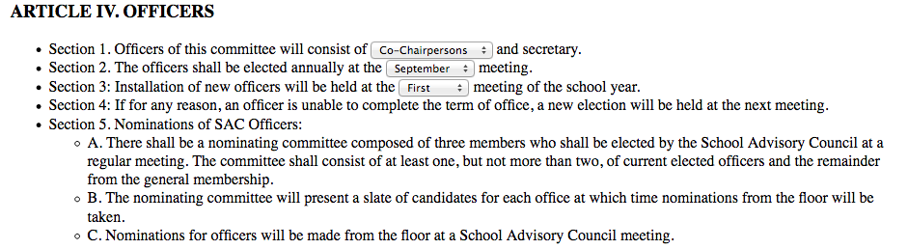
SAC BYLAW REVIEW
OFFICE OF SERVICE QUALITY

Slide 16
SAF
SCHOOL ADVISORY FORUM
SBBC POLICY 1.3 SCHOOL ADVISORY FORUM: Every school shall have a School Advisory Forum (SAF) that shall foster and promote communication between its stakeholders, the school, and the Area Advisory Council. The SAF shall bring forth recommendations, concerns and interests to and from their Area Advisory Council.
MEMBERSHIP: Oﬃcers should be elected per their school bylaws.
DUTIES: Actively participate with the SAC in identifying the needs and priorities of the school.
Comprehensive SAF information can be found by logging onto:
http://www.broward.k12.fl.us/sbbcpolicies/index.asp
OFFICE OF SERVICE QUALITY

Slide 17
District Advisory Council Cordially Invites You to
SCHOOL ADVISORY FORUM TRAINING
Training is available at two locations:
Morning Session: Wednesday, September 27, 2017 10 am to 12 pm
Location: Training Room
Office of School Performance and Accountability (OSPA)
610 NE 13 Ave, Pompano Beach, FL 33060 (754) 321-3838
Evening Session: Wednesday, October 4, 2017 6:30 pm to 9:00 pm
Location: Professional Development Room
McArthur High School
6501 Hollywood Blvd, Hollywood FL 33024
TOPICS: Why are we here? What do I do? Where do I get information? When do we meet? How do I get started? Where do I find the By Laws? How do I work with my Principal? Why do I need Agendas and Minutes? What is Sunshine Law and Robert’s Rules? Where do I find my check list? How do I deal with unruly members?

Slide 18
HOW DOES SAC RELATE TO SAF?
SAC School Advisory Council
Mandated by School Board Policy
Main purpose is increasing student achievement through school improvement
Chair(s) can be employee and/or parent
*************
SAF- School Advisory Forum
Mandated by School Board Policy
Main purpose is communication between stakeholders, the school,
and the Area Advisory Council Chair
MUST be a parent
SAF Chair is a member of SAC
OFFICE OF SERVICE QUALITY

Slide 19
SAC AND SAF ELECTION PROCEDURES
Once a nominating committee is named (as per your school's bylaws) the following procedures should be utilized.
1. Send out memo to school parent population (or otherwise advertise to your entire community, a notice that SAF elections will be held at the May meeting of the school year. Request nominations!
2. The Nominating Committee may extend a courtesy call to each of the present SAF officers asking if they wish to stay on as officers for the next school year (again, check your bylaws for limits on terms of office).
3. The Nominating Committee compiles a slate of officers from the names they have received from steps 1 and 2. It is the charge of the nominating committee to slate that candidate who is best qualified for the position.
4. The Nominating Committee makes a courtesy call to each slated officer to inform them of their nomination and reconfirm their acceptance of the nomination.
5. The Nominating Committee presents slate of officers to membership either at a general meeting usually one month prior to the election. (Check your bylaws!)
6. The Nominating Committee conducts the elections. They present the slate at the election meeting and ask for nominations from the floor. If there are no nominations from the floor the slate can be voted on as is - one vote for the entire slate.
7. If there are nominations from the floor you can have either an open or closed ballot election. An open ballot is typically taken by a show of hands; a closed ballot is taken by written ballot. You must vote for each position for which there is more than one nominee. Then, you can vote on the remainder of the slate. (For example: there is a nomination from the floor for the position of recording secretary. You must have a vote for the position of recording secretary (either open or closed) and then vote on the remainder of the slate.)
OFFICE OF SERVICE QUALITY

Slide 20
In the event there is no nominating committee formed then:
Send out memo to school parent population (or otherwise advertise to your entire community) a notice that SAF elections will be held at the May meeting of the school year that Nominations will be taken from the floor.
SAC AND SAF ELECTION PROCEDURES
In the event there is no nominating committee formed then:
1. Send out memo to school parent population (or otherwise advertise to your entire community) a notice that SAF elections will be held at the May meeting of the school year that Nominations will be taken from the floor.
2. Anyone can nominate a candidate, even the candidate themselves, from the floor. You can have either an open or closed ballot election. An open ballot is typically taken by a show of hands; a closed ballot is taken by written ballot. You must vote for each position for which there is a nominee.
SAF Minutes must reflect the voting procedure and who was elected to each position.
OFFICE OF SERVICE QUALITY

Slide 21
A+ RECOGNITION FUND
• All schools that qualify for A+ Funds Must complete the process by February 1, 2016, as required by Florida Statute 1008.36:
Schools that sustain high performance by receiving a school grade of "A;” or
Schools that demonstrate exemplary improvement due to innovation and effort by improving at least one letter grade; or
Schools that improve more than one letter grade and sustain the improvement the following school year; or
Schools designated as Alternative Schools that receive a school improvement rating of “Improving” or improve at least one level.
• Information about the A+ Fund Process may be found at:
http://www.broward.k12.fl.us/ospa/initiatives.asp?initiative_id=6
• Schools must place A+ documentation in the SAC Upload Center:
SAC Minutes, attendance and voting results for each A+ Recognition Funds Meetings
• Information about Accountability Rules and School Grade Calculations
http://www.fldoe.org/accountability/accountability-reporting/accountability-rules.stml
Important Note - Florida Statute 1008.36 states:
“If school staff and the School Advisory Council cannot reach agreement by February 1, the award must be equally distributed to all classroom teachers currently teaching in the school."
OFFICE OF SERVICE QUALITY

Slide 22
NEW & CONTINUATION WAIVERS
ALL WAIVER INFORMATION CAN BE FOUND AT:
http://www.broward.k12.fl.us/ospa/initiatives.asp?initiative_id=5
New Waiver Applications: Must be completed by February 8, 2018
Only schools that have completed an Intent to Apply form and
have been given permission to proceed may submit an application.
Continuation Waivers: All documentation must be completed by
April 26, 2018. Remember: The faculty must vote to continue
the waiver each year.
Special Note: Schedule Changes do not require a waiver. However, you must follow Article 15, Section K of the BTU Contract. Contact the Office Employee and Labor Relations for assistance.
OFFICE OF SERVICE QUALITY

Slide 23
SBBC SIP FOR ALL SCHOOLS
The SBBC SIP can be found by logging on to:
http://www.broward.k12.fl.us/ospa/ospa-central2/
New SAC chairs will be given access.
Username: P-number
Password: password1 (for first time users)
If you need help logging on,
your IF can assist you.
OFFICE OF SERVICE QUALITY
Notes:
All Schools will log on to SIP at this point in the training.

Slide 24
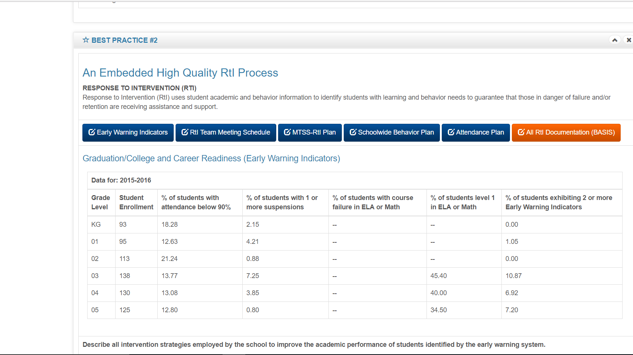
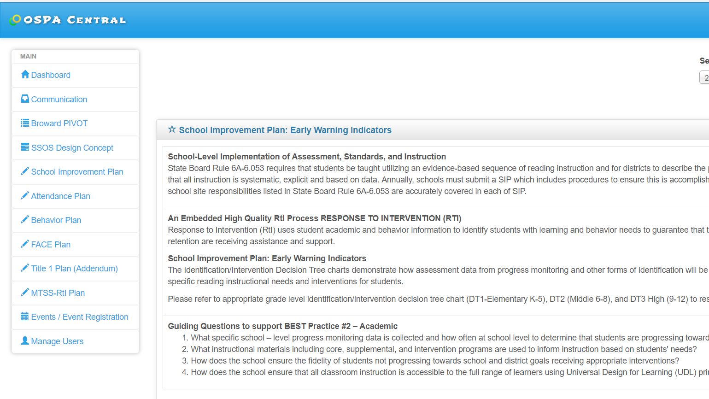
BEST Practice #2
An Embedded High Quality RtI Process
Click on Early Warning
Indicators
NEW
What specific school-level progress monitoring data is collected and how often?
What instructional materials are used to inform instruction based on needs?
How does the school ensure the fidelity of students not progressing towards school and district goals?
How does the school ensure that all classroom instruction is accessible to the full range of learners using UDL?
Academics-Literacy

Slide 25
State, District, and School Goals Alignment
FDOE
K-12 Reading Plan
BCPS Strategic Plan
School SIP
Standards-Based Instruction
Progress Monitoring Tools
MTSS/RtI
PLCs
Universal Design for Learning
Appropriate Instructional Resources
Academics - Literacy

Slide 26
BEST Practice #2
An Embedded High Quality RtI Process
Click on Early Warning
Indicators
NEW
What specific school-level progress monitoring data is collected and how often?
What instructional materials are used to inform instruction based on needs?
How does the school ensure the fidelity of students not progressing towards school and district goals?
How does the school ensure that all classroom instruction is accessible to the full range of learners using UDL?
Academics-Literacy

Slide 27
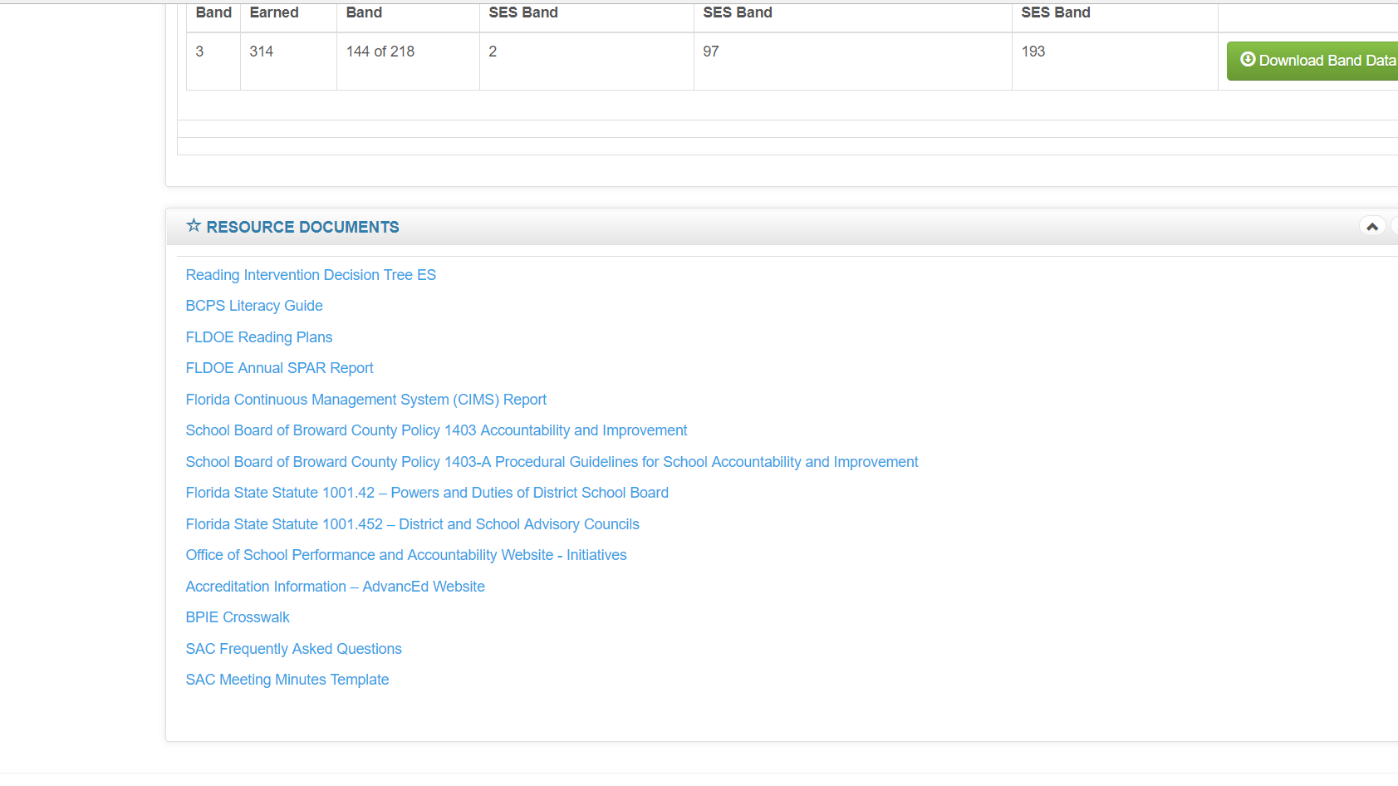
BEST Practice #2
An Embedded High Quality RtI Process
Resource Documents
Added:
Reading Decision Tree
Literacy Field Guide
FDOE Reading Plan
Academics - Literacy

Slide 28
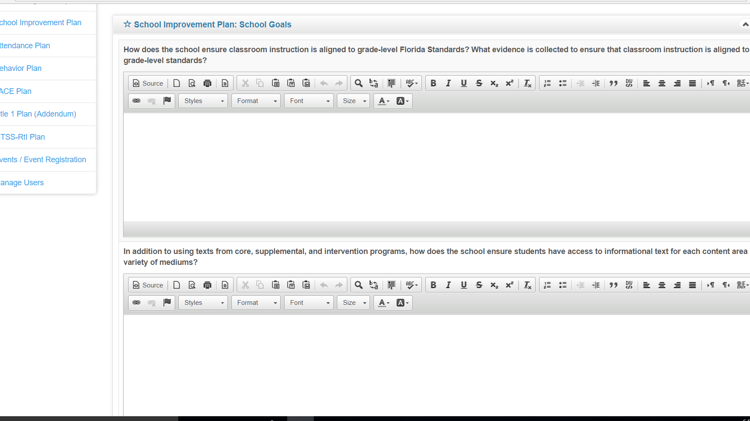
Best Practice #4 Scaling BEST Practices
NEW
How does the school ensure classroom instruction
Is aligned to grade-level standards?
NEW
In addition to using texts from core, supplemental, and intervention programs, how does the school ensure students have access to informational text for each content area In a variety of mediums?
Academics - Literacy

Slide 29
OFFICE OF SERVICE QUALITY
2. ATTENDANCE
PLAN
DISTRICT CONTACT:
Phillip Shaver, Coordinator of District Attendance,
Student Services Department, 754-321-1623

Slide 30
PLAN STRUCTURE: Attendance Plan
Data (Populated on August 2, 2017)
Goals for the Attendance Plan (Data Analysis with Goals)
Tier 1: Strategies
Tier 2: Strategies and Interventions
Tier 3: Individualized Responses and Legal Interventions
Attendance plan
Notes:
Image #535076351

Slide 31
ATTENDANCE PLAN DATA
Data is included in the SIP
Two-year data by semester can be compared by switching the year to 2015/16
1st Semester (2016/17) |  | Satisfactory (0-4.9% absences) |  | At-Risk 5-9.9% absences |  | Chronic Absences (10-19.9% absences) |  | Severe Absences (20% or more)
Grade | Total # of students | # | % | # | % | # | % | # | %
9th
10th
11th
12th
Totals |  | (Total #) | (Overall % of students) | (Total #) | (Overall % of students) | (Total #) | (Overall % of students) | (Total #) | (Overall % of students)
2nd Semester (2016/17) |  | Satisfactory (0-4.9% absences) |  | At-Risk 5-9.9% absences |  | Chronic Absences (10-19.9% absences) |  | Severe Absences (20% or more)
Grade | Total # of students | # | % | # | % | # | % | # | %
9th
10th
11th
12th
Totals |  | (Total #) | (Overall % of students) | (Total #) | (Overall % of students) | (Total #) | (Overall % of students) | (Total #) | (Overall % of students)
Attendance plan
Notes:
Image #535076351

Slide 32
ATTENDANCE PLAN GOALS
Analyze school-wide data with the SIP team
An emphasis on early grades in elementary (K & 1) and high school (9 & 10) may be a focus
All grades in middle school (6, 7, 8)
Set SMART goals for each semester
District Goal is to reduce chronic absenteeism by at least 1%.
Attendance plan
Notes:
Image #535076351

Slide 33
ATTENDANCE PLANS TIERS & STRATEGIES
Tiers for attendance strategies include:
Monitor Data
Engage students and Families
Recognize good and improved attendance
Provide personalized outreach
Remove barriers
Tier 1: Strategies aimed at all students and families
Tier 2: Strategies for students with at-risk attendance and a history of chronic absenteeism
Tier 3: Coordinated school and district response (Student Services Department). Legal intervention (last resort)
Attendance plan
Notes:
Image #535076351

Slide 34
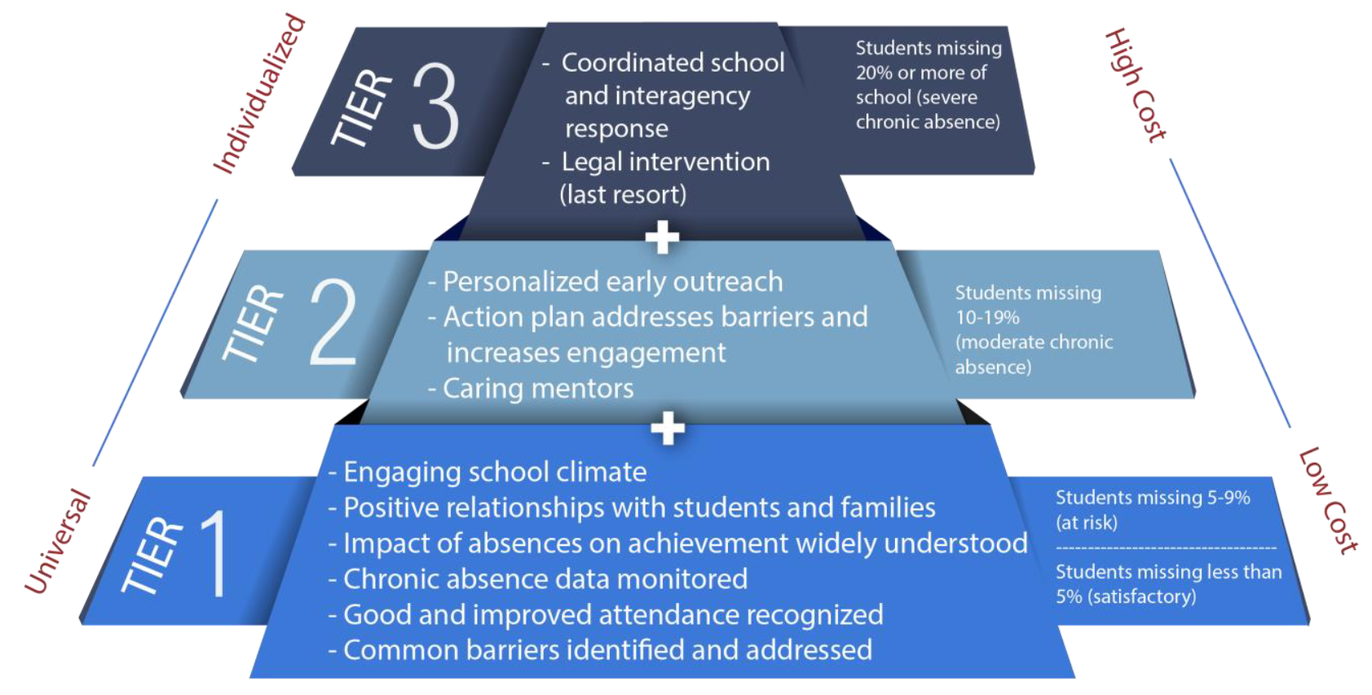
ATTENDANCE PLANS TIERS & STRATEGIES
Attendance plan
Notes:
Image #535076351

Slide 35
ATTENDANCE PLAN TIER 1 EXAMPLES
Attendance phone line for your school on the school website. EASILY ACCESSIBLE, not in a document that has to be downloaded.
  Recommended locations: 1. Contact Us and 2. Absence Reporting Policy. Use a phone number intended for attendance reporting.
  Add to the school’s splash page on the District website.
  Attendance Clerk at the school should monitor the messages. Try to keep up so parents don’t get the “voice mailbox is full” message.
Teachers take daily attendance. Administrators and teachers work together to resolve conflicts in attendance records as a result of testing, field trips, illness, and other causes of a student’s absence from the classroom.
Parents are expected to update school records with a reliable phone number. On the school plan, how will parents know to do this?
Attendance plan
Notes:
Image #535076351

Slide 36
ATTENDANCE PLAN TIER 2 EXAMPLES
Review attendance every week for students that are chronically absent or at-risk Look for patterns
Suggest a home visit or conference
Nurture teacher interest in helping to reach out to chronically absent students
Recognize good and improved attendance
Assign an attendance buddy (A student or teacher volunteer that checks in with students that have attendance concerns)
Refer families to appropriate services (Social worker, guidance counselor, HEART, health services)
Identify barriers (transportation, housing, income)
Attendance plan
Notes:
Image #535076351

Slide 37
ATTENDANCE PLAN TIER 3 EXAMPLES
Determine how many students have a history of missing 20% or more of school. Identify the students with your leadership team
Ensure continued positive contact with the family
Share data with appropriate agencies to coordinate services
Work with families to avoid legal consequences to the extent possible
Use appropriate protocol for B-TIP, CINS/FINS agencies
Attendance plan
Notes:
Image #535076351

Slide 38
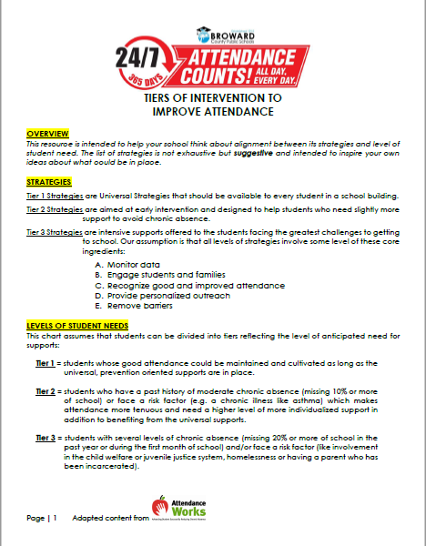
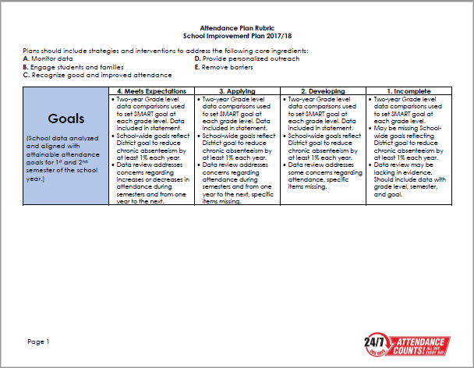
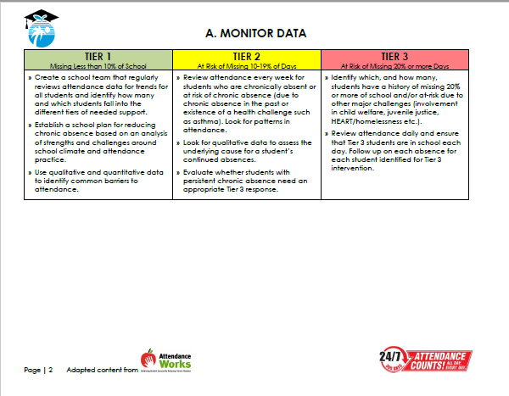
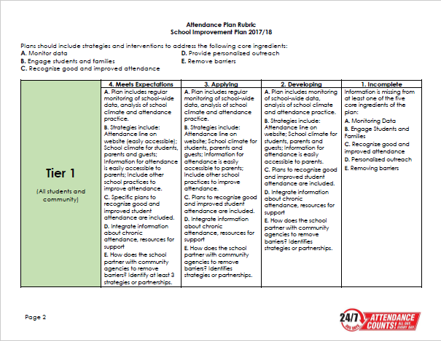
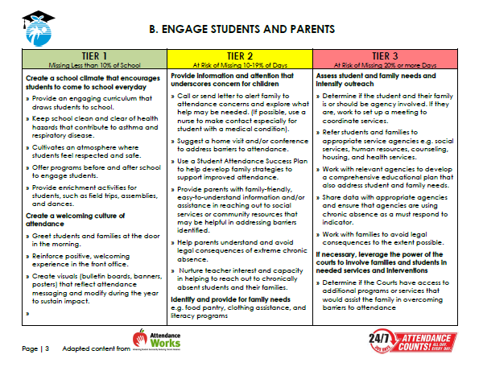
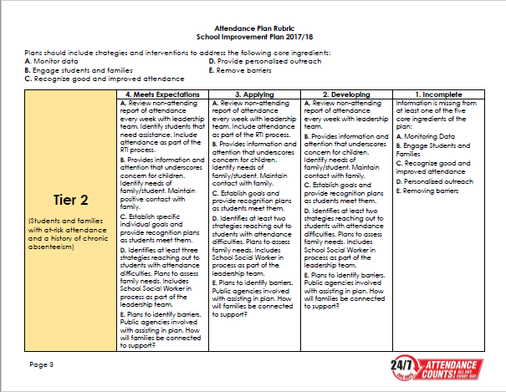
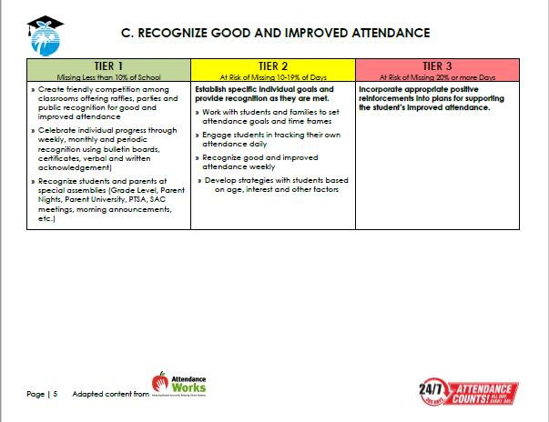
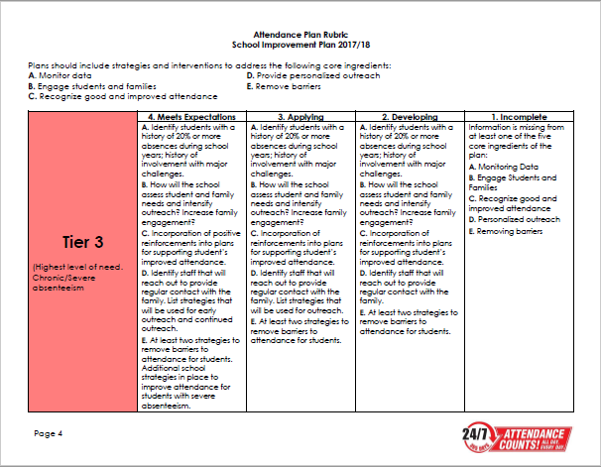
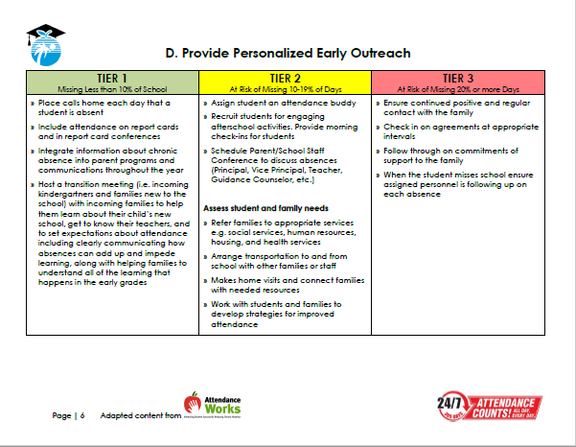
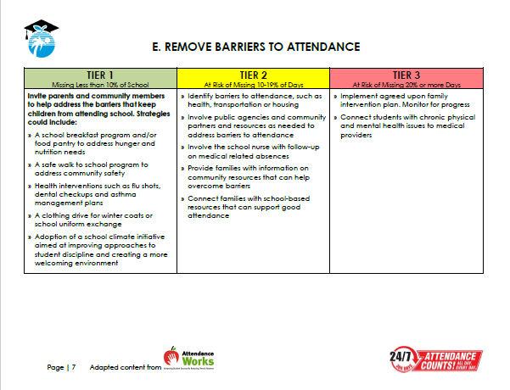
RESOURCES TO HELP WITH THE PLAN
RUBRIC – Rating to be led by SSW. Shared by SIP Team.
TIERED STRATEGIES RESOURCES.
Attendance plan
Notes:
Image #535076351

Slide 39
OFFICE OF SERVICE QUALITY
3. FACE PLAN
(Family and Community Engagement)
District contact:
Nadia Clarke, Assistant Director,
Office of Family and Community Engagement, 754-321-1599

Slide 40
Office of Family and Community Engagement (FACE)
FACE in Broward Schools
Engaging families and the community in support of healthy schools
Notes:
WELCOME
INTRODUCTIONS

Slide 41
Family and community engagement
Vision:
A district where every family actively partners with schools in supporting their children's learning and academic achievement. Schools have systems and practices in place that value and engage families and their communities in essential and meaningful ways
Mission:
To work collaboratively with families, community members and schools to ensure student success

Slide 42



From “Involvement” to “Engagement”
Involve is "to enfold or envelope“
Identifying projects, needs, and goals and then telling parents how they can contribute
Engage is "to come together and interlock“
Listening to what parents think, dream, and worry about with a goal of not to serve clients but to gain partners
Involvement implies doing to; in contrast, Engagement implies doing with
Family and community engagement

Slide 43
2017-2018 Strategy
Tier 3
Tier 2
Tier 1
Tier 1: All Schools and Communities
FACE Plan in SIP (BP 3)
Access to monthly engagement ideas
Monthly school-focused workshops
Parent workshops
Tier 2: Identified Schools & Faith-Based Partnerships
Site-based training with school team using AECF Planning tool
Facilitate planning session to identify ways to support school
Tier 3: SPARKS (Dillard and BA Zones)
Enhancing/strengthening support for educators, families and communities
Joint community partnership development
Zone engagement activities
SY 18 Project
Update Parent Resource Guide
Gulfstream Family Resource Center – FACE Center
Community University
Family and community engagement

Slide 44
FACE Plan in SIP
Family And Community Engagement (FACE) Plan
Impact Area: Program Environment/Culture
Engagement Goal: The environment or culture in which engaging programs take place must consider and plan for: families to feel welcomed, valued, and respected by program staff; two-way communication and relationship building with families are adapted to meet changing family and community circumstances; opportunities are provided for family support and development through the family partnership process and through intentional parent/family peer groups within the program and community.
Strategy (Specific action, including cultural proficiency connections as appropriate) | Date | What needs to be done for the activity? When does it need to be done? | Who is responsible? | What is our objective? | How will we measure our progress? | Identify artifacts to be uploaded
Review and distribute customer service handout to staff | Within the first 30 days | Link to the "Providing Quality Customer Service" document |  | Provide exceptional customer service to families and community stakeholders |  | Description of training held and copy of roster
Create a dedicated FACE Resource space in the building providing an updated calendar, district resources, academic & testing information, and specific community resources that can be accessed discreetly (FACE Resource tool provided to school by the Office of Family And Community Engagement) | Within the first 60 days | Identify space in the school that is frequently trafficked and easily accessible to families |  | Provide ongoing updated relevant resources to families and the community |  | Monthly photos of updated tool; copies of documents shared
Create Cultural Ambassadors and Resident Expert to facilitate a workshop around the cultural uniqueness of families served in the school/community | Between the 5th and 6th week of school | Link to the "10 Things You Should Know" document |  | Bridge the Cultural Gap between Families & Staff |  | Copy of information shared with the school community
Create a staff focused “Catch Them Being Good” program recognizing individuals supporting a positive environment/culture in your school | Monthly | Print/distribute/ post CTBG postcards for families to complete at anytime during the day/school year - embed link |  | Provide incentives to maintain a positive school environment |  | Ex. Scanned copies of submitted postcards, pictures from recognition activity
Engage in deliberate school-wide Social Emotional Learning (SEL) activities in LEAPS evidenced in SIP, Positive Behavior Plan (SPBP), RtI Action Plan, Attendance Plan | Daily | Embed activities in SIP, Behavior Plan, RtI Action Plan, Attendance Plan |  | Provide tiered support for Social Emotional Learning |  | LEAPs usage, SIP accreditation
Family and community engagement

Slide 45
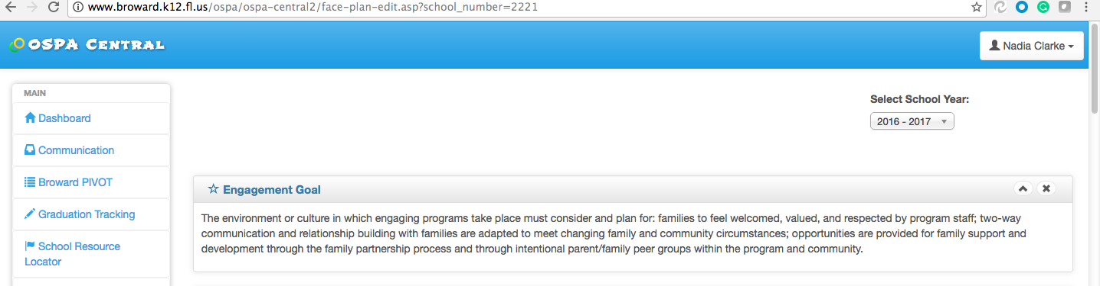
Engagement Goal
Ospa central – Face Plan

Slide 46
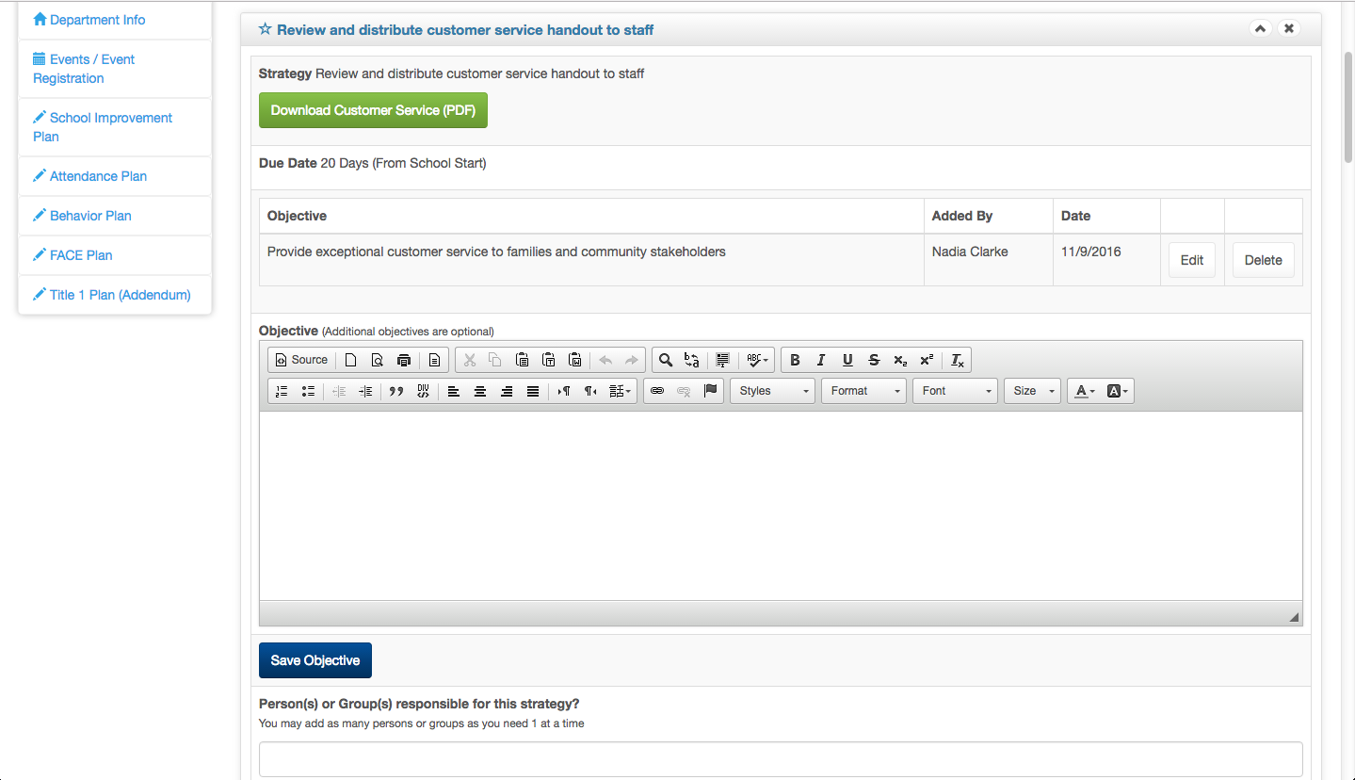
Strategy 1 – Customer Service
Ospa central – face plan

Slide 47
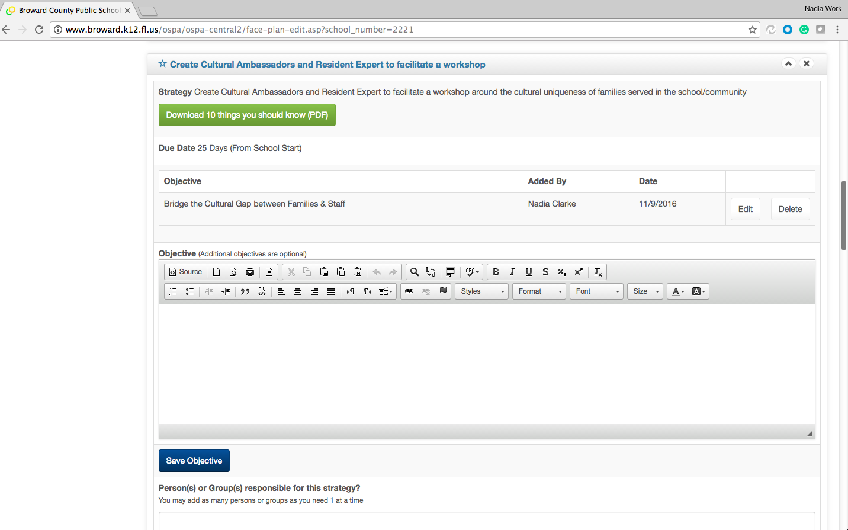
Strategy 2 – Cultural Ambassador
Ospa central – face Plan

Slide 48
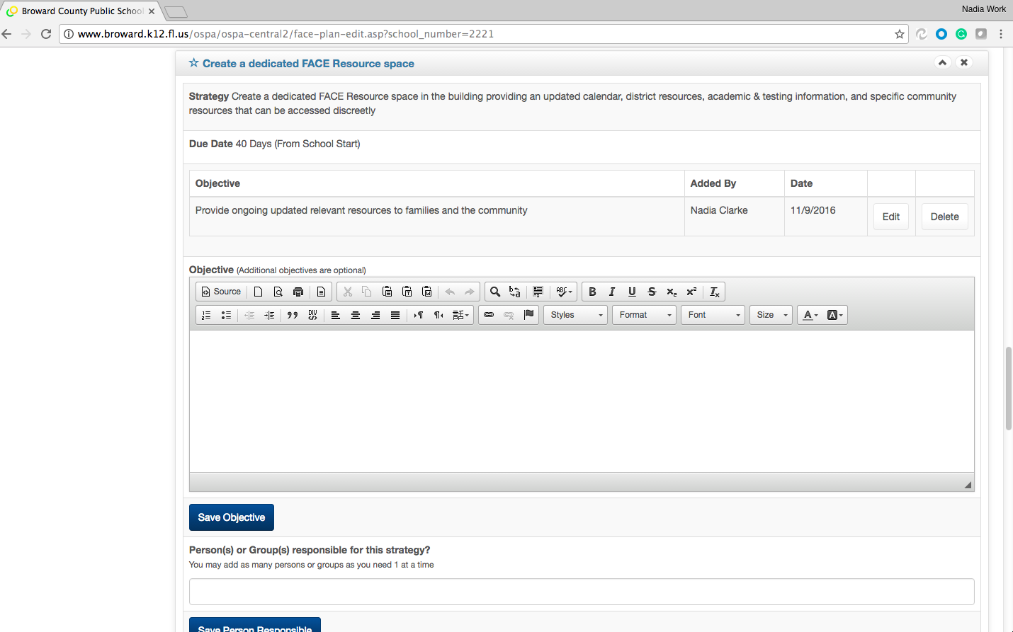
Strategy 3 – FACE Resource Space
Ospa central – face plan

Slide 49
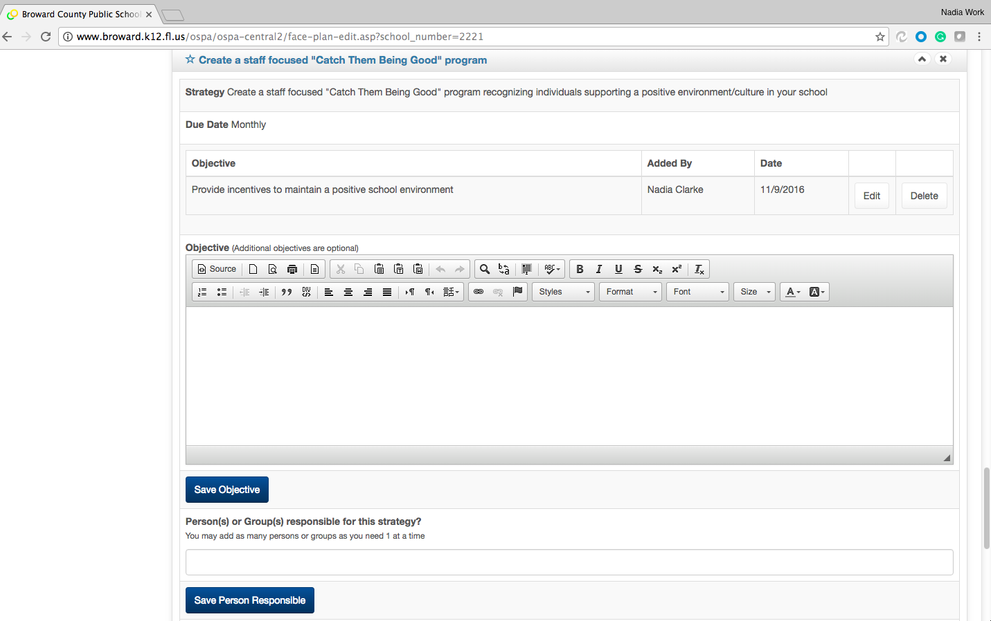
Strategy 4 – “Catch Them Being Good”
Ospa central – face plan

Slide 50
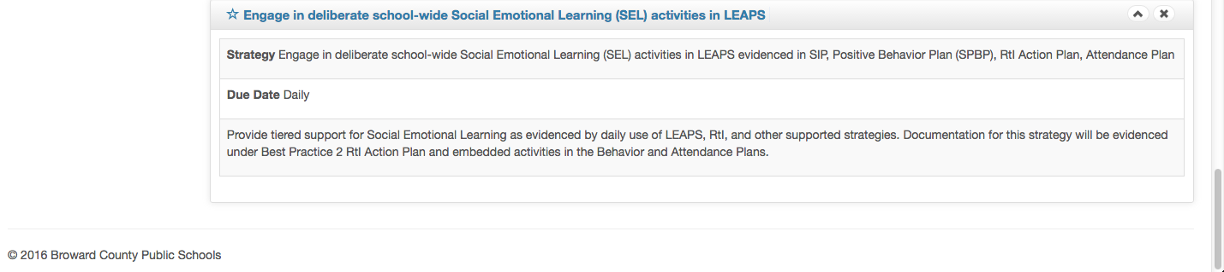
Strategy 5 – SEL
Ospa central – face plan

Slide 51
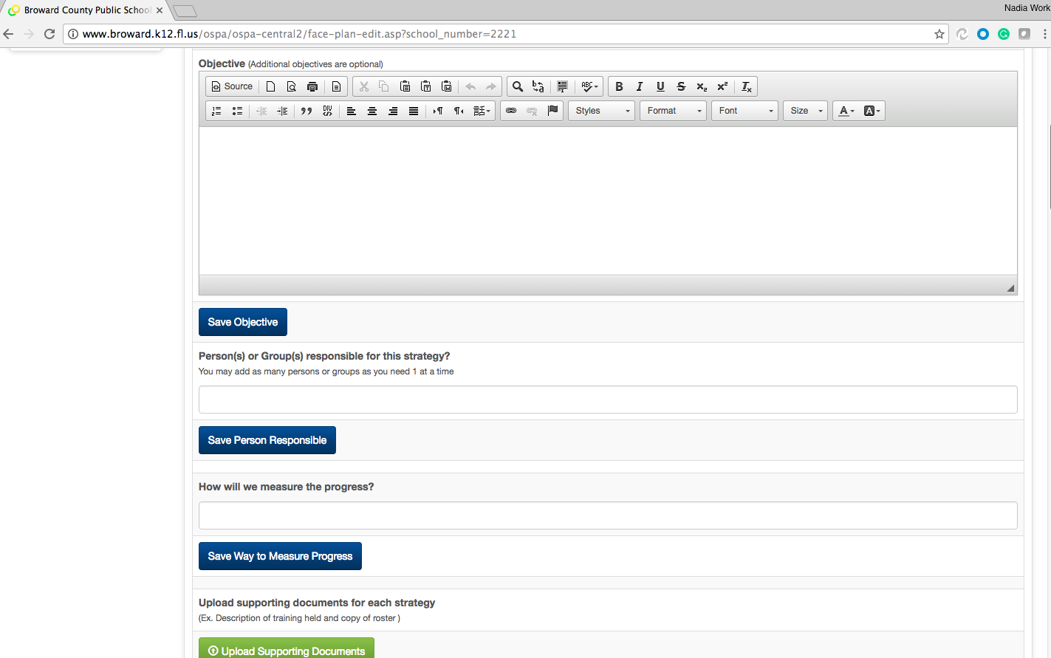
Optional Objectives and Upload Documents

Slide 52
Questions and Support
Nadia Clarke
Office of Family and Community Engagement
754-321-1599
nadia.clarke@browardschools.com
Family and community engagement

Slide 53
OFFICE OF SERVICE QUALITY
4. MTSS/RtI ACTION PLAN
Self-Assessment of Multi-Tiered System of Supports (SAM)
DISTRICT CONTACT:
Adrienne Dixson, RtI Specialist,
Diversity, Prevention & Intervention Department, 754-321-1691

Slide 54
Diversity, Prevention and Intervention
MTSS/RtI Action Plan
Self-Assessment of
Multi-Tiered System of Supports (SAM)

Slide 55
OUR VISION of MTSS
  Enhance the capacity of all schools to successfully implement and sustain a multi-tiered system of student supports with fidelity in every school;
  Accelerate and maximize student academic and social-emotional outcomes through the application of collaborative data-based problem solving utilized by effective leadership at all levels of the educational system;
  Inform the development, implementation, and ongoing evaluation of an integrated, aligned, and sustainable system of service delivery that prepares all students for college and career within our global society
SAM

Slide 56
CRITICAL COMPONENTS OF MTSS
Multiple Tiers of Instruction & Intervention
Problem Solving Process
Leadership
Data & Evaluation
Inform and Engage Parents
Frequently
Capacity & Infrastructure Building
Communication & Collaboration
SAM
Notes:
In looking at these components of a MTSS, we often find that educators misconceive that MTSS is only one of these components – for instance, they may think that MTSS is only the 3 tiers of instruction and intervention. All of these components are necessary for a comprehensive MTSS.
There must be:
1) Multiple tiers of instruction and intervention, aligned to standards, utilizing evidence based strategies, matched to student needs, and with assessments that allow the measurement of effectiveness
2) A structured, consistent, team-based, problem solving process, with decision rules used to make educational decisions
3) An integrated data system that allows for ongoing assessment of student learning as well as decision making
4) Open and transparent communication and collaboration between stakeholders with relationships based upon mutual respect and shared responsibility
5) The capability for the system to build the necessary capacity and infrastructures necessary for MTSS implementation including data-driving professional development, aligning policies and procedures to support MTSS, and the creation of implementation plans
6) Leadership that expects and supports data-based decision making, team functioning, and coaching supports
MTSS is a framework to ensure successful education outcomes for ALL students by using a data-based problem solving process to provide, and evaluate the effectiveness of multiple tiers of integrated academic, behavior, and social-emotional instruction/intervention supports matched to student need in alignment with educational standards.
These are the six essential components of MTSS within the state of Florida(Read each). These essential components are backed by what we know to be effective, evidence-based practices that lead to sustainable implementation.
MTSS is an evidence-based model of educating students
Data-based problem solving is essential
Academic and behavioral instruction and intervention are interrelated
Need-driven decision-making is necessary to ensure that resources reach the appropriate students at appropriate levels to accelerate the performance of ALL students to achieve and/or exceed proficiency
Collaborative teaming is essential for effective implementation of MTSS

Slide 57
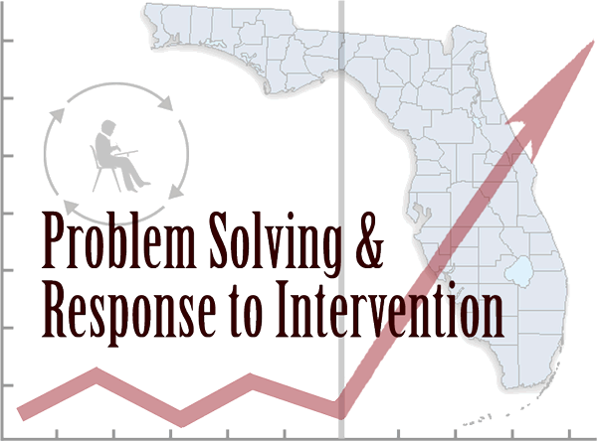



THE BIG PICTURE
+
_______________________________________________________________________
=
SAM
Notes:
Academic Success is related to behavior in school AND Behavioral success is related to academics which EQUALS “MTSS” a Multi-Tiered integrated support system that addresses both academics and behavior for all students.
Response-to-Intervention (RtI)
RtI:B - Positive Behavioral Interventions & Supports (PBIS)
Social and Emotional Learning (SEL)
Family and Community Engagement (FACE)
Professional Learning Communities (PLCs)
General & Special Education Collaboration

Slide 58
SAM
Self-Assessment of Multi-Tiered System of Supports Instrument Overview
Notes:
Current tools not adequate for assessing all components of MTSS
Desire for an instrument to guide action planning towards improved implementation

Slide 59
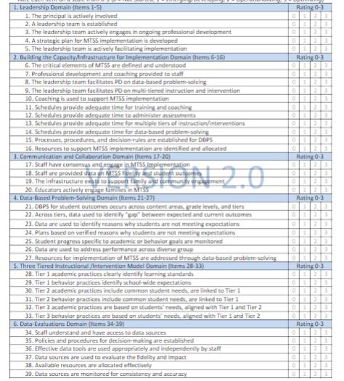
ELEMENTS AND SCORING RUBRIC
“0” = Not Implementing
        The school does not have the consensus or infrastructure to implement the components of an MTSS model
“1” = Emerging/Developing
  The school is building consensus and designing the infrastructure to implement an MTSS model
“2” =Operationalizing
  The school implements the structures designed during the Emerging/Developing stage and works to build consistency and integrity
“3” = Optimizing
  The MTSS model is embedded with integrity. The focus is on how effective the model is and changes are based on data
SAM

Slide 60
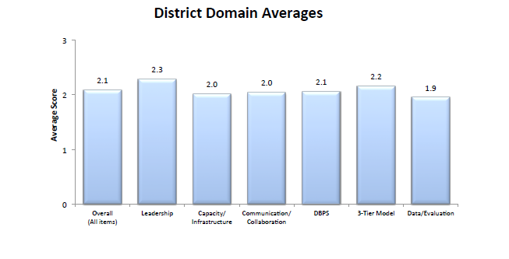
SAM REPORT
Download your SAM report, convene your school -based team, analyze your SAM data, identify effective practices, identify lowest levels of implementation, and complete your action plan. At a minimum the school -based team must address the 2 lowest average SAM domains and at a maximum address all 6 SAM domains.
SAM

Slide 61
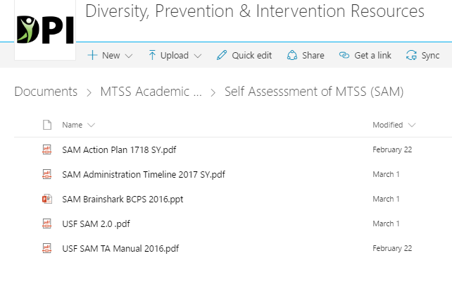
ADMINISTRATION PROCEDURES
School leadership team members receive instrument beforehand
  Members should independently review instrument and think about school ratings
School leadership team meets
  Designated facilitator guides team through instrument, coming to consensus on the rating for each item
Designated team member enters final version into Qualtrics online database
Notes:
-Critical for school leadership team members to have the opportunity to review SAM before team completion. Allows individual team members to familiarize themselves with the SAM and come to the team meeting more prepared for conversations regarding their school’s implementation level.
-ONE SAM PER SCHOOL!

Slide 62
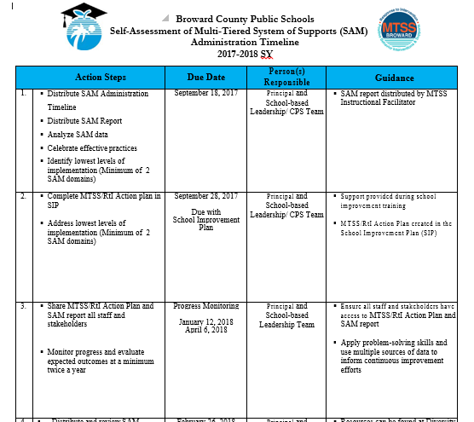
ADMINISTRATION TIMELINE

Slide 63
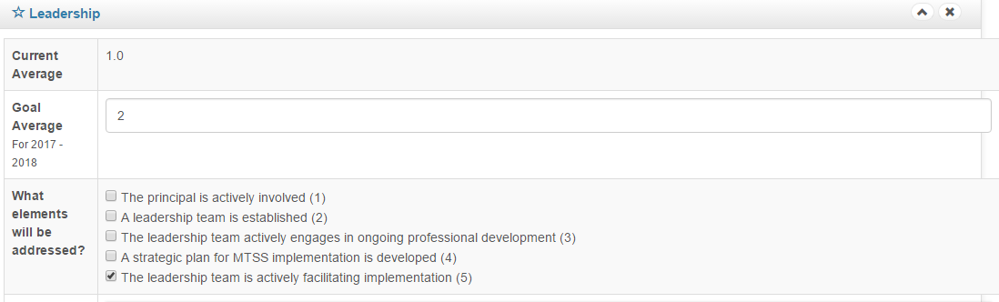
SAM PROBLEM SOLVING: STEP #1
SAM

Slide 64
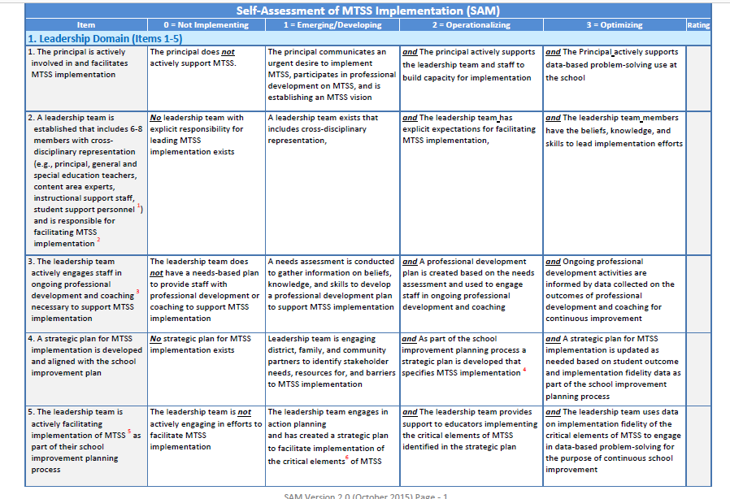
SAM PROBLEM SOLVING: STEP #1
SAM

Slide 65
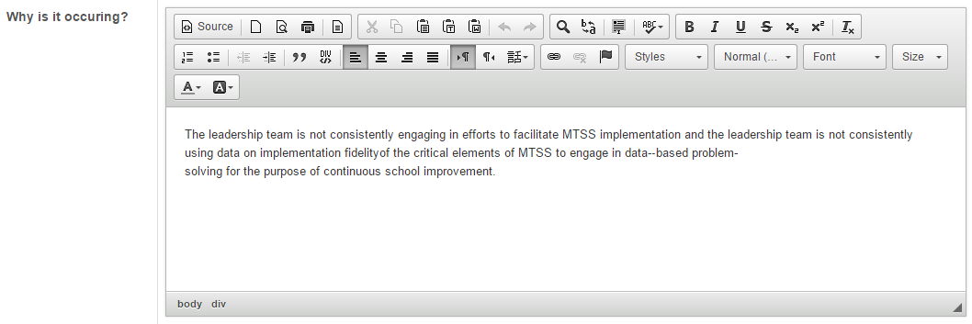
SAM PROBLEM SOLVING: STEP #2
SAM

Slide 66
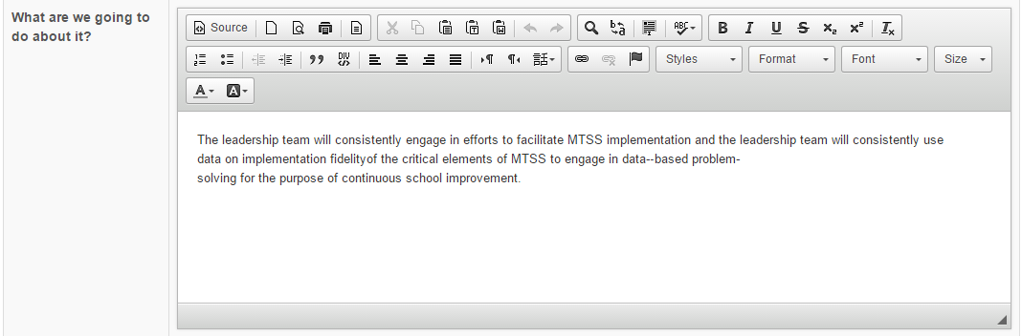
SAM PROBLEM SOLVING: STEP #3
SAM

Slide 67
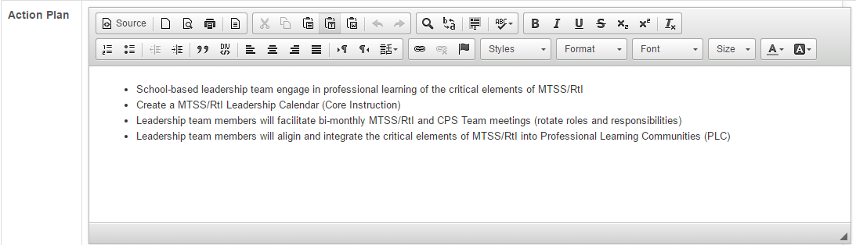
SAM PROBLEM SOLVING: STEP #3
SAM

Slide 68
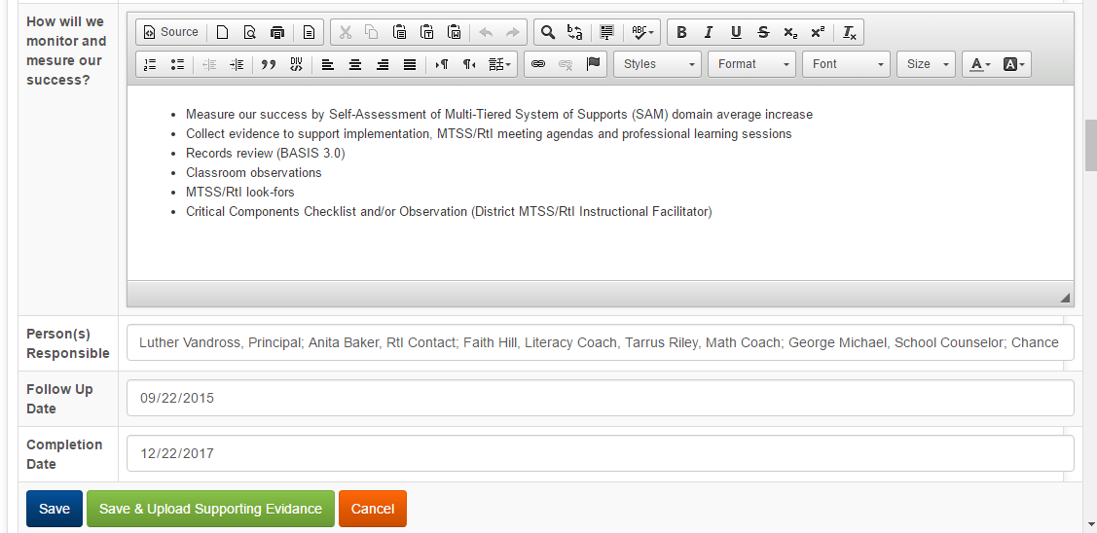
SAM PROBLEM SOLVING: STEP #4
SAM

Slide 69
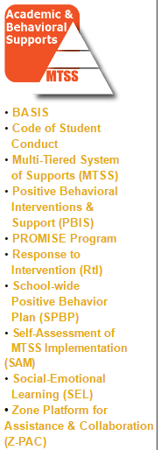
RESOURCES AND SUPPORT
Diversity, Prevention & Intervention SharePoint
      https://browardcountyschools.sharepoint.com/sites/Intranet/Academics/SS/DPI/Pages/default.aspx
        MTSS/RtI Instructional Facilitator
        (See Support Matrix)
        Diversity, Prevention & Intervention
        754-321-1655
        Adrienne T. Dixson
        954-235-6886
SAM

Slide 70
PROFESSIONAL LEARNING
“An Introduction to a Multi-Tiered System of Supports” (MTSS) accessible through Florida’s Professional Development Portal
http://pdportal.florida-ese.org
What Is an MTSS and Why Is It Important
Multi-Tiered System of Support
The Problem-Solving Process
ESE Eligibility in an MTSS
Case Study Applications of MTSS Practices
Contact Diversity, Prevention & Intervention – 754-321-1655
Email certificate of completion to adrienne.Dixson@browardschools.com

Slide 71
OFFICE OF SERVICE QUALITY
5. TITLE I PLAN
(ADDENDUM)

Slide 72

Title I, Migrant & Special Programs
2017-2018 Title I Plan (Addendum)
Adriana Karam, Program Specialist
Tamara Battle, Grant Facilitator
Yolanda Nails, Grant Facilitator
Notes:
WELCOME
INTRODUCTIONS

Slide 73
Title I Plan (Addendum)
Why do Title I Schools complete the SIP
and/or Title I Plan (Addendum)?
Public Law No. 107-110, Section 1114(b)(1),
codified at 20 U.S.C. § 6314(b)
requires that all Title I Schools complete a
School-wide Plan.
.
2017 – 2018 Title I Plan (Addendum)

Slide 74
Title I Plan (Addendum)
In Broward County:
If your school has a grade of D or F
(focus or priority school):
You are required to complete
The Florida Department of Education
School Improvement Plan
template, which has embedded the required components of a schoolwide program, as set forth in the No Child Left Behind (NCLB) Act of 2001 (reauthorized as the Every Student Succeeds Act in 2015).
2017 – 2018 Title I Plan (Addendum)

Slide 75
Title I Plan (Addendum)
In Broward County:
If your school has a grade of A, B or C…
You are required to complete the
Broward School Improvement Plan template.
This template does not include the
Title I required components,
therefore,
a Title I Plan (Addendum) must be completed.
2017 – 2018 Title I Plan (Addendum)

Slide 76
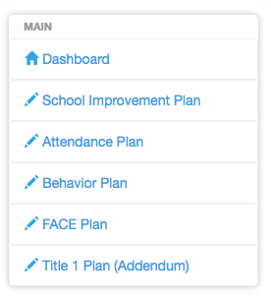
Let’s Review!
Title I Plan (Addendum)
2017 – 2018 Title I Plan (Addendum)

Slide 77
Title I Plan (Addendum)
*REQUIREMENTS*
Comprehensive Needs Assessment of the entire school (including the needs of migrant children)
Instruction by STATE CERTIFIED TEACHERS in all core content area classes
(Strategies) Attract HIGH QUALITY, STATE CERTIFIED TEACHERS to the school
2017 – 2018 Title I Plan (Addendum)

Slide 78
Title I Plan (Addendum)
*ADDITIONAL REQUIREMENTS*
Coordination & Integration
Title I, Part A
Title I, Part C-Migrant
Title I, Part D
Title II (Professional Development)
Title III (ELL)
Title X, Homeless Education
2017 – 2018 Title I Plan (Addendum)

Slide 79
Title I Plan (Addendum)
*ADDITIONAL REQUIREMENTS, cont.*
Coordination & Integration
Supplemental Academic Instruction
Violence Prevention Programs
Nutrition Programs
Housing Programs
2017 – 2018 Title I Plan (Addendum)

Slide 80
Title I Plan (Addendum)
*ADDITIONAL REQUIREMENTS, cont.*
Coordination & Integration
Head Start
Adult Education
Career and Technical Education
Job Training
Other
2017 – 2018 Title I Plan (Addendum)

Slide 81
*PRE-SCHOOL TRANSITION*
Indicate how your school services the pre-school aged students
(i.e. Head Start, Title I/VPK, Specialized Pre-K ESE)
Describe the process for orienting new families to your school
(i.e. Kindergarten Round-Up)
2017 – 2018 Title I Plan (Addendum)

Slide 82
PARENT INVOLVEMENT Action Plan
Level/Expected Level of Parent Involvement as it relates to total number of participants
2017 – 2018 Title I Plan (Addendum)

Slide 83
PARENT & FAMILY ENGAGEMENT Action Plan
Parent Involvement Action Plan Activities
(Aligned to School-Level PIP)
New Name: Parent and Family Engagement Plan ~ PFEP
2017 – 2018 Title I Plan (Addendum)

Slide 84
PARENT & FAMILY ENGAGEMENT Action Plan
High Quality and Ongoing Professional Development
(Aligned to Title I, Part A School-Based Budget)
2017 – 2018 Title I Plan (Addendum)

Slide 85
Suggestions for Best Practices
Include your Title I Liaison on your SIP team. (6 eBinder compliance items reference the SIP/Title I Plan)
Complete ALL requirements in a detailed, narrative format.
Please indicate if the requirement is not applicable to your school.
Refer to the “More Information” pull down tab as needed for examples.
Be complete and concise with your responses.
Title I Plan (Addendum)

Slide 87
Need help? Contact us!
Adriana Karam
754-321-1417
Tamara Battle
754-321-1400
Yolanda Nails
754-321-1400
2017 – 2018 title I addendum

Slide 88
OFFICE OF SERVICE QUALITY
4. BEHAVIOR
PLAN
Upload Completed Behavior Plan to the 2017-2018 SIP Template

Slide 89

School-wide Positive Behavior Plan
SPBP
Tyyne Hogan

Slide 90


Objectives
After this presentation, you will know:
Why all schools need to complete a SPBP
How the SPBP is connected to PBIS
What the template contains this year
What your next steps should be
Where to find the resources to complete the SPBP
When the SPBP is due
HINT: April 30
every year!
Notes:
By the end of this presentation, you will know:
* When the SPBP is due

Slide 91
Rationale
Does every school have to have a SPBP?
Yes, the SPBP is a part of the School Improvement Plan (SIP) and includes the BTU contracted discipline plan. Even if your school completes the state SIP they still need to complete the SPBP. It is also an embedded piece of Best Practice # 2: Ensuring High Quality Embedded RtI Processes.
Why?
The SPBP is the blueprint of your behavior curriculum. It needs to be documented and monitored for you to be able to evaluate the success of your curriculum. All schools, regardless of level or type, must have an individualized implementation plan submitted on the District’s template.
Notes:
Every school has to complete a SPBP as a part of their SIP. Regardless of level or type, schools need to chart out their academic curriculum programs to ensure that their students meet academic achievement, even if that curriculum needs to be differentiated or individualized. Similarly, * all schools need to have a behavior blueprint, clearly indicating the critical elements of a comprehensive Tier 1 behavior plan. *The SPBP template is found in OSPA Central in your SIP plan under Best Practice # 2, and teams can start working on it immediately.

Slide 92
Multi-Tiered System of Supports (MTSS)
The District’s Initiative
MTSS is a term used to describe an evidenced based model of schooling that uses data based problem solving to integrate academic and behavioral instruction and intervention. The integrated instruction and intervention is delivered to students in varying intensities (multiple tiers) based on student need.
Notes:
Just to quickly review, the SPBP lives in a multi tiered systems of support or MTSS. MTSS promotes data based problem solving for all aspects of school decisions and within all tiers of student need.

Slide 93

Outcomes of Tier 1 PBIS
effectively and consistently implementing
PBIS
Builds environments in which positive behavior is more effective than problem behavior
Is a collaborative, assessment-based approach to developing effective interventions for problem behavior
Emphasizes the use of preventative, teaching, and reinforcement-based strategies to achieve meaningful and durable behavior and lifestyle outcomes
Decrease in office discipline referrals & suspensions
Increase in student attendance
Increased academic engaged time for teachers and students
Improved school climate
Increased student and staff safety
Decreased staff absenteeism
23,363 SCHOOLS
IMPLEMENT TIER 1
PBIS IN U.S.A.
Notes:
The positive outcomes of implementing PBIS are well documented in our state and nationally. Implementing PBIS through your SPBP builds a positive environment for all stakeholders emphasizing the use of preventative teaching and reinforcement strategies. *And because behavior and academics are so inter-twined, the effects of having a positive school climate impacts student academic achievement.
Of course, for this impact, *PBIS has to be implemented effectively and consistently.

Slide 94

Connection to PBIS
10 Critical Elements
1. Functioning RtI:B/Discipline Team
2. Faculty & stakeholder buy-in & commitment
3. School-wide Expectations with Lesson Plans
4. Location-based Rules with Lesson Plans
5. Effective Discipline Process and Procedures
6. Effective Reward/Recognition Program
7. Implementation Planning
8. Data-based decision making
9. Classroom Management System (CHAMPs)
10. Ongoing Progress Monitoring & Evaluation
Notes:
As some members on your team may remember, there are 10 Critical Elements in PBIS and we have been adding 1 to 2 elements each year until all 10 are included in the SPBP. This year we have added a * narrative question about your school-wide reward system and a *formula for you to analyze your core effectiveness. We have also expanded the * discipline process by looking at your school’s discipline flow chart.
These new elements will have * lightbulb before them in the SPBP template and an encouragement for your team to watch the specific Brainshark for that element.

Slide 95
Step 1: Create a team
Teams will:
Represent all major stakeholders of the school
Meet quarterly to collect and analyze Tier 1 behavior data
Create the SPBP, based on behavior data analysis
Share information with staff and stakeholders during the year
  Hold a faculty vote on the SPBP
  Submit the SPBP in OSPA v.2.0 by April 30th every year
Notes:
This team meets at least quarterly to discuss Tier 1 data. After analyzing behavior data and developing the plan, the team shares plan details, such as school-wide expectations, location-specific rules, and behavior lesson plans with their respective stakeholders for feedback. The final SPBP for the new year is voted on by faculty then submitted.

Slide 96
Step 2: Meet quarterly
Teams will:
Check SPBP for meeting dates; set up first meeting if not held already
Review SPBP documentation and actual implementation
Review behavior data for trends and weak areas
Modify the SPBP as needed
Share information with staff quarterly
Share information with stakeholders and SAC quarterly
ODRs:
Location, time, etc.
Reinforcements
Suspensions
Tardies
Notes:
This team meets at least quarterly to discuss Tier 1 data. After analyzing behavior data and developing the plan, the team shares plan details, such as school-wide expectations, location-specific rules, and behavior lesson plans with their respective stakeholders for feedback. The final SPBP for the new year is voted on by faculty then submitted.

Slide 97
Step 3: Use your resources
Resource:
PBIS Team Agenda &
Problem Solving Form
PBIS Data Collection Template
Review and organize data
4 Step Problem Solving Process
ODRs: students, type of behavior, location, time,
Reinforcements
Suspensions
Tardies
http://www.browardprevention.org/mtssrti/rtib/
Under “Teaming”
Notes:
This team meets at least quarterly to discuss Tier 1 data. After analyzing behavior data and developing the plan, the team shares plan details, such as school-wide expectations, location-specific rules, and behavior lesson plans with their respective stakeholders for feedback. The final SPBP for the new year is voted on by faculty then submitted.

Slide 98
Step 3: Use your resources
Broward:
http://www.browardprevention.org/mtssrti/rtib/
  Principal Brainshark
  Team mini “how to” Brainsharks
  SPBP Lesson Plan samples
  In-depth Critical Element Brainsharks and resources
Tyyne.Hogan@browardschools.com
State:
http://flpbs.fmhi.usf.edu/
PBIS (RtI:B) information, forms, webinars, etc.
Notes:
This team meets at least quarterly to discuss Tier 1 data. After analyzing behavior data and developing the plan, the team shares plan details, such as school-wide expectations, location-specific rules, and behavior lesson plans with their respective stakeholders for feedback. The final SPBP for the new year is voted on by faculty then submitted.

Slide 99

Step 4: Send out a pre-SPBP Survey
To earn 3 bonus points:
Copy and disseminate the survey to all of your staff
Give staff sufficient time to complete and return to you
Collect and analyze survey data (or copy surveys for you)
Put all original surveys (and your school name) in a pony envelope
5. Send to: Tyyne Hogan, Lauderdale Manors Center, Room 1709
1. Must have a minimum of 50% of your staff complete the survey
2. Pony must be received before April 1
http://www.browardprevention.org/mtssrti/rtib/
Under “Additional Items”
Notes:
To receive your bonus points, simple pony your original surveys to me. I will send the Principal an email, indicating you have receive the additional points. Make sure you have at least 50% of your staff completing the survey to earn your points.

Slide 100
Step 5: Look for the new template
January 15th: Principal memo, Brainshark, and new template available
Location of template will be indicated in the Principal memo
Template will be similar to last year
Template will expand to include all 10 PBIS Critical Elements:
  Classroom Management
  Implementation Planning
January 17th: SPBP Webinar 9:00-10:00
http://browardschools.adobeconnect.com/spbp2018/
(will be posted on website if you can/t attend)
Notes:
To receive your bonus points, simple pony your original surveys to me. I will send the Principal an email, indicating you have receive the additional points. Make sure you have at least 50% of your staff completing the survey to earn your points.

Slide 101
Attend a PBIS training:
3 consecutive days: October 3, 4, and 5, 2017
For teams of 4-6 people per school (support staff and/or teachers)
Must have same administrator (in charge of behavior) attend all 3 days
Teams will be able to update their SPBP with guidance and support during the training
School will become a “Certified PBIS School” and will receive further supports and materials for free
Email Tyyne.Hogan@browardschools.com
if interested in attending OR if interested in
attending another date
Notes:
To receive your bonus points, simple pony your original surveys to me. I will send the Principal an email, indicating you have receive the additional points. Make sure you have at least 50% of your staff completing the survey to earn your points.

Slide 102

Helpful Hints
BEST
PRACTICES
Don’t wait to start working on your SPBP
Complete a pre-SPBP survey with staff
Make it a multi-disciplinary team project
Explain to staff how it will provide a consistent
language across the school and will benefit them
Play the RtI:B 101 Brainshark for staff at a meeting
Obtain stakeholder’s feedback on updates
Hold your vote early to be able to make any needed
changes before the deadline
Become a PBIS school
Ask for help!
Pony your staff surveys
and receive Bonus
points!
Notes:
*You have the information you need to start working on your SPBP today. We all know testing is coming up and none of us has extra time to devote to the SPBP then. Start working on it as soon as possible.
*Ask staff for their input before you even start working on it. Attached is an anonymous staff survey you can use. Not only will this help your team to create a staff friendly SPBP and increase staff buy in, but you can also earn bonus points!
*This is not a project for one person. Ensure that you have a variety of representation on your team and especially an administrator who can support the implementation of your plan.
*Explain to staff the reasoning and purpose behind the SPBP; provide a rationale for the time and effort they will spend
*Give them some background information such as the RtI:B Brainshark
*Ask them for feedback along the way so you don’t get surprised by a vote that doesn’t pass
*Hold that vote early so you can get suggestions from staff and modify the SPBP as needed
And finally, * ask for help! If you are unsure of what you are supposed to do, please email me!

Slide 103



Contact
For more information on becoming a PBIS School,
contact tyyne.hogan@browardschools.com
Diversity, Prevention & Intervention
Lauderdale Manors Resource Center
754-321-1655
or visit our website at:
www.browardprevention.org
@ Broward, Prevention & Intervention
@ DiversityBCPS
Notes:
Thank you for watching this Webinar. I hope that you now have further understanding of the SPBP and will be able to confidently lead this initiative at your school. Please review the resources for more information. We will stay on the line for a few more minutes if anyone has any further questions. Otherwise, feel free to contact me, Tyyne Hogan, if you have any more questions or are interested in becoming a certified PBIS school.

Slide 104
SIP TRAINING 2017-18
SIP TRAINING 2017-18
SIP TRAINING 2017-18
Quarter 1: Schools Supported by OSQ
Quarter 2: December 4 - December 8
Quarter 3: February 26 – March 2
Quarter 4: May 7 – May 11
OFFICE OF SERVICE QUALITY

