Slide 1



SCHOOL IMPROVEMENT TRAINING
SEPTEMBER 2016
Oﬃce of Service Quality
Veda Hudge, Director
Donna Boruch, Coordinator, School Improvement
Broward County Public Schools

Slide 2
WELCOME 2016-2017 SCHOOL IMPROVEMENT
TEAM!

Slide 3
AGENDA
Broward County Public Schools
• School Advisory Council (SAC)
• School Advisory Forum (SAF)
• School Improvement Plan (SIP)
• Accreditation School Portfolio

Slide 4
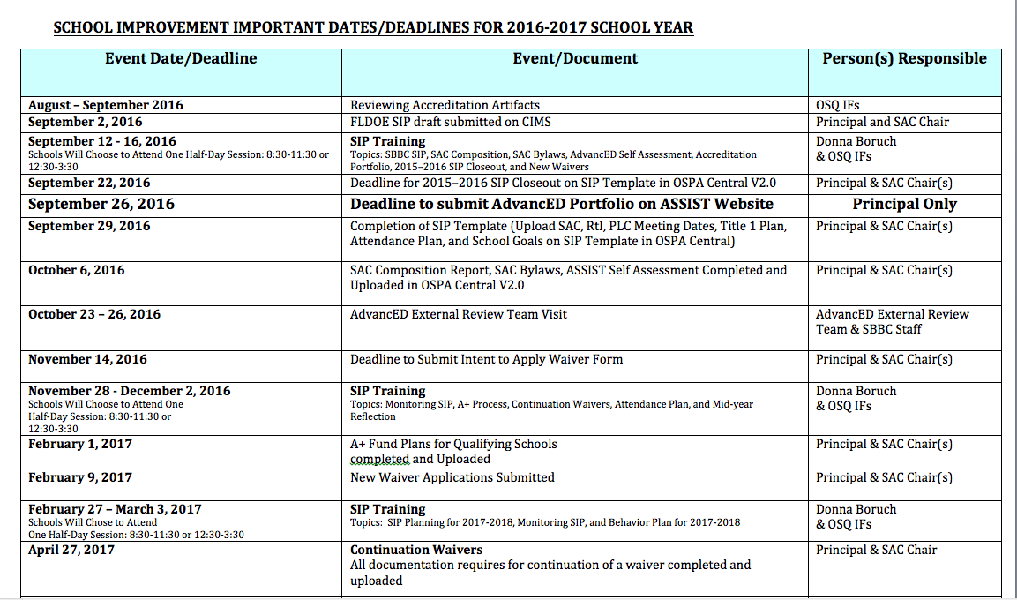
Notes:
PROVIDE INFORMATION IN A HAND OUT FOR ALL PARTICIPANTS.

Slide 5
OSPA WEBSITE
Broward County Public Schools
For all School Improvement information, log on to:
http://www.broward.k12.fl.us/ospa/initiatives.asp?initiative_id=3
• View any school’s School Improvement Plan
• Access SAC & SIP Standard Operating Procedural Manuals
• A+ Recognition Fund Process Information
• Waiver Application
• Log on to OSPA Central 2.0 to access SIP template

Slide 6
SAC
SCHOOL ADVISORY COUNCIL
Broward County Public Schools
ESTABISHED BY LAW AND SBBC POLICY
2015 FLORIDA STATUTES 1001.452
District and school advisory councils.—(1) ESTABLISHMENT.—(a) The district school board shall establish an advisory council for each school in the district and shall develop procedures for the election and appointment of advisory council members. Each school advisory council shall include in its name the words “school advisory council.”
SBBC POLICY 1403: School Accountability and Improvement
The entire policy can be viewed by logging on to:
http://www.broward.k12.fl.us/sbbcpolicies/index.asp

Slide 7
PURPOSE OF SAC
Broward County Public Schools
• Facilitate the development
of the School Improvement
Plan (SIP)
• Monitor progress of the SIP
and make modifications as
needed

Slide 8
SAC MEMBERSHIP
Broward County Public Schools
Council Members representing teachers, education support employees, students, and parents shall be elected by their respective peer groups at the school in a fair and equitable manner as follows:
1. Teachers shall be elected by teachers.
2. Education support employees shall be
elected by education support employees.
3. Students shall be elected by students.
4. Parents shall be elected by parents.

Slide 9
MANDATORY
SAC COMPOSITION
Broward County Public Schools
SAC Composition must represent school population and must include:
Principal (Not assistant principal)
Teachers
BTU Steward (Or designee)
Parents
Innovation Zone Representative (Must be a parent)
SAF Chairperson (Must be a parent)
ESOL Representative (Must be the parent of ELL student)
ESE Representative (Must be the parent of an ESE student)
Gifted Representative (Must be the parent of a Gifted student)
Pre-K (If applicable-parent or certified teacher)
Non-Instructional Employees
Community/ Business Representatives
Students (mandatory for High School, optional for Middle School)

Slide 10
SAC CHAIR(S)
Broward County Public Schools
Elected AFTER SAC members are chosen
Must represent SAC at Area Advisory Meetings
Will represent SAC as a voting member at School Advisory Forum Meetings

Slide 11
SAC BYLAWS
Broward County Public Schools
• School Advisory Councils should review their SAC Bylaws in
the beginning of each year and make necessary revisions
during the fall.
• School Advisory Councils need to review their Bylaws and
revise them using the SAC Bylaws Template.
• Once the SAC Bylaws have been revised and approved, they
are to be submitted through the SAC Documentation Upload
on the SBBC SIP
• Schools are also expected to maintain a copy of their annual
SAC Bylaws and should ensure that they are available for
anyone who may wish to see them.

Slide 12
SAF
SCHOOL ADVISORY FORUM
Broward County Public Schools
SBBC POLICY 1.3 SCHOOL ADVISORY FORUM: Every school shall have a School Advisory Forum (SAF) that shall foster and promote communication between its stakeholders, the school, and the Area Advisory Council. The SAF shall bring forth recommendations, concerns and interests to and from their Area Advisory Council.
MEMBERSHIP: Oﬃcers should be elected per their school bylaws.
DUTIES: Actively participate with the SAC in identifying the needs and priorities of the school.
Comprehensive SAF information can be found by logging onto:
http://www.broward.k12.fl.us/sbbcpolicies/index.asp

Slide 13
HOW DOES SAC RELATE TO SAF?
Broward County Public Schools
********
SAC School Advisory Council
Mandated by State Statute
Main purpose is increasing student achievement through school
improvement
Chair(s) can be employee and/or
parent
SAF- School Advisory Forum
Mandated by School Board Policy
Main purpose is communication between stakeholders, the school,
and the Area Advisory Council Chair
MUST be a parent
SAF Chair is a member of SAC

Slide 14
SIP
SCHOOL IMPROVEMENT PLAN
Broward County Public Schools
F.S.C. 1001.42
& SBBC
POLICY 1403
REQUIRE THAT ALL SIPs
INCLUDE:
• School mission
• Baseline data to identify needs
• Expected student learning outcomes
• Strategies & timeframes for improvement
• Action steps for:
- instructional strategies
- budget
- training
- instructional materials & technology
- student support services and other
resources
• Necessary training & technical assistance

Slide 15
SBBC SCHOOL IMPROVEMENT PLAN
IMPORTANT CLARIFICATION POINTS
• All schools must complete the SBBC School Improvement Plan
which is aligned with the District Strategic Plan.
• The FLDOE SIP (Required for all DA Schools) is a component
of the SBBC SIP in Best Practice 4.
• The SAC Composition Report needs to be updated and uploaded
as a PDF periodically to SAC Upload section to reflect the actual,
current membership.
• Entire ASSIST Self-Assessment needs to be placed in the
Accreditation Artifact Upload section each year.

Slide 16
A+ RECOGNITION FUND
Broward County Public Schools
• All schools that qualify for A+ Funds Must complete the process by February 1, 2016, as required by Florida Statute 1008.36:
Schools that sustain high performance by receiving a school grade of "A;” or
Schools that demonstrate exemplary improvement due to innovation and effort by improving at least one letter grade; or
Schools that improve more than one letter grade and sustain the improvement the following school year; or
Schools designated as Alternative Schools that receive a school improvement rating of “Improving” or improve at least one level.
• Information about the A+ Fund Process may be found at:
http://www.broward.k12.fl.us/ospa/initiatives.asp?initiative_id=6
• Schools must place A+ documentation in the SAC Upload Center:
SAC Minutes, attendance and voting results for each A+ Recognition Funds Meetings
• Information about Accountability Rules and School Grade Calculations
http://www.fldoe.org/accountability/accountability-reporting/accountability-rules.stml
Important Note - Florida Statute 1008.36 states:
“If school staff and the School Advisory Council cannot reach agreement by February 1, the award must be equally distributed to all classroom teachers currently teaching in the school."
-

Slide 17
NEW & CONTINUATION WAIVERS
ALL WAIVER INFORMATION CAN BE FOUND AT:
http://www.broward.k12.fl.us/ospa/initiatives.asp?initiative_id=5
New Waiver Applications: Must be completed by February 9, 2017
Only schools that have completed an Intent to Apply form and
have been given permission to proceed may submit an application.
Continuation Waivers: All documentation must be completed by
April 27, 2016. Remember: The faculty must vote to continue
the waiver each year.

Slide 18
SBBC SIP
For ALL Schools
The SBBC SIP can be found by logging onto:
http://www.broward.k12.fl.us/ospa/ospa-central2/
New SAC chairs will be given access.
Username: P-number
Password: password1 (for first time users)
If you need help logging on, your IF can assist you.
Notes:
AT THIS POINT IF WILL HELP SAC CHAIRS LOG ON TO THE SCHOOL IMPROVEMENT PLAN ON OSPA CENTRAL 2.O AND NAVIGATE THE DIFFERENT COMPONENTS OF THE SIP(30 Minutes).
10 MINUTE BREAK BEFORE MOVING ON TO ACCREDITATION.

Slide 19
ACCREDITATION
Broward County Public Schools
• AdvancED Accreditation Review Fall 2016
• Broward County Schools, first accredited in 1962, must participate in an external review every five years in order to retain AdvancED School System Accreditation.
• The team will review the system and its schools to evaluate the system’s adherence to the AdvancED Accreditation Standards.

Slide 20
ACCREDITATION STANDARDS
& SBBC STRATEGIC PLAN
Broward County Public Schools
Standard 1: Purpose and Direction
The SBBC Strategic Plan maintains and communicates at all levels of the organization a purpose and direction for continuous improvement that commits to high expectations for learning as well as shared values and beliefs
about teaching and learning.
Standard 2: Governance and Leadership
The SBBC Strategic Plan is a part of a system of governance and leadership that promotes and supports student performance and system effectiveness.
Standard 3: Teaching and Assessing for Learning
The SBBC Strategic Plan supports the district’s practices for curriculum, instructional design, and assessment,
ensuring teacher effectiveness and student learning across all grades and courses.
Standard 4: Resources and Support Systems
The SBBC Strategic Plan leverages BCPS resources and provides services in all schools to support its purpose and direction to ensure success for all students.
Standard 5: Using Results for Continuous Improvement
The SBBC Strategic Plan supports the district’s comprehensive assessment process that generates a wide range of
data about student learning and system effectiveness and uses the results to guide continuous improvement.

Slide 21
ACCREDITATION PORTFOLIO FOR SCHOOLS
Broward County Public Schools
.
• Executive Summary
• Self Assessment
• Stakeholder Feedback Diagnostic
• Student Performance Diagnostic
• AdvancED Assurances

Slide 22
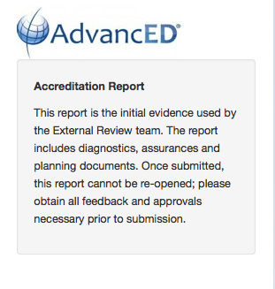
ACCREDITATION
PORTFOLIO SUBMISSION
Broward County Public Schools
The principal, after reviewing the portfolio, is responsible for authorizing submission of the portfolio by September 26, 2016.
Once submitted, all information is FINAL and the PORTFOLIO CANNOT BE REOPENED.
OSPA IFs can assist principals in the portfolio review process.

Slide 23
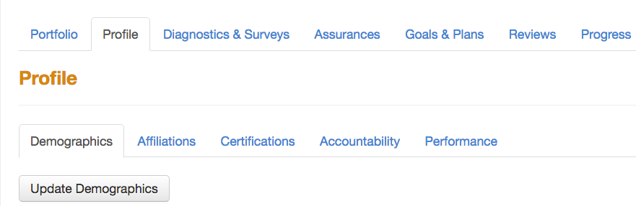

Step #1: Update AdvancED ASSIST SCHOOL PROFILE
LOG ON TO ASSIST AND CLICK ON “Profile”
Logon: Principal’s email Password: broward06
Logon: Principal’s email Password: broward
• Click on “Update Demographics”
• Click to add, update and review all institution information
⬅

Slide 24
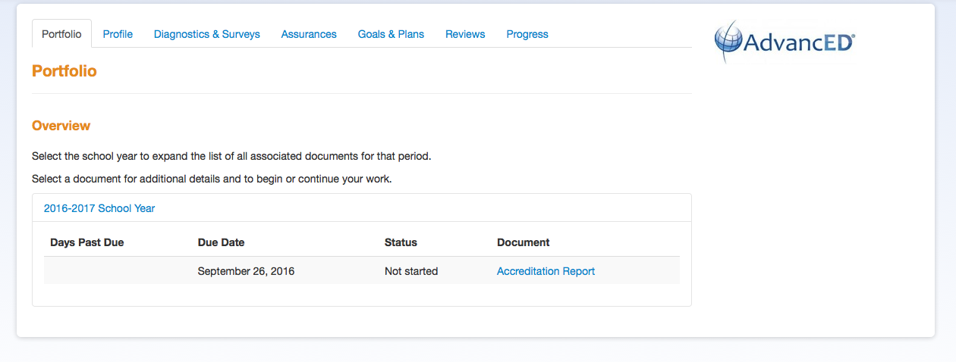
STEP #2: Open AdvancED ASSIST SCHOOL PORTFOLIO
⬅
LOG ON TO ASSIST AND CLICK ON ACCREDITATION REPORT
Logon: Principal’s email Password: broward06

Slide 25
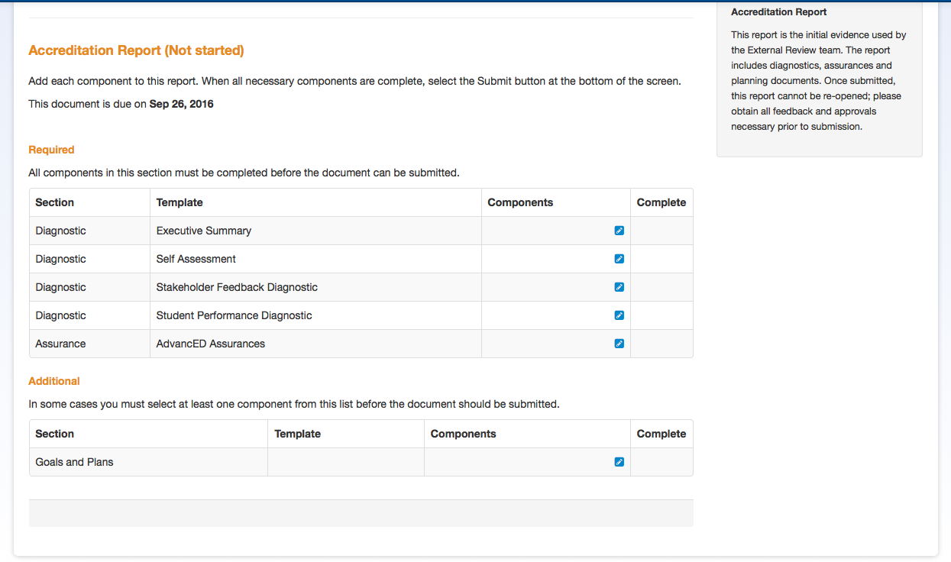
⬅
CLICK ON EXECUTIVE SUMMARY

Slide 26


Step #3: Review and Finalize the
EXECUTIVE SUMMARY
A Completing the Executive Summary tutorial is available at:
http://www.screencast.com/t/h6SOaSO9V
Broward County Public Schools
• Click this:
• Then check the box and click on Executive Summary to open:
• Copy and paste the final draft of your school’s Executive Summary into the
template.
• When the template is finished click the Complete button:
Important Note: The Executive summary can be reopened at any time for editing before submitting the diagnostic portfolio.

Slide 27
⬅
CLICK ON SELF ASSESSMENT

Slide 28
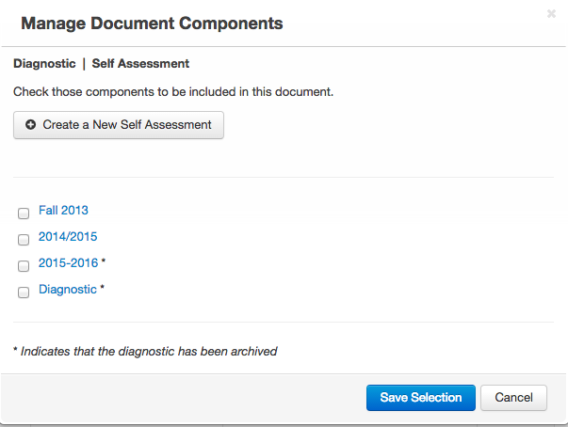
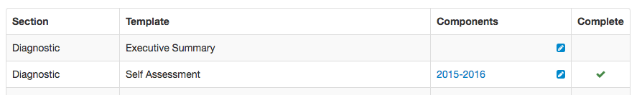
Step #4: Review and Save the
SELF ASSESSMENT
A Completing the Self Assessment tutorial is available at:
http://www.screencast.com/t/536Y8xgzY7lg
This is what will appear:
• Check box for 2015-2016
• Then click on Save Selection
• A green check will appear on your Portfolio next to Self Assessment

Slide 29
⬅
CLICK ON STAKEHOLDER FEEDBACK DIAGNOSTIC

Slide 30

Step #5: Complete & upload template for STAKEHOLDER FEEDBACK DIAGNOSTIC
A Completing Stakeholder Feedback Diagnostic tutorial is available at: http://www.screencast.com/t/vcogeN6LnZC
• Click this:
• Then check the box and click on this box and open:
• Go to Survey Scoring Summary and view your schools survey results:
- Log on to AdvancED: http://www.advanc-ed.org/login
- Click on ”Diagnostics & Surveys" tab. Then Click on the "Survey" tab
- Choose Parent Survey, Student Survey, or Staff Survey
- Click on "Survey Scoring Summary, click on “Average Score Data”, record results for each standard
- Click on Overall Score to get an average score for each Standard
(Use the *Stakeholder Feedback Worksheet if you need assistance converting the any surveys
from a 3-point to a 5-point scale.)
• Based on your survey results, answer all questions in the Stakeholder Feedback section
• For answer to question #1 click YES, then upload the *BCPS Stakeholder Feedback Data document.
• When the all sections are finished click the Complete button
* Stakeholder Feedback Worksheet and BCPS Stakeholder Feedback Data Document will be emailed
to you by your Instructional Facilitator
Notes:
IFs: Have Stakeholder Feedback Worksheet and BCPS Stakeholder Feedback Data Document readily available on your desktop to email to the SAC Chairs.

Slide 31
⬅
CLICK ON STUDENT PERFORMANCE DIAGNOSTIC

Slide 32

Step #6: Update information on
STUDENT PERFORMANCE DIAGNOSTIC
A Completing Student Performance Diagnostic tutorial is available at:
http://www.screencast.com/t/zuaLab2ZztY
Broward County Public Schools
This section needs to be updated with the new 2016 FSA data.
• Click this:
• Then check the box and click on this box and open:
• Go to Data Warehouse (http://bcps.browardschools.com/VirtualCounselor/ ) and download in PDF
format your school’s new FSA Demographic Report 2016.
• For the Student Performance Data section, Question #1 , click “YES” and upload the FSA Demographic
Report 2016 from Data Warehouse. (Your login for the DWH Reports Folder is your 4-digit school
number and your password is your schools SIP number.)
• Based on the FSA results and any other testing results available at your school, answer all questions in
the Student Performance section. If you use other testing data reports, upload PDF copies in #1.
• Prior to clicking the Complete upload any progress monitoring data your school uses.
• When the all sections are finished click the Complete button.

Slide 33
⬅
CLICK ON AdvancED ASSURANCES

Slide 34

Step #7: Review your school’s ASSURANCES
A Completing the Assurances tutorial is available at: http://www.screencast.com/t/BEGXhfGEAz
• Click this:
• Then check the box and click on this box and open:
• Answer “Yes” to all questions.
• For Question #5 you must upload a PDF of your SIP.
- Schools with a FLDOE SIP need to Upload a PDF copy of their SIP from FL CIMS
- A, B, and C schools need to upload a PDF copy of their SIP from OSPA Central 2.0.
- Title I schools need to upload a PDF copy of their Title I Plan

Slide 35
Step #8: Submitting the
COMPLETED SCHOOL PORTFOLIO
A Submitting the Report tutorial is available at: http://www.screencast.com/t/lpTR9DoXt8
Once all sections of the Accreditation Portfolio are complete
and each section has a green checkmark,
the portfolio is ready to be submitted.
ONLY THE PRINCIPAL
CAN AUTHORIZE SUBMISSION OF THE PORTFOLIO
All portfolios must be submitted by September 26, 2016.

Slide 36

THANK YOU!
Oﬃce of Service Quality 754-­‐321-­‐3850
NEXT TRAINING: NOVEMBER 28 - DECEMBER 2
Broward County
Public Schools

