Slide 1



SCHOOL IMPROVEMENT TRAINING - QUARTER 2
November 28 - December 2, 2016
Oﬃce of Service Quality
Veda Hudge, Director
Donna Boruch, Coordinator, School Improvement
Broward County Public Schools

Slide 2
AGENDA
Broward County Public Schools
• AdvancED Accreditation Exit Report
• A+ Process • New and Continuation Waivers
• Stakeholder Survey 2016-2017 • SAC & SAF Board Policy/Meeting Documentation • Conducting SAC and SAF Meetings • FACE - Family and Community Engagement Plan

Slide 3
GREAT JOB
SCHOOL IMPROVEMENT TEAM!
BROWARD COUNTY PUBLIC SCHOOLS ARE NOW FULLY ACCREDITED UNTIL JUNE 30, 2022!

Slide 4
ACCREDITATION EXIT REPORT
Broward County Public Schools
The External Review Team recommended to the AdvancED Accreditation Commission that the Broward County School District earn the distinction of Accreditation by AdvancED. (Expires June 30, 2022)
Complete Exit Report is available at: http://www.broward.k12.fl.us/ospa/initiatives.asp?initiative_id=4

Slide 5
POWERFUL PRACTICES
1. Through the reallocation of resources, the district has developed and implemented a succession planning process that acknowledges and rewards exemplary leadership and provides opportunities for building local leadership capacity at the school and system level.
2. The Superintendent, district office leadership, and school administrators foster a culture of collaboration that supports shared leadership, innovation, and professional growth in an effort to develop high quality leadership to ultimately enhance student achievement.
BCPS STRENGTHS AND ACCOMPLISHMENTS

Slide 6
POWERFUL PRACTICES
3. The leadership has committed to a system of continuous
improvement through the creation of an office dedicated to the improvement of student learning [OSPA].
4. Broward County Public Schools (BCPS) has secured funding in the form of a bond and grants to provide resources to support the system’s strategic plan. In a time of declining financial support, the district has aggressively pursued and obtained alternative sources of funding.
BCPS Notable Achievements

Slide 7
IMPROVEMENT PRIORITY
Develop, implement and regularly evaluate a framework for board evaluation based on the system’s core values and in line with best practice as defined by the Florida School Board Association with the necessary professional development for quality implementation.
Unify the district instructional processes to ensure the
implementation of a rigorous systemic and systematic
instructional framework in support of student achievement.
Two years following the Review, BCPS must submit the Accreditation Progress Report detailing progress toward addressing the required actions.

Slide 8
A+ RECOGNITION FUND
Broward County Public Schools
• All schools that qualify for A+ Funds Must complete the process by February 1, 2016,
as required by Florida Statute 1008.36:
Schools that sustain high performance by receiving a school grade of "A;” or
Schools that demonstrate exemplary improvement due to innovation and effort by improving at least one letter grade; or
Schools that improve more than one letter grade and sustain the improvement the following school year; or
Schools designated as Alternative Schools that receive a school improvement rating of “Improving” or improve at least one level.
• Information about the A+ Fund Process may be found at:
http://www.broward.k12.fl.us/ospa/initiatives.asp?initiative_id=6
• Schools must place A+ documentation in the SAC/SAF Upload Center:
SAC Minutes, attendance and voting results for each A+ Recognition Funds Meetings
• Information about Accountability Rules and School Grade Calculations
http://www.fldoe.org/accountability/accountability-reporting/accountability-rules.stml
Important Note - Florida Statute 1008.36 states:
“If school staff and the School Advisory Council cannot reach agreement by February 1, the award must be equally distributed to all classroom teachers currently teaching in the school."
-

Slide 9
NEW & CONTINUATION WAIVERS
ALL WAIVER INFORMATION CAN BE FOUND AT:
http://www.broward.k12.fl.us/ospa/initiatives.asp?initiative_id=5
New Waiver Applications: Must be completed by February 9, 2017
Only schools that have completed an Intent to Apply form and
have been given permission to proceed may submit an application.
Continuation Waivers: All documentation must be completed by
April 27, 2017. Remember: The faculty must vote to continue
the waiver each year.

Slide 10
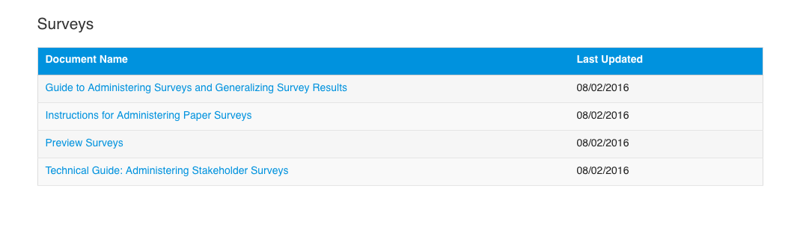
STAKEHOLDER SURVEY:
MARCH 6 – MARCH 31
GO TO http://extranet.advanc-ed.org/schools
TO DOWNLOAD DOCUMENTS ABOUT SURVEY ADMINISTRATION

Slide 11
SIP & SAC
BOARD POLICY
Broward County Public Schools
SAC/SIP: SBBC POLICY 1403 SCHOOL ACCOUNTABILITY AND IMPROVEMENT:
Each school has a School Advisory Council (SAC) to facilitate the development and monitor progress of the annual School Improvement Plan. Agendas and minutes reflect annual needs assessment, SIP monitoring and allocation of Accountability Funds.
SAF: SBBC POLICY 1.3 SCHOOL ADVISORY FORUM: Every school shall have a School Advisory Forum (SAF) that shall foster and promote communication between its stakeholders, the school, and the Area Advisory Council. The SAF shall bring forth recommendations, concerns and interests to and from their Area Advisory Council.
Both policies can be viewed at: http://www.broward.k12.fl.us/sbbcpolicies/index.asp

Slide 12
SAC & SAF MEETINGS
Broward County Public Schools
The SAC and SAF shall use guidelines developed by the district, develop and adopt procedural Bylaws, conduct meetings in accordance with the Florida Sunshine Laws, and conduct meetings according to Robert’s Rules of Order.

Slide 13
SAC & SAF BYLAWS
Broward County Public Schools
Database to create and revise SAC Bylaws: http://www.broward.k12.fl.us/schoolimprove/sac_bylaws/login.asp
Template to create and revise SAF Bylaws:
http://www.broward.k12.fl.us/ospa/initiatives
• Once the SAC and SAF Bylaws have been revised and approved, they are to be submitted as a PDF through the Documentation Upload on the SBBC SIP.
• Schools are also expected to maintain a copy of their annual SAC and SAF Bylaws and should ensure that they are available for anyone who may wish to see them.

Slide 14
SUNSHINE LAW
Broward County Public Schools
What are the requirements of the Sunshine law?
The Sunshine law requires that
meetings of boards or commissions must be open to the public;
reasonable notice of such meetings must be given, and
minutes of the meeting must be taken.
The entire Florida Sunshine Law can be found at:
http://www.myflsunshine.com/pages.nsf/Main 321B47083D80C4CD8525791B006A54E3#1

Slide 15
ROBERT’S RULES
OF ORDER
Broward County Public Schools
"The application of parliamentary law is the best method yet devised to enable assemblies of any size, with due regard for every member’s opinion, to arrive at the general will on the maximum number of questions of varying complexity in a minimum amount of time and under all kinds of internal climate ranging from total harmony to hardened or impassioned division of opinion."
[Robert's Rules of Order Newly Revised [RONR (11th ed.), Introduction, p. liii]
Simplified Roberts Rules of Order:
http://www.intelec.org/public_docs/intSimplifiedRobertsRulesofOrder.pdf
Training Videos for Roberts Rules of Order and the Sunshine Law:
http://www.broward.k12.fl.us/talentdevelopment/html/committee_training-new.html

Slide 16
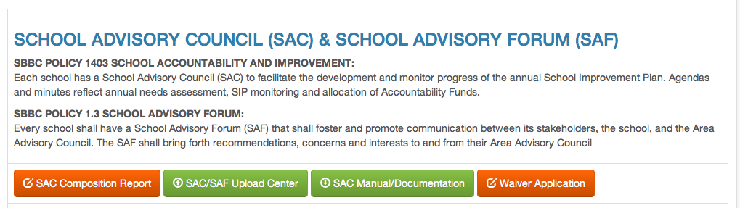
SIP DOCUMENT UPLOAD
Broward County Public Schools

Slide 17
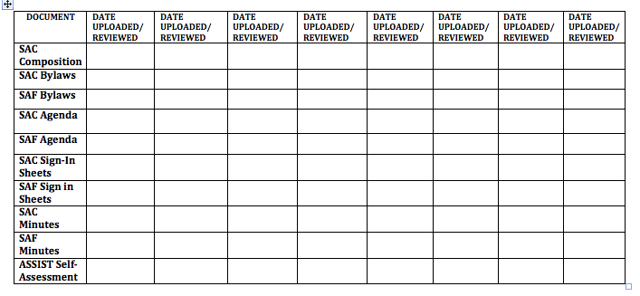
SAC & SAF UPLOAD
CHECKLIST
Broward County Public Schools
Notes:
INSTRUCTIONAL FACILITATORS WILL REVIEW EACH SCHOOL’S SAC/SAF UPLOAD AND HELP THEM COMPLETE THEIR SCHOOL’S CHECKLIST.
SCHOOLS WILL BE ASKED TO LOG ON TO OSPA CENTRAL 2.0 AND OPEN THEIR SIP.
GOAL: MAKE SCHOOLS AWARE OF ALL DOCUMENTATION REQUIRED FOR THE SAC/SAF UPLOAD SITE AND HAVE THEM KEEP TRACK OF THE DOCUMENTATION FOR THEMSELVES BY USING THE CHECKLIST
• SAC/SAF AGENDAS, SIGN IN SHEETS AND MINUTES CAN BE UPLOADED TOGETHER
• SAC COMPOSITION MUST BE KEPT UPDATED

Slide 18
FACE
Family & Community Engagement
Broward County Public Schools
Engagement Goal: The environment or culture in which engaging programs take place must consider and plan for: families to feel welcomed, valued, and respected by program staff; two-way communication and relationship building with families are adapted to meet changing family and community circumstances; opportunities are provided for family support and development through the family partnership process and through intentional parent/family peer groups within the program and community.
Location of Plan: http://www.broward.k12.fl.us/ospa/ospa-central2/
Date Due: January 26, 2017
Contact: Nadia Clarke, Assistant Director, Office of Family and Community Engagement 754-321-1599
Notes:
NADIA CLARKE, ASSISTANT DIRECTOR OF FAMILY ANAD COMMUNITY INVOLVEMENT OFFICE WILL PRESENT THIS SECTION.

Slide 19
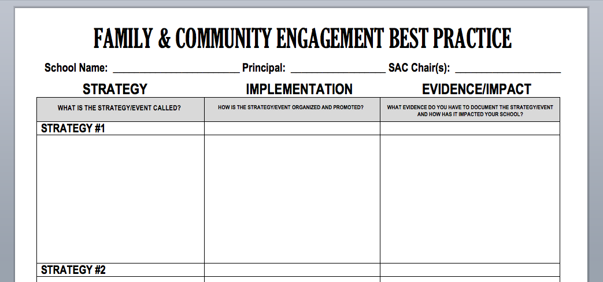
FACE: SHARING
A BEST PRACTICE
Broward County Public Schools
Highlight 1 or 2 successful engagement strategies your school has employed.
Notes:
IFs WILL FACILITATE WITHIN THEIR CADRE GROUP: SCHOOLS WILL BE ASKED TO SHARE BEST PRACTICES WITH THE GROUP. THEY WILL COMPLETE THE FORM WITH AT LEAST ONE ONE STRATEGY TO SHARE. BEST PRACTICES WILL BE POSTED ON THE WALL AND PARTICIPANTS WILL DO A GALLERY WALK TO VIEW ALL BEST PRACTICES.
CLOSING: SCHOOLS WILL BE ASKED TO SHARE WHICH BEST PRACTICE THEY WILL TAKE BACK TO THEIR SCHOOL.

Slide 20

THANK YOU!
Oﬃce of Service Quality 754-­‐321-­‐3850
NEXT TRAINING: FEBRUARY 27 – MARCH 3
Broward County
Public Schools

