Slide 1
Office of Service Quality
SCHOOL IMPROVEMENT TRAINING – QUARTER 4
2017-2018
Notes:
WELCOME
INTRODUCTIONS

Slide 2
YOU MAKE THE BCPS
SCHOOL IMPROVEMENT
TEAM GREAT!
And for that, we
sincerely thank you!
OFFICE OF SERVICE QUALITY 754-321-3850

Slide 3
BCPS STRATEGIC PLAN GOAL:
EFFECTIVE COMMUNICATION
From BCPS Strategic Plan:
We are all ambassadors for Broward County Public Schools. With accurate information, we can make a positive impact on public awareness.
We will continue to keep stakeholders informed about where we have been, where we are going and how we plan to educate all students to reach their highest potential. We value input as we work to enable BCPS students to make a positive impact on the future.
OFFICE OF SERVICE QUALITY 754-321-3850

Slide 4
SCHOOL IMPROVEMENT INFORMATION
NEEDS TO BE POSTED ON ALL SCHOOL WEBSITES
• Dates, Times and Locations of all School Advisory Council (SAC) Meetings
• School Advisory Council (SAC) By Laws
• Agendas & Minutes for School Advisory Council Meetings (SAC)
• Link to SIP: http://www.broward.k12.fl.us/ospa/select_school.asp
• Dates, Times and Locations of all School Advisory Forum (SAF) Meetings
• School Advisory Forum (SAF) By Laws
• Agendas & Minutes for School Advisory Forum Meetings
• Dates, Times and Locations of Area Advisory Meetings:
http://www.broward.k12.fl.us/ospa/initiatives.asp?initiative_id=15
Helpful Hints: Do not list as SAC/SAF
Use the complete title of each entity and list separately
Descriptions of SAC and SAF should be from board policies 1403 & 1.3
OFFICE OF SERVICE QUALITY 754-321-3850

Slide 5
DESCRIPTIONS FOR WEBSITES
School Advisory Council (SAC): The School Advisory Council shall be the sole body responsible for final decision-making at the school relating to implementation of ss.1001.42(18) and1008.345.U The SAC is composed of parents, teachers, community members, school administrators, non-instructional support staff, and other stakeholders who meet regularly to establish priorities, set annual objectives, and monitor action steps for school improvement.
School Advisory Forum (SAF): School Board policy requires that each school have a School Advisory Forum (SAF) composed of parents, teachers, community members, school administrators, non-instructional support staff, and other stakeholders. The SAF provides an opportunity for stakeholders to discuss and recommend actions on a variety of school issues.
The School Advisory Forum (SAF) shall foster and promote communication between its stakeholders, the school, and the Area Advisory Council. The SAF shall bring forth recommendations, concerns and interests to and from their Area Advisory Council.
School Improvement Plan (SIP): A School Improvement Plan containing specific objectives and action steps for achieving Florida's educational goals is required by Florida. The SAC has the primary responsibility for monitoring the implementation of the annual SIP. The SIP must be approved by the School Board.
OFFICE OF SERVICE QUALITY 754-321-3850

Slide 6
SCHOOL IMPROVEMENT
DATES/DEADLINES 2018-2019
Event Date/Deadline | Event/Document | Person(s) Responsible
September 11 - 14, 2018 Schools Attend One Half-Day Session: 8:30-11:30 or 12:30-3:30 | SIP Training Topics: School Improvement Plan Information for 2018-2019, SAC Composition, SAC Bylaws, eProve Survey Results, 2017–2018 SIP Closeout, New Waivers, Attendance Plan, Behavior Plan, FACE Plan, RtI Plan, BPIE, School Counseling Plan, Requirements for SIP, Title I Addendum, SAC Policy Compliance | Donna Boruch & OSQ IFs
September 14, 2018 | Closeout of 2017-2018 SIP Enter results of goals and strategies in OSPA Central V2.0 | Principal & SAC Chair(s)
October 18, 2018 | Completion of SIP Template Upload SAC, RtI, PLC Meeting Dates, and complete entire SIP Template on OSPA Central: Title I Addendum, Attendance, Behavior, RtI, & FACE Plans. | Principal & SAC Chair(s)
October 25, 2018 | SAC Composition Report & SAC Bylaws, Completed and Uploaded in OSPA Central V2.0 | Principal & SAC Chair(s)
November 15, 2018 | Intent to Apply Waiver Form Must be submitted by schools applying for a new waiver or schools that have a waiver ending in 2018-2019 that stakeholders wish to continue | Principal & SAC Chair(s)
December 11- 14, 2018 Schools Attend One Half-Day Session: 8:30-11:30 or 12:30-3:30 | SIP Training Topics: Monitoring SIP, SAC Meeting Structure utilizing Roberts Rules of Order & Sunshine Law, A+ Process, Val-ED, Continuation Waivers and Mid-Year Reflection | Donna Boruch & OSQ IFs
February 1, 2019 | Mid-Year Reflection Completed with the Leadership Team, reviewed with SAC, and uploaded in the SAC Upload section on the BCPS SIP. DA Schools must enter information in the FLDOE SIP located of Florida CIMS. | Principal & SAC Chair(s)
February 1, 2019 | A+ Fund Plans (This is a mandatory FLDOE deadline) Qualifying schools must complete upload all documentation to OSPA Central | Principal & SAC Chair(s)
February 8, 2019 | New Waiver Applications Completed, signed, and submitted to Office of Service Quality for approval | Principal & SAC Chair(s)
February 26 – March 1, 2019 Schools Attend One Half-Day Session: 8:30-11:30 or 12:30-3:30 | SIP Training Topics: Monitoring SIP, SIP Planning for 2019-2020, & Attendance Plan, Behavior Plan, FACE Plan, RtI Plan for 2019-2020 | Donna Boruch & OSQ IFs
March 4, 2019 - April 4, 2019 | BCPS Stakeholder Survey: AdvancED eProve Survey Online survey for all stakeholders with completion rate targets of 20% for parents, 40% for students and 60% for teachers
April 25, 2019 | Continuation Waivers Updated Applications All documentation required for continuation of a waiver completed & uploaded | Principal & SAC Chair
May 7 – 10, 2019 Schools Attend One Half-Day Session: 8:30-11:30 or 12:30-3:30 | SIP Training Topics: School Improvement Planning for 2019-2020, Organization and Elections of SAC & SAF for next school year | Donna Boruch & OSQ IFs
OFFICE OF SERVICE QUALITY 754-321-3850

Slide 7
AGENDA
2. SAC/SIP
POLICY 1403
COMPLIANCE
1. BCPS SCHOOL
IMPROVEMENT
PLAN
2018-2019
3. SAC MINUTES:
FLDOE
REQUIRED
FORMAT
6. UPDATES:
ATTENDANCE PLAN
FACE PLAN
MTSS/RtI PLAN
TITLE 1 ADDENDUM
BEHAVIOR PLAN
BPIE
5. AdvancED
ePROVE
STAKEHOLDER
SURVEY
RESULTS
4. SAC BY LAWS:
RULES THAT
GOVERN
COMPOSITION &
ELECTIONS
OFFICE OF SERVICE QUALITY 754-321-3850

Slide 8
OFFICE OF SERVICE QUALITY 754-321-3850
1. BCPS SCHOOL
IMPROVEMENT
PLAN
2018 - 2019

Slide 9
SCHOOL IMPROVEMENT PLAN
Best Practice #1
PLC (Professional Learning
Communities) Meeting
Schedule
Best Practice #2
Early Warning Indicators
RtI Team Meeting Schedule
School Wide Behavior Plan
Attendance Plan
MTSS/RtI Action Plan
School Counseling Plan
Best Practice #3
FACE Plan
eProve Survey Link
eProve Survey Results
SAC Composition Report
Waiver Application
Best Practice #4
Goals, Strategies and Activities or FLDOE SIP
Title I School Plan (for Title I A,B, or C Schools
BPIE Documents
School Goals:
Based on Pre-Populated Targets
Must have Literacy Goal
SMART Goals need to include Specific Strategies
Accountability Money must be earmarked in BP #4
SMART Goal
Specific: explicit about what will change
and when
Measurable: quantified and tracked with
assessments and other data
Attainable: challenging and realistic
Results-focused: direct impact student
learning
Time-bound: Goal has a specific
timeframe for completion.
OFFICE OF SERVICE QUALITY 754-321-3850

Slide 10
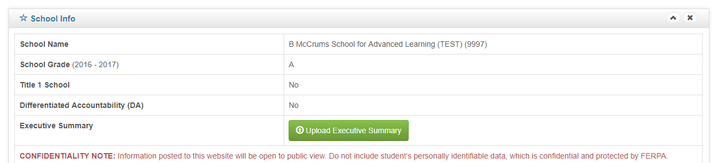
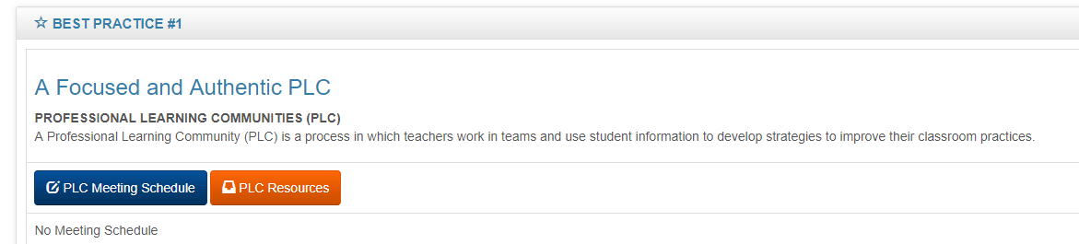
BEST Practice #1
OFFICE OF SERVICE QUALITY

Slide 11
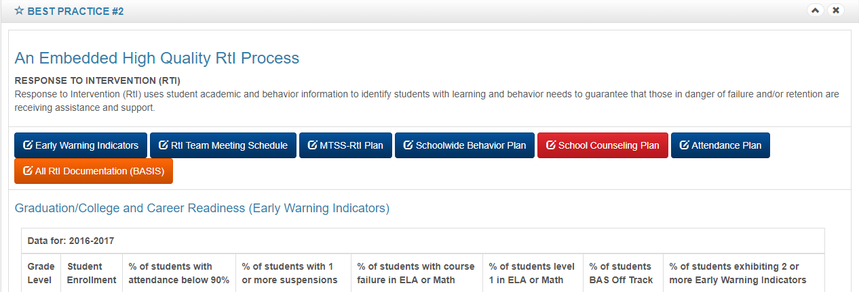
BEST Practice #2
NEW
FOR 2018-19 School Counseling Plan and K-2 BAS data has been added to early warning indicators (students reading below grade level (OFF Track red in AP#3)
School Counseling Plan will be completed by Guidance Counselor(s), approved by principal, and uploaded in BP #2.
OFFICE OF SERVICE QUALITY 754-321-3850

Slide 12
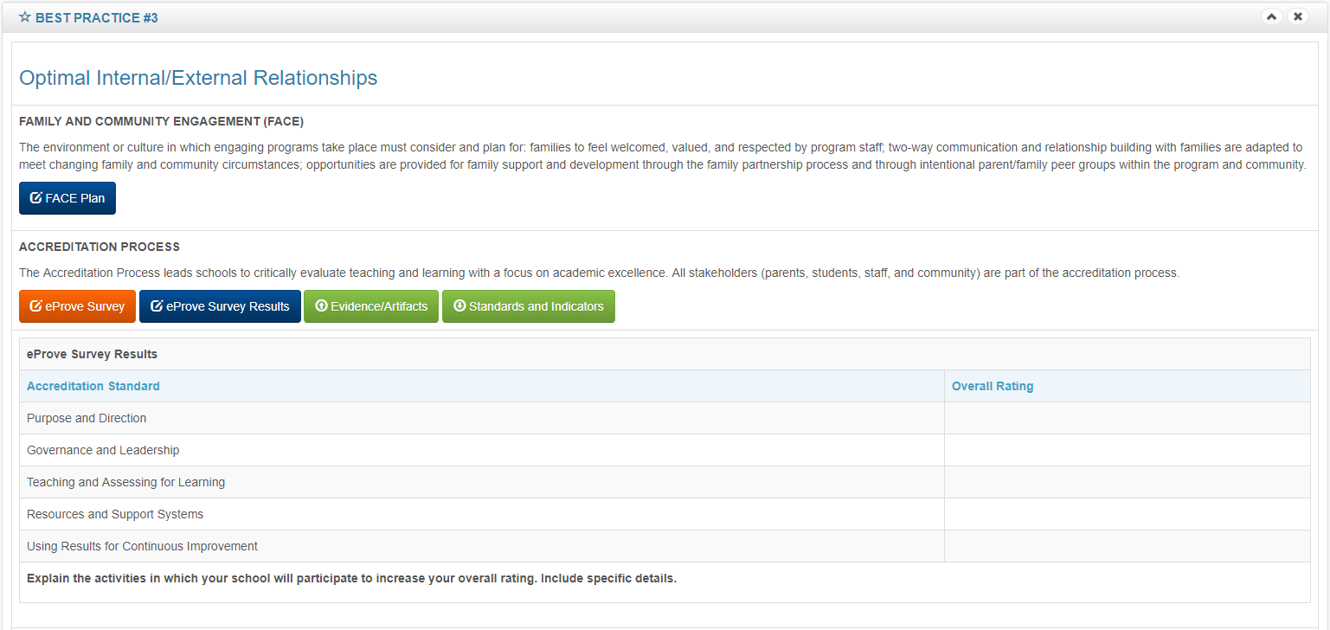
BEST Practice #3
NEW
OFFICE OF SERVICE QUALITY 754-321-3850

Slide 13
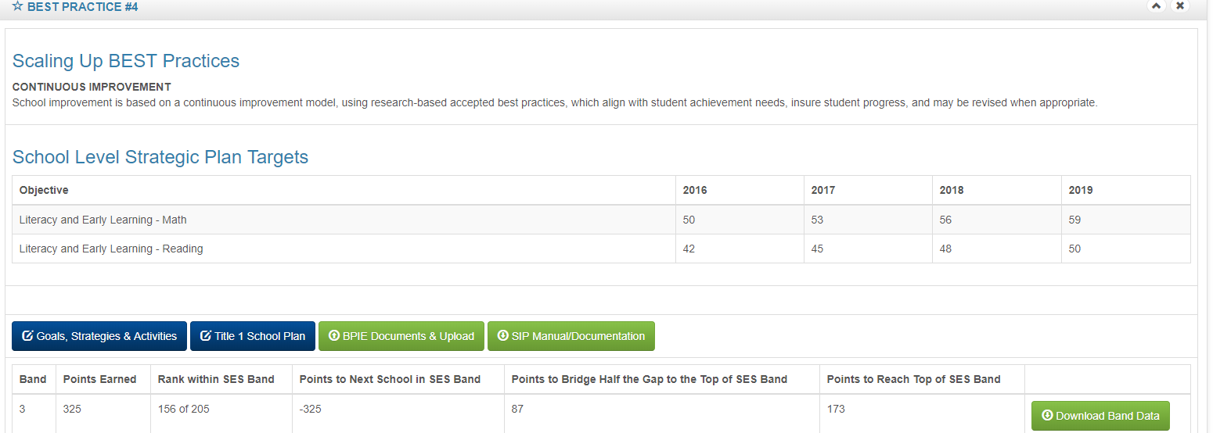
Best Practice #4
Revised18-19
Revised 18-19
CONTINUOUS IMPROVEMENT
OFFICE OF SERVICE QUALITY 754-321-3850

Slide 14
Best Practice #4
Revised18-19
Revised 18-19
CONTINUOUS IMPROVEMENT
As evidenced in the SES Band Data, which content area(s) will be the focus for improving student achievement and why was this area chosen?
What specific BEST Practice(s) will be implemented or scaled-up to improve teaching and learning in order to increase performance within the SES Band?
Describe in detail how the BEST Practice(s) will be scaled-up.
OFFICE OF SERVICE QUALITY 754-321-3850

Slide 15
Best Practice #4
Revised18-19
Revised 18-19
HIGH QUALITY INSTRUCTION
What specific school-level progress monitoring data is collected and how often?
How does the school ensure the fidelity of students not progressing towards school and district goals?
How does the school ensure that all classroom instruction is accessible to the full range of learners using Universal Designs for Learning (UDL) for effective instructional design (planning) and delivery (teaching)?
How does the school ensure Tier 1 Standards-Based classroom instruction is being implemented properly and effectively?
Elementary school focus: Balanced Literacy
Describe texts used for core, supplemental, and intervention programs at each grade level. How does the school ensure students have access to a balance of literary and informational text in a variety of mediums?
Academics

Slide 16
State, District, and School Goals Alignment
Key Concepts
Balanced Literacy /Standards-Based Tier 1 Core Instruction and Tier 2 and 3 Intervention Instruction
Progress Monitoring Assessment Tools
Appropriate Core, Supplemental, and Intervention Programs
Professional Learning Communities
Universal Design for Learning
MTSS/RtI
FDOE
K-12 Reading Plan
BCPS Strategic Plan
School SIP
Academics

Slide 17
Best Practice #4
Revised18-19
Revised 18-19
SOCIAL – EMOTIONAL LEARNING
How does your school implement the Broward County Public Schools Social and Emotional Learning Standards to ensure students are developing social and emotional skills?
Please go to on the website www.browardprevention.org to view the BCPS SEL standards
In which ways are the five competencies of the Social Emotional Learning explicitly taught and/or integrated school-wide and in the classroom?
Please go to the website www.browardprevention.org to view the SEL Core Competencies
How does your school-wide policy and practices support the social emotional learning for students?
School wide SEL programs/initiatives; school wide mentoring programs
student support initiatives Kimberly Williams, SEL Coordinator, 754-321-1627

Slide 18
SOCIAL AND EMOTIONAL LEARNING
Social and Emotional Learning is the process by which students and adults acquire the knowledge, attitudes, and skills associated with the core areas of social and emotional competency.
More specifically:
recognize and manage their emotions,
demonstrate caring and concern for others,
establish positive relationships,
make responsible decisions, and constructively handle challenging social situations.
student support initiatives Kimberly Williams, SEL Coordinator, 754-321-1627

Slide 19
BCPS SEL VISION & MISSION
The Vision is to provide students with the Social and Emotional Learning Skills to become responsible citizens, to contribute to their own economic well-being and to that of their families and communities, and to enjoy productive and satisfying lives. To these ends, the goals of each school district, with the involvement of parents and community members, shall be to provide opportunities for all students to develop the required knowledge and skills.
This Mission is to make Social and Emotional Learning (SEL) an essential part of the Broward County Public School Board Education and Curricula.
student support initiatives Kimberly Williams, SEL Coordinator, 754-321-1627

Slide 20
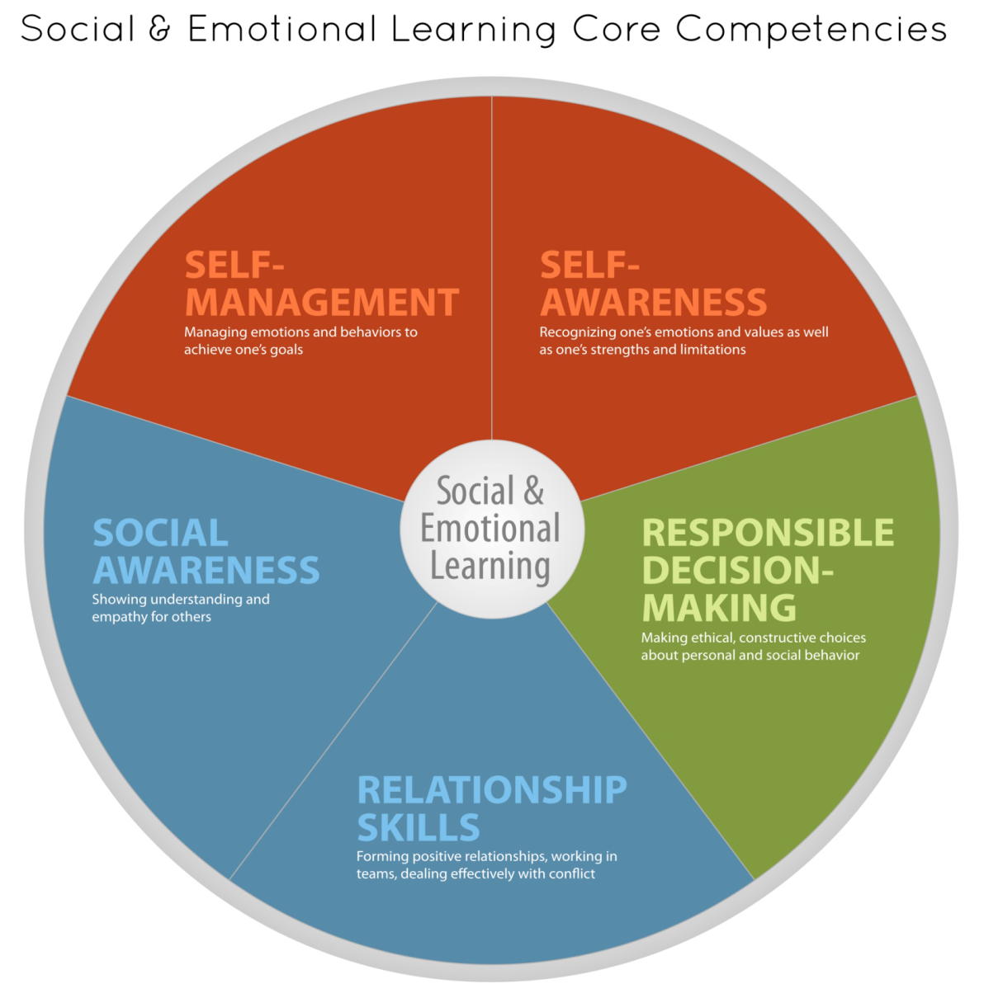
SKILLS THAT MATTER!
student support initiatives Kimberly Williams, SEL Coordinator, 754-321-1627
Notes:
Self-Awareness
The ability to accurately recognize one’s emotions and thoughts, and their influence on behavior. This includes accurately assessing one’s strengths and areas for growth, and possessing a well grounded sense of confidence and optimism.
Self-Management
The ability to regulate one’s emotions, thoughts, and behaviors effectively in different situations. This includes managing stress, controlling impulses, motivating oneself, and setting and working towards achieving personal and academic goals.
Social Awareness
The ability to take the perspective of and empathize with others from diverse backgrounds and cultures, to understand social and ethical norms for behavior, and to recognize family, school, and community resources and support.
Relationship Skills
The ability to establish and maintain healthy and rewarding relationships with diverse individuals and groups. This includes communicating clearly, listening actively, cooperating, resisting inappropriate social pressure, negotiating conflict constructively, and seeing and offering help when needed.
Responsible Decision Making
The ability to make constructive and respectful choices about personal behavior and social interactions based on considerations of ethical standards, safety concerns, social norms, the realistic evaluation of consequences of various actions, and the well-being of self and others.

Slide 21
Developmental Tasks of
Social & Emotional Competence
Preschool
Become and be engaged socially and academically.
Manage emotions (appropriately for a young child), especially with adult support.
Stay connected to adults, while beginning to develop peer relationships.
In play and learning, pay attention and follow directions, wait, sit still, and effectively join and leave groups.
Elementary
Become increasingly successful at navigating peer relationships and friendships independent
of adult support.
Show and share emotions appropriately, and with appropriate people.
Middle and High School
Form closer relationships with peers of both genders.
Manage increasingly complex academic content and tasks, with increasing independence
from adults.
Effectively manage transitions to middle and high school.
Increase independence from adults.
Begin preparing for adult roles (e.g., become more nurturing to younger children, begin preparing and practicing for work roles).
student support initiatives Kimberly Williams, SEL Coordinator, 754-321-1627

Slide 22
Skills for Social and Academic Success
Research Links SEL to Higher Student Success
    23 percentile point increase in SEL skills
    9 point gain in attitudes about self/others/school
    9 point gain in pro-social behavior
    11 point gain on standardized tests (math and reading)
    And Reduced Risks for Failure
    Problem behaviors down 9 points
    Emotional distress down 10 points
Source: Durlak, J.A., Weissberg, R.P., Dymnicki, A.B., Taylor, R.D., and
Schellinger, K. (in press). “The Impact of Enhancing Students’ Social and Emotional Learning: A Meta-Analysis of School-Based Universal Interventions.” Child Development.
STUDENT SUPPORT INITIATIVES Kimberly Williams, SEL Coordinator, 754-321-1627
Notes:
22
Time: 2 minutes Elapsed time: 21 minutes
This research was provided from a meta-analysis that was done to show the link between academic success and Social and Emotional Learning Programs.
Research supports the link between social and emotional learning and academic success. We also know that kids who are part of SEL programs have better attitudes about themselves , others and school and that problem behaviors decrease.

Slide 23
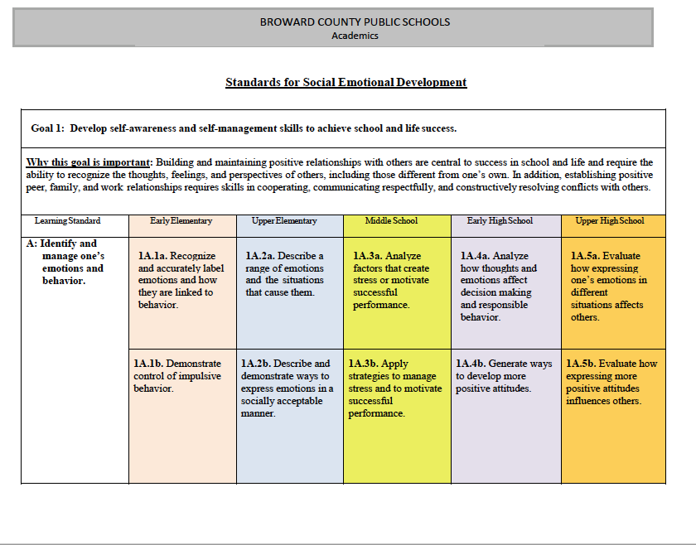

Slide 24
Social & Emotional Learning Goals
Self
Other
Decision-making
SEL Goal 1
Develop self-awareness and self-management skills to achieve school and life success.
SEL Goal 2
Use social-awareness and interpersonal skills to establish and maintain positive relationships.
SEL Goal 3
Demonstrate decision-making skills and responsible behaviors in personal, school, and community contexts.
STUDENT SUPPORT INITIATIVES Kimberly Williams, SEL Coordinator, 754-321-1627
20
Notes:
24
Goal 1
Develop self-awareness and self management skills to achieve school life and success.
Identify and manage one’s emotions and behavior
Recognize personal qualities and external supports
Demonstrate skills related to achieving personal and academic goals
Goal 2
Use social-awareness and interpersonal skills to establish and maintain positive relationships.
Recognize the feelings and perspectives of others
Recognize individual and group similarities and differences
Use communication and social skills to interact effectively with others
Demonstrate an ability to prevent, manage, and resolve interpersonal conflicts in constructive ways
Goal 3
Demonstrate decision making skills and responsible behaviors in personal, school, and community contexts.
Consider ethical, safety, and societal factors in making decisions
Apply decision making skills to deal with academic and social situations
Contribute to the well-being of one’s school and community

Slide 25
SEL: A Four Pronged Approach
To ensure comprehensive implementation aligned to researched best-practices, we must focus on educating the whole child, the whole day, using strategies throughout the whole school.
Direct instruction using research-based programing to deliberately teach the five foundational SEL practices necessary for success in school and in life WHOLE CHILD.
SEL strategies embedded throughout the day and in all curricular areas, including opportunities to model, teach, and reinforce SEL skills WHOLE DAY.
A safe, welcoming and respectful learning environment that is well-managed, supportive, and engaging WHOLE SCHOOL .
Creating opportunities for parents and families in the school community WHOLE CHILD, FAMILY, AND COMMUNITY.
STUDENT SUPPORT INITIATIVES Kimberly Williams, SEL Coordinator, 754-321-1627

Slide 26
Examples of Programmatic Efforts
WHOLE CHILD: SUPPORTING DIRECT INSTRUCTION
• Providing introduction to SEL training
• Sanford Harmony , LEAPS, Second Step and Others programs that you may be using
• Offer continuous support around the implementation
• Summer and school SEL Professional Development
WHOLE SCHOOL: EMBEDDING SEL THROUGHOUT THE DAY
• Work to prioritize SEL content embedded in literacy adoption
• Providing trainings on how embedding SEL into core content areas & instructional strategies
DISTRICT LEVEL SEL PROMOTION
• Collaborating with non instructional hours to coordinate SEL Instruction
• Reviewing proposals for new SEL content
• Speaking with community partners on shared SEL opportunities
• Prioritizing staff self-care strategies in all trainings
• Supporting youth voice and self-advocacy in response to current events
WHOLE CHILD, FAMILY, AND COMMUNITY
• School Creates Safe, Supportive “Family”
• Health and Wellness
• Learning by Doing, Part of a Real-World Curriculum
STUDENT SUPPORT INITIATIVES Kimberly Williams, SEL Coordinator, 754-321-1627

Slide 27
SEL Successes
EXAMPLES OF WHOLE CHILD:
• Implementing Sanford Harmony or other programs with fidelity
• Fidelity checks occur regularly
EXAMPLES OF WHOLE DAY:
• SEL themes integrated into classroom content
• SEL skill prompts used prior to transitions (exp. Recess, lunch, hallways and bus)
• Teachers prioritize reinforcing skills through instructional practices throughout the school day
EXAMPLES OF WHOLE SCHOOL:
• Dedicated time in master schedule for SEL
• Train all staff in SEL foundational skills
• Weekly/Monthly SEL themes school wide
• Prioritizing SEL activities in lesson plans
EXAMPLES OF FAMILY AND COMMUNITY:
• SEL Parent Night
• Literacy, Math, Science Night
• Community SEL presentation up dates
STUDENT SUPPORT INITIATIVES Kimberly Williams, SEL Coordinator, 754-321-1627

Slide 28
SEL Implementation Steps
Readiness Stage
  Principal is committed to implementing SEL in the school.
  Principal engages key stakeholders and creates SEL steering committee.
Planning Stage
  Develop a shared vision of SEL.
  Conduct a school wide needs and resource assessment.
  Develop an action plan.
  Select a SEL Liaison.
  Use the 4 prong approach to the implementation of SEL or select an evidence-
  based program.
Implementation Stage
  Conduct initial professional development activities.
  Launch SEL instruction in classrooms.
  Expand classroom-based SEL programming and integrate SEL school wide.
  Revisit implementation activities and adjust for continuous improvement.
STUDENT SUPPORT INITIATIVES Kimberly Williams, SEL Coordinator, 754-321-1627

Slide 29
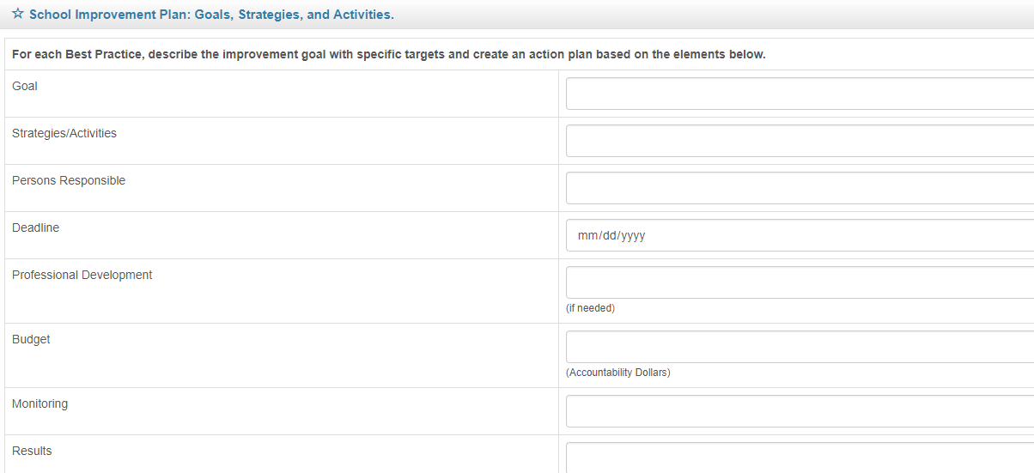
GOALS, STRATEGIES & ACTIVITIES
School Goals:
Based on Pre-Populated Targets
Must have Literacy Goal
SMART Goals need to include Specific Strategies
Accountability Money must be earmarked in BP #4
SMART Goal
Specific: explicit about what will change and when
Measurable: quantified and tracked with assessments
and other data
Attainable: challenging and realistic
Results-focused: direct impact student learning
Time-bound: Goal has a specific timeframe for completion.
OFFICE OF SERVICE QUALITY 754-321-3850

Slide 30
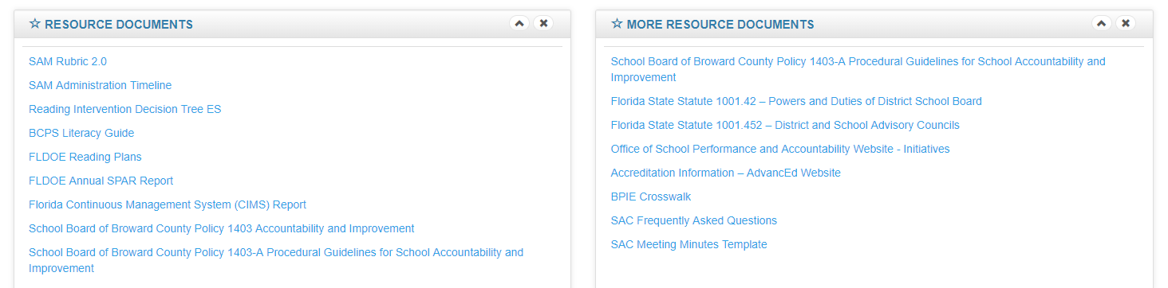
SIP RESOURCES
NEW!
Reading Decision Tree
Literacy Field Guide
FDOE Reading Plan
Can Do Descriptors
OFFICE OF SERVICE QUALITY 754-321-3850

Slide 31
OFFICE OF SERVICE QUALITY 754-321-3850
2. SIP/SAC
POLICY 1403
COMPLIANCE

Slide 32
OSPA/OSQ WEBSITE
For all School Improvement information, log on to:
http://www.broward.k12.fl.us/ospa/initiatives.asp?initiative_id=3
• View any school’s School Improvement Plan (SIP)
• Access SAC & SIP Standard Operating Procedural Manual
• A+ Recognition Fund Process Information
• Waiver Application & Waiver Database
• Log on to OSPA Central 2.0 to access SIP template
OFFICE OF SERVICE QUALITY 754-321-3850

Slide 33
SBBC POLICY 1403 & 1403-A
POLICY 1403: SCHOOL ACCOUNTABILITY AND IMPROVEMENT:
Each school has a School Advisory Council (SAC) to facilitate the development and
monitor progress of the annual School Improvement Plan. Agendas and minutes reflect
annual needs assessment, SIP monitoring and allocation of Accountability Funds.
POLICY 1403-A SCHOOL ACCOUNTABILITY AND IMPROVEMENT GUIDELINES:
This guide is designed to assist in the implementation of School Board Policy 1403: School Accountability and Improvement. It includes a description of School Advisory Councils’ roles and responsibilities and a timeline for implementation.
Both policies can be viewed at: http://www.broward.k12.fl.us/sbbcpolicies/index.asp
OFFICE OF SERVICE QUALITY 754-321-3850

Slide 34
SBBC POLICY 1403-A
SCHOOL ACCOUNTABILITY & IMPROVEMENT GUIDELINES
SCHOOL ADVISORY COUNCIL MEMBERSHIP
• Each school is required to establish a School Advisory Council (SAC) that is representative of the population served by the school. Per State statute (S 1001.452) a majority of the SAC members cannot be employees of the Broward County Public Schools.
• SAC members must be elected by their peer groups (teachers by teachers, parents by parents, etc.). The business and community representatives are selected by the principal and approved by the SAC.
• Once the SAC is established, its members elect their officers. Each SAC must have a SAC Chair and a parent member designated as I-Zone representative. Other officers are elected according to each SAC’s bylaws.
• The membership of each School Advisory shall be submitted online to the District Accountability Department by no later than October 31st of each year.
• Changes in SAC membership during the year must be reflected in the SAC meeting minutes and must be entered into the Online SAC Membership/Attendance System.
• SAC membership is entered into the online SAC Membership/Attendance system that is accessed through the Accountability & School Improvement website. The system generates the SAC Composition Report, which is then submitted by the school online in October.
OFFICE OF SERVICE QUALITY 754-321-3850

Slide 35
SBBC POLICY 1403-A
SCHOOL ACCOUNTABILITY & IMPROVEMENT GUIDELINES
SCHOOL ADVISORY COUNCIL MEETINGS
• Once members are entered into the system, the online SAC Composition System generates sign in sheets for use at SAC meetings. These are the sign-in sheets that must be used. The system will also generate a guest sign-in sheet that must be used to document attendance by guests at all SAC meetings.
• Per State Statute, SAC members who have two unexcused absences shall be replaced on the SAC.
• In order to conduct business at a SAC meeting, a quorum must be present. To establish a quorum, a majority of SAC members must be present. A quorum must be present to conduct a vote.
• All schools are required to enter SAC attendance into the online SAC Attendance System after each SAC meeting.
• All School Advisory Council meetings must be open, advertised (at least three days in advance), and are subject to the Sunshine Law.
Each month, School Advisory Council meeting agendas, sign-in sheets, and meeting minutes must be sent to the school’s Area Office. (Via SAC Upload)
OFFICE OF SERVICE QUALITY

Slide 36
SBBC POLICY 1403-A
SCHOOL ACCOUNTABILITY & IMPROVEMENT GUIDELINES
SCHOOL ADVISORY COUNCIL BY LAWS
• Each School Advisory Council is required to adopt procedural bylaws.
• A Bylaws template will be provided each year for use by all schools. This template, along with directions, will be posted on the Accountability & School Improvement website.
• Once the School Advisory Council has revised and approved the amended bylaws, the document must be submitted to the Area Office.
• Schools must maintain a copy of their SAC Bylaws as the procedural guide for conducting business.
OFFICE OF SERVICE QUALITY

Slide 37
SBBC POLICY 1403-A
SCHOOL ACCOUNTABILITY & IMPROVEMENT GUIDELINES
SCHOOL IMPROVEMENT PLAN
• Each School Advisory Council shall assist in the preparation and evaluation of the school improvement plan.
• Each School Advisory Council is responsible for monitoring the implementation of the school improvement plan.
• The school’s leadership is responsible for providing quarterly student performance data reports to facilitate formative evaluation of the school improvement plan and revision of the action plan.
• Each School Advisory Council is responsible for allocating Accountability Funds to support the school improvement plan goals and objectives. These allocations shall be documented in the school improvement plan and revisions to these allocations must be approved by the School Advisory Council and documented in the Council meeting minutes.
OFFICE OF SERVICE QUALITY

Slide 38
SBBC POLICY 1403-A
SCHOOL ACCOUNTABILITY & IMPROVEMENT GUIDELINES
WAIVERS
• The School Board shall consider requests for waivers of School Board policy, School Board approved guidelines, and provisions of collective bargaining agreements required to implement and/or support the implementation of school improvements.
• An online Waiver database is accessible on the Accountability & School Improvement website at: http://www.broward.k12.fl.us/schoolimprove.
• Schools are responsible for entering their new waivers into this database by the second week of February of each year and for updating waiver information annually by May of each year.
• Flowcharts for the new waiver and continuation waiver process, an updated waiver timeline and pertinent waiver information are posted on the online Waiver database at: http://www.broward.k12.fl.us/schoolimprove/OnlineWaivers/OWHome.asp
OFFICE OF SERVICE QUALITY

Slide 39
NEW & CONTINUATION WAIVERS
ALL WAIVER INFORMATION CAN BE FOUND AT:
http://www.broward.k12.fl.us/ospa/initiatives.asp?initiative_id=5
New Waiver Applications: Must be completed by February 8, 2018
Only schools that have completed an Intent to Apply form and
have been given permission to proceed may submit an application.
Continuation Waivers: All documentation must be completed by
April 26, 2018. Remember: The faculty must vote to continue
the waiver each year.
Special Note: Schedule Changes do not require a waiver. However, you must follow Article 15, Section K of the BTU Contract. Contact the Office Employee and Labor Relations for assistance.
OFFICE OF SERVICE QUALITY

Slide 40
SBBC SIP FOR ALL SCHOOLS
The SBBC SIP public view site can be found
by logging on to:
http://www.broward.k12.fl.us/ospa/select_school.asp
ALL STAKEHOLDERS CAN VIEW ALL
COMPONENTS OF ALL SCHOOL
IMPROVEMENT PLANS FOR ALL SCHOOLS
IN THE DISTRICT
OFFICE OF SERVICE QUALITY
Notes:
All Schools will log on to SIP at this point in the training.

Slide 41
OFFICE OF SERVICE QUALITY
3. SAC MINUTES:
FLDOE
FORMAT
https://www.floridacims.org/downloads

Slide 42
FLDOE SAC MEETING MINUTES TEMPLATE
Attendance:
List members and attendees.
Call to Order:
A meeting of the ___(name of school)___School Advisory Council was held in the (place of meeting) on date . Chair name called the meeting to order at time . Name will record minutes for this meeting.
Minutes:
(Name) motions to approve the minutes of (date) , with the following corrections _(detail the corrections)_. Motion outcome. Note: nothing is ever erased from the minutes. Corrections are made in the margin and initialed. If wording is to be expunged, a line is drawn through the words that are to be expunged. Crossed out words should still be readable. When minutes are approved, the word approved and the secretary’s initials and date of the approval are written next to the signature of the secretary OR a line can be provided at the bottom of the page that says “approval date”. To correct minutes previously approved require a 2/3 vote (Roberts Rules). Minutes should be written “promptly” and distributed public as per Sunshine Law requirements.
OFFICE OF SERVICE QUALITY

Slide 43
FLDOE SAC MEETING MINUTES TEMPLATE
Old Business: Guidelines for Minutes guides regarding Sunshine Laws
Board members are not prohibited from using written ballots to cast a vote as long as the votes are made openly at a public meeting, and the ballots are maintained and made available for public inspection in accordance with the Public Records Act. A secret ballot violates the Sunshine Law. (AGO 73-264)
“Minutes of Sunshine Law meetings need not be verbatim transcripts of the meetings; rather the use of the term "minutes" in Section 286.011, Florida Statutes., contemplates a brief summary or series of brief notes or memoranda reflecting the events of the meeting.”
Section. 286.011(2), F.S, provides, in part, that: "The minutes of a meeting of any . . . board or commission of any . . . state agency or authority shall be promptly recorded, and such records shall be open to public inspection."
OFFICE OF SERVICE QUALITY

Slide 44
FLDOE SAC MEETING MINUTES TEMPLATE
New Business: How to Write Meeting Minutes
The minutes provide a permanent record, provide a reference to check commitments and decisions, and provide a record of results for those who were not present at the meeting. Essential elements are noted, such as:
  type of meeting,
  name of the organization,
  date, time, and venue,
  names of those in attendance, and
  main topics and the time of adjournment.
Minutes should include approval of previous minutes, and all resolutions. Taking minutes is not the same as taking dictation. Record what is done, not what is said. Do not reflect personal opinions about anything that is said or done.
Sunshine Law requires “prompt” minutes. Benefits of prompt minutes include easier writing of the minutes while memory is fresh, and it is very important in helping the chair create the next meeting agenda.
Record the motions made and the names of people who originate them. You do not need to record the name of the “second” to the motion pursuant to Robert’s Rules. (Individual societies may decide to record seconds to the motion). Record whether motions are adopted or rejected, how the vote is taken (i.e., by show of hands, voice or other method). Write the names of the attendees who approve or oppose each motion if there is a split vote. The SAC may wish to use motion forms to ensure accurate wording of all motions. Refer to the form for specific wording when completing the minutes. Do not record motions that are withdrawn, all points of order, and appeals.
Attach long resolutions, reports or other supplementary material to the minutes as an appendix.
Helpful Hint: Use the agenda for the meeting as an outline so that you can jump right to the topic without a pause and kept the order of minutes aligned to the agenda. Throughout the agenda, the chair should use suggested time limits for discussion/items on the agenda.
OFFICE OF SERVICE QUALITY

Slide 45
FLDOE SAC MEETING MINUTES TEMPLATE
Reports:
Report Name
Open Agenda
Helpful Hint: Public must have an opportunity to participate and the SAC may allow public participation throughout the meeting.
Next Meeting Date & Time:
The next meeting will be held on (day and time) in the (place of next meeting)__
Meeting Adjournment:
Motion: name of person making motion motioned to adjourn the meeting at ________. Motion carried unanimously.
Submitted by,
Name of Recorder___________ ,
Name of Position on Board_____
Approval Date: ______________
OFFICE OF SERVICE QUALITY

Slide 46
ROBERTS RULES OF ORDER
"The application of parliamentary law is the best method yet devised to enable assemblies of any size, with due regard for every member’s opinion, to arrive at the general will on the maximum number of questions of varying complexity in a minimum amount of time and under all kinds of internal climate ranging from total harmony to hardened or impassioned division of opinion."
[Robert's Rules of Order Newly Revised [RONR (11th ed.), Introduction, p. liii]
Simplified Roberts Rules of Order:
http://www.intelec.org/public_docs/intSimplifiedRobertsRulesofOrder.pdf
Training Videos for Roberts Rules of Order and the Sunshine Law:
http://www.broward.k12.fl.us/talentdevelopment/html/committee_training-new.html
OFFICE OF SERVICE QUALITY

Slide 47
OFFICE OF SERVICE QUALITY
4. SAC BY LAWS:
RULES THAT GOVERN
COMPOSITION &
ELECTIONS

Slide 48
SAC BYLAWS
• School Advisory Councils should review their SAC Bylaws
the periodically and make necessary revisions.
• School Advisory Councils need to review their Bylaws and
revise them using the SAC Bylaws Template.
• Once the SAC Bylaws have been revised and approved, they
need to be submitted through the SAC Documentation Upload
on the SBBC SIP.
• Schools are also expected to post SAC Bylaws on their website,
maintain a hard copy of their annual SAC Bylaws in the main
office and should ensure that they are available for anyone who
may wish to see them.
OFFICE OF SERVICE QUALITY

Slide 49
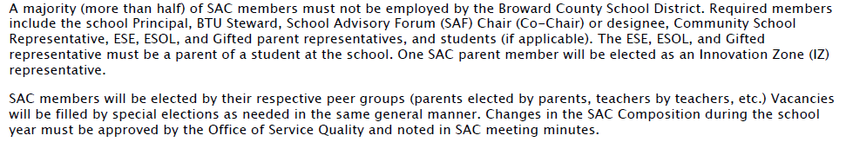
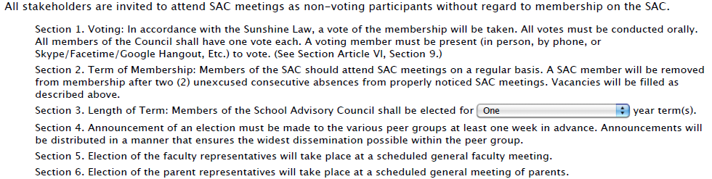
SAC MEMBERSHIP
OFFICE OF SERVICE QUALITY

Slide 50
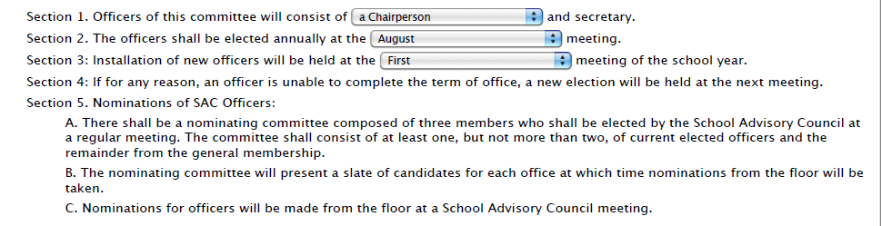
SAC OFFICERS
OFFICE OF SERVICE QUALITY

Slide 51
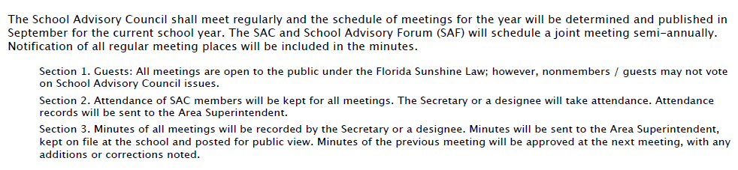
SAC MEETINGS
OFFICE OF SERVICE QUALITY

Slide 52
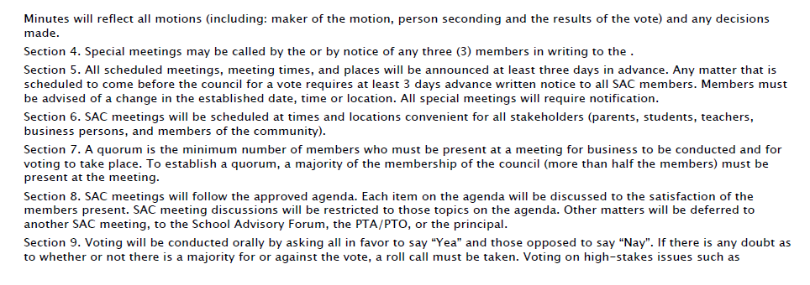
SAC MEETINGS
OFFICE OF SERVICE QUALITY

Slide 53
OFFICE OF SERVICE QUALITY
5. AdvancED
ePROVE
STAKEHOLDER
SURVEY

Slide 54
AdvancED eProve
STAKEHOLDER SURVEYS
Administration
Window:
April 2
through
May 24
(Revised Date)
Parent Survey
This survey asks parents their opinions about their child’s school, including questions about teachers, administrators, and other aspects of their child’s and their own experiences with the school.
Completion Targets:
Parents 20%
Students 40%
Staff 60%
Student Survey
(Elementary: 3-5, Middle & High: 6-12)
This survey asks middle and high school students their opinions about their school, including their teachers, administrators, their peers, and other aspects of their experiences at school.
Staff Surveys
This survey asks staff their opinions about their school, including teachers, administrators, students, and other aspects of their experiences at their school
OFFICE OF SERVICE QUALITY

Slide 55
SURVEY PROCESS
BCPS will be using the AdvancED eProve Surveys as the 2018 Stakeholder Survey. The surveys will be available online only and will be available in multiple languages.
• Parent Survey Code: https://eprovesurveys.advanced.org/surveys/#/action/60990/p568
Send the survey message with the codes to parents and post on the school website. Since the survey is only online, please make computers available for parents who may not have access to the internet.
• Staff Survey Code: https://eprovesurveys.advanc-ed.org/surveys/#/action/60989/p568
Send survey message to staff via email. Surveys taken in a group setting generally have a positive effect on the completion rate.
• Student Survey Code for Elementary (grades 3-5):
https://eprovesurveys.advanc-ed.org/surveys/#/action/60992/p568
Only grades 3-5 will be asked to take the survey and this is best done in a lab or class setting.
• Student Survey Code for Middle and High (grades 6-12):
https://eprovesurveys.advanc-ed.org/surveys/#/action/60993/p568
It is best to assign a specific subject area to be responsible for survey completion.
Check Survey Responses for Your School:
Log on to http://www.advanc-ed.org/login and click on eProve Surveys. Each school’s survey target response quotas will be sent to the principals via PIVOT.
OFFICE OF SERVICE QUALITY

Slide 56
SURVEY COMMUNICATION
• PARENT Survey Invitation - use for any communication to distribute the link information:
In an effort to improve System Practices, Broward County School District is conducting a Parent Survey. We
value your opinion and ask that you please take time to complete this survey. In order to complete the survey, go
to: https://eprovesurveys.advanc-ed.org/surveys/#/action/60990/p568 Please be assured that your responses to
this survey will be anonymous. Your honest opinion is appreciated. Thank you for taking your time to complete the
survey.
• STAFF Survey Invitation - use for any communication to distribute the link information:
In an effort to improve System Practices, the Broward County School District is conducting a Staff Survey. We
value your opinion and ask that you please take time to complete this survey. In order to complete the survey, go
to: https://eprovesurveys.advanc-ed.org/surveys/#/action/60989/p568 Please be assured that your responses to
this survey will be anonymous. Your honest opinion is appreciated. Thank you for taking your time to complete the
survey.
• STUDENT Survey Invitation - use for any communication to distribute the link information:
In an effort to improve System Practices, the Broward County School District is conducting a Student Survey. We
value your opinion and ask that you please take time to complete this survey. Please be assured that your responses
to this survey will be anonymous. Your honest opinion is appreciated. Thank you for taking your time to complete the
survey.
Elementary (Grades 3-5): https://eprovesurveys.advanc-ed.org/surveys/#/action/60992/p568
Middle/High (Grades 6-12): https://eprovesurveys.advanc-ed.org/surveys/#/action/60993/p568
OFFICE OF SERVICE QUALITY

Slide 57
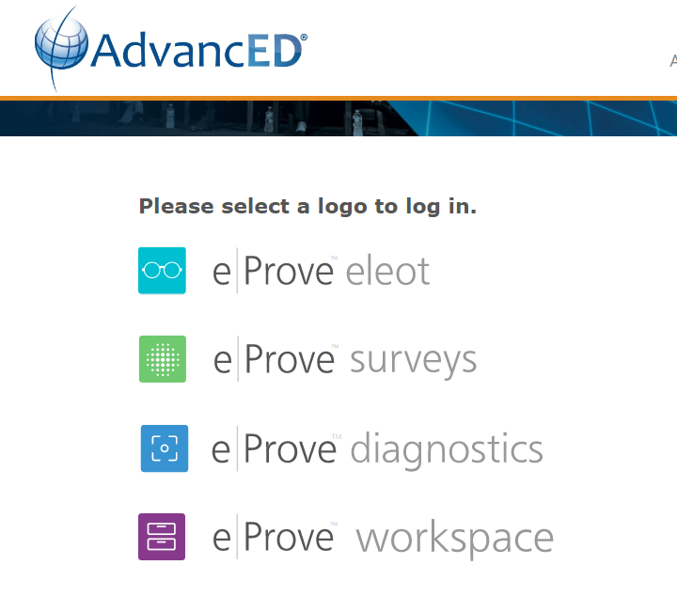

Check Survey Responses for Your School:
Log on to http://www.advanc-ed.org/login and click on eProve Surveys
Principals need to go to the log in page of AdvancED and click on eProve Surveys.
- Click on “request a password”.
- Then type in their BCPS email address and click on “request a password” again.
- The password link to your email address.
OFFICE OF SERVICE QUALITY

Slide 58
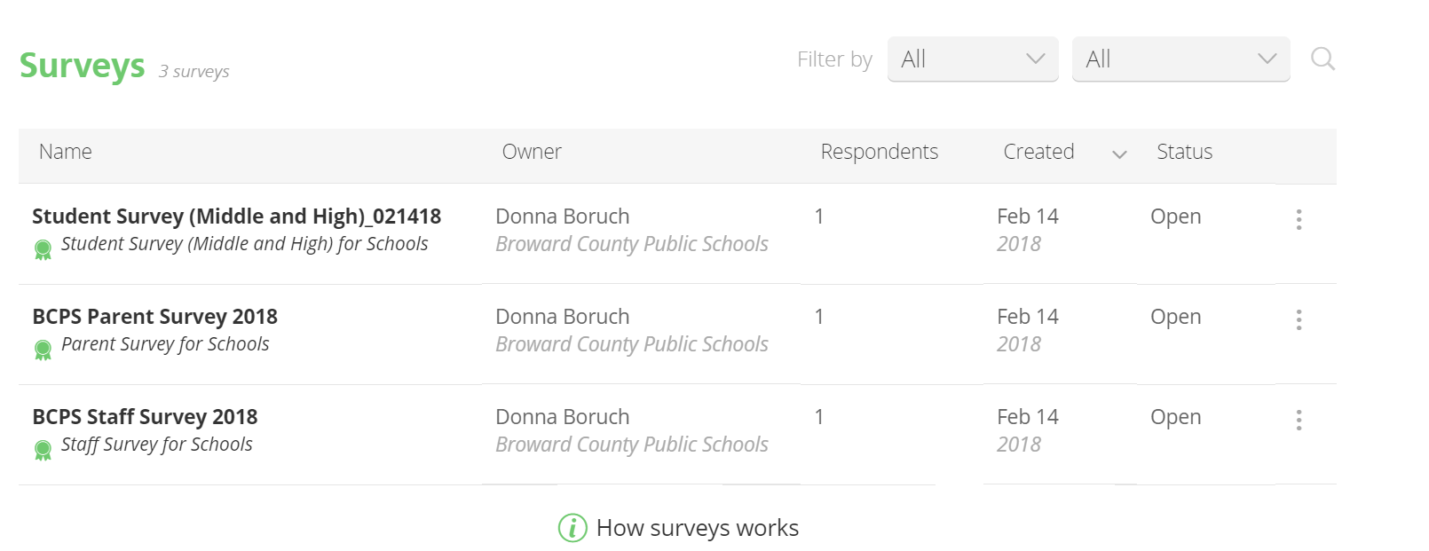
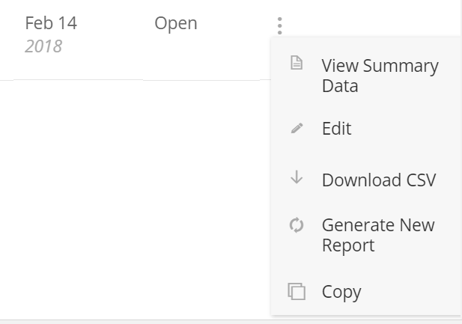
SHARE SURVEY RESULTS
Directions to Access All eProve School Survey Results
Login to AdvancED. (Remember: only the principal has an account with AdvancED.) Click on eProve Surveys and search for your school name.
You will see a list of surveys. Here, next to the blue arrow, you can see the number of respondents for each survey.
For a more complete survey report, go to the three-dot menu to the right of the status (open).
OFFICE OF SERVICE QUALITY

Slide 59
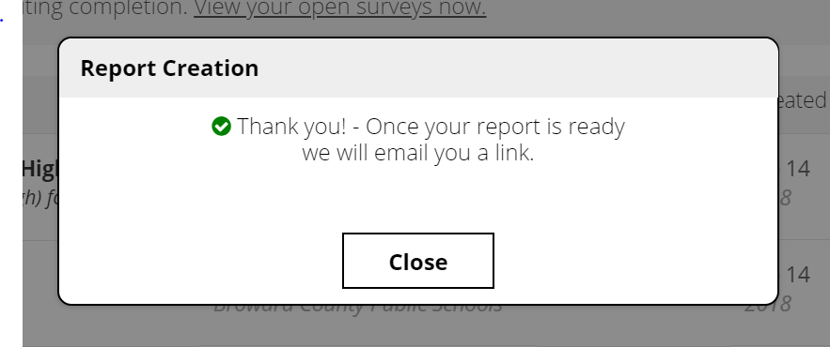
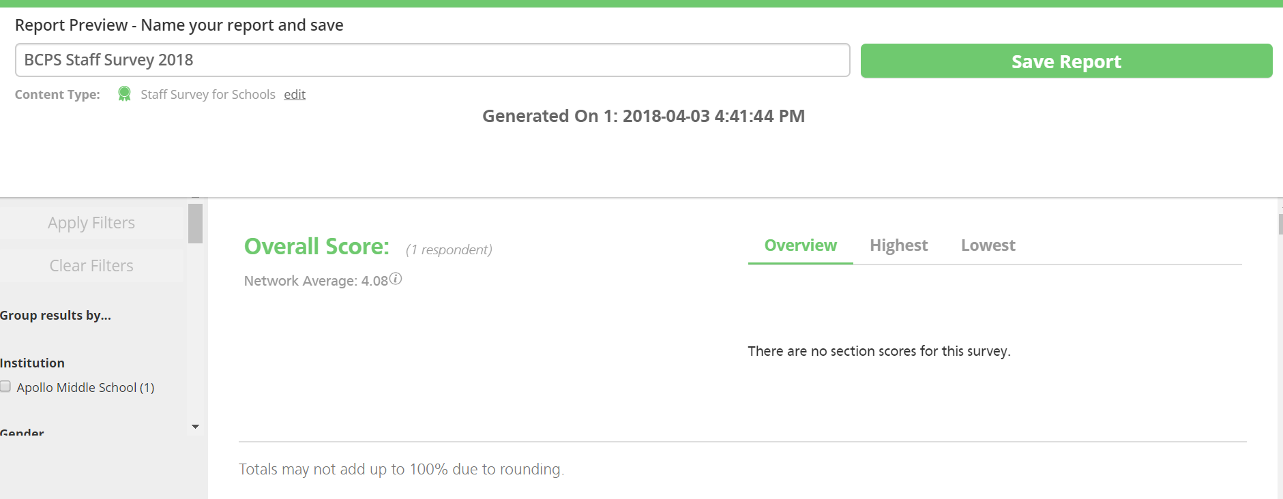
Click on Generate New Report and you will see a window that says report creation
When the report is created you will see the message below
Close the window and you will receive an email with a link to the survey results – this can take a few minutes
This is what the email will look like:
Your report for the BCPS Staff Survey 2018 for Apollo Middle School is now available. Click on the link below to view. https://eprovesurveys.advanc-ed.org/surveys/#/preview-report?report=NDMxMjJfNjI5NDFfODYxMw== This link will expire in 90 days.
Click on the link and it will take you to the eProve survey login screen. Login again and you will see the report on the screen.
Edit the name of the report (if you wish) and save the report.
Once you save the report, you will see a screen with the ability to download the report as a pdf export.
OFFICE OF SERVICE QUALITY

Slide 60
OFFICE OF SERVICE QUALITY
6. UPDATES:
ATTENDANCE PLAN
FACE PLAN
      MTSS/RtI PLAN
TITLE 1 ADDENDUM
BEHAVIOR PLAN
BPIE

Slide 61
Attendance plan
ATTENDANCE
PLAN
DISTRICT CONTACT:
Phillip Shaver, Coordinator of District Attendance,
Student Services Department, 754-321-1623

Slide 62
PLAN STRUCTURE: Attendance Plan
Data (Will be populated August 2018)
Goals for the Attendance Plan (Data Analysis with Goals)
Tier 1: Strategies
Tier 2: Strategies and Interventions
Tier 3: Individualized Responses and Legal Interventions
Attendance plan
Notes:
Image #535076351

Slide 63
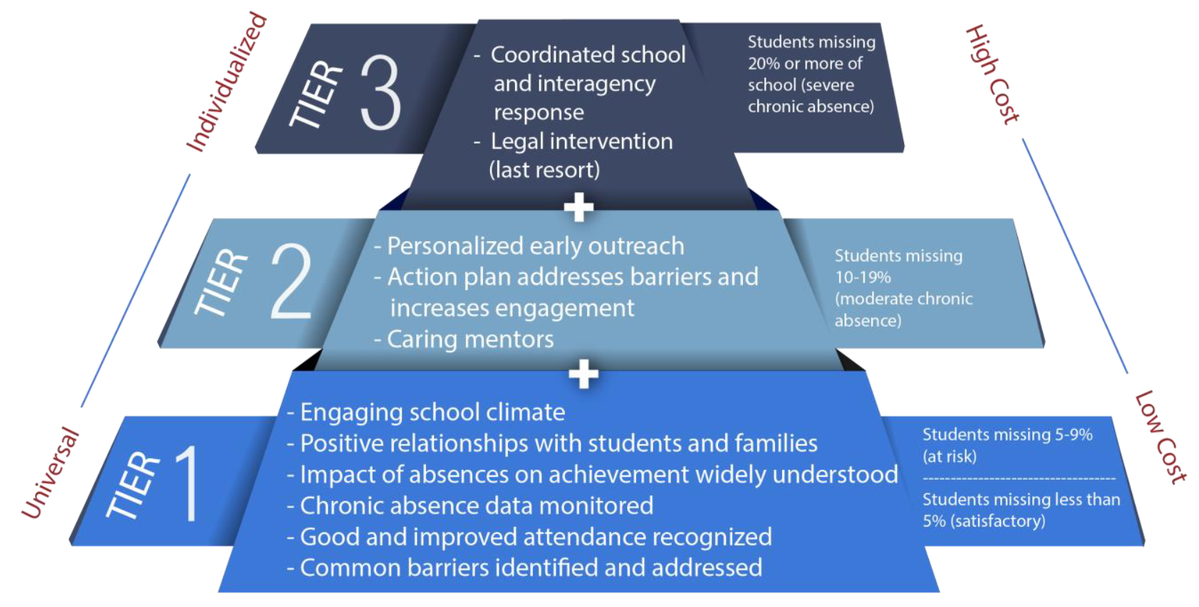
Attendance Plan: Tiers and Strategies
Attendance plan
Notes:
Image #535076351

Slide 64
Attendance Plan: Chronic Absenteeism
BCPS Definition
Chronic Absenteeism: Missing 10% or more of school days.
We use the 10% definition to promote the use of early warning systems.
Chronic absence (missed 10% or more of school days) in the prior year.
Starting at the beginning of the school year, student has:
2 absences
2-3 absences
Missing 10% any time after.
4 absences
Attendance plan
Notes:
Image #535076351

Slide 65
ATTENDANCE PLAN DATA
Updated data will be included in the Attendance Plan online
OSPA Central 2.0
1st Semester (2016/17) |  | Satisfactory (0-4.9% absences) |  | At-Risk 5-9.9% absences |  | Chronic Absences (10-19.9% absences) |  | Severe Absences (20% or more)
Grade | Total # of students | # | % | # | % | # | % | # | %
9th
10th
11th
12th
Totals |  | (Total #) | (Overall % of students) | (Total #) | (Overall % of students) | (Total #) | (Overall % of students) | (Total #) | (Overall % of students)
2nd Semester (2016/17) |  | Satisfactory (0-4.9% absences) |  | At-Risk 5-9.9% absences |  | Chronic Absences (10-19.9% absences) |  | Severe Absences (20% or more)
Grade | Total # of students | # | % | # | % | # | % | # | %
9th
10th
11th
12th
Totals |  | (Total #) | (Overall % of students) | (Total #) | (Overall % of students) | (Total #) | (Overall % of students) | (Total #) | (Overall % of students)
Attendance plan
Notes:
Image #535076351

Slide 66
ATTENDANCE PLAN GOALS
Analyze school-wide data with the SIP team
An emphasis on early grades in elementary (K & 1) and high school (9 & 10) may be a focus
All grades in middle school (6, 7, 8)
Set SMART goals for each semester
District Goal is to reduce chronic absenteeism by at least 1%.
Attendance plan
Notes:
Image #535076351

Slide 67
ATTENDANCE PLANS TIERS & STRATEGIES
Tiers for attendance strategies include:
Monitor data
Engage students and families
Recognize good and improved attendance
Provide personalized outreach
Remove barriers
Tier 1: Strategies aimed at all students and families
Tier 2: Strategies for students with at-risk attendance and a history of
chronic absenteeism
Tier 3: Coordinated school and district responses. Partnerships with other agencies to assist in providing family support and legal interventions.
Attendance plan
Notes:
Image #535076351

Slide 68
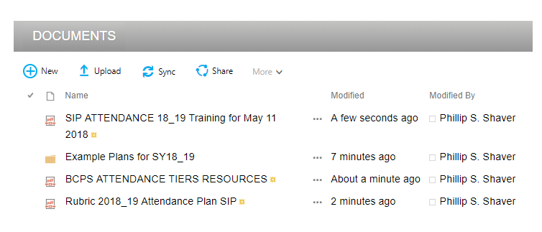
RESOURCES TO HELP WITH THE PLAN
WHERE CAN YOU FIND RESOURCES?
At the bottom of the Attendance Plan online at OSPA Central 2.0.
Intranet @ Student Services > Attendance > SIP Attendance 2019
Example Plans – *NEW* What should your plan look like?
RUBRIC – How do you know if the plan has what it needs?
TIERS RESOURCES – A bank of examples that can be included in your plan.
Policy 5.5: Attendance
Attendance plan
Notes:
Image #535076351

Slide 69
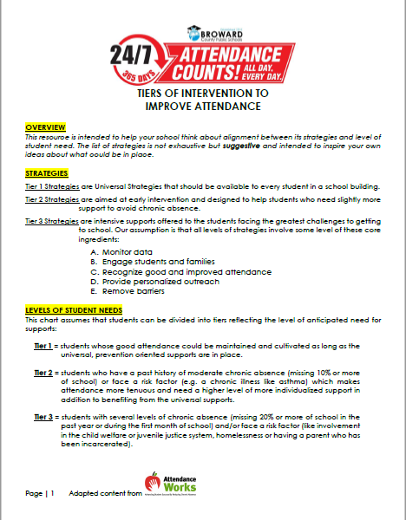
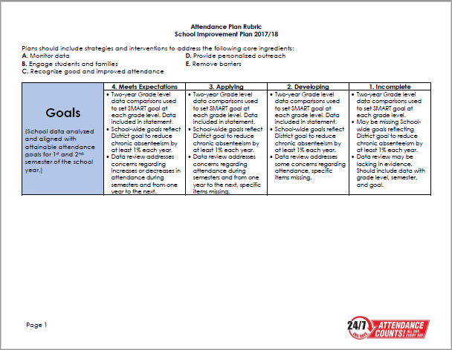
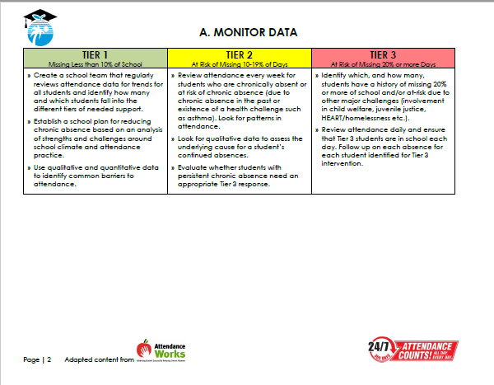
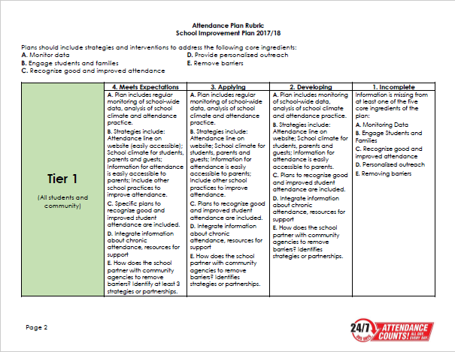
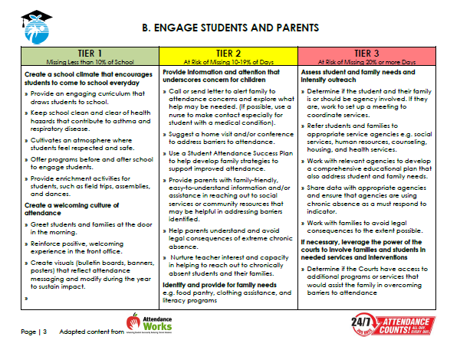
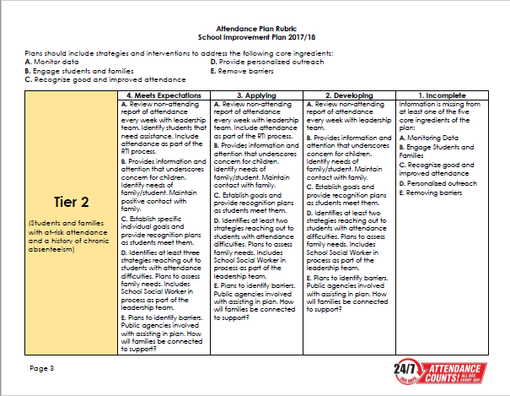
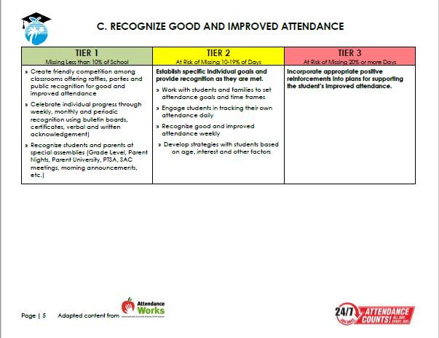
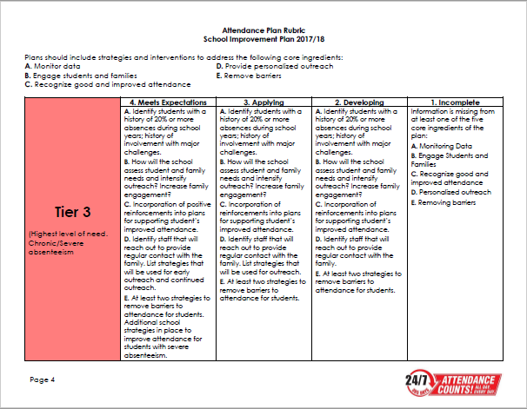
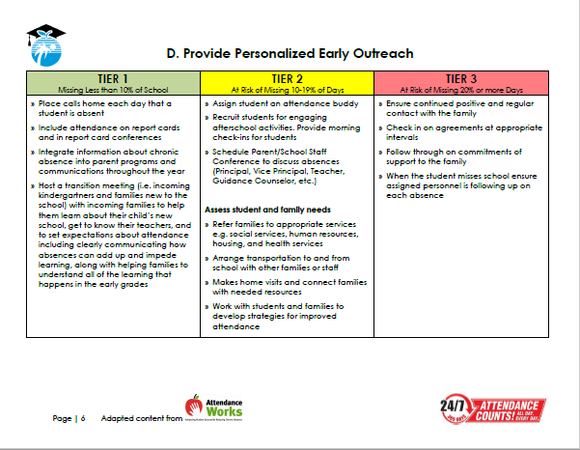
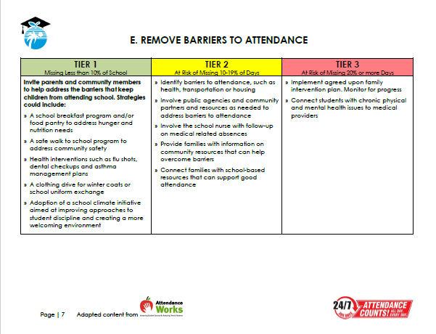
RESOURCES TO HELP WITH THE PLAN
RUBRIC – Rating to be led by SSW. Shared by SIP Team.
TIERED STRATEGIES RESOURCES.
Attendance plan
Notes:
Image #535076351

Slide 70
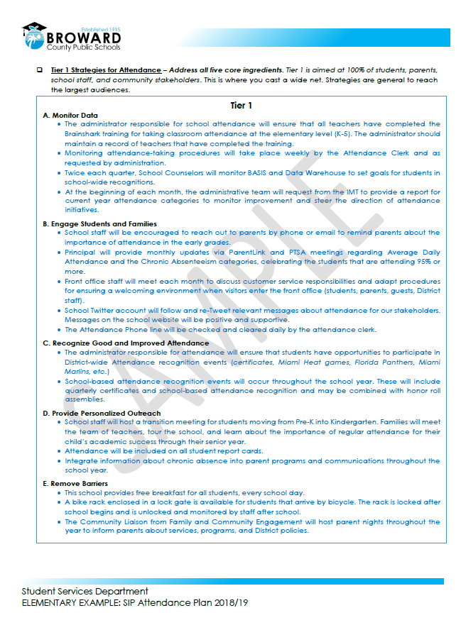
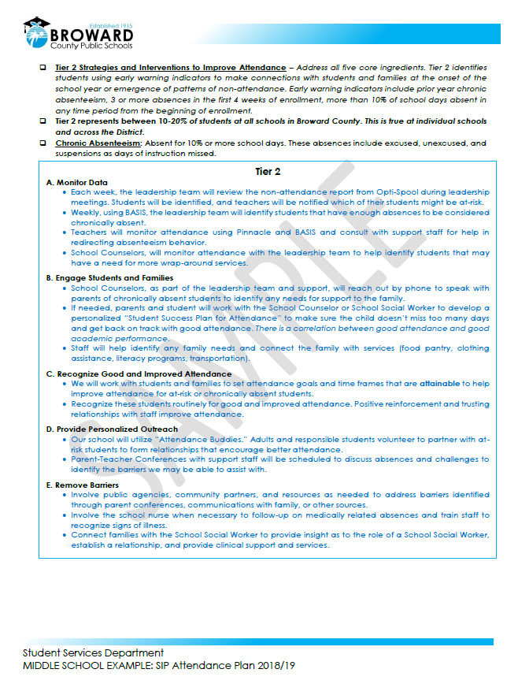
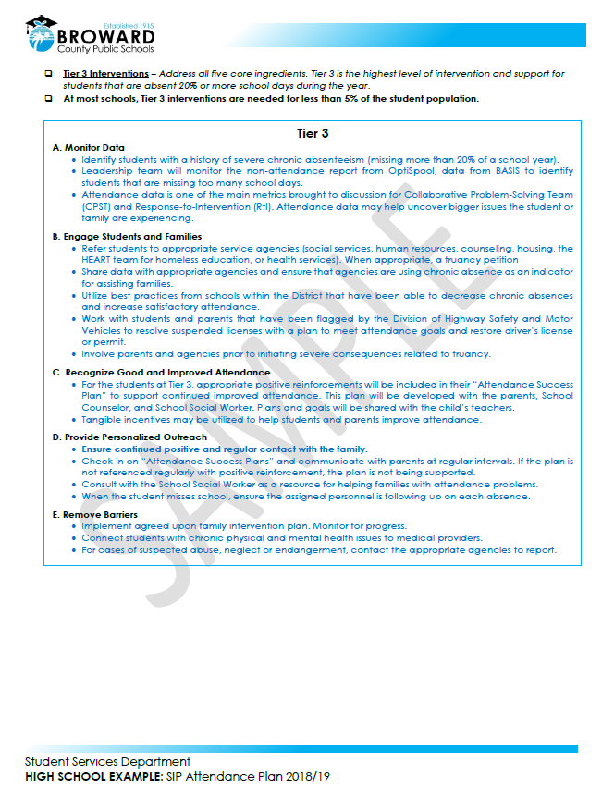
RESOURCES TO HELP WITH THE PLAN
Attendance plan
Notes:
Image #535076351

Slide 71
OFFICE OF SERVICE QUALITY
FACE PLAN
(Family and Community Engagement)
District contact:
Nadia Clarke, Assistant Director,
Office of Family and Community Engagement, 754-321-1599

Slide 72

Office of
Family and Community Engagement
Our purpose is for families to be full partners with school staff and members of the community in the work of supporting and sustaining excellence in Broward County Public Schools.
Family and community engagement

Slide 73



From “Involvement” to “Engagement”
Involve is "to enfold or envelope“
Identifying projects, needs, and goals and then telling parents how they can contribute
Engage is "to come together and interlock“
Listening to what parents think, dream, and worry about with a goal of not to serve clients but to gain partners
Involvement implies doing to; in contrast, Engagement implies doing with
Family and community engagement

Slide 74
FACE Plan in SIP
Engagement Goal
The environment or culture in which engaging programs take place must consider and plan for:
Families to feel welcomed, valued, and respected by program staff
Two-way communication and relationship building with families to meet changing family and community circumstances
Opportunities for family support and development through the family partnership process and through intentional parent/family peer groups within the program and community.
Family and community engagement

Slide 75
FACE Plan in SIP
Strategy #1
Family And Community Engagement (FACE) Plan
Impact Area: Program Environment/Culture
Engagement Goal: The environment or culture in which engaging programs take place must consider and plan for: families to feel welcomed, valued, and respected by program staff; two-way communication and relationship building with families to meet changing family and community circumstances; opportunities for family support and development through the family partnership process and through intentional parent/family peer groups within the program and community.
Strategy (Specific action, including cultural proficiency connections as appropriate) | Date |  | What needs to be done for the activity? When does it need to be done? |  |  | Who is responsible? |  | What is our objective? | How will we measure our progress? | Identify artifacts to be uploaded
Review customer service expectations with staff | Within the first 30 days |  | After viewing the customer service document created for the 2016-17 FACE Plan, consider 2 scenarios: one providing an example of a good interaction and one that should be improved. Complete "Customer Service" document as a team. |  |  |  |  | Provide exceptional customer service to families and community stakeholders. |  | Upload Customer Service activity.
Family and community engagement

Slide 76
Strategy #1
Review customer service expectations with staff.
After reviewing the customer service document created for the 2016-17 FACE Plan,
Identify a positive interaction in which good customer service is
demonstrated. Elaborate on the positive features of the interaction.
Identify an interaction that could have been handled differently. Elaborate on the scenario and discuss what will be done to improve such interactions in the future.
Family and community engagement

Slide 77
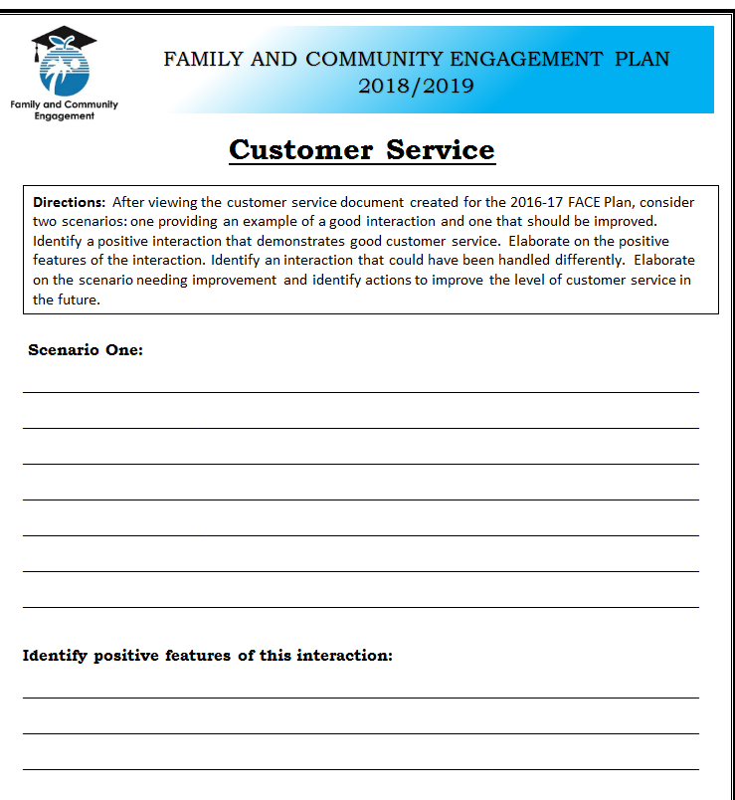
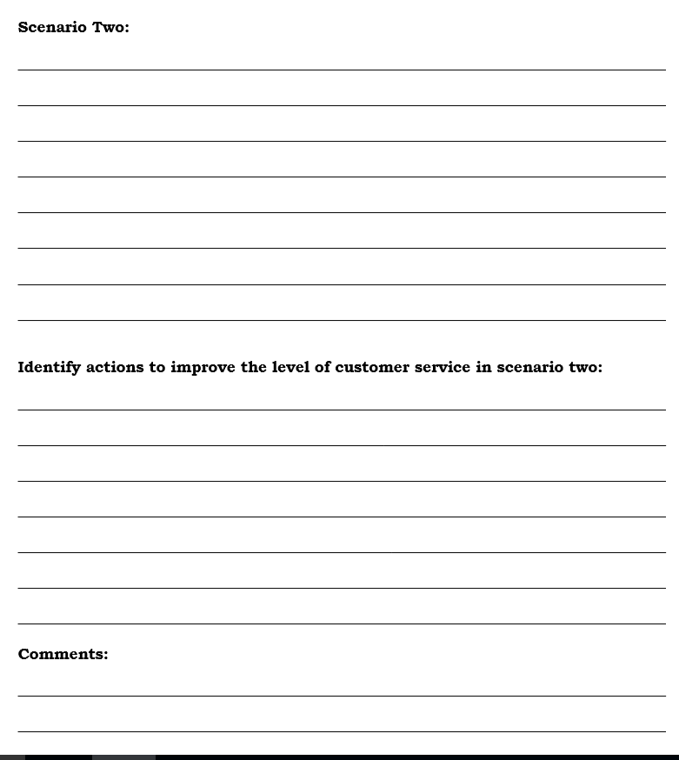
Strategy #1
Family and community engagement

Slide 78
FACE Plan in SIP
Strategy #2
Family And Community Engagement (FACE) Plan
Impact Area: Program Environment/Culture
Engagement Goal: The environment or culture in which engaging programs take place must consider and plan for: families to feel welcomed, valued, and respected by program staff; two-way communication and relationship building with families to meet changing family and community circumstances; opportunities for family support and development through the family partnership process and through intentional parent/family peer groups within the program and community.
Strategy (Specific action, including cultural proficiency connections as appropriate) | Date |  | What needs to be done for the activity? When does it need to be done? |  |  | Who is responsible? |  | What is our objective? | How will we measure our progress? | Identify artifacts to be uploaded
Connect families with school, district and local community resources. | Upload documents by the fifth week of each quarter. |  | Convene a FACE Resource Team comprised of one representative from administration, instructional, paraprofessional, cafeteria, custodial, after school program, social worker, and school counseling. Meet once each quarter to identify needs of community and discuss available school/ community resources and services for families that will minimize barriers - food, shelter, illnesses, hardship assistance, job referral agencies, etc. Update FACE SPACE with relevant information based on identified needs. Complete "Program Services" document. |  |  |  |  | Provide ongoing updated relevant resources to families and the community |  | Photos of updated FACE space; Upload completed Programs and Services sheet; Upload FACE Resource team members.
Family and community engagement

Slide 79
Strategy #2:
Connect families with school, district and local community resources.
Convene a FACE Resource Team (administration, instructional, paraprofessional, cafeteria, custodial, after school program, social worker, and school counseling).
        Meet once each quarter to identify needs of community and discuss available school/ community resources.
        Update FACE SPACE with relevant information based on identified needs.
Family and community engagement

Slide 80
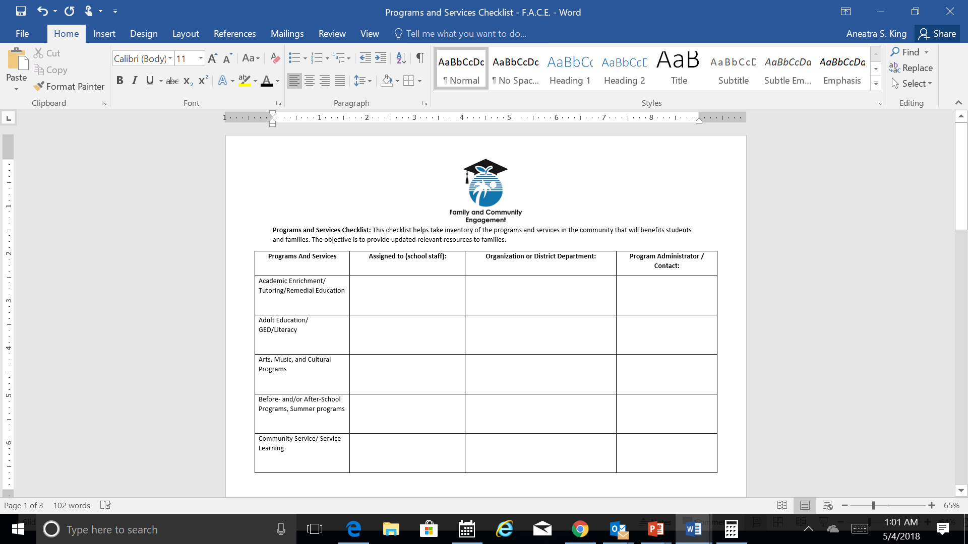
Strategy #2
Programs and Services Checklist
Family and Community Engagement

Slide 81
FACE Plan in SIP
Strategy #3
Family And Community Engagement (FACE) Plan
Impact Area: Program Environment/Culture
Engagement Goal: The environment or culture in which engaging programs take place must consider and plan for: families to feel welcomed, valued, and respected by program staff; two-way communication and relationship building with families to meet changing family and community circumstances; opportunities for family support and development through the family partnership process and through intentional parent/family peer groups within the program and community. .
Strategy (Specific action, including cultural proficiency connections as appropriate) | Date |  | What needs to be done for the activity? When does it need to be done? |  |  | Who is responsible? |  | What is our objective? | How will we measure our progress? | Identify artifacts to be uploaded
Recognize the cultural uniqueness of families served in the school/community. | Between the 5th and 6th week of school |  | Based on information provided by cultural ambassador/resident expert, identify ways that values and traditions of the community will be incorporated in your school's culture. (ex. serving dishes from a particular culture during school events; acknowledging traditions and holidays; signage in different languages, etc.) Print and complete Cultural Awareness sheet. |  |  |  |  | Bridge the Cultural Gap between Families & Staff |  | Upload completed Cultural Awareness sheet.
Family and community engagement

Slide 82
Strategy #3
Recognize the cultural uniqueness of families served in the school/community.
Identify ways that values and traditions of the community will be incorporated in your school's culture (ex. serving dishes from a particular culture during school events; acknowledging traditions and holidays; signage in different languages, etc.).
Family and Community Engagement

Slide 83
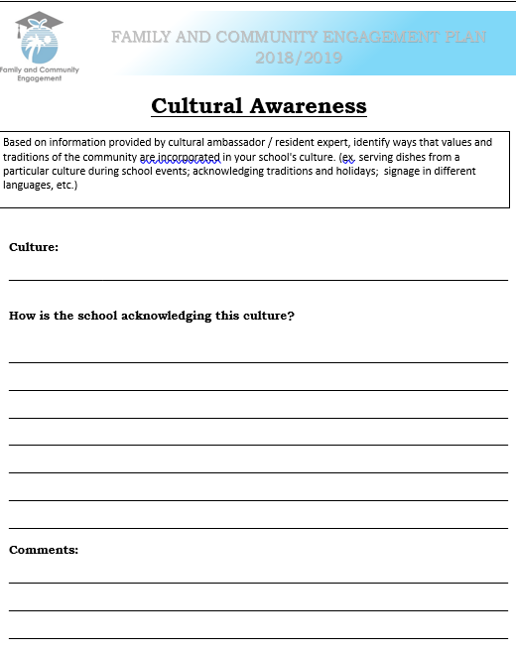
Strategy #3
Family and community engagement

Slide 84
FACE Plan in SIP
Strategy #4
Family And Community Engagement (FACE) Plan
Impact Area: Program Environment/Culture
Engagement Goal: The environment or culture in which engaging programs take place must consider and plan for: families to feel welcomed, valued, and respected by program staff; two-way communication and relationship building with families to meet changing family and community circumstances; opportunities for family support and development through the family partnership process and through intentional parent/family peer groups within the program and community. .
Strategy (Specific action, including cultural proficiency connections as appropriate) | Date | What needs to be done for the activity? When does it need to be done? |  |  | Who is responsible? |  | What is our objective? | How will we measure our progress? | Identify artifacts to be uploaded
Continue the “Catch Them Being...” program recognizing individuals supporting a positive environment/culture in your school. | Monthly | During a staff meeting, highlight a faculty and/or staff who have been “Caught Being Great”. Have the individual(s) complete the form and share with peers the specific steps or actions taken to achieve the accolade/recognition. Complete "Catch Them Being Great" document. |  |  |  |  | Provide incentives to maintain a positive school environment |  | Upload the completed Catch them Being Great form and a list of staff who were "Caught Being Great".
Family and community engagement

Slide 85
Strategy #4
Continue the Catch Them Being Great Program
During a staff meeting, highlight a faculty and/or staff who have been “Caught Being Great”. Have the individual(s) share with peers the specific steps or actions taken to achieve the accolade/recognition.
Example…Mr. Smith really knows how to make families feel welcome.
Steps/actions Mr. Smith exhibits to help families feel welcome.
• Warm genuine smile
• Greets parents by name
• Gives his fullest attention
• Has open body language
• Consistent communication about student's progress
Family and community engagement

Slide 86
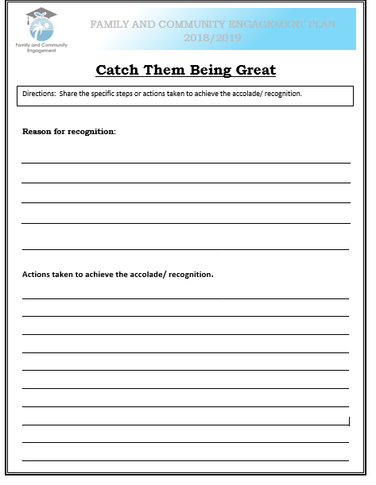
Strategy #4
Family and community engagement

Slide 87
FACE Plan in SIP
Strategy #5
Family And Community Engagement (FACE) Plan
Impact Area: Program Environment/Culture
Engagement Goal: The environment or culture in which engaging programs take place must consider and plan for: families to feel welcomed, valued, and respected by program staff; two-way communication and relationship building with families to meet changing family and community circumstances; opportunities for family support and development through the family partnership process and through intentional parent/family peer groups within the program and community. .
Strategy (Specific action, including cultural proficiency connections as appropriate) | Date |  | What needs to be done for the activity? When does it need to be done? |  |  | Who is responsible? |  | What is our objective? | How will we measure our progress? | Identify artifacts to be uploaded
Share Social and Emotional Learning Competencies with families | 1st Semester |  | Distribute SEL competencies to families (https://casel.org/wp-content/uploads/2017/01/Competencies.pdf) and/or facilitate a workshop for families on modeling behaviors that promote SEL skills at home. Information can be found at https://www.browardprevention.org/instructional-strategies/social-emotional-learning/ |  |  |  |  | Provide tiered support for Social Emotional Learning |  | Upload copy of sign-in sheets.
Family and community engagement

Slide 88
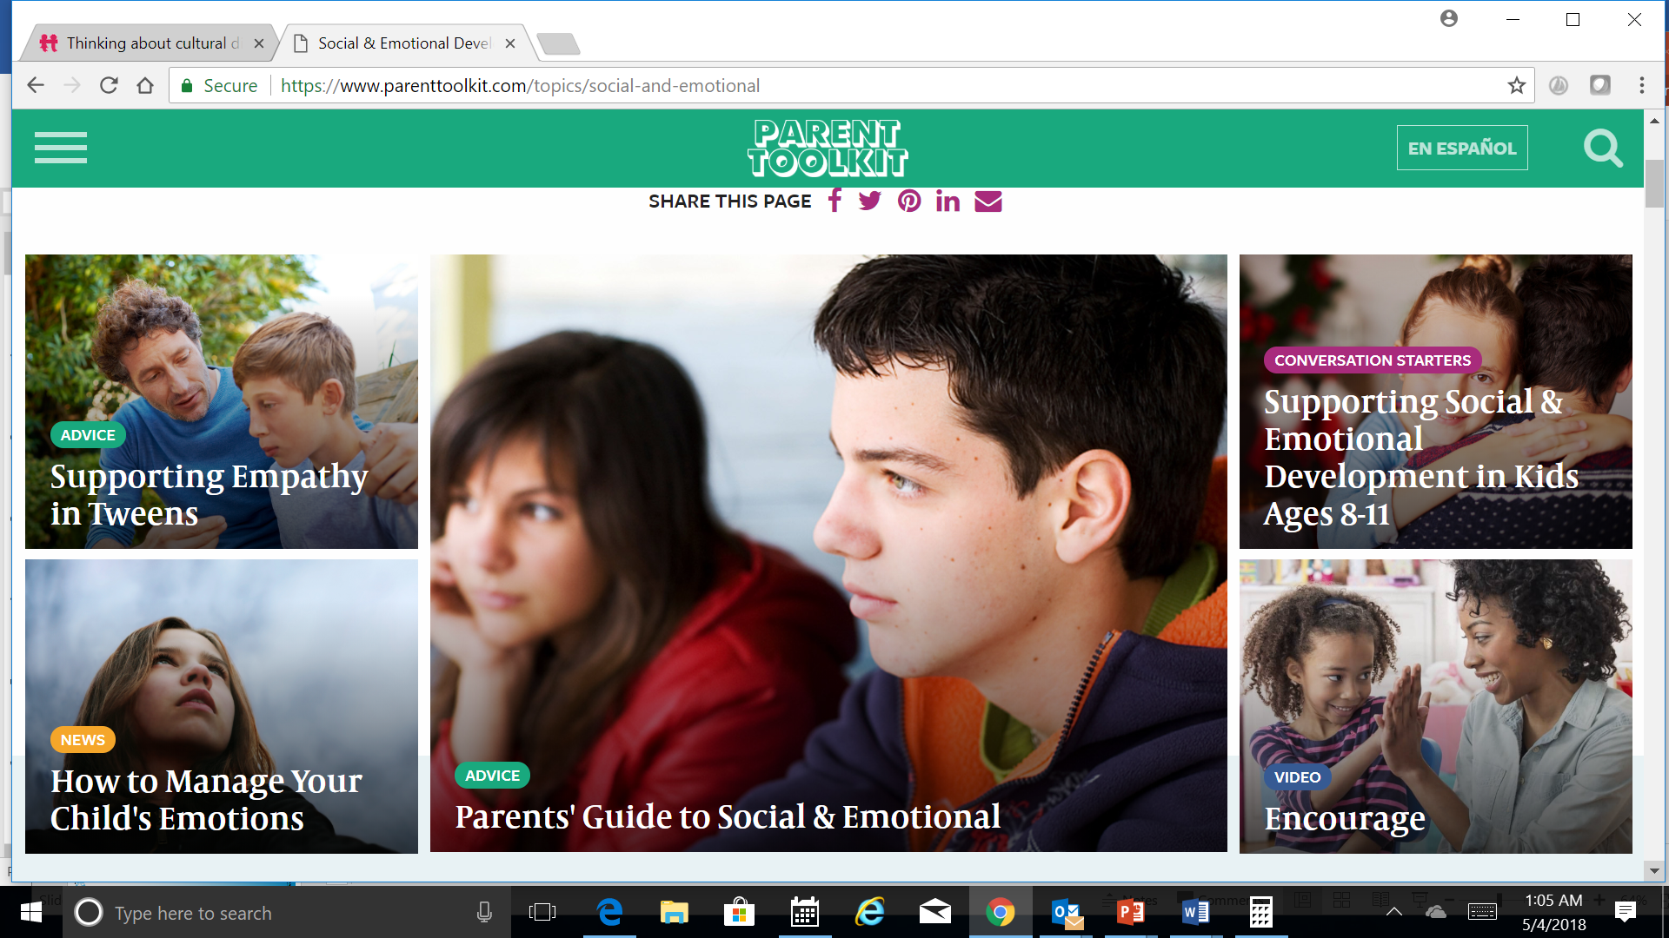
Strategy #5
Share Social and Emotional Learning Competencies with Families
Distribute SEL competencies to families
Facilitate a workshop for families on modeling behaviors that promote SEL skills at home.
Information can be found at
www.browardprevention.org/instructional-strategies/social-emotional-learning/
Family and community engagement

Slide 89
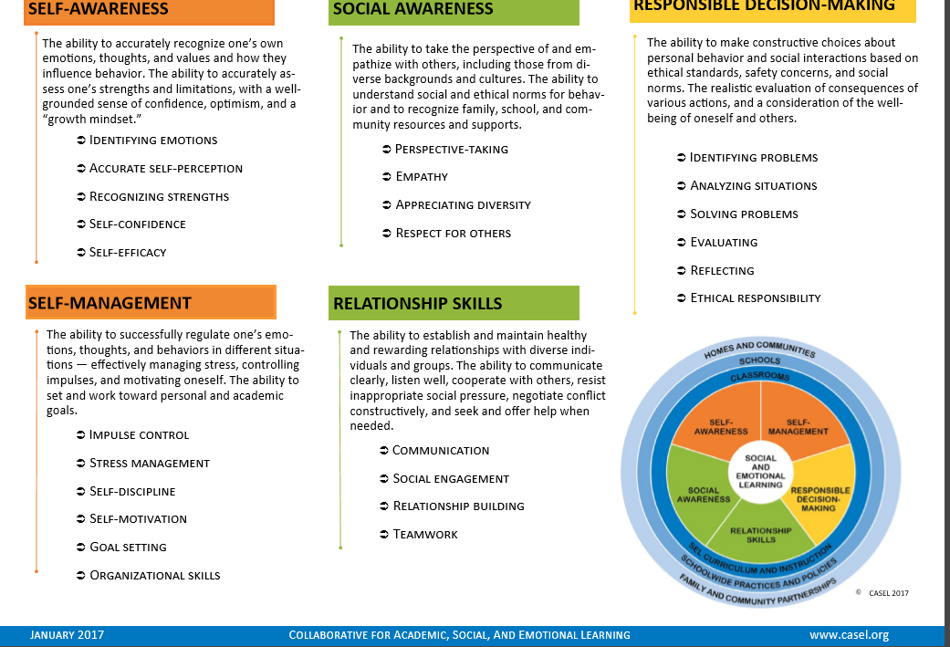
Strategy #5
Family and community engagement

Slide 90
Questions and Support
Nadia Clarke
Office of Family and Community Engagement
754-321-1599
nadia.clarke@browardschools.com
Family and community engagement

Slide 91
OFFICE OF SERVICE QUALITY
MTSS/RtI ACTION PLAN
Self-Assessment of Multi-Tiered System of Supports (SAM)
DISTRICT CONTACT:
Adrienne Dixson, RtI Specialist,
Diversity, Prevention & Intervention Department, 754-321-1691

Slide 92
SAM
Self-Assessment of Multi-Tiered System of Supports Instrument
Notes:
Current tools not adequate for assessing all components of MTSS
Desire for an instrument to guide action planning towards improved implementation

Slide 93
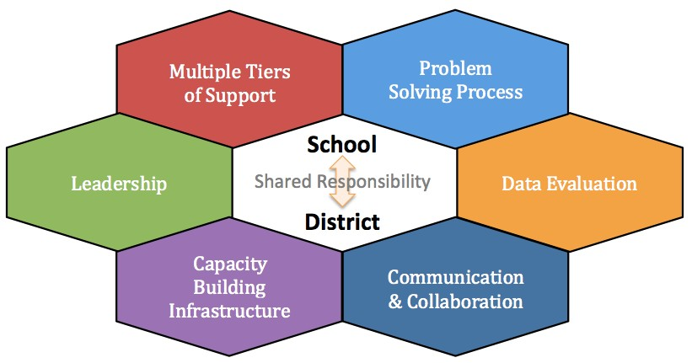

Multi-Tiered System of Supports
Response to Intervention
Diversity, Prevention & Intervention Department Adrienne Dixson, RtI Specialist - 754-321-1691
Notes:
MTSS is a framework to ensure successful education outcomes for ALL students by simply giving kids whatever they need to succeed everyday all day.
A Multi-Tiered System of Supports (MTSS) is a term used to describe an evidence-based model of schooling that uses data-based problem-solving to integrate
academic and behavioral instruction and intervention.
The integrated instruction and intervention is delivered to students in varying intensities (multiple tiers) based on student need.
“Need-driven” decision-making seeks to ensure that resources reach the appropriate students at the appropriate levels to accelerate the performance
of ALL students to achieve and/or exceed proficiency for college and career readiness.
Florida Problem-Solving/ Response to Intervention Project (FL PS/RtI)
In looking at these components of a MTSS, we often find that educators misconceive that MTSS is only one of these components – for instance, they may think that MTSS is only the 3 tiers of instruction and intervention. All of these components are necessary for a comprehensive MTSS.
There must be:
1) Multiple tiers of instruction and intervention, aligned to standards, utilizing evidence based strategies, matched to student needs, and with assessments that allow the measurement of effectiveness
2) A structured, consistent, team-based, problem solving process, with decision rules used to make educational decisions
3) An integrated data system that allows for ongoing assessment of student learning as well as decision making
4) Open and transparent communication and collaboration between stakeholders with relationships based upon mutual respect and shared responsibility
5) The capability for the system to build the necessary capacity and infrastructures necessary for MTSS implementation including data-driving professional development, aligning policies and procedures to support MTSS, and the creation of implementation plans
6) Leadership that expects and supports data-based decision making, team functioning, and coaching supports

Slide 94

100% SAMS Completed

Slide 95
MTSS/RtI Policy
Every Student Succeeds Act (ESSA)
Broward County Public Schools Strategic Plan
BEST Blueprint
Florida Rule 6A-6.0331(1) (e) F.A.C.,
BCPS Policy 6000.1, Student Progression Plan
  Establishes Response to Intervention (RtI) as a key framework to be implemented by all schools to improve the academic, behavioral and social-emotional outcomes for all students.
  Also, requires that schools implement a multi-tiered system of supports with evidence-based interventions and supports to address identified area(s) of concern in the general education environment for all students.
Diversity, Prevention & Intervention Department Adrienne Dixson, RtI Specialist - 754-321-1691

Slide 96
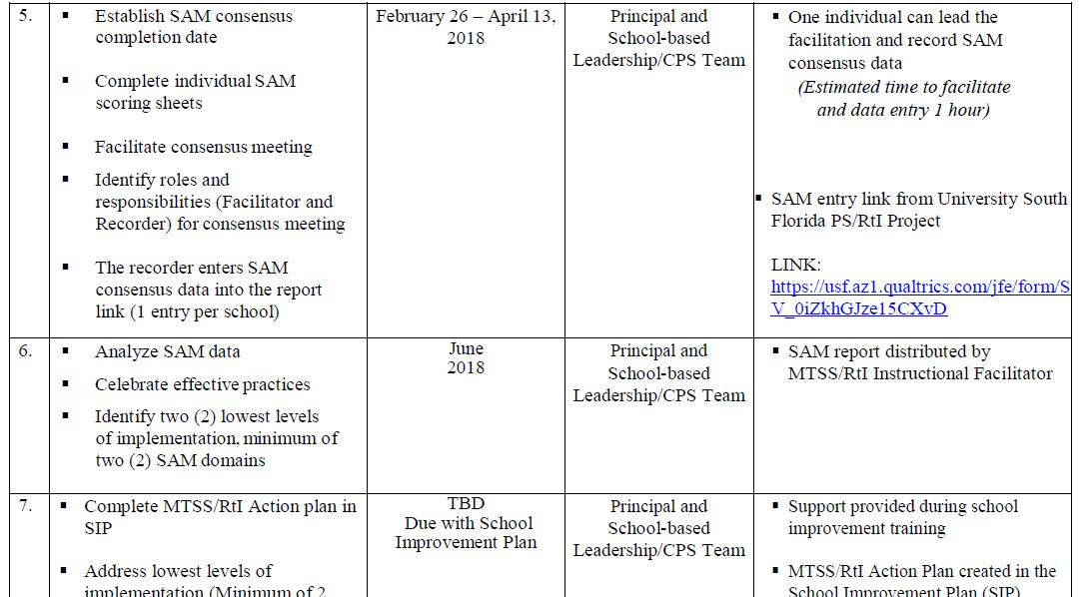

SAM Administration Timeline
The SAM instrument is used to measure school level implementation of a Multi-Tiered System of Supports.
Diversity, Prevention & Intervention Department Adrienne Dixson, RtI Specialist - 754-321-1691

Slide 97
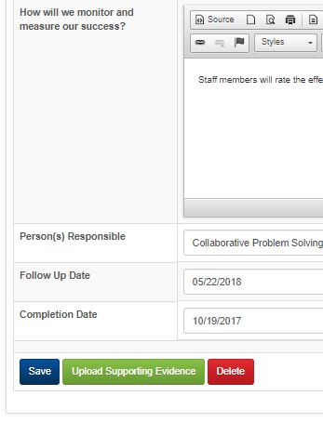
SAM Next Steps
Engage MTSS/RtI Instructional Facilitators for support
Upload supporting evidence in SAM 17/18 goals
Analyze SAM data 18/19 (reports will be distributed by MTSS/RtI IFs)
  Celebrate effective practices
  Identify two (2) lowest levels of implementation
  Utilize SAM data to support school plans
  Align with 2018 – 2019 PLCs and PD
Diversity, Prevention & Intervention Department Adrienne Dixson, RtI Specialist - 754-321-1691
Notes:
-Critical for school leadership team members to have the opportunity to review SAM before team completion. Allows individual team members to familiarize themselves with the SAM and come to the team meeting more prepared for conversations regarding their school’s implementation level.
-ONE SAM PER SCHOOL!

Slide 98
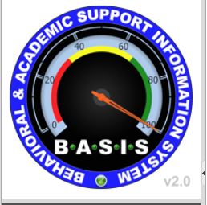
MTSS/RtI 2017 – 2018 End of Year Procedures
REVIEW PREVIOUSLY CREATED FORM, form will become READ ONLY, upon creation of a new form
All pending referrals must have an Initial Meeting Note completed
Closing pending referrals, no further action required, record is archived
Accepting pending referrals, requires an Individualized Plan AND Progress Monitoring Note completed
MTSS/RtI End of Year Procedures
must be completed by
Thursday, June 7, 2018
Diversity, Prevention & Intervention Department Adrienne Dixson, RtI Specialist - 754-321-1691

Slide 99
MTSS/RtI 2017 – 2018 End of Year Procedures
REVIEW PREVIOUSLY CREATED FORM, form will become READ ONLY, upon creation of a new form
Holding pending referrals, requires a Progress Monitoring Note completed AND an Individualized Plan if Hold is reviewed and then accepted, (suggest accept or close)
All RtI Needs Review, Hold, In-Progress records require a Progress Monitoring Form completed (other forms required as determined)
Export BASIS Excel files for 2017 – 2018 data
  Risk Factors Tab
  Attendance Tab
  RtI Maintenance Queue
MTSS/RtI End of Year Procedures
must be completed by
Thursday, June 7, 2018
Diversity, Prevention & Intervention Department Adrienne Dixson, RtI Specialist - 754-321-1691

Slide 100
Professional Learning
“An Introduction to a Multi-Tiered System of Supports” (MTSS) accessible through Florida’s Professional Development Portal
http://pdportal.florida-ese.org
    What Is an MTSS and Why Is It Important
    Multi-Tiered System of Support
    The Problem-Solving Process
    ESE Eligibility in an MTSS
    Case Study Applications of MTSS Practices
Contact Diversity, Prevention & Intervention – 754-321-1655
Email certificate of completion to adrienne.Dixson@browardschools.com
Diversity, Prevention & Intervention Department Adrienne Dixson, RtI Specialist - 754-321-1691

Slide 101
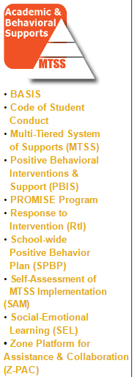
Resources And Support
Diversity, Prevention & Intervention SharePoint
      https://browardcountyschools.sharepoint.com/sites/Intranet/Academics/SS/DPI/Pages/default.aspx
        MTSS/RtI Instructional Facilitator
        (See Support Matrix)
        Diversity, Prevention & Intervention
        754-321-1655
        Adrienne T. Dixson-Paul
        954-235-6886

Slide 102

Questions & Answers
Diversity, Prevention & Intervention Department Adrienne Dixson, RtI Specialist - 754-321-1691

Slide 103
OFFICE OF SERVICE QUALITY
TITLE I PLAN
(ADDENDUM)

Slide 104
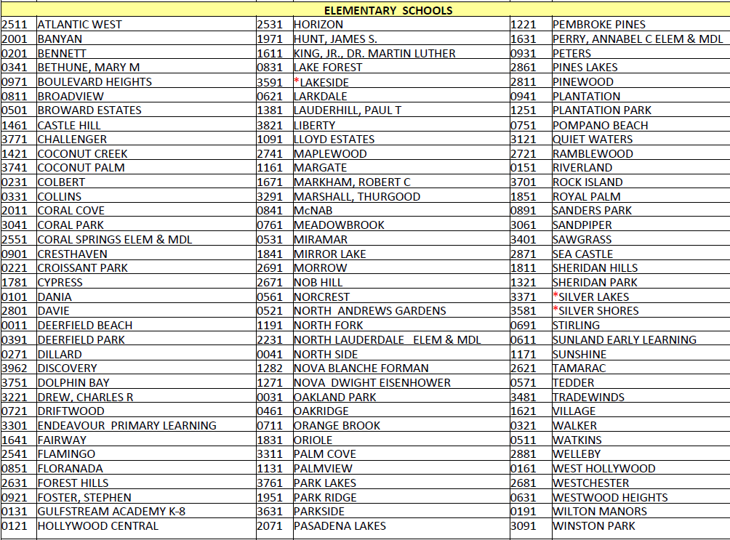
TITLE 1 SCHOOLS 2018-2019
Title 1 Adriana Karam, Program Specialist - 754-321-1417

Slide 105
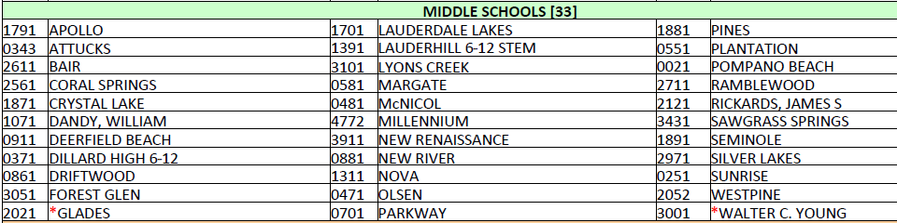
TITLE 1 SCHOOLS 2018-2019
Title 1 Adriana Karam, Program Specialist - 754-321-1417

Slide 106

Title I Plan (Addendum)
Why do Title I Schools complete the SIP
and/or Title I Plan (Addendum)?
Public Law No. 114-95,
Section 1116
requires that all Title I Schools complete a
School-wide Plan.
.
Title 1 Adriana Karam, Program Specialist - 754-321-1417

Slide 107
Title I Plan (Addendum)
In Broward County:
If your school has a grade of D or F
(focus or priority school):
You are required to complete
The Florida Department of Education
School Improvement Plan
template, which has embedded the required components of a schoolwide program, as set forth in the No Child Left Behind (NCLB) Act of 2001 (reauthorized as the Every Student Succeeds Act in 2015).
Title 1 Adriana Karam, Program Specialist - 754-321-1417

Slide 108
Title I Plan (Addendum)
In Broward County:
If your school has a grade of A, B or C…
You are required to complete the
Broward School Improvement Plan template.
This template does not include the
Title I required components,
therefore,
a Title I Plan (Addendum) must be completed.
Title 1 Adriana Karam, Program Specialist - 754-321-1417

Slide 109
DIRECT LINK TO OSPA CENTRA 2.0
Welcome to OSPA Central 2.0
http://www.broward.k12.fl.us/ospa/ospa-central2/login.asp
Title 1 Adriana Karam, Program Specialist - 754-321-1417

Slide 110
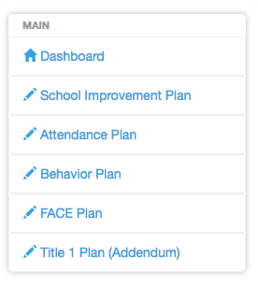
Let’s Review!
Title I Plan (Addendum)
2017 – 2018 Title I Plan (Addendum)

Slide 111
Title I Plan (Addendum)
*REQUIREMENTS*
Comprehensive Needs Assessment of the entire school (including the needs of migrant children)
Instruction by STATE CERTIFIED TEACHERS in all core content area classes
(Strategies) Attract HIGH QUALITY, STATE CERTIFIED TEACHERS to the school
2017 – 2018 Title I Plan (Addendum)

Slide 112
Title I Plan (Addendum)
*ADDITIONAL REQUIREMENTS*
Coordination & Integration
Title I, Part A
Title I, Part C-Migrant
Title I, Part D
Title II (Professional Development)
Title III (ELL)
Title X, Homeless Education
2017 – 2018 Title I Plan (Addendum)

Slide 113
Title I Plan (Addendum)
*ADDITIONAL REQUIREMENTS, cont.*
Coordination & Integration
Supplemental Academic Instruction
Violence Prevention Programs
Nutrition Programs
Housing Programs
2017 – 2018 Title I Plan (Addendum)

Slide 114
Title I Plan (Addendum)
*ADDITIONAL REQUIREMENTS, cont.*
Coordination & Integration
Head Start
Adult Education
Career and Technical Education
Job Training
Other
2017 – 2018 Title I Plan (Addendum)

Slide 115
*PRE-SCHOOL TRANSITION*
Indicate how your school services the pre-school aged students
(i.e. Head Start, Title I/VPK, Specialized Pre-K ESE)
Describe the process for orienting new families to your school
(i.e. Kindergarten Round-Up)
2017 – 2018 Title I Plan (Addendum)

Slide 116
PARENT INVOLVEMENT Action Plan
Level/Expected Level of Parent Involvement as it relates to total number of participants
2017 – 2018 Title I Plan (Addendum)

Slide 117
PARENT & FAMILY ENGAGEMENT Action Plan
Parent Involvement Action Plan Activities
(Aligned to School-Level PIP)
New Name: Parent and Family Engagement Plan ~ PFEP
2017 – 2018 Title I Plan (Addendum)

Slide 118
PARENT & FAMILY ENGAGEMENT Action Plan
High Quality and Ongoing Professional Development
(Aligned to Title I, Part A School-Based Budget)
2017 – 2018 Title I Plan (Addendum)

Slide 119
Suggestions for Best Practices
Include your Title I Liaison on your SIP team. (6 eBinder compliance items reference the SIP/Title I Plan)
Complete ALL requirements in a detailed, narrative format.
Please indicate if the requirement is not applicable to your school.
Refer to the “More Information” pull down tab as needed for examples.
Be complete and concise with your responses.
Title I Plan (Addendum)

Slide 120
Need help? Contact us!
Adriana Karam
754-321-1417
Tamara Battle
754-321-1400
Yolanda Nails
754-321-1400
2017 – 2018 title I addendum

Slide 121
OFFICE OF SERVICE QUALITY
BEHAVIOR
PLAN
Upload Completed Behavior Plan to the 2017-2018 SIP Template

Slide 122

School-wide Positive Behavior Plan
May 2018

Slide 123

Whew!

Slide 124
Next Steps…
1
Look for your individual feedback form and school score by JULY 1, 2018
  • Feedback form is in OSPA in same place you uploaded your SPBP
  • Feedback form is sent to school’s Cadre Director

Slide 125
Where is my feedback?
Directions to get on to OSPA v 2.0 for the School-wide Positive Behavior Plan
Go to http://browardschools.com/
Hover on “About Us” and click on “Departments”
Click on “Office of School Performance and Accountability” (OSPA)
Click on “OSPA Central v2.0” in the quick links box on the right side
Log in using PIN number and Password
(user must have access to the plan from your Principal)
Click on “Behavior Plan” in the Dashboard on the left side
Click on “View”
Make sure you are in 2018-19 school year in upper right corner
Read directions and click on the green download button to get your new SPBP template

Slide 126
Next Steps…
2
Consider modifying the SPBP based on the feedback form
  Over the summer
  During Preplanning 2018

Slide 127
Next Steps…
3
Set first PBIS/SPBP team meeting in early August
  Print up SPBP Implementation Plan
  Create SPBP Documentation Folder

Slide 128
Next Steps…
4
Present SPBP to all staff BEFORE August 15, 2018
Present SPBP to stakeholders BEFORE October 1, 2018

Slide 129
Next Steps…
5
SPBP Team meets quarterly:
  Review SPBP implementation fidelity and student data
  Present implementation fidelity and student data to staff quarterly

Slide 130

Finally…
Look for 2019-20 SPBP template & brainsharks
available January 15, 2019
Due April 30, every year

Slide 131
Resources
MTSS Website
www.browardprevention.org
FLPBIS Website
http://flpbis.cbcs.usf.edu/
LEAPs
https://www.goleaps.com/
Positive Behavior Intervention & Support
www.pbisworld.com

Slide 132



Contact & Support
For more information on becoming a PBIS School,
contact tyyne.hogan@browardschools.com
Diversity, Prevention & Intervention
Lauderdale Manors Resource Center
754-321-1655
or visit our website at:
www.browardprevention.org
@ Broward, Prevention & Intervention
@ DiversityBCPS

Slide 133

best practices for inclusive education
School BPIE
(Best Practices for Inclusive Education Self Assessment)
Division of Exceptional Student Learning Support, 754-321-3400

Slide 134
best Practices for Inclusive Education
“Once every 3 years, each school district and school shall complete a Best Practices for Inclusive Education (BPIE) assessment with a Florida Inclusion Network facilitator and include the results of the BPIE assessment and all planned short-term and long-term improvement efforts in the school district’s exceptional student education policies and procedures. BPIE is an internal assessment process designed to facilitate the analysis, implementation, and improvement of inclusive educational practices at the district and school team levels.” §1003.57(1)(f), Florida Statutes

Slide 135
The BPIE Process
2. VERIFY YOUR SCHOOL BPIE ACCOUNT
1. READ THE GUIDE
3. IDENTIFY, SCHEDULE, INVITE THE BPIE TEAM
4. PREP FOR/ CONDUCT TEAM MEETING
5. IDENTIFY BPIE INDICATORS TO PRIORITIZE FOR IMPROVEMENT
6. UPLOAD YOUR FINAL SELF ASSESSMENT TO YOUR SIP
BEST PRACTIVES FOR INCLUSIVE EDUCATION

Slide 136
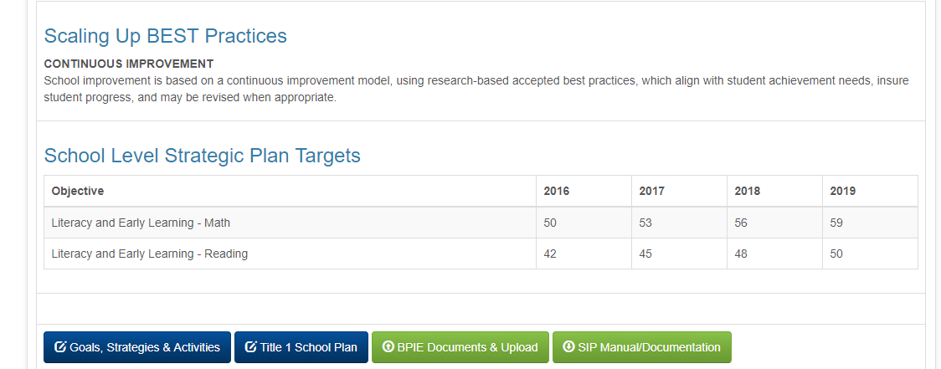
Scroll down to BEST Practice #4. Click on BPIE Documents & Upload Tab. Access resources under BPIE Documents. Upload completed BPIE Assessment PDF.
Best practices for inclusive education

Slide 137

Best Practices for Inclusive Education
Notes:
Then you will click on the Blue Upload File Tab to upload the PDF BPIE assessment results for your school.
Remember to Select School Year 2018-19 if you are completing the assessment next year.
There are some resources on the BPIE Process and the alignment to the school improvement plan housed there as well.

Slide 138

School BPIE Crosswalk
Best practices for inclusive education
Notes:
Domain: Instruction and Student Achievement of the BPIE aligns more consistently with an academic focus of the K-12 Reading Plan. If your school has prioritized Indicators #18-26 this might be a great time to refer to your BPIE Crosswalk and/or your BPIE Assessment results to include in the drafting of your SIP. *Note: It is a best practice that all BPIE prioritized Indicators are addressed in the SIP.

Slide 139

BPIE Guidance Document
Best practices for inclusive education
Notes:
The State Guidance Document for BPIE and SIP can assist schools that complete the tradition SIP/State process, D and F schools in Broward.

Slide 140

Assistance to Complete the School BPIE
https://browardschools.instructure.com/enroll/FCLTK9
Best Practices for Inclusive Education
Notes:
The Florida Inclusion Network in collaboration with the Exceptional Student Learning Support Division will provide professional learning opportunities in a variety of formats to school personnel who will be facilitating their school BPIE Assessment process.
A Canvas Course has been developed. Please enroll in the ‘course‘ and review the resources in the modules.
The List of Schools and Due Dates are in the first module.

Slide 141
Assistance to Complete the School BPIE
June 26, 2018 Professional Learning Sessions
Four 90-minute sessions will be held at Arthur Ashe Campus to review the School BPIE Process for School Administrators and/or ESE Specialists.
More information will be shared with ESE Specialists in May, 2018.
Best Practices for Inclusive Education
Notes:
We will offer 4 90 minute sessions to school administrators and or ESE Specialists on June 26th at the Arthur Ashe Campus. More information will be emailed to and shared with ESE Specialists at this week’s meeting emailed to ESE Specialists.
Additional sessions will be offered quarterly during the 2018-19 school year and will be posted in the Canvas Course Announcements.

Slide 142
Questions and Support
Florida Inclusion Network Facilitators
754-321-3400
jasheena.ekhator@browardschools.com
barbarakrakower@browardschools.com
Best practices for inclusive education

Slide 143
SIP TRAINING 2017-18
SIP TRAINING 2017-18
SIP TRAINING 2018-19
Quarter 1: September 11 - September 14
Quarter 2: December 11 - December 14
Quarter 3: February 26 – March 1
Quarter 4: May 7 – May 10
OFFICE OF SERVICE QUALITY

