Slide 1



• Accreditation (AdvancED) Process
• School Improvement Activities
February 2016
Office of Service Quality
Veda Hudge, Director
Donna Boruch, Coordinator of School Improvement

Slide 2
ACCREDITATION REVIEW OCTOBER 2016
October 24 - 26, 2016 Broward County Public Schools will host an AdvancED External Review Team
The Team will:
• Review the system and its schools to evaluate the system’s adherence to the AdvancED Accreditation Standards
• Make a recommendation for AdvancED School System Accreditation
Broward County Schools, first accredited in 1962, must participate in an external review every five every years.

Slide 3
Accreditation Artifacts
REVIEW PROCESS
• Prior to Accreditation documents being uploaded to OSPA Central 2.0, schools
will review the documents with the school administration and SAC.
• Once the school chooses the Accreditation artifacts, they are then uploaded to
OSPA Central 2.0.
• The OPSA Instructional Facilitators work in collaboration with schools to review
all the uploaded documents using the Accreditation Artifact Checklist.
• Schools receive feedback about their uploaded documents aligned to the five
Accreditation Standards by March 18. 2016
• Documents that don’t align to the Accreditation Standards are removed and/or
replaced by March 31, 2016 (Deadline for all artifact revisions)
• Accreditation Artifact Upload Center will be locked on April 1, 2016

Slide 4
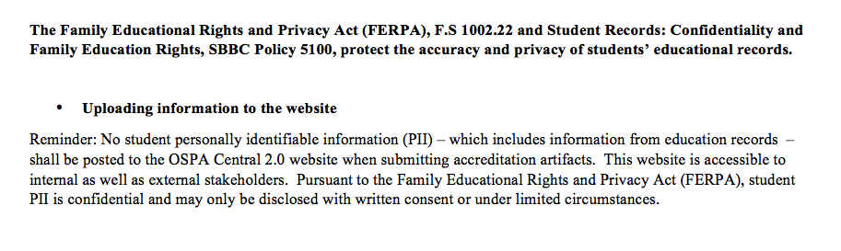
ACCREDITATION
PRIVACY OF STUDENT INFORMATION

Slide 5
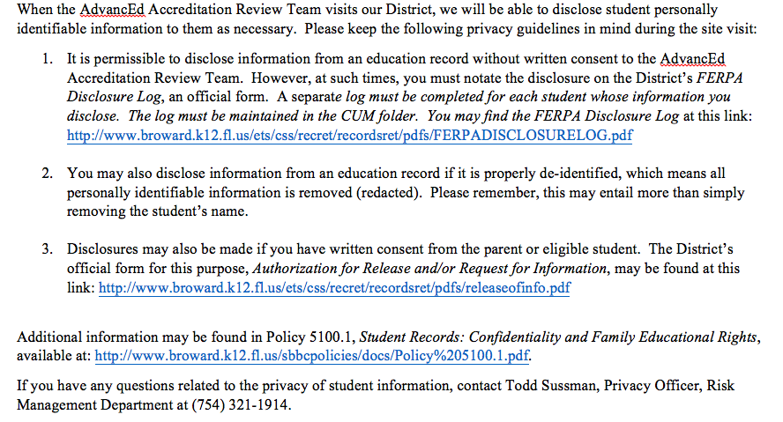
DURING ACCREDITATION VISIT

Slide 6
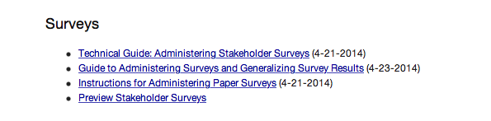
UPCOMING SCHOOL IMPROVEMENT EVENT:
ASSIST STAKEHOLDER SURVEY: FEBRUARY 29 – MARCH 18
DIRECTIONS HAVE BEEN SENT TO PRINCIPALS
GO TO http://extranet.advanc-ed.org/assist_resources_and_tools/
TO DOWNLOAD DOCUMENTS ABOUT SURVEY ADMINISTRATION

Slide 7
SURVEY ADMINISTRATION
INFORMATION
Parent Surveys
• Required minimum response rate for each school: at least 20% of all parents need to take the survey
• Parent survey can be taken on the web or through paper surveys
• Each principal will be emailed a zip file with copies of the school’s paper parent surveys so they can be reproduced and distributed.
Staff Surveys
• Required minimum response rate at each school: at least 60% of all instructional staff need to take the survey
• Staff survey will only be taken on the web
Student Surveys
• Required minimum response rate at each school: at least 40% of all students need to take the survey
• Student survey will only be taken on the web
• Schools will use three types of student surveys: Early Elementary (K-2), Elementary (3-5) and/or Middle & High (6-12)
Monitoring
• Web based survey response rate can be monitored by logging on to the school’s ASSIST account: https://cas.advanc-ed.org/cas/login
• Paper survey response rate can only be monitored by the school

Slide 8
AdvancED
ASSIST CUSTOMER SURVEY PARENT SURVEY DIRECTIONS
• Web PARENT Survey Link: http://www.advanc-ed.org/survey/public/9805149
Send this link home to parents via Parent Link, flyer, email, etc. if your school chooses to use the web for the
parent survey.
• Web PARENT Survey Invitation - use for any communication to distribute the link information:
In an effort to improve System Practices, Broward County School District is conducting a Parent Survey. We
value your opinion and ask that you please take time to complete this survey. In order to complete the survey,
go to: http://www.advanc-ed.org/survey/public/9805149 Please be assured that your responses to this survey
will be anonymous. Your honest opinion is appreciated. Thank you for your time and attention to this matter.
• Paper PARENT Survey:
Principals will be emailed a zip file with their school’s parent surveys. Each zip file contains uniquely identified
surveys for the noted school and should not be administered to other institutions. The zip file contains surveys
in multiple languages. The paper surveys need to be reproduced and distributed by the school.
• Paper Survey Directions: Attached is an AdvancED booklet entitled Instructions for Administering
Paper Surveys. Please read and follow these directions carefully.

Slide 9
AdvancED
ASSIST CUSTOMER SURVEY
STAFF SURVEY DIRECTIONS
• Web STAFF Survey Link: http://www.advanc-ed.org/survey/public/4375282
This survey is to be completed by INSTRUCTIONAL staff only.
• Web STAFF Survey Invitation - use for any communication to distribute the link information:
In an effort to improve System Practices, the Broward County School District is conducting a Staff
Survey. We value your opinion and ask that you please take time to complete this survey. In order to
complete the survey, go to: http://www.advanc-ed.org/survey/public/4375282 Please be assured
that your responses to this survey will be anonymous. Your honest opinion is appreciated. Thank
you for your time and attention to this matter.
• Paper surveys will not be available for the staff.

Slide 10
AdvancED
ASSIST CUSTOMER SURVEY
STUDENT SURVEY DIRECTIONS
• Web STUDENT Survey Links – Please use with the appropriate grade level:
Early Elementary (Grades K-2) http://www.advanc-ed.org/survey/public/1995813
Elementary (Grades 3-5) http://www.advanc-ed.org/survey/public/5341904
Middle & High (Grades 6-12) http://www.advanc-ed.org/survey/public/9286919
• Web STUDENT Survey Invitation - use for any communication to distribute the link information:
In an effort to improve System Practices, the Broward County School District is conducting a
Student Survey. We value your opinion and ask that you please take time to complete this survey.
Please be assured that your responses to this survey will be anonymous. Your honest opinion is
appreciated. Thank you for your time and attention to this matter.
• Paper surveys will not be available for the students.

Slide 11
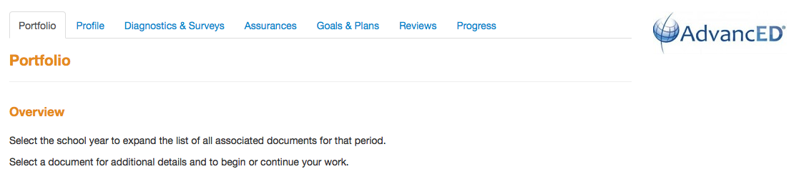
AdvancED ASSIST:
PORTFOLIO FOR SCHOOLS
In May 2016 each school will be required to complete their
ASSIST Portfolio on the AdvancEd website:
Schools cannot access the portfolio until AdvancEd makes it available in May 2016.

Slide 12
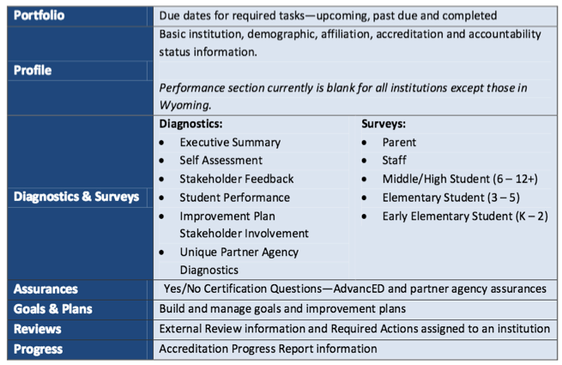
THIS IS AN OUTLINE OF THE ASSIST SCHOOL PORTFOLIO.

Slide 13
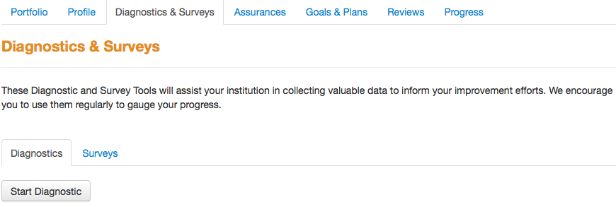
AdvancED ASSIST:
EXECUTIVE SUMMARY
THE EXECUTIVE SUMMARY WILL EVENTUALLY BE PART OF EACH SCHOOLS’ ASSIST PORTFOLIO

Slide 14
EXECUTIVE SUMMARY:
SUBMIT REVISED DRAFT
• Executive Summary draft needs to be finalized in collaboration with
administration, school leadership team and SAC.
• Summary needs to be text only, no charts and graphs.
• Instructional Facilitators will work collaboratively with schools to finalize
the Executive Summary.
• Email a copy of your school’s Executive Summary Final Draft to your
Instructional Facilitator by March 4, 2016
• Revisions to Executive Summary Draft due April 29, 2016
• Final Executive Summary will be uploaded to each schools ASSIST
Portfolio May 2-6, 2016

Slide 15
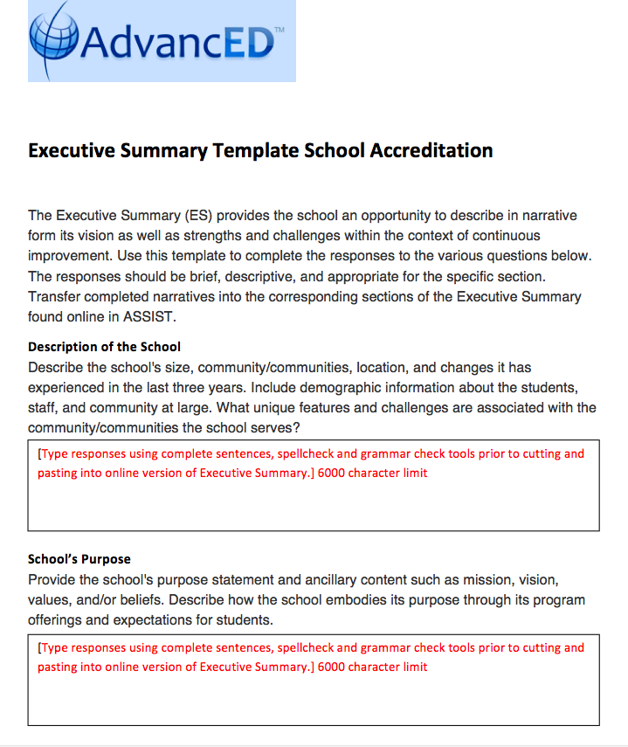

Slide 16
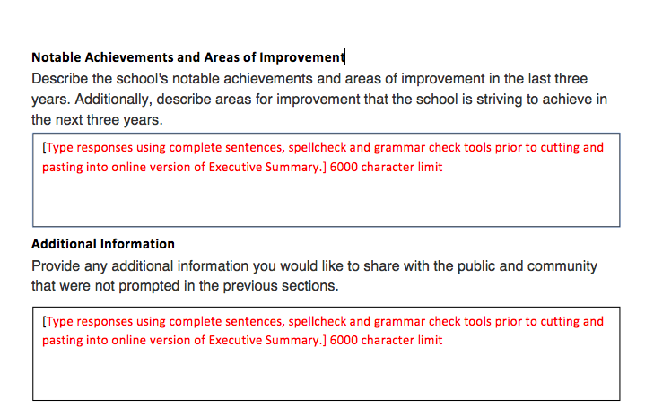

Slide 17
NEXT SCHOOL IMPROVEMENT TRAINING
MAY 2-6, 2016
Schools will be assigned a date and time by Cadre
AGENDA:
• AdvancED ASSIST Portfolio Completion
• Closing 2015-2016 SIP
• School Improvement Planning for 2016-2017

Slide 18
SCHOOL IMPROVEMENT MID-YEAR REFLECTION
1. Has your school made progress towards achieving the goal?
A. How do the structures and systems in place at your school ensure all facets of the school culture create predictable environments and a school climate that supports your SIP goal?
B. What are the gaps that exist between your current state and your desired state?
C. How will you address them between now and the end of this school year?

Slide 19
SCHOOL IMPROVEMENT
MID-YEAR REFLECTION
2. Have alterable barriers been eliminated or reduced? (Alterable barriers are in-house infrastructure mechanisms such as scheduling, class structures, teacher attendance, student attendance, staff development plan, etc.)
A. What evidence do you see that a barrier has been reduced or eliminated?
B. What evidence do you have that the barriers are wide-reaching and will help you achieve your goal?
C. If progress towards eliminating the barrier is not sufficient, where or what is the breakdown?
D. Did you identify other barriers that could serve as effective re- entry points into the plan?

Slide 20
SCHOOL IMPROVEMENT
MID-YEAR REFLECTION
Are your strategies being implemented with fidelity?
A. Were decisions to continue, intensify, modify, or terminate strategies or action steps based on specific evidence?

Slide 21
SCHOOL IMPROVEMENT MID-YEAR REFLECTION
What are your benchmarks for success?
A. How will you progress towards your goal impact student achievement?
B. What is your desired state?
C. What gaps exist between your current state and your desired state?

Slide 22
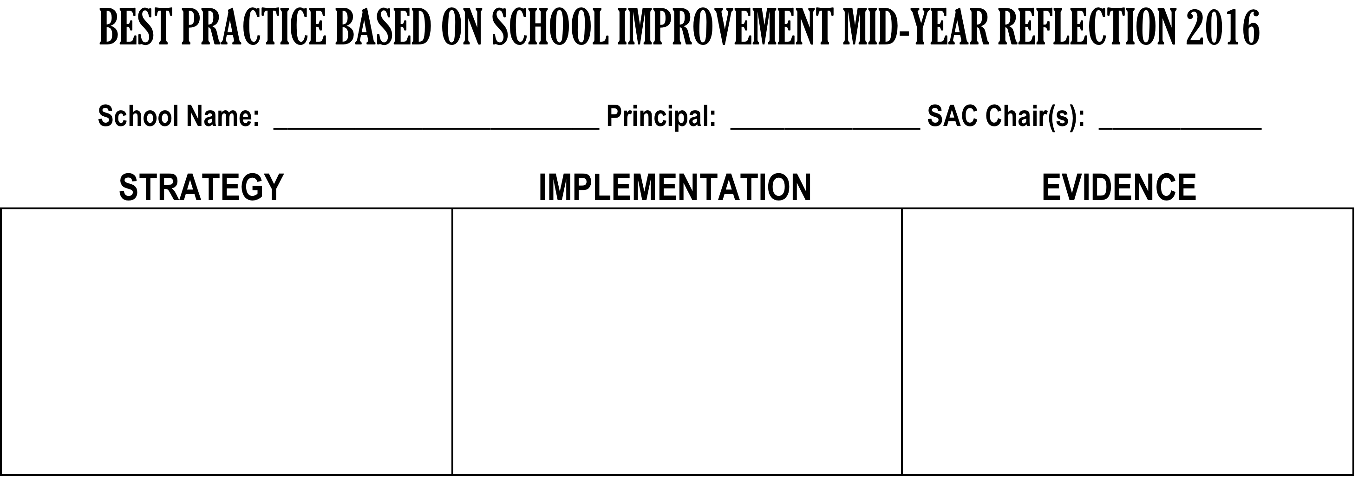
SHARING BEST PRACTICES
GALLERY WALK

Slide 23
FOLLOW- UP
• DA Schools are required to input their Mid-Year Reflection in CIMS by MARCH 11, 2016.
• ALL Schools can use the completed Mid-Year Reflection form as Accreditation Artifact for Indicator 5.4
• All schools can share their Mid-Year Reflection with SAC and upload into the SAC Upload Center

Slide 24

THANK YOU!
Please call us if you need assistance:
Office of Service Quality 754-321-3850

