Slide 1
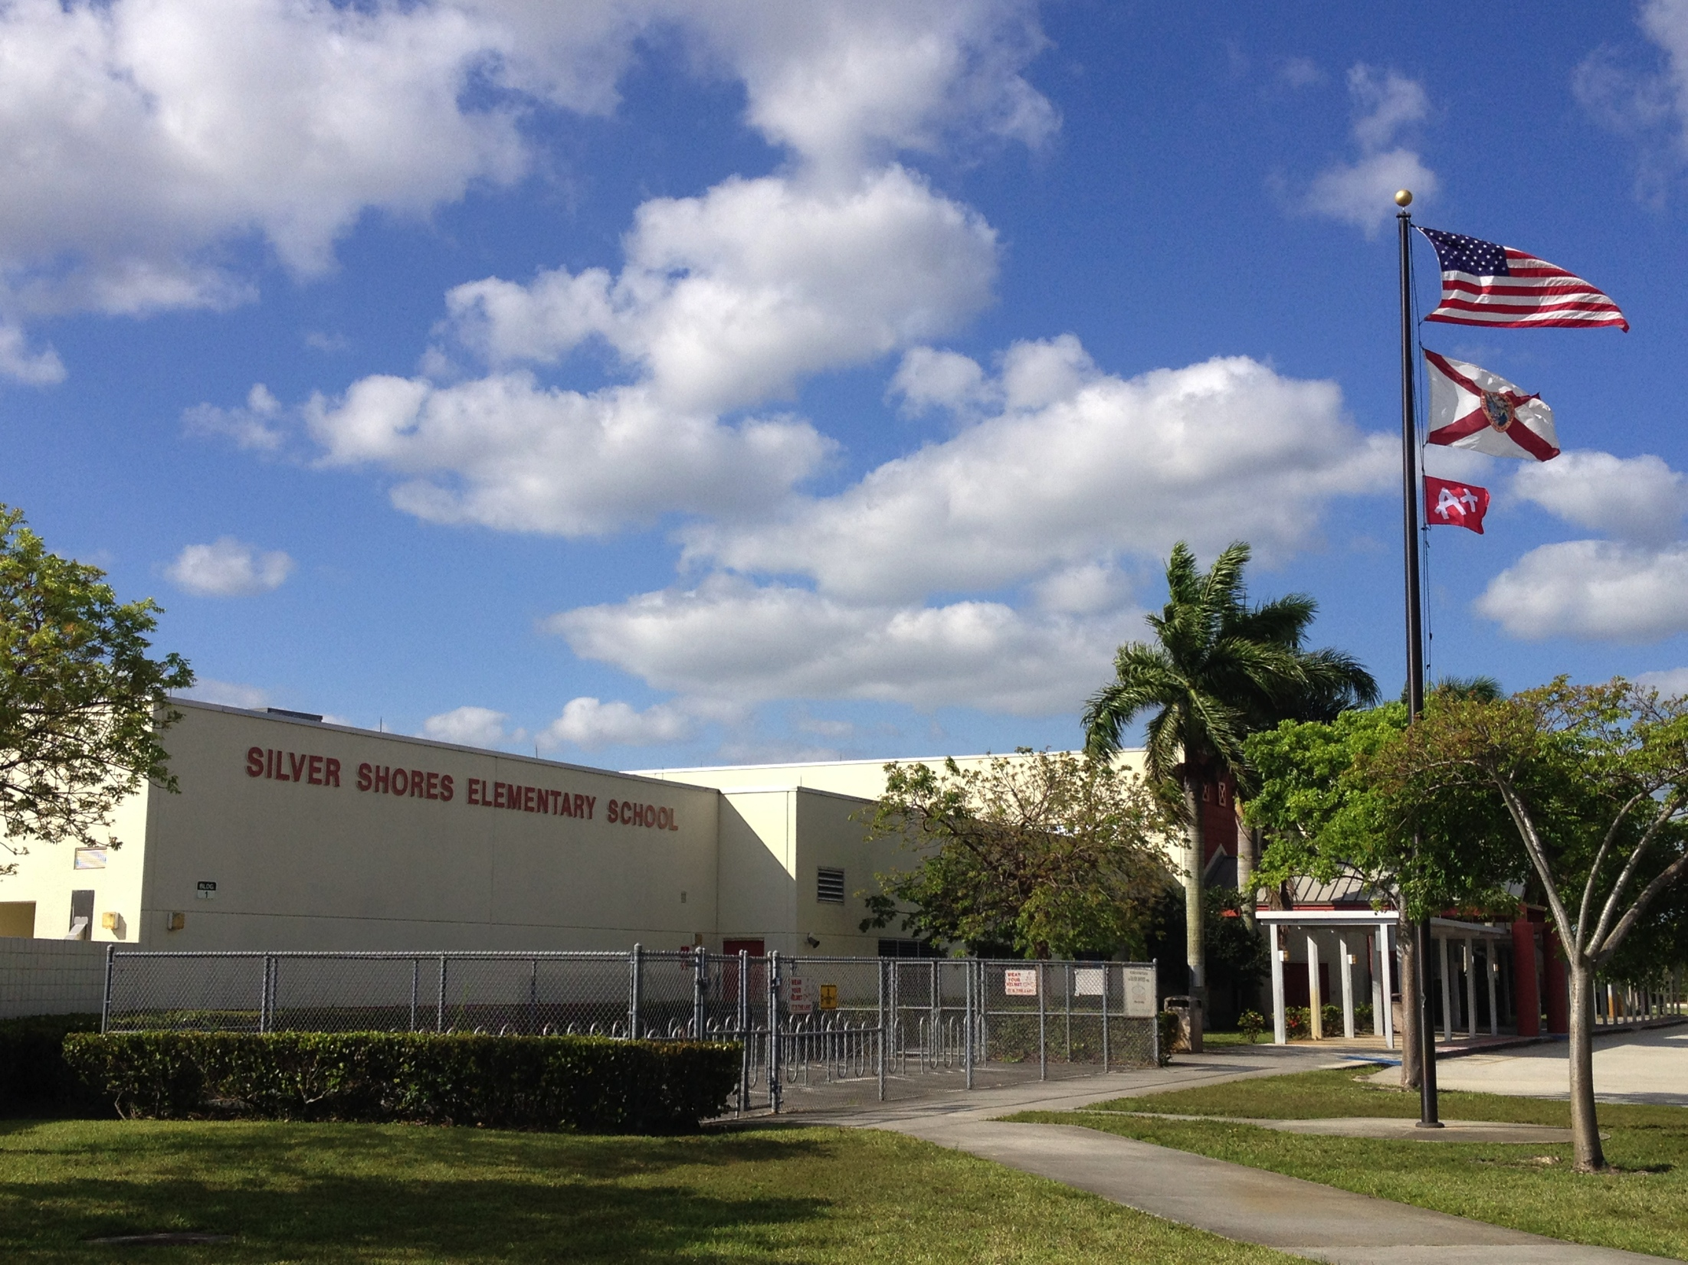
SILVER SHORES ELEMENTARY SCHOOL “The GREATEST Corner in the universe” 2018 – 2019

Slide 2
VISION / MISSION
VISION
Silver Shores Elementary School – “The GREATEST Corner in the UNIVERSE!!”
MISSION STATEMENT
Silver Shores Elementary School is committed to providing a safe, collaborative, positively charged, fully-inclusive school, supported by the new Florida Standards, to successfully prepare our students to be college or career ready.

Slide 3
Snapshot of Silver Shores “The Greatest Corner in the Universe”
Current Demographics:
236 boys (54%) / 197 girls (46%) = total of 433 students
White – 199 (46%)
Black – 172 (40%)
Asian – 41 (9%)
Multi – 21 (5%)
Hispanic – 202 (47%) – total school population
Traditional K-5; InD Special Programs; ESE Pre K

Slide 4
support TEAM (754) 323-7550
Dr. Jonathan Leff, Principal
Mrs. Lisa Monroe – Assistant Principal
Ms. Jessica Abraham – Literacy Coach
Mrs. Christine Coschignano – Guidance Counselor
Mrs. Mary Verrastro – ESE Specialist
Mrs. Dawn Lopez – Media Specialist
Mr. James Lott – Music Teacher / Title I Liaison
Ms. Stephanie Castellana – Art Teacher / Resident Muralist
Mrs. Nicole Lawson – Office Manager
Officer Dora Chalk – SRO
Ms. Franki Pasquale – Before/After Care Coordinator
Mrs. Kathie Englert – Cafeteria Manager

Slide 5
STUDENT SUPPORT TEAM
GUIDANCE – Ms. Christine Coschignano
c.coschignano@browardschools.com
Educational, behavioral, emotional and social performance questions
Crisis / support during school hours
ESOL Coordinator
SOCIAL WORKER – Ms. Raziela Boylan
Raziela.boylan@browardschools.com
Mental Health Services (counseling and support groups)
Community Resources
SCHOOL PSYCHOLOGIST – Ms. Caroline Hejja
caroline.hejja@browardschools.com
Academic, behavioral, emotional and social concerns
ESE / Gifted Services / Testing

Slide 6
Student online forms
http://www.browardschools.com/bts
Move from paper to online submission of Back-to-School forms to simplify the process for parents/guardians, as well as improve the accuracy of the information provided
Having current phone numbers and email addresses in our Student Information System/Parentlink is vital to communicate with parents/guardians in an emergency.
The submission of the Back-to-School forms online streamlines the process of updating parent contact information, and is the preferred method of data collection.

Slide 8
Title I
Silver Shores is a Title I school for the
2018-2019 School Year.
We highly encourage
you to apply for
free and reduced lunch.
www.myschoolapps.com

Slide 9
Title I funding
According to the U.S. Department of Education the purpose of Title 1 funding, “is to ensure that all children have a fair, equal, and significant opportunity to obtain a high quality education and reach, at minimum, proficiency on challenging state academic achievement standards and state academic assessments.”
For an entire school to qualify for Title 1 funds, at least 40% of students must enroll in the free and reduced lunch program.
Largest federal assistance program for our Nation’s Schools
Serves millions of children in elementary and secondary schools each year.

Slide 10
Title I school-parent compact – school responsibilities
Provide high-quality curriculum and instruction in a supportive and effective learning environment that enables the participating children to meet the State’s student academic achievement standards
Hold parent-teacher conferences (at least annually in elementary schools) during which this compact will be discussed as it relates to the individual child’s achievement
Provide parents with frequent reports on their children’s progress
Provide parents reasonable access to staff
Provide parents opportunities to volunteer and participate in their child’s class, and to observe classroom activities

Slide 11
Title I school-parent compact – parent responsibilities
Make sure my child has the necessary school supplies and is ready for school each morning;
Monitor my child’s on-time attendance;
Make sure that homework is completed;
Monitor the amount of television my children watch;
Volunteer in my child’s classroom;
Participate, as appropriate, in decisions relating to my children’s education;
Promote positive use of my child’s extracurricular time;
Stay informed about my child’s education and communicate with the school by promptly reading all notices from the school or the school district either received by my child or by mail and responding, as appropriate;
Serve on Title I committees – both at the school and state level
More info to follow…

Slide 12
safety and security
School Hours are 8:00am – 2:00pm
Doors open 7:30am for Breakfast – NO Supervision prior to 7:30am
Last early pick up is 1:30pm
Monthly drills: fire and code red – will be announced PRIOR to drill
Front office – Single Point of Entry
Electric strike – proximity cards (faculty) or buzzer
Student pick up and drop off procedures
Car Riders
Walkers and Bicyclists
Walk-Up Walkers (pedestrian pick-up)
ID badges must be worn by everyone at all times when in school

Slide 13
5 year trend

Slide 14
School-Wide Focus
The Florida Standards – what students need to know and be able to do
Mathematics Florida Standards (MAFS)
Language Arts Florida Standards (LAFS)
Reading and Writing Across the Curriculum
Balanced Literacy
Social Emotional Learning

Slide 15
STUDENT expectations
Abide by our School Positive Behavior Plan (SPBP)
Attend school regularly and arrive prior to 8:00am
Complete all classwork and homework assignments
Write in agenda daily – homework, classroom announcements, etc…
45 Minutes per Week of iReady (computer program) with 80% Passing Rate
Respect for peers and adults
Fridays – Spirit Days (Jeans and SSE T-shirt or Superhero T-Shirt)

Slide 16
parent expectations
Ensure your child is on time everyday
Support the school’s SPBP
Check Backpacks Daily-Agenda and Take Home Folder for Assignments and Important Information
Communication with Teachers and Staff
Assist your child with homework
Read at night with your child / work on math fluency
Attend our evening parent events (when scheduled)
Be an ACTIVE participant in your child’s education
Call / ask questions when in doubt

Slide 17
Family / Home / Community Involvement
Why?
Effective, continual communication
PTA / SAC / SAF
Room Parent – VERY IMPORTANT!!
Partners in Education
Volunteering / Mentoring
Before / After Care Services at SSE
YMCA Summer Camp
GET INVOLVED!!! ☺
https://www.browardschools.com/Page/32043

Slide 18
Beliefs about Learning
Learning needs to be purposeful, meaningful, life-long and most of all – FUN!!!
We choose to learn what we are passionate about
We engage ourselves in converting information into life-long knowledge
We learn by: Reading! Doing! Practicing! ENJOYING!!

Slide 19
Principal’s Expectations
Together, we will create a positive, safe school climate
Together, we will create an atmosphere where we treat each other with dignity and respect
Together, we will teach our children the best way they learn
Together, we will make decisions that are in the best interest of our children

Slide 20
“HOME AWAY FROM HOME”
Webster’s Definitions:
A domicile, dwelling, a place where people live.
A place where people come to flourish.
Center of the Community
A place where adults and children are excited to come
A place where love and positive encouragement fill the hallways

Slide 22
WELCOME HOME!!! to
SILVER SHORES ELEMENTARY SCHOOL
“The Greatest Corner in the Universe”

