Slide 1
• School Improvement Activities • Accreditation (AdvancED) Process
Office of Service Quality
Veda Hudge, Director
Donna Boruch, Coordinator, School Improvement

Slide 2
NEW SBBC SIP
• The School Improvement Plan is a live, public document that will change throughout the year based on review by SAC
• The main purpose of SAC is to focus on increasing student achievement through school improvement
• The new SBBC School Improvement Plan can be
viewed by all stakeholders at:
http://www.broward.k12.fl.us/ospa/select_school.asp

Slide 3


Slide 4
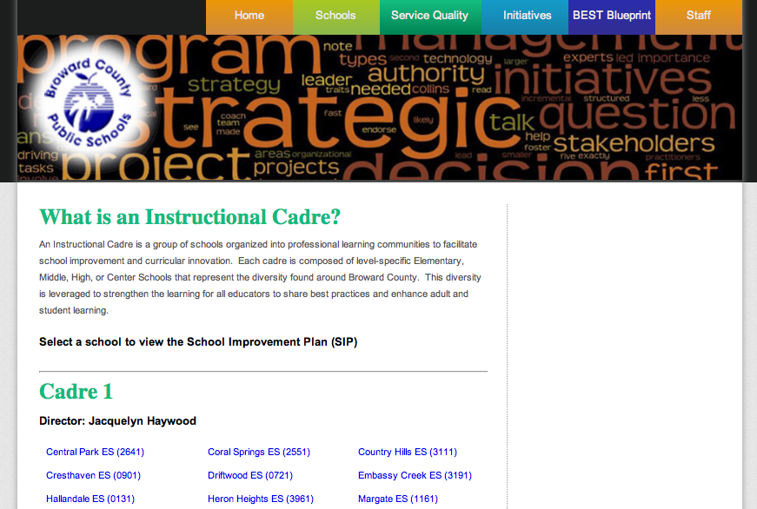


Slide 5
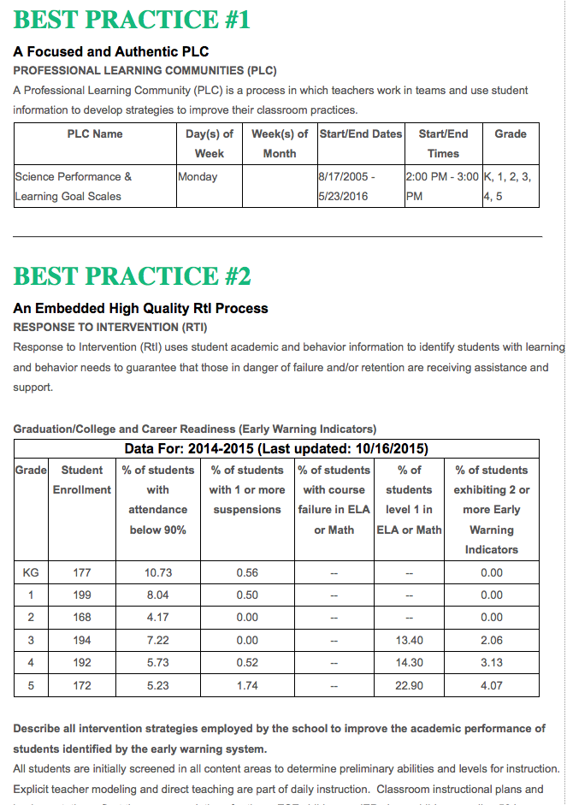
USER
FRIENDLY
LAYOUT

Slide 6
DETAILED INFORMATION ABOUT
SCHOOL IMPROVEMENT ACTIVITIES

Slide 7
SCHOOL IMPROVEMENT IS ALIGNED WITH DISTRICT BEST PRACTICES

Slide 8
SBBC SCHOOL IMPROVEMENT PLAN IMPORTANT CLARIFICATION POINTS
• All schools must complete the SBBC School Improvement Plan
which is aligned with the District Strategic Plan: The BEST Blueprint.
• The FLDOE SIP is a component of the SBBC SIP in Best Practice 4.
• The SAC Composition Report needs to be updated and uploaded as a PDF
periodically to SAC Upload section to reflect the actual, current membership.
• Entire ASSIST Self-Assessment needs to be placed in the
Accreditation Artifact Upload section.

Slide 9
UPCOMING SCHOOL IMPROVEMENT EVENT: A+ RECOGNITION FUND PROCESS (Now-Feb 1st)
• All schools that believe they may qualify for A+ Funds:
Must complete the process by February 1, 2016, as required by Florida Statute 1008.36
• Information about the A+ Fund Process may be found at: http://www.broward.k12.fl.us/ospa/initiatives.asp?initiative_id=6
• SBBC Schools must place the following A+ documentation in the SAC Upload Center:
SAC Minutes, attendance and voting results for each A+ Recognition Funds Meeting held prior to Feb. 1st
• The FLDOE is proposing changes to the Accountability Rules:
Information about the proposed changes to how school grades will be calculated may be found at: http://www.fldoe.org/accountability/accountability-reporting/accountability-rules.stml
Important Note - Florida Statute 1008.36 states:
"If school staff and the School Advisory Council cannot reach agreement by February 1, the award must be equally distributed to all classroom teachers currently teaching in the school."

Slide 10
UPCOMING SCHOOL IMPROVEMENT EVENT: VAL-ED SURVEY: JANUARY 4 -31
• The VAL-ED is an online survey all directors, principals, and teachers will take to rate the effectiveness of instructional leadership at each school site
• The survey results will serve as a guide for professional development for cadre directors
• Schools will receive a survey code and unique access codes to be randomly distributed
• Ratings for each question are scored from 1 (lowest) to 5 (highest) • When a score for each item is given, an item from the “evidence” choices needs to be indicated • Survey answers are completely anonymous and the online survey will take about 20-30 minutes • It is advised that the survey be completed in one sitting
SPECIFIC DIRECTIONS WITH ACCESS CODES WILL BE SENT TO
PRINCIPALS THE WEEK OF DECEMBER 14TH.

Slide 11
UPCOMING SCHOOL IMPROVEMENT EVENT: NEW & CONTINUATION WAIVERS
ALL WAIVER INFORMATION CAN BE FOUND AT:
http://www.broward.k12.fl.us/ospa/initiatives.asp?initiative_id=5
New Waiver Applications: Must be completed by February 12, 2016
Only schools that have completed an Intent to Apply form and have
been given permission to proceed may submit an application
Continuation Waivers: All documentation must be completed by
May 6, 2016. Remember: Faculty must vote to continue waiver
each year

Slide 12
UPCOMING SCHOOL IMPROVEMENT EVENT: ASSIST STAKEHOLDER SURVEY: FEBRUARY 29 – MARCH 18
DIRECTIONS WILL BE SENT TO PRINCIPALS IN JANUARY
PROCEDURES FOR ADMINISTRATION WILL BE REVIEWED AT
FEBRUARY SCHOOL IMPROVEMENT TRAINING AND POSTED ON OSPA WEBSITE
GO TO http://extranet.advanc-ed.org/assist_resources_and_tools/
TO PREVIEW DOCUMENTS ABOUT SURVEY ADMINISTRATION

Slide 13
NEXT SCHOOL IMPROVEMENT TRAINING
FEBRUARY 22-26, 2016
Schools will be assigned a date and time by Cadre
AGENDA:
• School Improvement Planning
• ASSIST Stakeholder Survey
• Review Final Accreditation Documents for Portfolio
• Finalize Executive Summary

Slide 14
ACCREDITATION
• Plan for AdvancED Accreditation Review Fall 2016
• Focus on 2011 Required Actions: Promote Standards,
Improve Public Perception, Increase Site-Based Leadership
• All Accreditation Artifacts uploaded by January 22, 2016
• Self Assessment completed for all schools
• ASSIST Stakeholder Survey will be February/March 2016
• Continue Stakeholder Group Presentations
• Executive Summary Draft for schools completed by Feb. 23, 2016

Slide 15
ACCREDITATION ARTIFACTS

All artifacts are on the NEW SBBC SIP Template under BEST Practice # 3
Click on green Evidence/Artifacts button.

Slide 16
SCHOOL NUMBER AND DATE WILL AUTOMATICALLY BE ADDED TO FILE NAME AFTER IT IS UPLOADED

DIRECTIONS:
CLICK ON “EDIT STANDARD” TO ASSIGN STANDARD & INDICATOR TO EACH ARTIFACT.
RENAME OR DELETE ALL 2014-2015 ROLLED-OVER ARTIFACTS.
3. EACH ARTIFACT MUST HAVE 2015-2016 (OUR ACCREDITATION YEAR) ON IT.

Slide 17
SUGGESTED ARTIFACTS
Suggested Artifacts for Schools can be found at:
http://www.broward.k12.fl.us/accreditation/index.asp
or
http://extranet.advanc-ed.org/assist_resources_and_tools/
FAQ: Are we limited in the evidence we supply to the list that is provided?
“No. Institutions should feel free to include evidence outside of the list provided if they believe it is relevant to the indicator for which they are responding. Institutions should provide evidence they believe supports
the performance level they have selected for each indicator.”
Required:
• One quality artifact for each of the 33 indicators
• One artifact may be used for more than one indicator
• Any dated artifacts must have our Accreditation Year 2015-2016

Slide 18
AdvancED ASSIST: PORTFOLIO FOR SCHOOLS
In May 2016 each school will be required to complete their
ASSIST Portfolio on the AdvancEd website:
Schools cannot access the portfolio until AdvancEd makes it available in May 2016.
AdvancEd Technical Assistance: 888-413-3669

Slide 19
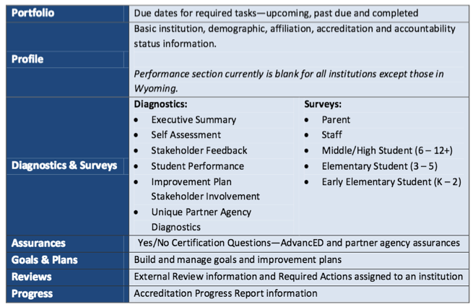
THIS IS AN OUTLINE OF THE ASSIST SCHOOL PORTFOLIO.

Slide 20
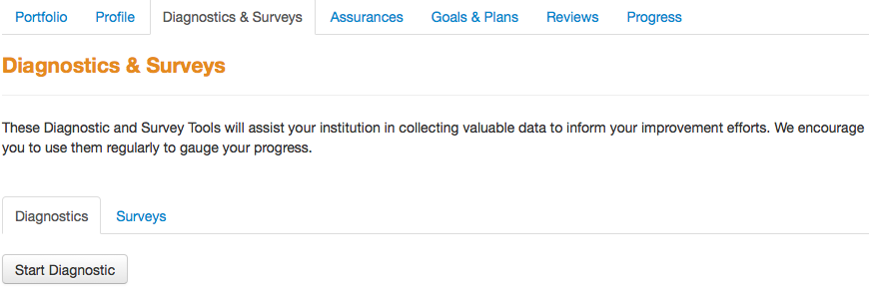
AdvancED ASSIST: EXECUTIVE SUMMARY
THE EXECUTIVE SUMMARY WILL EVENTUALLY BE PART OF EACH SCHOOLS’ ASSIST PORTFOLIO


Slide 21
EXECUTIVE SUMMARY:
CREATE A DRAFT
STEPS TO CREATE AN EXECUTIVE SUMMARY DRAFT:
• Log on to:
http://extranet.advanc-ed.org/school_resources_and_tools/index.html
• Under “Tools” click on “School Executive Summary Offline Template”
• Template will be downloaded to your computer.
EACH SCHOOL’S COMPLETED DRAFT EXECUTIVE SUMMARIES WILL BE REVIEWED BY OSPA INSTRUCTIONAL FACILITATORS
AT THE NEXT SCHOOL IMPROVEMENT TRAINING IN FEBRUARY

Slide 22
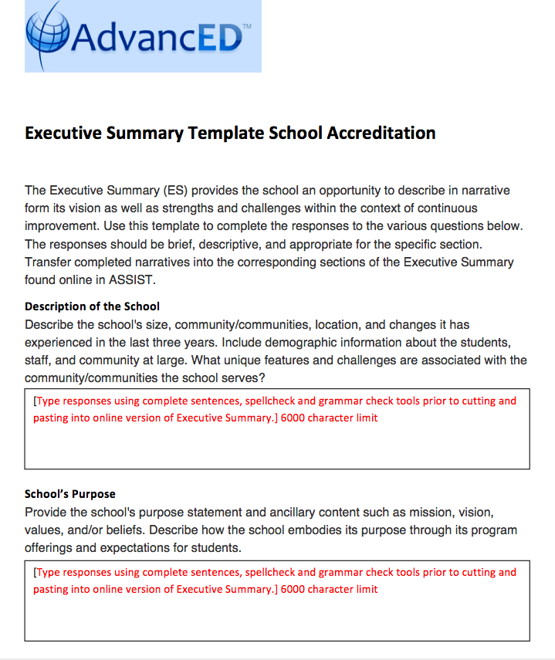

Slide 23
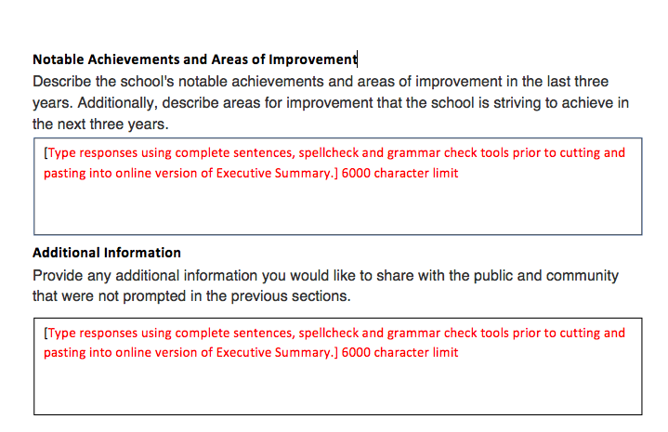

Slide 24
INFORMATION FOR THE EXECUTIVE SUMMARY
RESOURCES
Broward Schools Website - http://www.browardschools.com/School-Info
FLDOE Annual SPAR Report - http://doeweb-prd.doe.state.fl.us/eds/nclbspar/index.cfm
Florida Continuous Management System (CIMS) Report - https://www.floridacims.org/districts/broward
Logon: Principal email Password: broward
SAMPLE EXECUTIVE SUMMARY
Online Search – AdvancED Executive Summary

Slide 25
THANK YOU!
Please call us if you need assistance:
Office of Service Quality 754-321-3850

