Slide 1
• School Improvement Updates • Accreditation (AdvancED) Process • ASSIST Portfolio for Schools
May 2016
Office of Service Quality
Veda Hudge, Director
Donna Boruch, Coordinator, School Improvement

Slide 2
School
Improvement
Updates

Slide 3
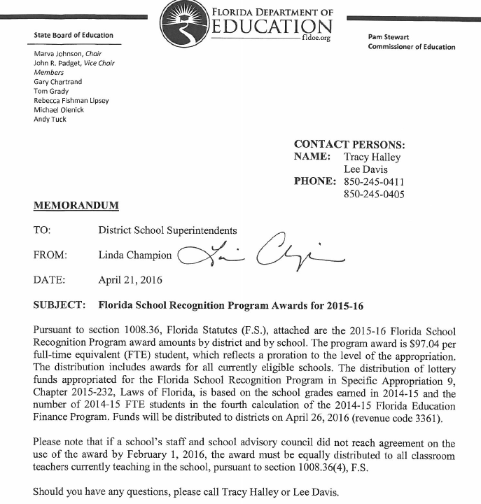
A+ RECOGNITION FUND DISTRIBUTION
A+ monies have been disbursed to qualifying schools by the BCPS Budget Office.
PIVOT communication to principals posted on Friday, April 29, has all the relevant information.

Slide 4
CONTINUATION WAIVERS
ALL WAIVER INFORMATION CAN BE FOUND AT:
http://www.broward.k12.fl.us/ospa/initiatives.asp?initiative_id=5
• Continuation Waivers:
All documentation must be completed by May 6, 2016.
Remember: Faculty must vote to continue waiver each year.
• New Waiver Applications for 2017-2018:
All applications must be completed by February 2017.
Only schools that have completed an Intent to Apply form and
have been given permission to proceed may submit an application.

Slide 5
AdvancED
Accreditation
Information

Slide 6
AdvancED STAKEHOLDER SURVEY RESULTS
Thank you for your help in the
successful completion of the
2016 Staff, Student, and Parent
AdvancED Stakeholder Surveys!

Slide 7
ACCREDITATION REVIEW DATES
Broward County Public Schools will host an
AdvancED External Review Team
October 23-26, 2016
Please keep these dates in mind as you prepare
your school’s schedule for the 2016-2017 school year.

Slide 8
PURPOSE FOR REVIEW
• Broward County Schools, first accredited in 1962, must participate in an external review
every five years in order to retain
AdvancED School System Accreditation.
• The team will review the system and its schools to evaluate the system’s adherence
to the AdvancED Accreditation Standards.

Slide 9
ACCREDITATION STANDARDS
Standard 1: Purpose and Direction - The system maintains and communicates at all
levels of the organization a purpose and direction for continuous improvement.
Standard 2: Governance and Leadership - The system operates under governance and leadership that promote and support student performance and school effectiveness.
Standard 3: Teaching and Assessing for Learning – The curriculum, instructional design
and assessment practices guide and ensure teacher effectiveness and student learning.
Standard 4: Resources and Support Systems - The system has resources and provides services in all schools that support its purpose and direction to ensure success for all students.
Standard 5: Using Results for Continuous Improvement - The system implements a comprehensive assessment system that generates a range of data about student learning and system effectiveness and uses the results to guide continuous improvement.

Slide 10
ACCREDITATION TEAM RESPONSIBILITIES
A Team of trained professionals from across the state and nation will:
• Review Broward County Schools documents
and performance data
• Interview system, school and community
stakeholders
• Conduct site reviews of several schools
• Observe system and school practices in action

Slide 11
ACCREDITATION REPORT
The Accreditation Team report will include:
• Recognition of Strong Practices
• Areas for Improvement to the System
In two years, the district will be required to report to
AdvancED its progress in addressing the team’s
Improvement Priorities.

Slide 12
2011 ACCREDITATION
EXIT REPORT
To review previous commendations and recommendations made by the AdvancED External Review Team, log on to
http://www.browardschools.com/www-browardschools-com/departments/accreditation
and read the Exit Report SBBC 2011.

Slide 13
BENEFITS OF THE ACCREDITATION REVIEW
AdvancED School System Accreditation process will demonstrate to students, parents and community that the District is focused on:
• Raising student achievement
• Providing safe and enriching learning environments
• Maintaining efficient and effective operations staffed by
highly qualified educators

Slide 14
AdvancED ASSIST Portfolio
• Executive Summary
• Self Assessment
• Stakeholder Feedback Diagnostic
• Student Performance Diagnostic
• AdvancED Assurances

Slide 15
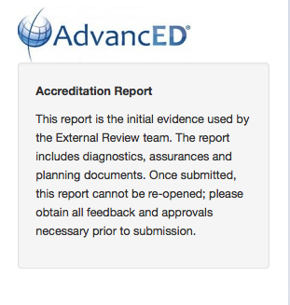
IMPORTANT INFORMATION ABOUT SUBMITTING THE PORTFOLIO
The principal, after reviewing the portfolio, will be responsible for authorizing submission of the portfolio by September 26, 2016.
Once a portfolio is submitted, all information is FINAL and the PORTFOLIO CANNOT BE REOPENED.
OSPA IFs are available to assist principals in the portfolio review process.

Slide 16
AdvancED ASSIST SCHOOL PROFILE
LOG ON TO ASSIST AND CLICK ON “Profile”
Logon: Principal’s email Password: broward
Logon: Principal’s email Password: broward
• Click on “Update Demographics”
• Click to add, update and review all institution information
⬅

Slide 17
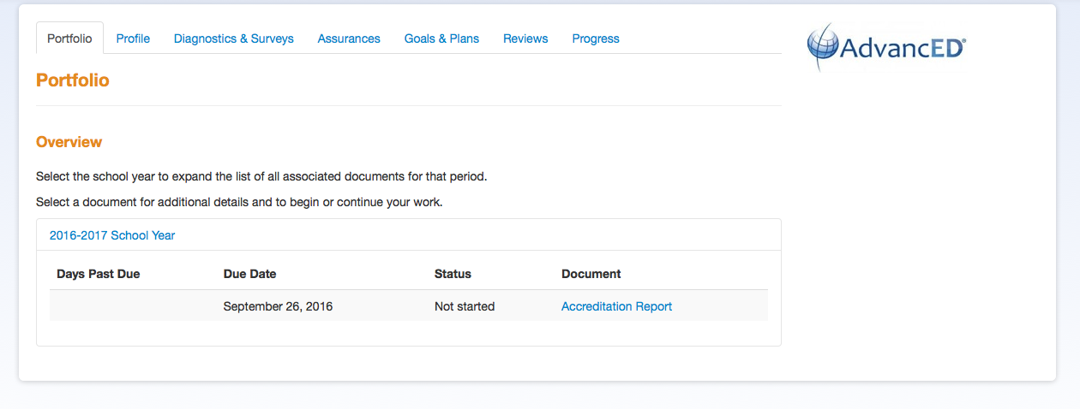
AdvancED ASSIST SCHOOL PORTFOLIO
⬅
LOG ON TO ASSIST AND CLICK ON ACCREDITATION REPORT
Logon: Principal’s email Password: broward

Slide 18
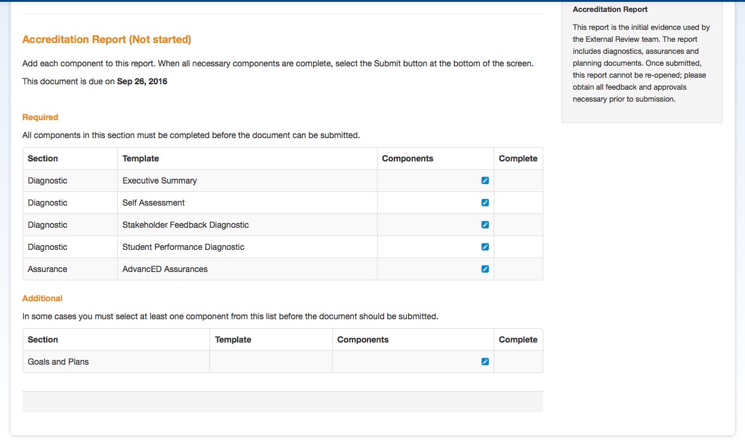
⬅
CLICK ON EXECUTIVE SUMMARY

Slide 19
EXECUTIVE SUMMARY A Completing the Executive Summary tutorial is available at: http://www.screencast.com/t/h6SOaSO9V
• Click this:
• Then check the box and click on Executive Summary to open:
• Copy and paste the final draft of your school’s Executive Summary into the
template.
• When the template is finished click the Complete button:
Important Note: The Executive summary can be reopened at any time for editing before submitting the diagnostic portfolio.

Slide 20
⬅
CLICK ON SELF ASSESSMENT

Slide 21
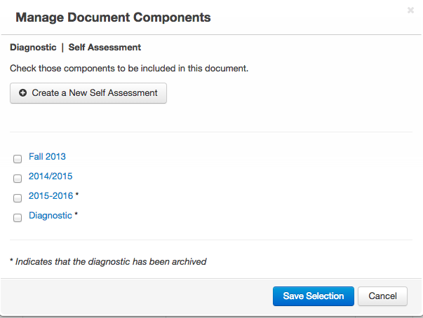
SELF ASSESSMENT
A Completing the Self Assessment tutorial is available at:
http://www.screencast.com/t/536Y8xgzY7lg
This is what will appear:
• Check box for on 2015-2016
• Then click on Save Selection
• A green check will appear on your Portfolio next to Self Assessment

Slide 22
⬅
CLICK ON STAKEHOLDER FEEDBACK DIAGNOSTIC

Slide 23
STAKEHOLDER FEEDBACK DIAGNOSTIC A Completing Stakeholder Feedback Diagnostic tutorial is available at: http://www.screencast.com/t/vcogeN6LnZC
• Click this:
• Then check the box and click on this box and open:
• Go to Survey Scoring Summary and view your schools survey results:
- Log on to AdvancED: http://www.advanc-ed.org/login
- Click on "Reports" tab. Then Click on the "Survey" tab
- Choose Parent Survey, Student Survey, or Staff Survey
- Click on "Survey Scoring Summary, click on “Average Score Data” and record results for each standard
- Click on Overall Score to get average score for each Standard
• Based on your survey results, answer all questions in the Stakeholder Feedback section.
• For answer to question #1 click YES, then upload the BCPS Data document your instructional
facilitator will help you complete today.
• When the all sections are finished click the Complete button:

Slide 24
⬅
CLICK ON STUDENT PERFORMANCE DIAGNOSTIC

Slide 25
STUDENT PERFORMANCE DIAGNOSTIC A Completing Student Performance Diagnostic tutorial is available at: http://www.screencast.com/t/zuaLab2ZztY
This section will need to be updated upon the release of the 2016 FSA data.
• Click this:
• Then check the box and click on this box and open:
• Go to Data Warehouse (http://bcps.browardschools.com/VirtualCounselor/ ) and download in PDF format
your schools FSA Demographic Report 2015.
• For the Student Performance Data section, Question #1 , click “YES” and upload the FSA Demographic
report from Data Warehouse. (Your login for the DWH Reports Folder is your 4-digit school number and
your password is your schools SIP number.)
• Based on the FSA results and any other testing results available at your school, answer all questions in the
Stakeholder Feedback section. If you use other testing data reports, upload PDF copies in question #1.
• Prior to clicking the Complete upload any progress monitoring data your school uses.
• When the all sections are finished click the Complete button.

Slide 26
⬅
CLICK ON AdvancED ASSURANCES

Slide 27
ASSURANCES
A Completing the Assurances tutorial is available at: http://www.screencast.com/t/BEGXhfGEAz
• Click this:
• Then check the box and click on this box and open:
• Answer “Yes” to all questions.
• For Question #5 you must upload a PDF of your SIP.
Schools with a FLDOE SIP need to Upload a PDF copy of their SIP from FL CIMS
A, B, and C schools need to upload a PDF copy of their SIP from OSPA Central 2.0.
Title I schools need to upload a PDF copy of their Title I Plan

Slide 28
PORTFOLIO SUBMISSION A Submitting the Report tutorial is available at: http://www.screencast.com/t/lpTR9DoXt8
Once all sections of the Accreditation Portfolio are complete and
each section has a green checkmark,
the portfolio is ready to be submitted.
ONLY THE PRINCIPAL
CAN AUTHORIZE SUBMISSION OF THE PORTFOLIO
All portfolios must be submitted by September 26, 2016.

Slide 29
THANK YOU!
Please call us if you need assistance:
Office of Service Quality 754-321-3850

